Slide 1
Nuclear Energy

Slide 2
What you should be able to do
Do simple calculations on nuclear transformations;
Understand the concept of mass difference and binding energy;
Understand the atomic mass unit, u;
Convert from one unit to another using 1 u = 931.1 MeV, E = mc²;
Appreciate that E = mc² applies to all energy changes;
Know the graph of average binding energy per nucleon against nucleon number, A;
Understand fission and fusion processes.

Slide 3
Einstein
What three effects did Einstein notice?
Time dilation
Length contraction
Mass increase as energy gained
Explain the significance of E = mc²
In respect of:
      A torch
      A car
      An atom
Only in atoms is the effect
substantive
What is the minimum photon energy for pair production?
2 mc²

Slide 4
Energy losses in radioactive decay
Einstein’s equation is also
written as
Q = Δm c²
Why?
Because energy release is
associated with a change (loss) of
mass
Calculate the amount of energy that would be released from 1kg of matter
What happens to the
energy in :
α-decay
β-decay
E = 1 x [3x10⁸]² = 9x10¹⁶ J
This is equivalent to 2.5x10¹⁰ kWh, it would heat each of the 10 000 houses in a medium sized town with a 1 kW fire for nearly 300 years

Slide 5
Units of Mass
The Atomic Mass unit is convenient for nuclear masses. It is equal to
Exactly 1/12th the mass of a carbon 12 atom
1 atomic mass unit (u) = 1.661 × 10⁻²⁷ kg
The relative atomic mass of an atom is useful. It is defined as:
Mass of the atom × 12
Mass of carbon 12 atom
The relative atomic mass of atoms is usually very close to a whole number, which is consistent with the idea of a nucleus made up of whole numbers of nucleons

Slide 6
Particle | Mass (u)
Electron | 0.000549
Neutron | 1.008665
Proton | 1.007276
Hydrogen atom (1p⁺ + 1 e⁻) | 1.007825
Helium atom (2p⁺ + 2 n + 2e⁻) | 4.002063
α particle (2p⁺ + 2 n) | 4.001505
We need to be careful to distinguish between the atomic mass and the nuclear mass.
The atomic mass is the mass of an atom complete with its electrons;
The nuclear mass is the mass of the nucleus alone.
To get the nuclear mass we need to take away the mass of the electrons.

Slide 7
Questions:
1. What is the nuclear mass of helium 3 (³He) of which the atomic mass is 3.016030 u?
(Electron 0.000549 u; Neutron 1.008665u ; Proton 1.007276 u)
Take away the mass of two electrons (1)
Nuclear mass = 3.016030 u – (2 × 0.000549 u)
= 3.014932 u (1)
2. Convert 1 MeV into:
(a) Joules (b) kg
(a) 1 MeV = 1.6x10⁻¹⁹ x 10⁶ = 1.6x10⁻¹³ J
(b) Using E = mc²
1.6x10⁻¹³ = m x (3x10⁸)²
so m = 1.7x10⁻³⁰ kg

Slide 8
Energy release in nuclear decay
Calculate the energy
equivalence of 1u in
a. Joules
b. Electron volts
E = 1.661 x 10⁻²⁷ kg x (2.998 x 10⁸)²
E = J
= 931.3 MeV
(divide by 1.602 x 10 ⁻¹⁹ to get an answer in eV)
So for every u of mass lost, 931.3MeV of energy is given out

Slide 9
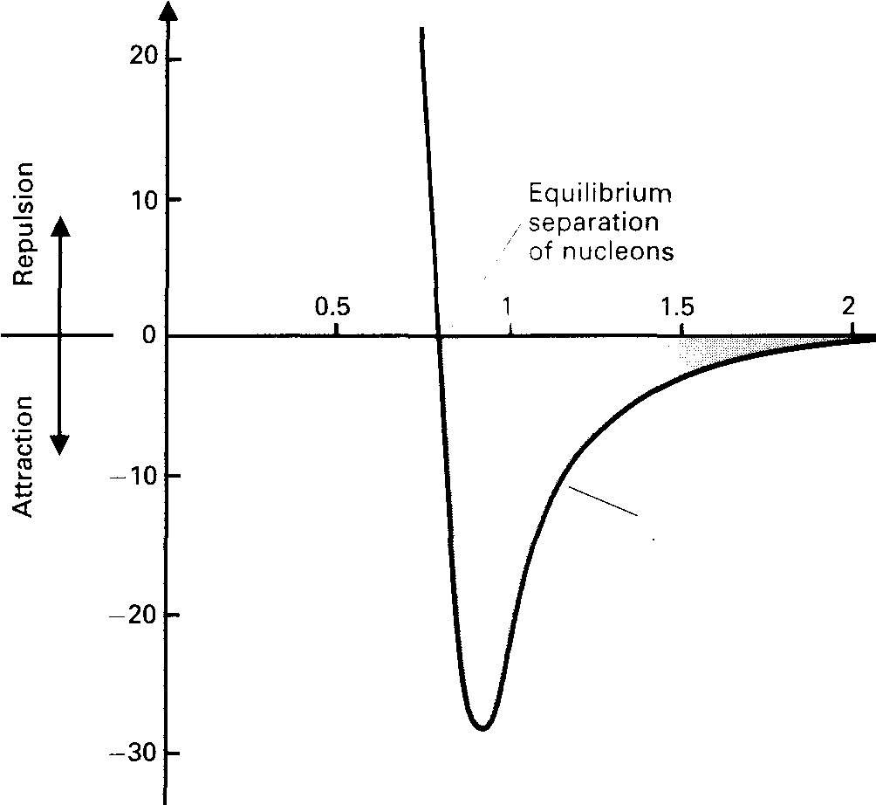
Breaking up nuclei (Nuclear Fission)
What is the magnitude of the strong nuclear force between two protons?
Using
F ∼ 200N
What is the work done (in Mev) in removing a proton to a distance where the strong force is negligible, a distance of 3.2Fm away from the nucleus?
Work = 4MeV

Slide 10
10.2
Imagine that you were asked to make a nucleus. You are given the four pieces (two protons and two neutrons), asked to measure their masses, make them stick them together somehow and then measure the mass of the finished helium nucleus. What would you expect to see?
p
n
n
p
Helium 4
protons (2) 2 x 1.007 276 = 2.014 552
neutrons (2) 2 x 1.008 665 = 2.017 330
Mass of two protons + two neutrons = 4.031 882
Mass of "completed" helium nucleus = 4.001 508
There is a difference of 0.030374 u between them, the helium nucleus is lighter than the four particles that made it.

Slide 11
Mass defect
If we think of this mass difference as a difference of energy:
How much less energy does the alpha particle have than the four particles it is made from?
What is the implication of this?
The alpha particle has 28.3 MeV less energy
It means that this energy would be needed to split up the helium nucleus
Element Mass defect (u)
12 Carbon 6 0.099 00
16 Oxygen 8 0.137 08
40 Calcium 20 0.367 41
56 Iron 26 0.528 75
208 Lead 82 1.757 84
235 Uranium92 1.935 38

Slide 12
Mass Defect
The difference between the mass of an atom and the mass of its particles is known as the Mass defect, Δm.
State three conditions for the mass defect
1. The mass defect is small compared to the total mass of the atom.
2. The energy released when an atom is formed from its constituent particles is given by
ΔE = Δmc²
3. Mass must be in kg, E will be in Joules.

Slide 13
Binding energy
What is the significance of ΔQ = Δm c²
Mass and energy are interchangeable
How big is the strong
nuclear force ?
How much work must be
done to extract a nucleon?
F = 200N
W = 4MeV
What happens to the
energy supplied in
removing a nucleon from
the nucleus?
The potential energy of the nucleon is increased.
This energy is known as the binding energy per nucleon

Slide 14
Questions
1. Find the mass of a Ca- 40 atom.
Electron 0.00055 u
Neutron 1.00867u
Proton 1.00728 u
  (20 x 1.00728u) + (20 x 1.00867u) + (20 x 0.00055 u)
  = 40.3300u
2. If the actual mass is 39.96259u,
(a) Calculate the difference between these values and
(b) work out the binding energy, both in Joules and in eV.
a) 0.36741u
5.484 x 10 ⁻¹¹ J
342.3 MeV

Slide 15
Explain why we cannot simply make atoms from nucleons and electrons.
Only nuclear rearrangements are possible at room temperature
The term “binding energy” for an atom is used to show how much energy would be released if it were formed from separate protons, neutrons and electrons.
It is equivalent to the work done to separate the atom into it’s constituent parts.
It is NOT the energy holding the atom together.
The total ionisation energy for all of the electrons to be removed is trivial in comparison with the energy needed to separate the nucleons and is usually ignored.

Slide 16
Another useful quantity is the binding energy per nucleon, this is the average energy needed to "break off" just one nucleon from the nucleus. It is defined as:
Binding Energy per nucleon = Binding Energy
Nucleon Number
Element | Mass of nucleons / u | Nuclear Mass / u | Binding Energy /MeV | Binding Energy per Nucleon /MeV
Deuterium | 2.01594 | 2.01355 | 2.23 | 1.12
Helium 4 | 4.03188 | 4.00151 | 28.29 | 7.07
Lithium 7 | 7.05649 | 7.01336 | 40.15 | 5.74
Beryllium 9 | 9.07243 | 9.00999 | 58.13 | 6.46
Iron 56 | 56.44913 | 55.92069 | 492.24 | 8.79
Silver 107 | 107.86187 | 106.87934 | 915.23 | 8.55
Iodine 127 | 128.02684 | 126.87544 | 1072.53 | 8.45
Lead 206 | 207.67109 | 205.92952 | 1622.27 | 7.88

Slide 17
Nuclear stability
Energy released by fusion
Energy released by fission
9
8
7
6
5
4
3
2
1
Binding energy per nucleon (MeV)
0 20 40 60 80 100 120 140 160 180 200 220 240
Mass number (A)
Write a general statement relating stability to binding energy per nucleon

Slide 18
Binding energy per nucleon
Which element lies at the top of the curve?
⁵⁶ Fe
How does the binding energy per nucleon of this element relate to its abundance?
The higher the Binding energy per nucleon, the more stable it is and so it won’t decay.
Look at the handout, and locate the elements on the curve. Use this information to explain the use of deuterium and uranium in energy generation.
Why does the decay of heavy isotopes stop at lead?

Slide 19
Fission
Complete worksheet 10.3
Fission nuclei
Neutron
Fission neutrons
U- 235
U-236
You only get a chain reaction if there is enough uranium 235 and it is the right shape otherwise too many neutrons will escape from the outside and the reaction will stop.
The smallest amount of uranium needed to keep a chain reaction going is called the CRITICAL MASS.

Slide 20
Nuclear fusion
On which side of the binding energy graph does fusion occur?
The left, but the nucleon number of any product must be less than 50
Why can’t nuclei of Silver be fused together to produce energy?
They are heavier than iron,
Binding energy per nucleon would need to be increased
What conditions must be met for fusion to occur?
The BE per nucleon of the product nucleus must be greater than those of the individual nuclei
High speed collisions are needed to overcome the electrostatic repulsion of the nuclei, and enable the strong force to take over

Slide 21
Internet links
http://phet.colorado.edu/en/simulation/alpha-decay
http://phet.colorado.edu/en/simulation/nuclear-fission

