Slide 1
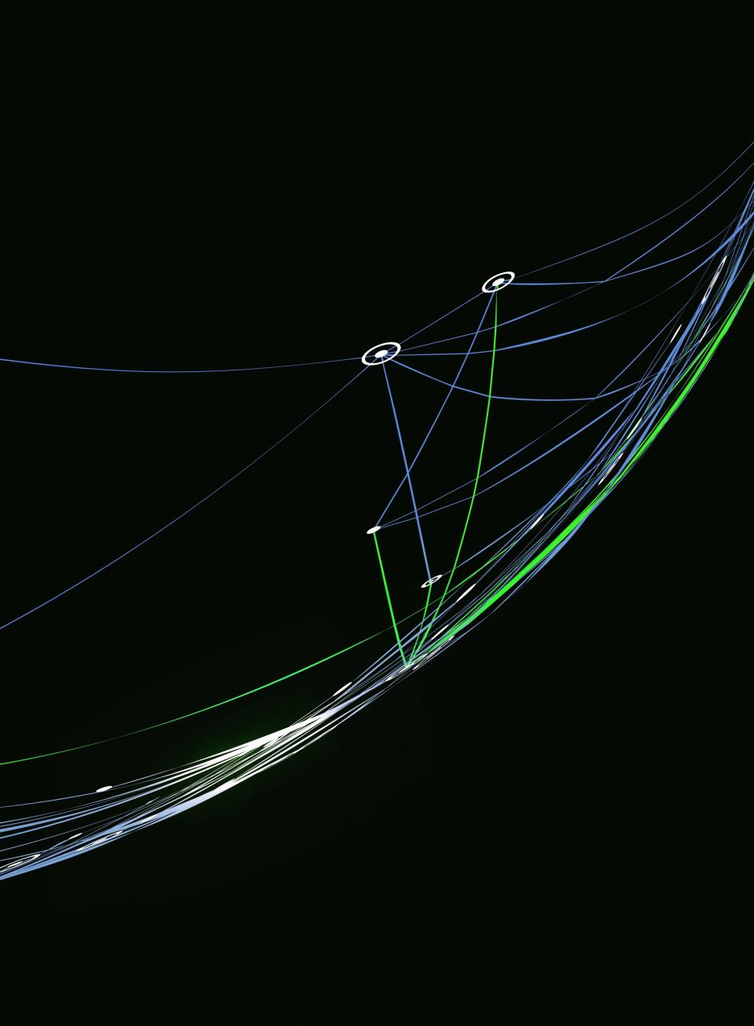
PowerPoint Presentation
Mavis Frimpomaa. Student ID:2439611

Slide 2
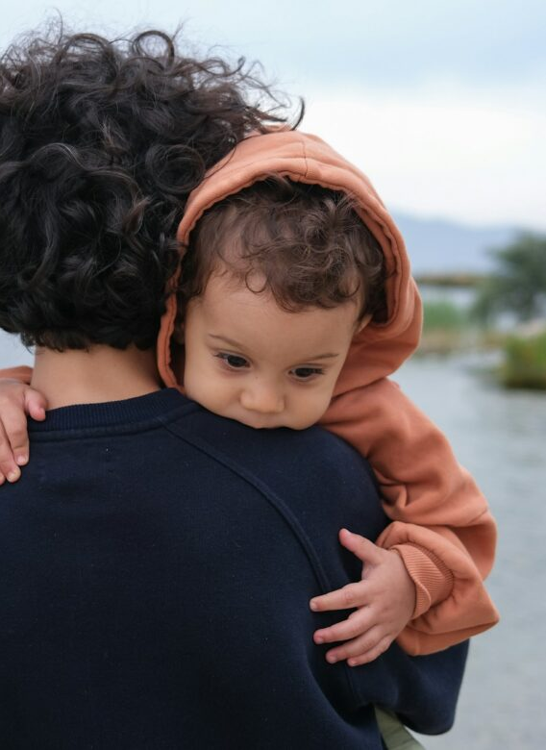
Understanding Isaac’s Development Through Bandura’s Social Learning Theory
Background Information:
Isaac lives with his mother, who is a single parent experiencing post natal depression, low confidence, and limited social support.
The family recently moved to London from another part of the UK, and Isaac has had disrupted childcare arrangements over the past two years.

Slide 3
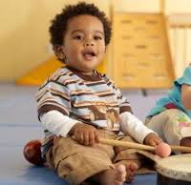
Why Bandura’s Social Learning Theory?
Bandura’s Social Learning Theory (SLT) explains how children learn through observing, imitating, and modelling the behavior of others (Bandura, 1977).
This is highly relevant to Isaac because his early environment has limited his opportunities to observe positive social, emotional, and language behaviors.
Children aged 0–5 rely heavily on observational learning to develop language, social skills, emotional regulation, and confidence (Bandura, 1986).
This Photo by Unknown Author is licensed under CC BY-NC

Slide 4

Why SLT Helps Us Understand Isaac
Maternal postnatal depression → reduced modelling of positive emotional expression (Murray & Cooper, 1997).
Disrupted childcare → inconsistent adult models for language and social behaviour.
Limited social support → fewer opportunities to observe peer play.
Withdrawn behaviour → may reflect learned responses from observing low‑confidence interactions.
Clinginess and distress → may be reinforced by anxious responses from his mother.
Language delay → fewer opportunities to observe rich language use (Hart & Risley, 1995).

Slide 5

Applying SLT to Isaac’s Development
Disrupted Childcare. Inconsistent caregivers → inconsistent modelling of routines, language, and social behavior. Children need stable models to learn predictable patterns (Howe, 2011).
Maternal Mental Health: Postnatal depression reduces emotional responsiveness, verbal interaction, positive reinforcement. Isaac may imitate withdrawn or low‑energy behavior (Murray & Cooper, 1997).

Slide 6

Limited Social Interaction: Fewer peers → fewer opportunities to observe turn‑taking, sharing, and group play. Emotional Responses, Isaac may have learned anxious responses by observing his mother’s stress (Bandura, 1986). Language Delay: Children learn language by hearing and copying adults. Low interaction = reduced modelling (Hart & Risley, 1995).

Slide 7
Nature and Nurture
Biological (Nature)
Temperament: Isaac may naturally be cautious or slow‑to‑warm (Thomas & Chess, 1977).
Brain development: Stress affects attention and memory, which are essential for observational learning (Shonkoff, 2012).
Sleep difficulties: Reduce ability to focus and retain new behaviors.

Slide 8
Environmental (Nurture)
Maternal depression → reduced modelling
Disrupted childcare → inconsistent reinforcement
Limited peer interaction → fewer social learning opportunities
Recent move → increased stress for both mother and child
SLT emphasizes that behavior is shaped by the interaction of personal factors, environment, and learned experiences.

Slide 9

Support Plan (Theory‑Informed Strategies)
1. Positive Adult Modelling
Staff demonstrate calm emotional regulation, turn‑taking, and confident social behaviour.
Use modelling language: “I’m feeling frustrated, so I’m taking a deep breath.”
2. Peer Modelling
Pair Isaac with confident, prosocial peers.
Use small‑group play to demonstrate sharing and communication.

Slide 10
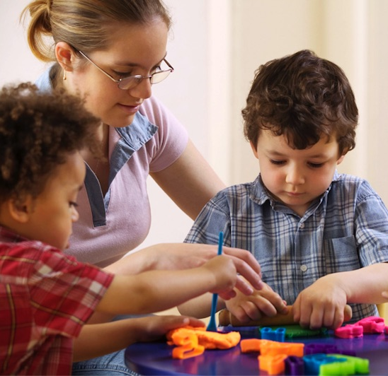
3. Language‑Rich Environment
Narrated play, singing, shared reading.
Staff model simple sentences and encourage imitation (Hart & Risley, 1995).
SALT involvement for targeted modelling.
4. Reinforcement to Build Self‑Efficacy
Praise effort, not just success (Bandura, 1997).
Use visual reward systems to reinforce participation.
5. Emotional Regulation Strategies
Staff model naming emotions and coping strategies.
Use co‑regulation and predictable routines.
This Photo by Unknown Author is licensed under CC BY-SA

Slide 11

Supporting the Mother
Parent‑child interaction modelling during stay‑and‑play.
Encourage serve‑and‑return communication (Harvard Center on the Developing Child, 2012).
Signpost to perinatal mental health services.
7. Multi‑Agency Collaboration
Speech and Language Therapy
Health Visitor
Family Support Worker
Early Help Team
Community mental health services

Slide 12

Critical Evaluation of SLT
Strengths
Explains how children learn social, emotional, and language behaviors.
Highly applicable to early years practice.
Supports modelling‑based interventions.
Recognizes environmental influence — crucial for Isaac.
Limitations
Underestimates biological factors (temperament, neurodevelopment).
Assumes children imitate what they observe — not always true.
Does not fully explain attachment‑related behaviors like separation anxiety.

Slide 13

Cultural and Social Considerations (London)
Children may observe different behaviors across cultures.
Modelling must be culturally sensitive.
Families may have different expectations for independence, communication, or emotional expression.
Practitioners must avoid assuming all behaviors are learned — some reflect cultural norms.

Slide 14

Conclusion
Key messages:
Bandura’s Social Learning Theory provides a strong framework for understanding Isaac’s development.
His early experiences have limited opportunities for positive modelling and reinforcement.
A modelling‑based, reinforcement‑focused support plan can strengthen his confidence, language, and social skills.
Multi‑agency, culturally sensitive practice is essential in London’s diverse communities.

Slide 15
Harvard‑Style Reference List
Bandura, A. (1977) Social Learning Theory. Englewood Cliffs, NJ: Prentice Hall.
Bandura, A. (1986) Social Foundations of Thought and Action. Englewood Cliffs, NJ: Prentice Hall.
Bandura, A. (1997) Self‑Efficacy: The Exercise of Control. New York: Freeman.
DfE (2021) Statutory Framework for the Early Years Foundation Stage. London: Department for Education.
Hart, B. and Risley, T. (1995) Meaningful Differences in the Everyday Experience of Young Children. Baltimore: Brookes.
Harvard Center on the Developing Child (2012) Serve and Return Interaction Shapes Brain Architecture. Howe, D. (2011) Attachment Across the Lifecourse. Basingstoke: Palgrave Macmillan.
Murray, L. and Cooper, P. (1997) Postpartum Depression and Child Development. New York: Guilford Press.
Shonkoff, J. (2012) ‘The science of early childhood development’, Pediatrics, 129(1), pp. e232–e246. Thomas, A. and Chess, S. (1977) Temperament and Development. New York: Brunner/Mazel.

