Slide 1



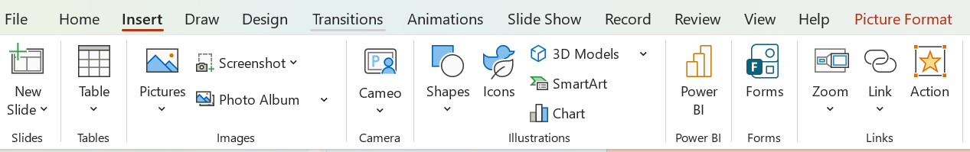
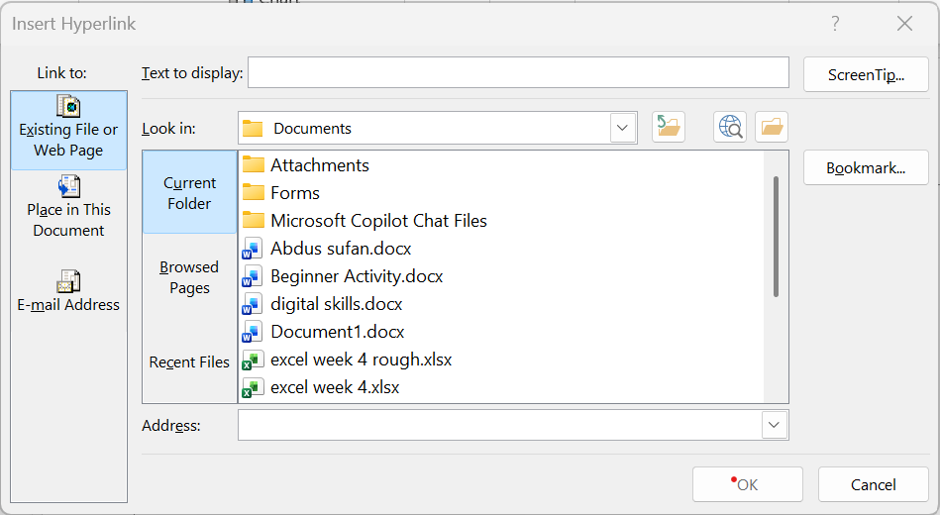

How to insert
Hyperlinks in a
PowerPoint
What is a Hyperlink?
Step One:
In PowerPoint presentations, hyperlinks are commonly used to direct viewers to external websites, specific slides within the presentation, email addresses, or downloadable files.
Begin by highlighting your clickable element such as text, an image, or a button. As shown in the example below.
This shows a highlighted piece of text. If you are using an image, select the image.
Next step:
Following step:
Locate the insert tab. Once complete, find and click the link. Alternatively,
right click, and you can also find the Link
option there.
Once clicked, a dialog box will open. click on the Existing file or Web Page tab.
In the address box, type or paste the website URL.
You can also link a word by writing in the text to display box located on the top. Click on ok.
Example of how to insert a hyperlink with
PowerPoint
Example of how to insert a link in PowerPoint
Insert a Hyperlink with PowerPoint
And finally:
Different Forms of Hyperlink:
Once you have added the hyperlink, go to Normal view. Find the text or picture you linked, right-click, select Open Hyperlink from the menu. This enables you to check if your link works.
Text Hyperlink – Uses a word or phrase to redirect visitors to another page, file or document
Image Hyperlink – Uses an image to redirect visitors to another page, file or document.
Bookmark Hyperlink – Uses text or an image to redirect to another part of a web page.
E-mail Hyperlink – Allows visitors to send an email message to the displayed email address.
Want to know more? www.support.microsoft.com

