Slide 1
BMSK6006 Developing Emotional Intelligence for the Workplace
Online Session 6

Slide 2
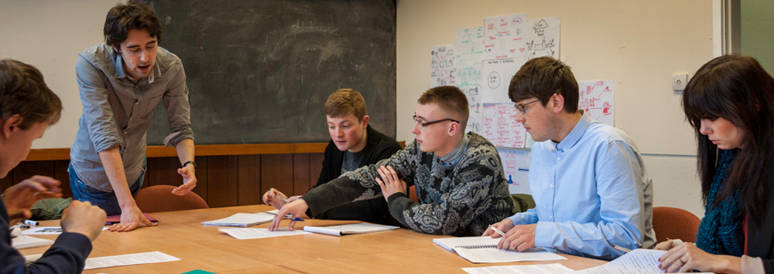
Research Review
Feedback and Discussion

Slide 3


Agenda
Generic Assessment Criteria
The Assignment
Some key concepts
70:20:10
Psychological dimensions of EQ
Relationships
Workforce development
Business performance
Bibliography
Research & report

Slide 4
Module Task Assessment
TASK
Common Assessment Criteria
Critically evaluate theories of emotional intelligence and their relevance to workforce development and business performance
Use theories of emotional intelligence and mindfulness to review the effect of emotions on your own workplace performance
Engagement with Literature Skills. (30)
Knowledge and Understanding Skills (25)
Cognitive and Intellectual Skills (25)
Practical Application Skills (10)
Transferable Skills for Life and Professional Practice (10)

Slide 5

Some Key Concepts
Working relationships
Trust
Cooperation
Collaboration
Communication
Open flow of ideas
Respect
Positive work environment
Feedback
Personal development
Mutual support
Problem solving
Continuous improvement
70:20:10
Notes:
70:20:10 model relates to the

Slide 6

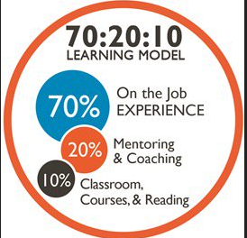


70:20:10

Slide 7

Psychological Dimensions of EQ
Emotional competency | Emotional maturity | Emotional sensitivity
Tackling emotional upset | Developing others | Self-awareness
High self-esteem | Delaying gratification | Know the threshold of emotions
Handling egoism | Adaptability and flexibility | Empathy
Improving interpersonal relations | Countering inferiority complex | Infectiousness of emotions

Slide 8

Major Relationship Management Challenges
Self
All work is done through relationships
Interpersonal
Social

Slide 9
Major Elements in Human Relations
Communication
Conflict resolution
Effective
Human Relations
Self-awareness
Self-disclosure
Self-acceptance
Trust
Motivation

Slide 10

Key Concepts – Organisational Performance!

Slide 11
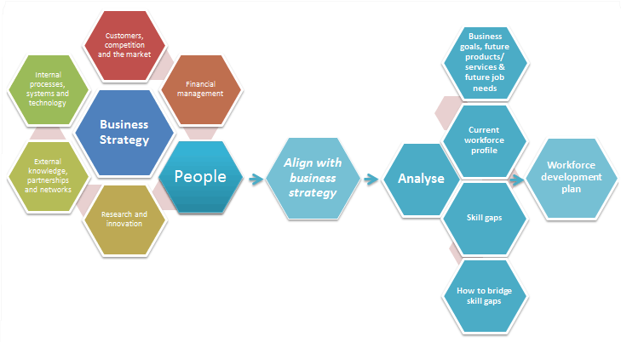
Workforce Development & Business Performance

Slide 12
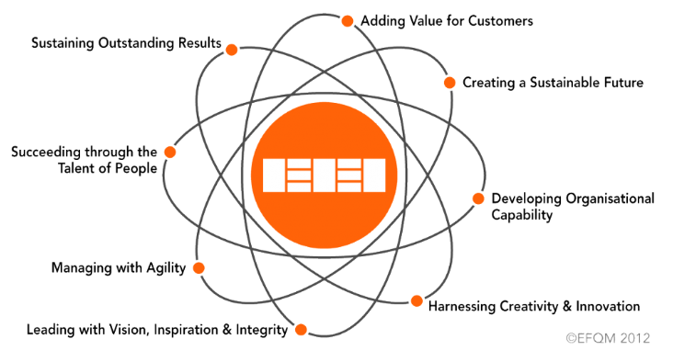
EFQM - Fundamental Concepts

Slide 13
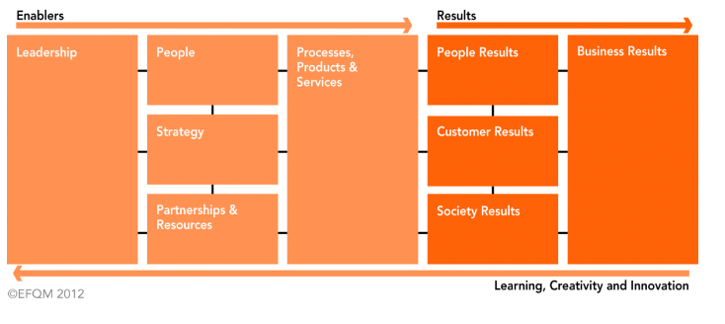
EFQM Business Excellence Model

Slide 14


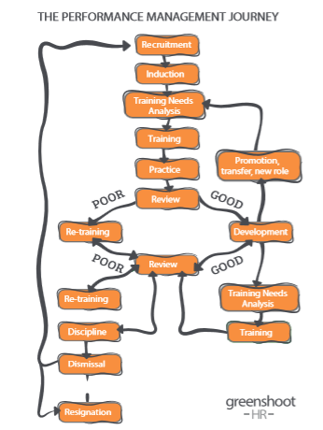



Slide 15

Another view: Vision to Performance
Operations
Vision and Mission
Development
Objectives
Culture, Values and Expectations
Strategies
Competencies and Behaviours
Cognitive and Emotional
Personal Development Plan
Personal and Organisational Assessment
Execution and Actions
Organisational Performance
Vision to Performance
Knight, J., et al (2018), p.31

Slide 16
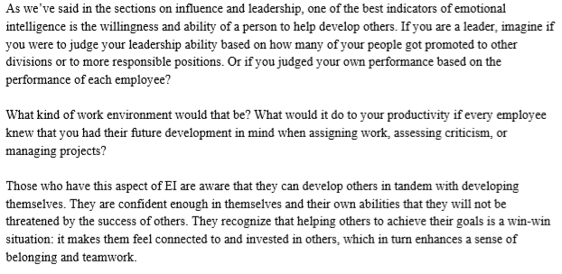
Developing Others
Unknown. (2010) Emotional Intelligence. Coventry, UK: MTD Training & Ventus Publishing ApS. P.54

Slide 17
Video Exercise
Please pay attention to the following short video clip and record what you believe are the: -
Key messages
Points of contention
Implications for leaders/managers….and employees

Slide 18

Emotional Intelligence

Slide 19
Video Review
What were the key learning points you identified from the video?
Prepare to discuss these as a group.

Slide 20

Summary
Take 5 minutes to reflect upon tonight – what have you learnt?
Any key areas you want to research further?
What can help you with your assignment?
What can help you in your career?

Slide 21
Chapter 16 and Chapter 17 of the Student Yearbook, Final Year
In the opinion of the author, why is emotional intelligence (E.I.) so important?
  Provide examples to underpin your conclusions
Team exercise – 30 mins to respond and record your team consensus ready for discussion.

