Slide 1

Digital Marketing – Assessment Component 2
Privacy, Trust & Security
Etienne Bosser

Slide 2
Content
Privacy, trust & security issues
What is the UK law online?
Digital channels risks

Slide 3

Privacy, trust & security issues
Internet : Large open memory
The need for organisations to have confidentiality policies

Slide 4
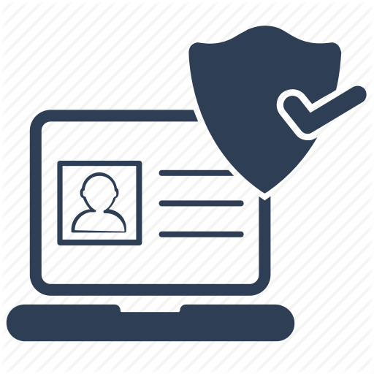
Privacy, trust & security issues
How users can protect themselves ?
Update passwords,
Private searching mode,
Use different research engine,
Don’t write over personal information on social networks,
Download anti-virus software

Slide 5
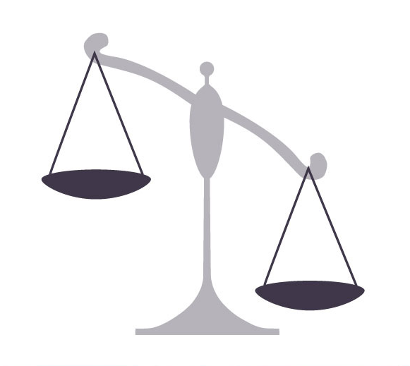
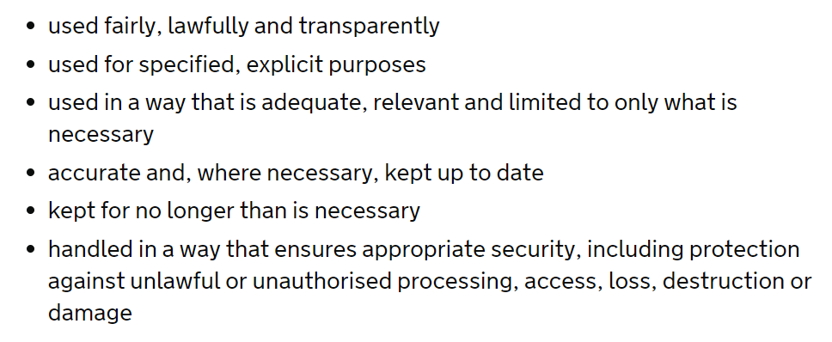
Law
2018 UK law, private data protection :

Slide 6
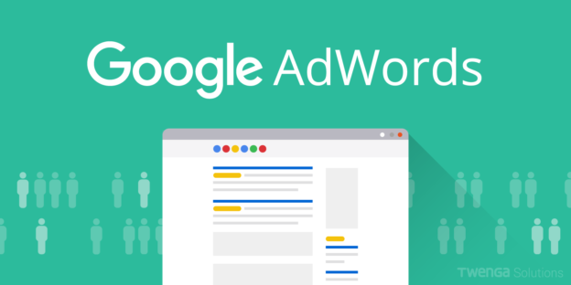
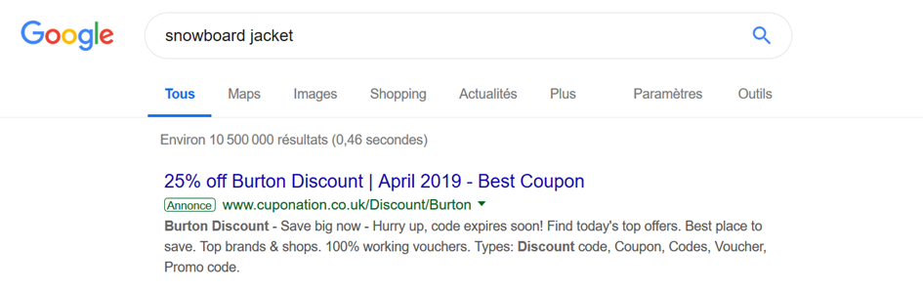
Digital channels risks
Google AdWords

Slide 7
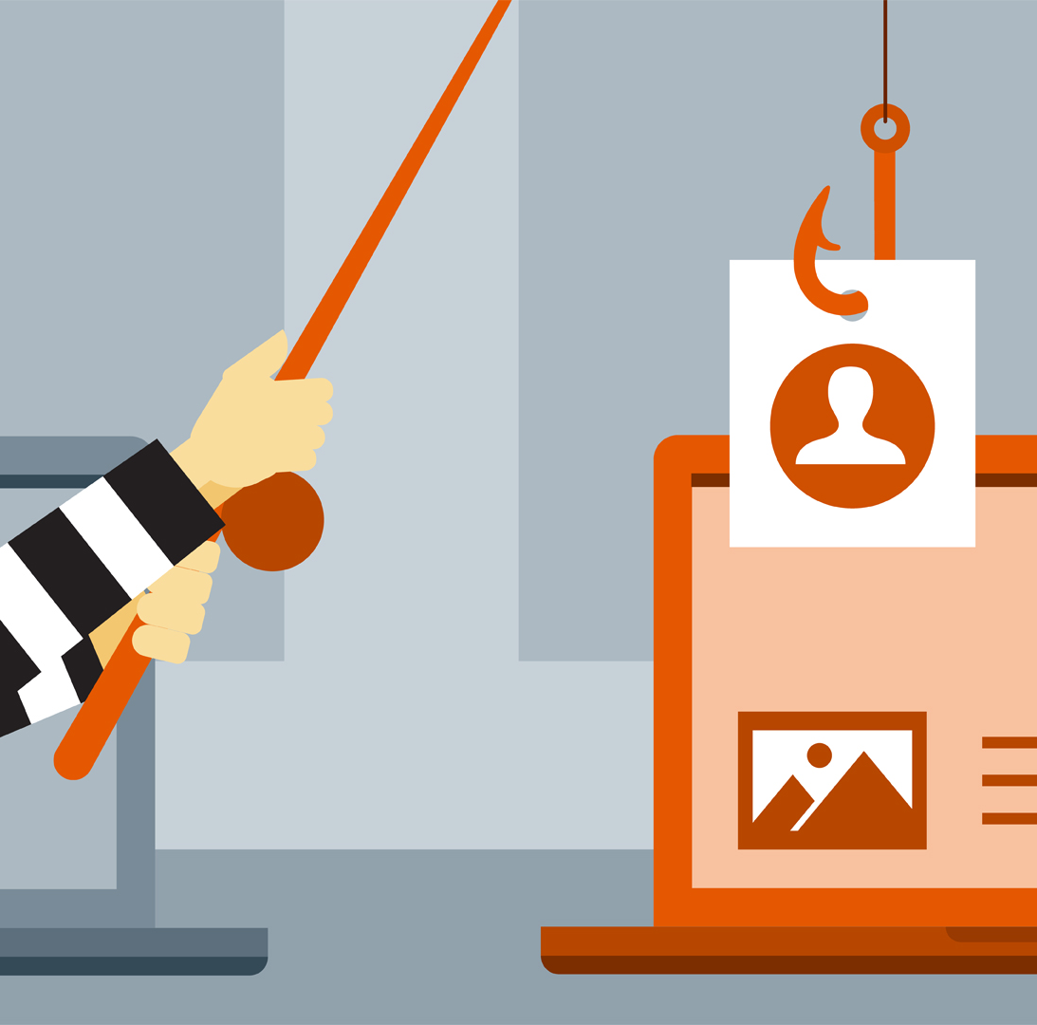

Digital channels risks
Social media

Slide 8
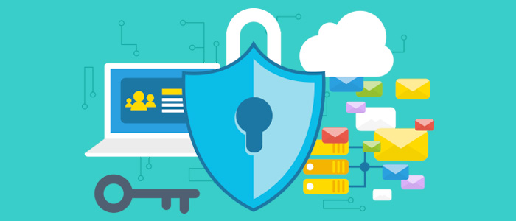
Conclusion
Ensure self-data protection
Applicate terms and condition agreement
Have data protection requirements

Slide 9
References
Baadsgaard, J. (2019). What is Google AdWords and Why Do I Need It? | Disruptive Advertising. [online] Disruptive Advertising. Available at: https://www.disruptiveadvertising.com/adwords/what-is-google-adwords/ [Accessed 4 May 2019]. Blog Altares. (2018). Les 12 principales conséquences d'une mauvaise gestion des données. [online] Available at: https://blog.altares.com/2018/05/09/12-consequences-potentielles-a-la-mauvaise-gestion-des-donnees/ [Accessed 5 May 2019]. Brooke, J. (2018). Online business | What is data protection. [online] Rocket Lawyer. Available at: https://www.rocketlawyer.co.uk/legal-centres/online-business.rl [Accessed 4 May 2019]. Chaffey, D. (2009). Internet marketing. Essex, JE: Pearson Education, pp.160; 161. GOV.UK. (2019). Data protection. [online] Available at: https://www.gov.uk/data-protection/find-out-what-data-an-organisation-has-about-you [Accessed 6 May 2019]. Morgene, M. (2018). Protection des données : les gestes à adopter. [online] Linfodurable.fr. Available at: https://www.linfodurable.fr/technomedias/comment-proteger-ses-donnees-sur-internet-1976 [Accessed 4 May 2019]. Sicari, S., Rizzardi, A., Grieco, L. and Coen-Porisini, A. (2010). Security, privacy and trust in Internet of Things: The road ahead. IEEE Xplore. Available at: https://ieeexplore.ieee.org/abstract/document/5708519/authors#authors [Accessed 4 May 2019]. Axentios, S. (2019). Google Adwords, un danger pour les entreprises?. [online] Rédaction créative et communication cohérente pour entreprises. Available at: https://steveaxentios.ch/google-adwords-un-danger-pour-les-entreprises/ [Accessed 4 May 2019].

