Slide 1
Module Title: Problem Solving and
Decision Making
Student Name: Michelle Tampos
Student Number: 2519515
Lecture Name: Ann Marie Dufficy
Module Code: LCLM 4004
Assessment: Component 2 Report -
Basil's Bakery

Slide 2
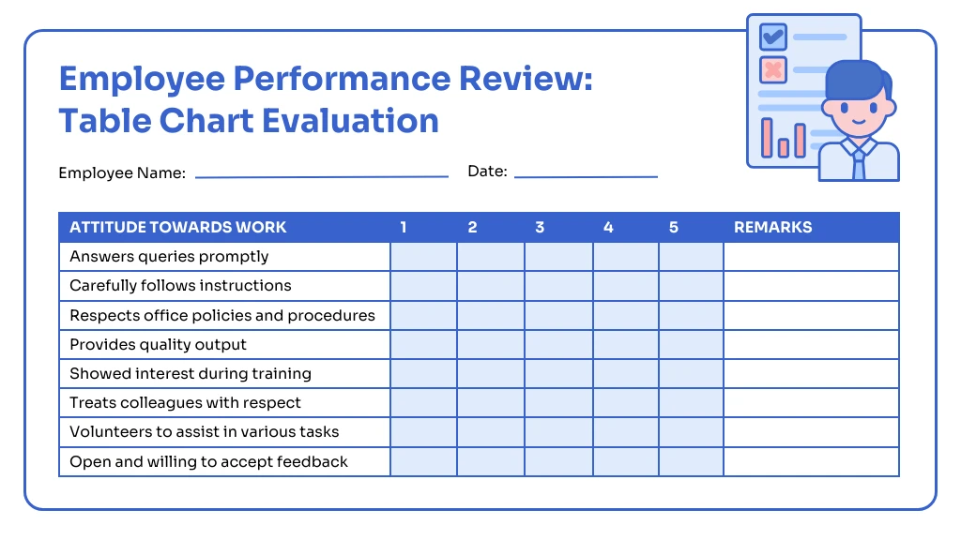
Appendices
Appendix 1: Task 3a - PMI Evaluation Tables
Appendix 2: Task 4a - Implementation Plan
Appendix 3: Task 5a - KPI and SMART
Objectives
•|| 4G ('
B
7
9
10

Slide 3
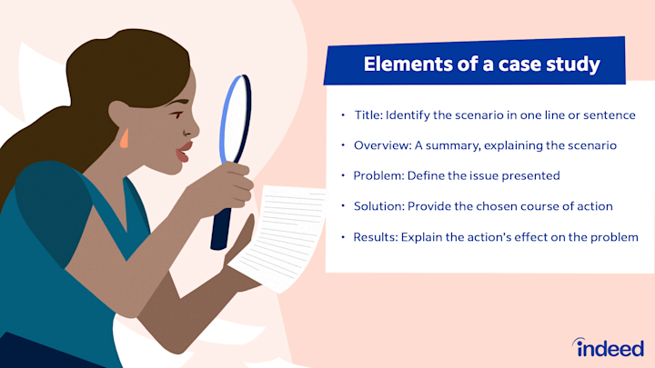
Task 1: Overview of Case-study
Basil's Bakery is a small, family-run business established for 12 years, supplying fresh bread and pastries to local shops, cafes, and direct customers. Recently, sales have fallen by 18% in 12 months, profit margins are squeezed, and customer complaints about consistency and delivery delays have risen.
Root problem: Inefficient production planning, lack of modern inventory control, and no structured sales tracking.
Contributing issues: Manual stock recording leads to over-ordering or shortages; old equipment slows output; no clear pricing strategy; and limited online visibility reduces reach.

Slide 4
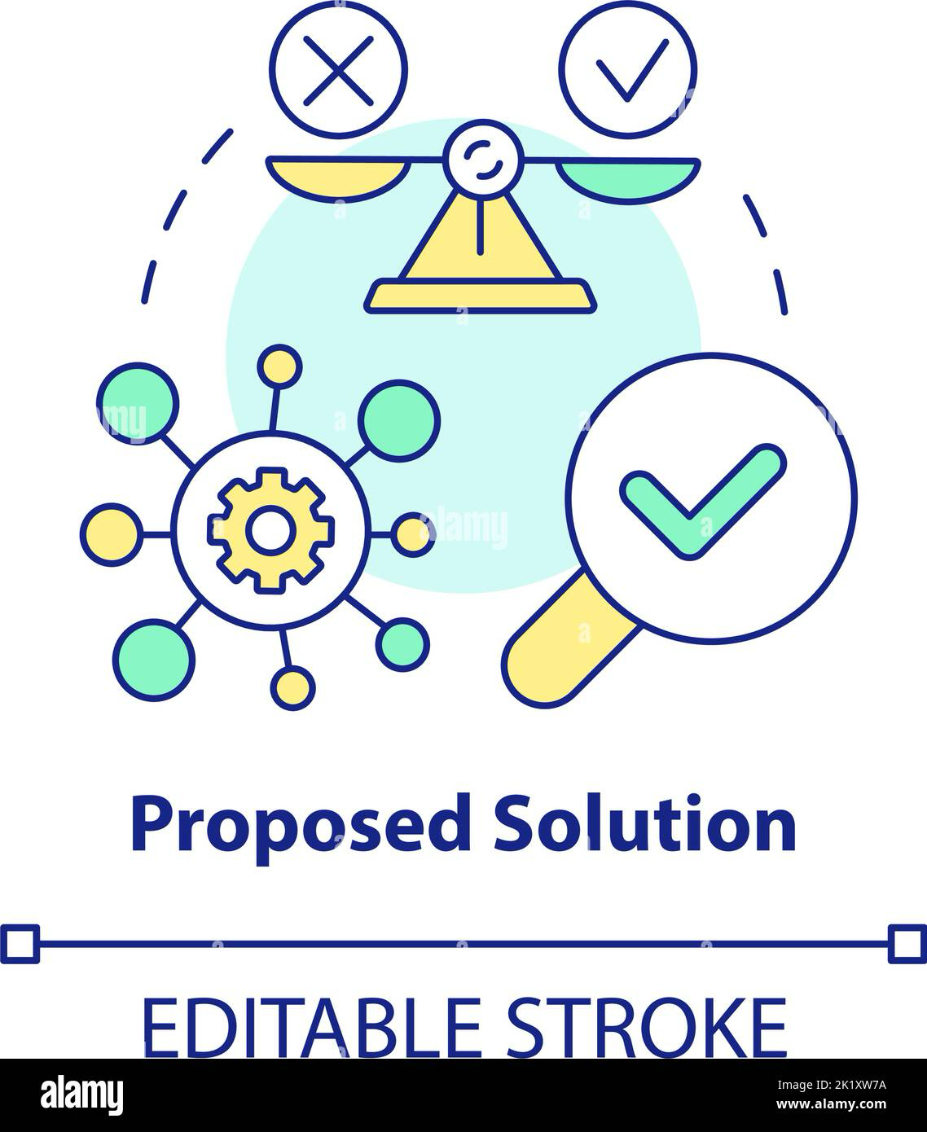
Task 2: Two Proposed Solutions
Solution A: Modernise Operations &
Inventory Control
This solution involves introducing simple inventory management software, scheduling regular equipment maintenance, and creating a standard production schedule. Staff will receive short training on using the system and planning workflows. It directly
addresses waste, stock errors, and slow output. By reducing over-production and spoilage, costs fall, while consistent quality improves customer satisfaction.

Slide 5
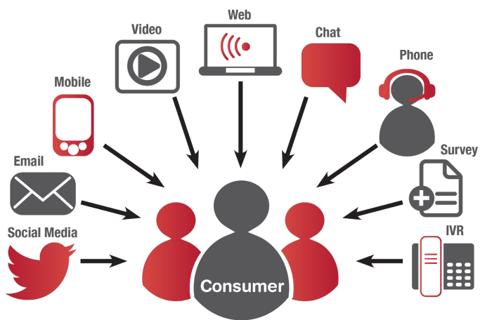
Solution B: Expand Sales Channels & Marketing
This solution focuses on launching a
basic website with online ordering, creating social media accounts, and supplying to two new local supermarkets. It also includes a small promotional campaign. This addresses falling sales and low visibility. However, it does not fix internal production or stock issues, meaning higher demand could cause delays or quality problems if processes remain unchanged.

Slide 6
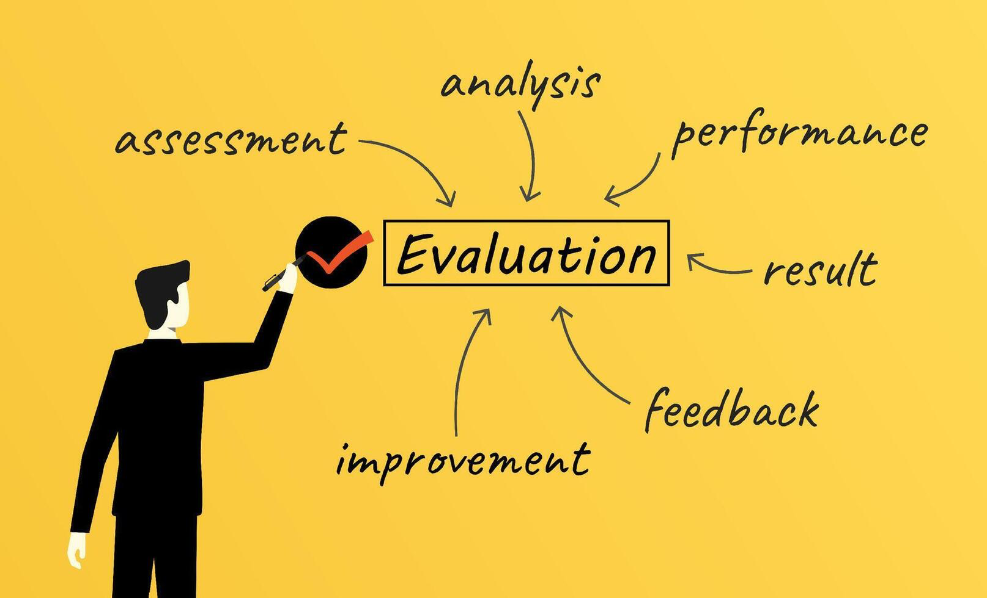
Task 3b: Evaluation Results and
Justifications
Based on the PMI analysis in Appendix 1, Solution A is the preferred choice.
The evaluation used three weighted criteria: cost efficiency (40%, feasibility (35%), and impact on quality/reliability (25%). Weightings reflect that fixing internal processes delivers long-term stability before expanding sales.
Solution A scores higher in "Plus" factors: lower ongoing costs, quick implementation, and direct reduction of waste and delays. While it has an initial cost, the benefits are immediate and support future growth. Solution B carries higher risk if operations are not ready. This makes Solution A the most sustainable and effective fix.

Slide 7
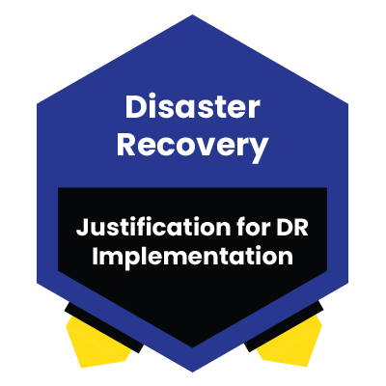
Task 4b: Justifications for the Implementation Plan
The plan in Appendix 2 follows a logical order: assess → train > implement → review. This sequence minimises disruption to daily baking.
﻿﻿Assessment first ensures the software and maintenance plan fit the bakery's actual size and budget.
﻿﻿Training before full rollout prevents errors and builds staff confidence.
﻿﻿Phased introduction means one area changes at a time, avoiding downtime.
﻿﻿Final review confirms improvements and allows adjustments.
Responsibilities are clear: the owner leads decisions, a t-time IT assistant
handles software, and production staff. follow new schedules. This ensures accountability and smooth progress.

Slide 8

Task 5b: Justifications for the KPI and SMART Objectives
The main KPI chosen is "Reduction in production waste and delivery delays", as it directly measures improvements to the root problem (Mullins, 2019). It is objective, measurable, and linked to profitability.
The SMART objectives (see Appendix 3)
are justified as follows:
﻿﻿Specific: Focus on clear outcomes (waste %, on-time rate).
﻿﻿Measurable: Data is tracked weekly from stock and delivery logs.
﻿﻿Attainable: Targets are realistic given the bakery's size and resources.
﻿﻿Relevant: Both lower waste and faster delivery raise profits and reputation.
﻿﻿Time-bound: Short deadlines keep progress visible and maintain momentum.
Together, they provide clear milestones to confirm success.

Slide 9

Task 7: Key Findings
﻿﻿The root cause of decline is inefficient internal processes, not just low sales.
﻿﻿Fixing production and inventory is more critical than expanding sales first.
﻿﻿Structured systems reduce waste, improve quality, and lower costs.
﻿﻿Training and clear roles ensure changes are adopted successfully.
﻿﻿Measurable targets make it easy to track if improvements work.

Slide 10

Reference List
﻿﻿De Bono, E. (1993) Serious Creativity:
Using the Power of Lateral Thinking to Create New Ideas. London:
HarperCollins. [PMI method]
﻿﻿Mullins, L.J. (2019) Management and Organisational Behaviour. 11th edn.
Harlow: Pearson.
﻿﻿O'Connell, J. and Cuthbertson , B.
(2009) Project Management in the Food Industry. Cambridge:
Woodhead Publishing.
[Implementation planning]
• Doran, G.T. (1981) 'There's a S.M.A.R.T. way to write management's goals and objectives, Management Review, 70(11), pp. 35-
36.
Slack, N., Brandon -Jones , A. and Johnson , R (2022)Operations Management. 9th edn .Harlow: Pearson.

Slide 11
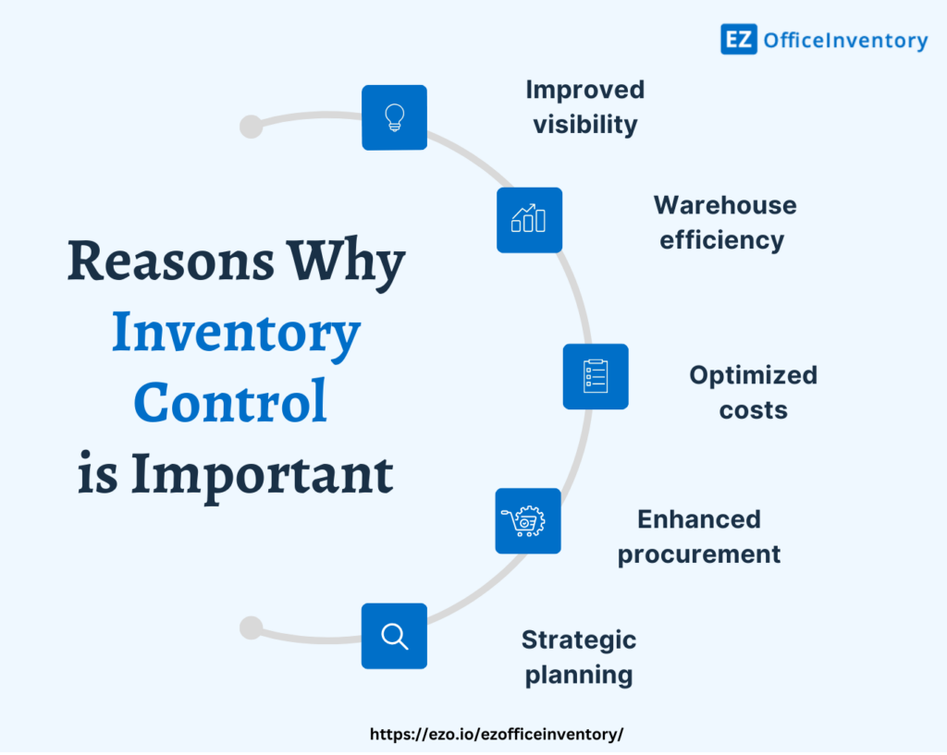
Appendices
Appendix 1: Task a - PMI Evaluation
Tables
Source: De Bono (1993)
Solution A: Modernise Operations &
Inventory Control
Plus | Minus
Reduces food waste and raw material costs | Small initial cost software & traini
Improves consistency and delivery reliability | Requires staff to new routines
Low ongoing running costs | Takes 2-3 weeks fully implement
Supports better planning for future orders | Limited immedia' impact on sales numbers
TOTAL: +4 | TOTAL: -2
Overall Total For Solution A =+5

Slide 12
Solution B: Expand Sales Channels & Marketing
Plus | Minus
Brings in new customers quickly | Higher ongoing cr (fees, advertising
Increases total revenue potential | More work for sta production is slon
Makes the business more visible online | Risk of poor servi demand outpaces capacity
Helps compete with larger bakeries | Profit margins ma lower for large contracts
TOTAL: +3 | TOTAL: -4
Overall Total for Solution B = +1

Slide 13
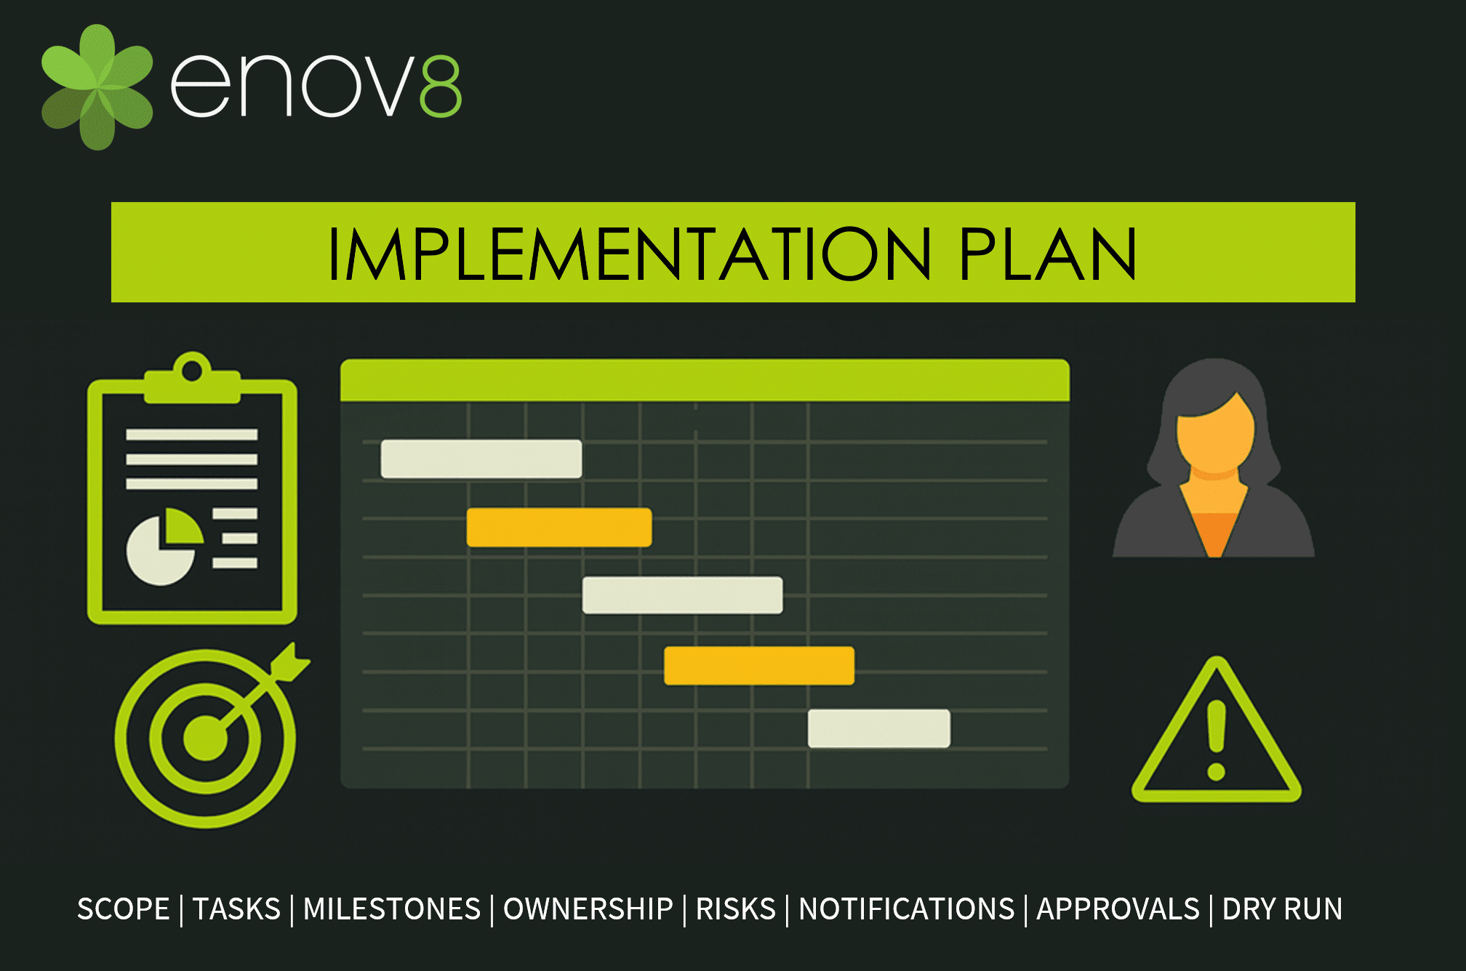
Appendix 2: Task 4a - Implementation Plan
Source: O'Connell and Cuthbertson
(2009)
Problem: Inefficient production, stock errors, and delays
Solution: Modernise Operations &
Inventory Control
No.
11)
Task
Assessment &
Selection
2
Training
3
Phased
Implementation
4
Review & Adjust
WHAT
Review current workflow; cho cost inventory software; schedule maintenance
Train 2 product staff on stock and new schedule
Start using new stock system; run production carry out first maintenance
Check waste l and delivery ti any issues.
WHEN |  | Basil (Owner)
Weeks 1-2 | Basil (Owner)

Slide 14
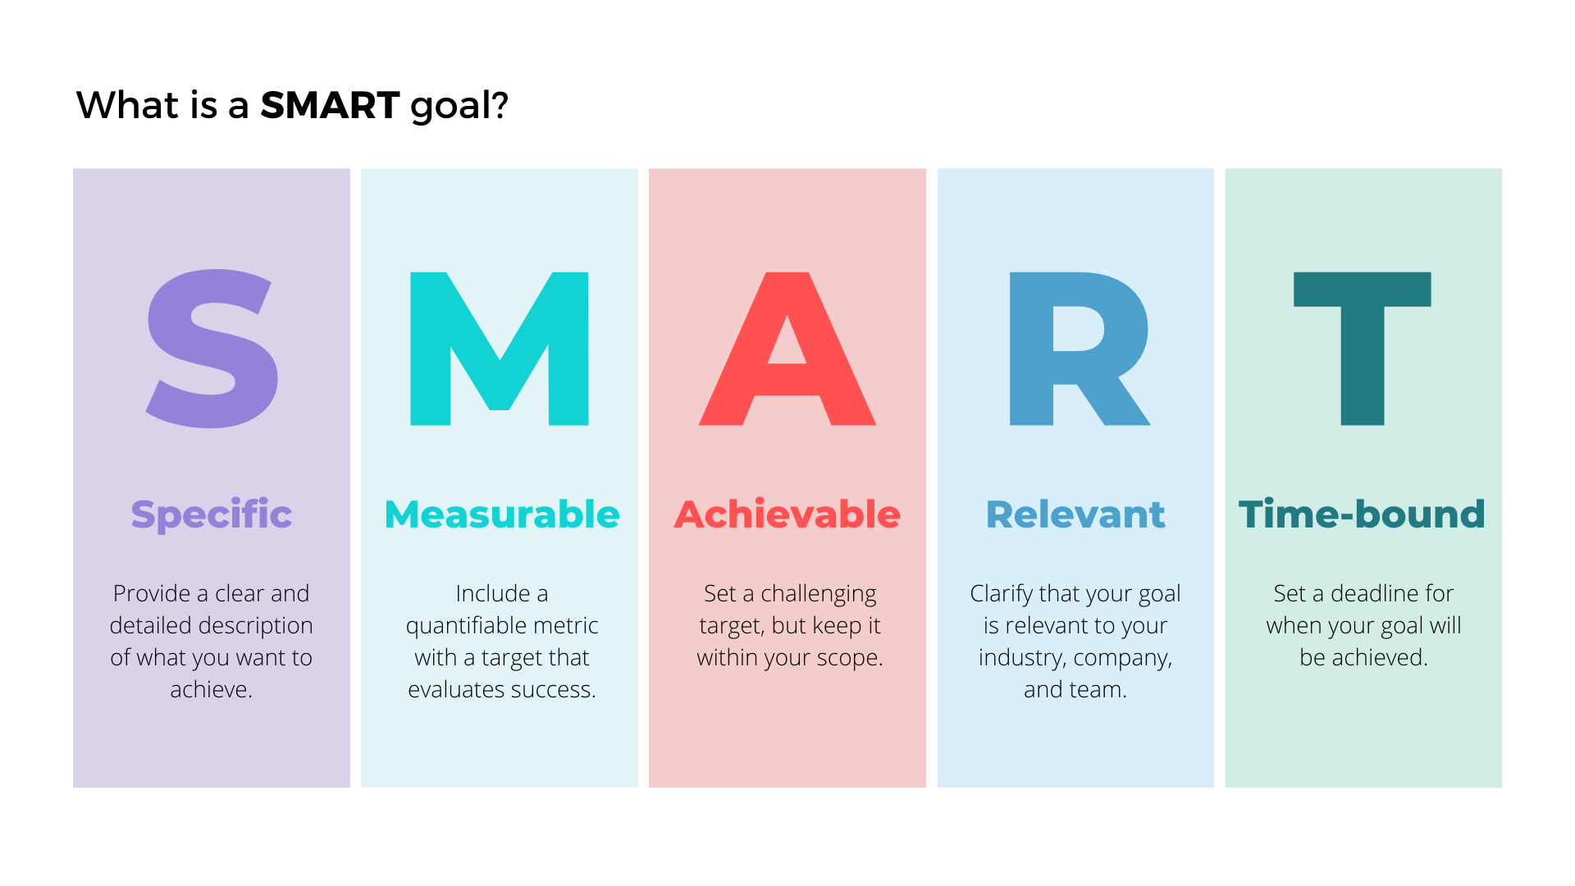
Appendix 3: Task 5a - KPI and SMART
Objectives
Source: Doran (1981); Slack et al.
(2022)
Key Performance Indicator:
Percentage reduction in production waste and percentage of orders delivered on time
Specific;
Reduce raw material and finished product waste.
Improve delivery reliability.
Time-Bound
Achieve within 3 months
Achieve within 2 months
 | Attainable | Relevant
Measurable Target: Reduce waste from 12% to 6% per week very Target: Raise on-time delivery from 75% to 95% | Attainable Using stock tracking and scheduling; realistic for current output Clearer routes and production planning; matches current capacity | Lower waste = lower costs and higher profit 口 止 Time-Bound Achieve within 3 months Better service = fewer complaints and repeat customers

Slide 15
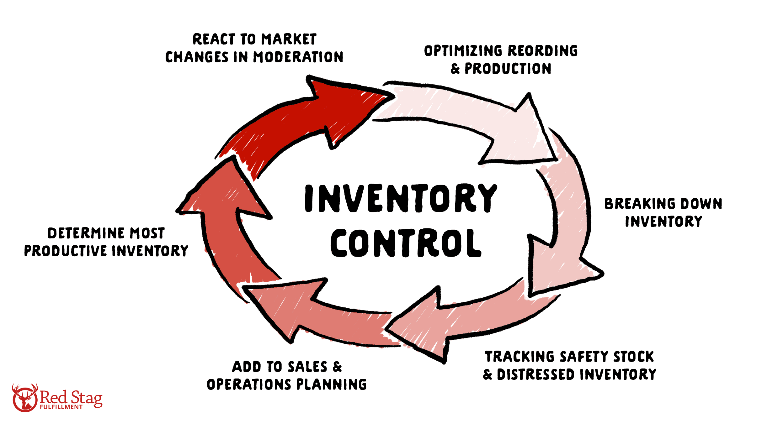
V Solution A: Modernise Operations
& Inventory Control
Plus
Reduces food waste and raw material cost
Improve consistency and delivery reliability
Low on going running cost
Supports better planning for future orders
Minus
Small initial cost for software & training
Requires staff to learn new routines
Takes 2-3 weeks to fully implement
Limited immediate impact on sales numbers
TOTAL: -2
Interesting
Can be scaled easily as the business grows later
Data collected helps make better long-term decisions
May reveal further small savings in workflow
Creates a stable base to add marketing later
TOTAL: +3
Overall Total = +4 - 2 + 3 = +5

Slide 16
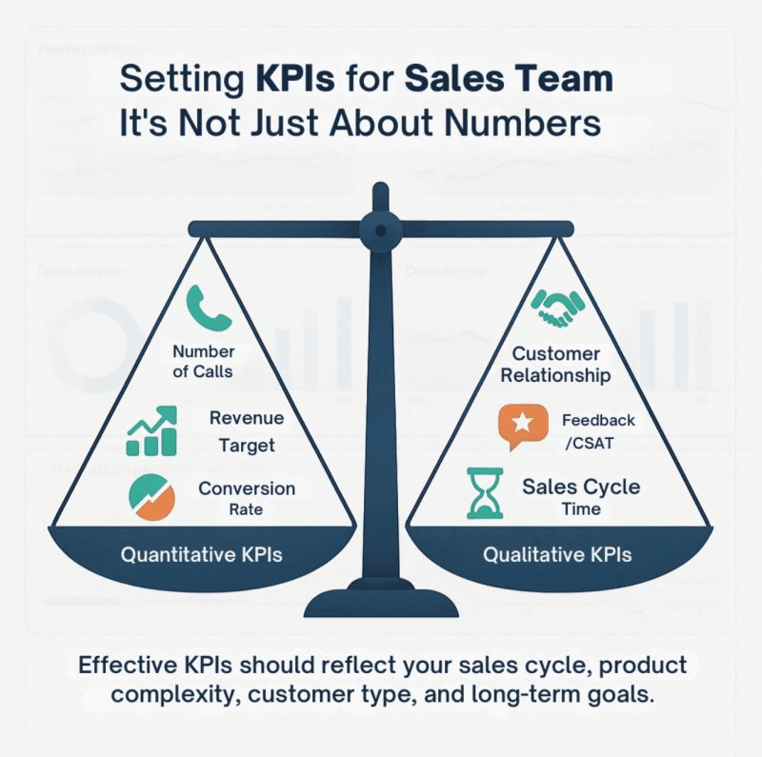
Solution B: Expand Sales Channels & Marketing
Source: De Bono, E. (1993)
Plus
Bring in new costumers quickly
Increase total revenue potential
Make the business visible online
Helps compete with larger bakeries
Total:-3
Minus
Higher on going cost ( fees Advertising)
More work for staff if production is slow
Risk of poor service if demand out spaces
Capacity.
Profit margins may be lower for large contracts
Total :-4
Overall total for solution B = (+3)+
(-4) +(+2)=+1
Interesting
Reveals which products are most popular with new buyers
Shows which areas have highest demand for delivery
Opens possible future partnerships with cafes/hotels
Can be run in low-cost stages to reduce risk
Total: +2

