Slide 1
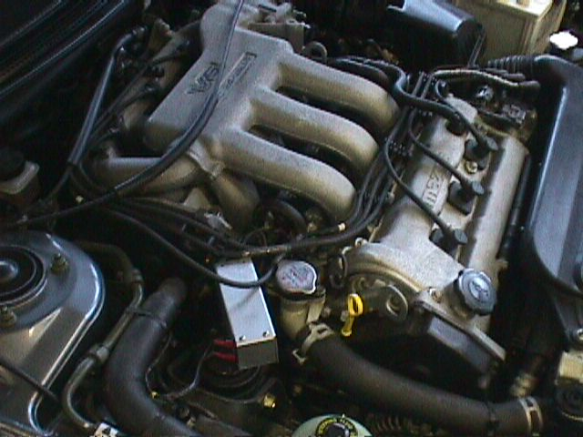
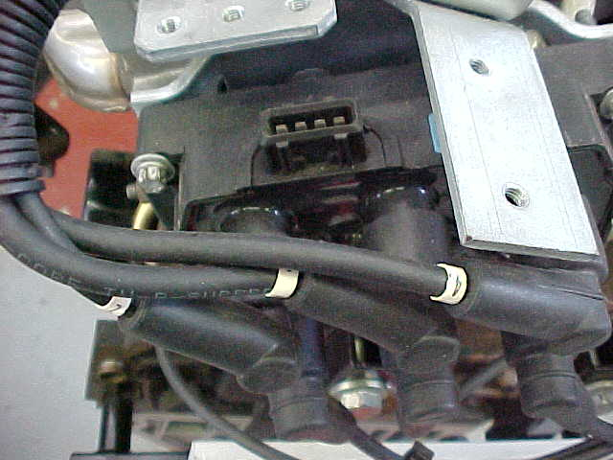
Distributorless Ignition Systems
Operation
Developments
Testing

Slide 2
Distributorless Ignition Systems
The principles of operation are basically no different than those for
distributor equipped electronic ignition systems that began appearing
on American automobiles in 1972.
There are 2 obvious differences:
A DI system does not have a mechanical distributor.
Most DI systems use one coil for every two spark plugs (however
some systems have one coil per cylinder i.e. BMW).

Slide 3
Distributorless Ignition Systems
In operation the only major difference is that DI systems fire
all of the engines spark plugs in ONE crankshaft revolution,
whereas the old mechanical distributor type fires all plugs every
TWO crankshaft revolutions.
On all four stroke engines, equipped with or with out distributors
require TWO crankshaft revolutions (720° travel) for the
combustion to occur on each cylinder.
On engines with an even number of cylinders, combustion occurs
in half of the cylinders in the first revolution (360°) and in the
other half in the second half of the revolution. Each cylinder that
has combustion in the first revolution has a companion cylinder
that fires 360° apart from it during the second revolution.

Slide 4
+
ECU
Layout
ECU
Primary
Secondary
Primary
Secondary
NGK
NGK
NGK
NGK

Slide 5
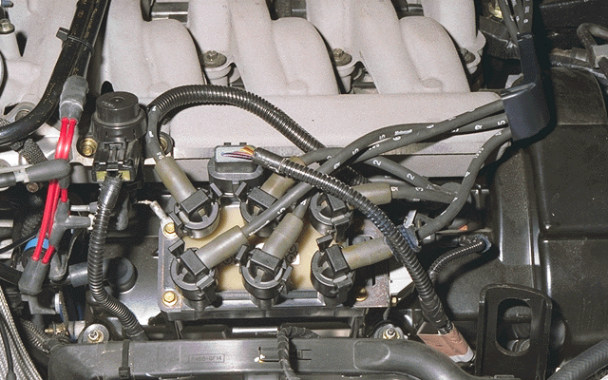

Slide 6
Distributorless Ignition Systems
In conventional systems the ignition coil is always connected
so that the secondary winding side will always be negative.
This is done because the electrons readily tend to leave a hot
surface much more easily than a cold surface (the outer
electrode is much colder because it sinks heat into the cylinder
head).
Therefore 30% more energy is needed to fire a plug backwards
(from the outer electrode to the centre electrode).
As DIS produces high voltages (40 KV), this eliminates any
difficulty in firing the plugs.

Slide 7
Conventional System
₋
₊
BATTERY
IGNITION
SWITCH
DISTRIBUTOR
CAP
STARTER
MOTOR
+
_
15
4
NGK
IGNITION
COIL
Terminal 15 +
Terminal 1 -
1
_
POINTS
CONDENSER

Slide 8
+
ECU
ECU
Primary
Secondary
Firing
1342
Primary
Secondary
NGK
NGK
NGK
NGK
TDC power TDC exhaust

Slide 9
+
ECU
ECU
Primary
Secondary
Firing
1342
Primary
Secondary
NGK
NGK
NGK
NGK

Slide 10
Distributorless Ignition Systems
As can been seen from the previous screens, the DI system
has 2 secondary terminals that are connected to the spark
plugs of companion cylinders.
The coil fires both spark plugs at the same time every crankshaft
revolution. One of the spark plugs is called TRUE firing, because
it occurs during the compression stroke and ignites the mixture.
The other plug is called WASTED firing because it occurs on the
exhaust stroke.

Slide 11
Distributorless Ignition Systems
Electron Flow - negative to positive
Primary
_
Secondary
+
NGK
NGK

Slide 12
_
+
ELECTRON FLOW - TO +
NGK
NGK
Primary
Secondary
NGK
NGK

Slide 13
Distributorless Ignition Systems
The arrows on the previous page show the direction of
electron flow in the circuit when a spark occurs. It can be seen
that the electron path is from the left end (-) of the secondary
winding through the centre electrode and then through the head
to the outer electrode of the right hand plug. After then jumping
over the gap to the centre electrode they flow to the right hand
end of the secondary (+) winding.
The series connection of the spark plugs causes one of the plugs
to always fire in the reverse direction. The wasted firing needs
very little energy to bridge the gap due to the lack of pressure in
the cylinder, leaving more power for the cylinder under pressure.

Slide 14
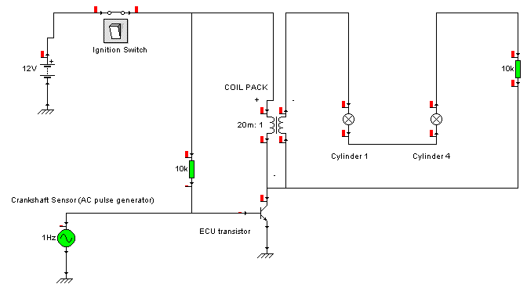
Distributorless Ignition Systems
Construct the following circuit in Crocodile Clips. It shows very
simply how one coil pack operates. Print out your design.

Slide 15
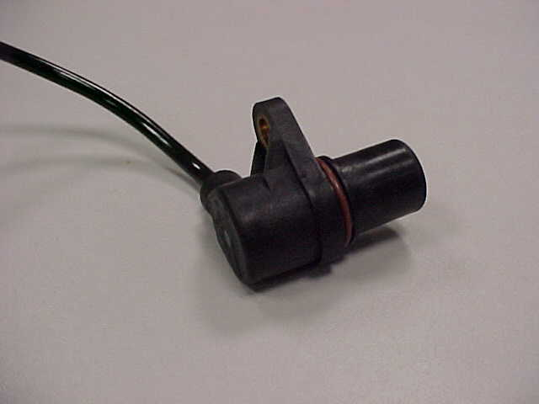
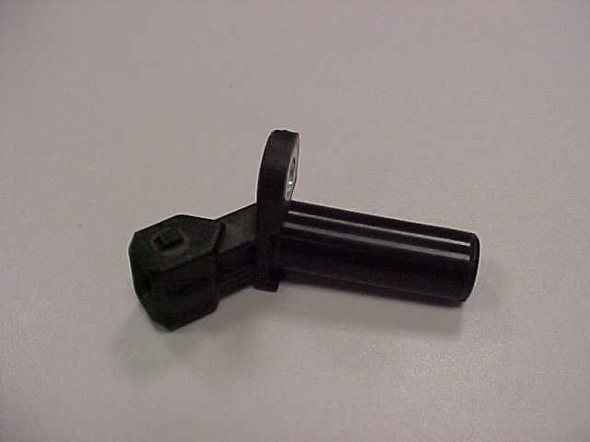
Distributorless Ignition Systems
On DIS systems the ECU obtains crankshaft position by the
means of an inductive sensor (many systems have a camshaft
sensor as a failsafe).
PERMANENT
MAGNET
Crankshaft Sensor
WINDING
SOFT IRON CORE
Camshaft Sensor

Slide 16
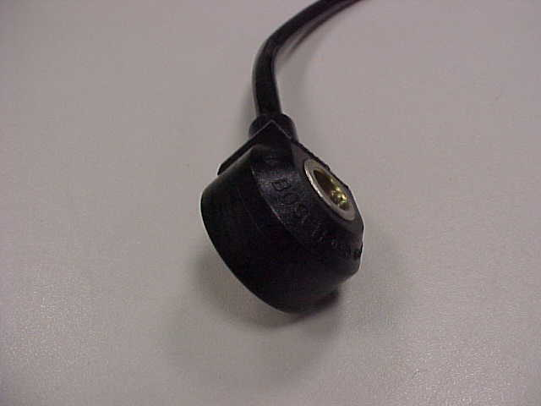
Distributorless Ignition Systems
The ECU utilises the KNOCK
sensor to maximise performance
and economy.
Knock always occurs soon after
TDC and lasts between 3 to 15
ms. Therefore the sensor is only
expected to send true knock
signals during a small window.
Within the window all the signals
are processed outside the window they are ignored.
Knock Sensor

Slide 17
Distributorless Ignition Systems
The D.I.S. system interfaces with
two double spark coils as discussed
before.
An ignition module (trigger box) is
fitted below the coil pack.
The purpose of the module is to switch the coils on and off at the
correct time when it receives a signal from the ECU. This signal
from the ECU is a low voltage signal (0.2 - 0.8 volts AC) known
as the Electronic Spark Timing (EST) signal.

Slide 18
Distributorless Ignition Systems
There are 4 connections to the D.I.S module:
1. Ignition live
2. Earth
3. EST A (cyls. 1 + 4)
4. EST B (cyls. 2 + 3)

Slide 19
Distributorless Ignition Systems
Coil Primary Resistance:
0.56 ohms +/- 0.05 ohms
Coil Secondary Resistance:
6 kohms +/- 50 ohms
When the ECU determines the dwell time the EST signal will
turn from low state (0.50v) to a high state (4.9v). After dwell time
the EST signal will turn from a high state (4.9v) to a low state
(0.5v).

Slide 20
Distributorless Ignition Systems
The dwell algorithm of the ECU
consists of 2 different modes. In
crank mode the dwell time is based
upon a fixed number of engine angles
as well as battery voltage.
In the run mode the dwell time is
based upon engine speed and battery
voltage.
The transition from crank to run mode takes place at 400 rpm.

Slide 21
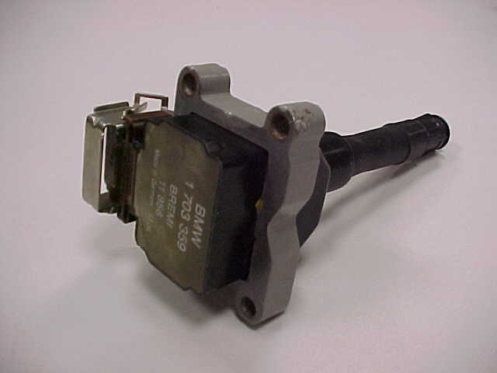
Distributorless Ignition Systems
Systems now use
1 coil per cylinder
as in the BMW’s.

Slide 22
Distributorless Ignition Systems
Tasks
1. When did electronic ignition systems first start appearing o
vehicles?
2. State the advantages of D.I. Systems.
3. State the major differences of D.I. Systems?
4. Draw and label a simple D.I. System.
5. What charge is the secondary winding and why?
6. How much energy is needed to fire the spark backwards?
7. How much voltage does a D.I. System produce?
8. What is meant by the terms Wasted and True firing?
9. Describe the electron flow in a D.I. Circuit?
10. Discuss and produce test procedures on a D.I. System.

