Slide 1
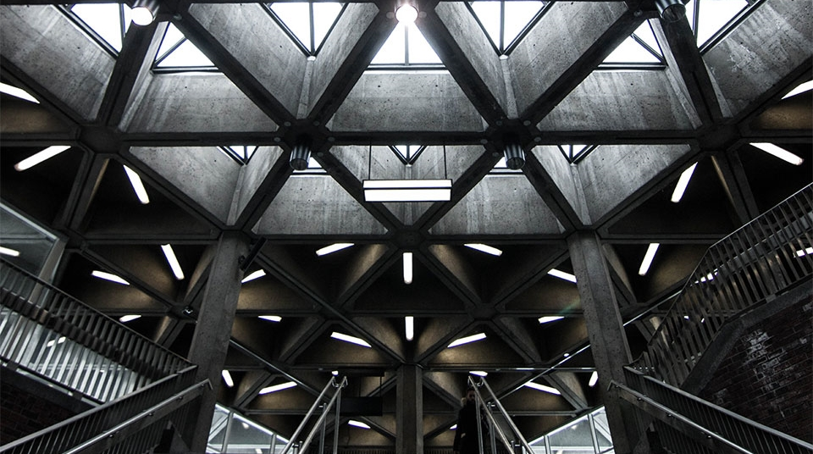
Welcome to the presentation on
Marketing Essentials
Module Code: BMIH4005
2
+
2
+
Notes:
The presentation focuses on marketing essentials

Slide 2
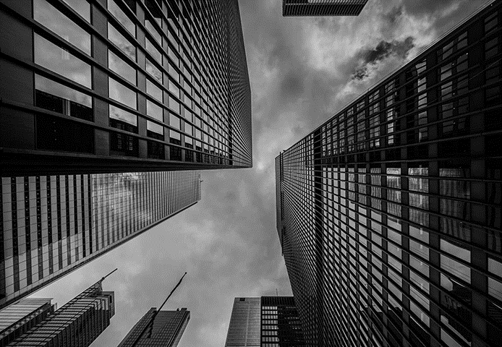

Contents
2
+
Introduction
Marketing mix
Customer value creation
Effective use of digital marketing
Micro environment analysis
Macro environment analysis
Conclusion
References
2
+
Notes:
These are the topics I am going to discuss today

Slide 3
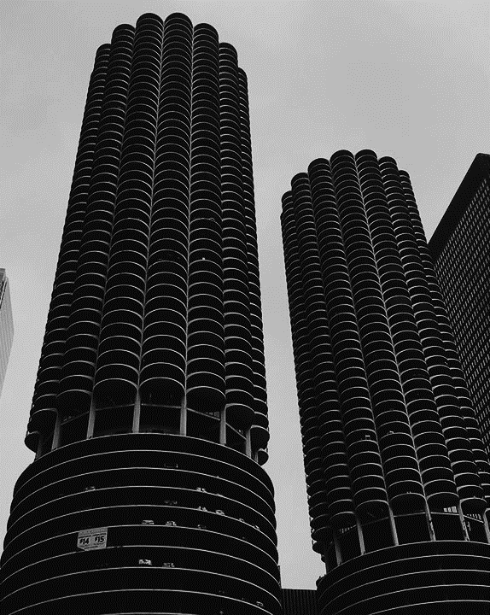
Introduction
2
+
Hotel management is a process of evaluating various aspects related to hotel
Eden Rocks, St Barths is a luxurious hotels under the Relais and Chateaux Group situated in Saint Barthelemy in the Caribbean (Eden Rock Villa Rental | Luxury Villas in St Barths, 2021)
The marketing plan will be showcasing the external opportunities and measurements of the hotel along with customer engagement
Notes:
Hotel management is a study of a variety of operation related to hotels. Here, I am going to discuss it based on Eden Rocks, St Barths. It is a five-star hotel located in Saint Barthelemy in the Caribbean. It is under the Relais and Chateaux Group. This marketing plan will forecast different aspects of attracting customers.

Slide 4

Marketing mix
2
+
Product/Service: Fresh breakfast delivery, private parties, private yachts, tailor-made picnics, Eden spa, daily maid service, 24/7 concierge service, welcome amenities (Steve, 2021)
Place: Through website and social media pages
Price: The premium pricing strategy
Promotion: Holiday packages, social media boosting , discounts, search engine optimisations.
Notes:
Product/Service: Fresh breakfast delivery, private parties, private yachts, tailor-made picnics, Eden spa, daily maid service, 24/7 concierge service, welcome amenities are the services provided by the hotel.
Place: The services are published through the website and social media pages.
Price: The hotel is luxurious and so follows the premium pricing strategy.
Promotion: It can offer holiday packages, discounts, social media boosting, and so on.

Slide 5
Customer value and engagement creation
2
+
Creating value through luxurious and beautiful scenic villas, comfortable services, and cleanliness
Offering various offers and discounts to current visitors
Using different marketing channels, like- social media marketing, video marketing, email marketing (Michman, 2015).
Notes:
It creates value through luxurious and beautiful scenic villas, comfortable services, and cleanliness. It can offer many discounts and packages to involve customers. It can use social media marketing, video marketing, email marketing as marketing channels.

Slide 6
Effective use of digital marketing
2
+
Sending offers and information through emails
Emphasising the growth in its website traffic and search engine optimisation (Morris, 2016)
Shooting videos
Boosting on social media
Creating cleanliness campaign
Notes:
It can adopt digital marketing and under this method, it can send emails, increase the traffic on the website and optimise the search engine, going for video marketing by shooting scenic beauties, introducing cleanliness campaigns to attract visitors.

Slide 7
Conclusion
2
+
The presentation showed the management and marketing analysis of Eden Rocks, St Barths
It mentioned the customer values and engagement
It also depicted the macro and micro-economic factors of marketing
Notes:
The presentation reflects the marketing aspects of hotel management in context of Eden Rocks, St Barths. It showed customer value and engagement of the hotel. Moreover, it reflected micro and macro environmental aspects of marketing of the hotel.

Slide 8
Micro-environment analysis
2
+
Strengths: Brand name, diversified services, efficient manpower, scenic beauty
Weaknesses: Expensive services, less executed strategies
Opportunities: More changes in service line, opening branches
Threats: Growing competitors, hit of pandemic (Smith and Jack, 2021)
Notes:
Strengths: Brand name, diversified services, efficient manpower, scenic beauty are the strengths of this hotel.
Weaknesses: Expensive services, less executed strategies, are the biggest weaknesses of this hotel.
Opportunities: More changes in the service line, the opening of new branches can be its opportunities.
Threats: Growing competitors, the hit of the pandemic are the greatest threat it is facing now.
The strengths can be used to attain popularity after the pandemic. The introduction of more services will lessen the threats and will help to gain new customers. New branches can be opened too.

Slide 9
Macro-environment analysis
2
+
Political factors: Strict policies of the government due to pandemic
Economic factors: Decline in the living standard of people due to pandemic hit
Social factors: Customers’ culture, religion, race
Technological factors: Online booking, updates, payment system, and digital marketing
Legal factors: COVID-19 measures, customer safety policy, employee laws, food hygiene, environment law (Jones, 2021)
Environmental factors: Cleanliness and environment-related activities
Notes:
Political factors: Strict policies of the government due to pandemic and lockdown has declined its customer crowd.
Economic factors: Decline in the living standard of people due to pandemic hit has made people less interested to go to such expensive place.
Social factors: Customers’ culture, religion, race are the aspects to influence its services.
Technological factors: Online booking, updates, payment system, and digital marketing are the factors to influence the hotel and its activities.
Legal factors: COVID-19 measures, customer safety policy, employee laws, food hygiene, environment law, etc. are the legal aspects of the hotel.
Environmental factors: Cleanliness and environment-related activities are the ones to affect environmentally to the hotel.
New environmental campaign will lessen problems related to environment and legal issues. Digital marketing will increase the technological advancements and new branches can help to overcome political issues. Discounts will help to mitigate economic constraints.

Slide 10
References
Edenrockvillarental.com. 2021. Eden Rock Villa Rental | Luxury Villas in St Barths. [online] Available at: <https://www.edenrockvillarental.com/en/home/> [Accessed 25 June 2021].
Jones, M., 2021. [online] Oetkercollection.com. Available at: <https://www.oetkercollection.com/hotels/eden-rock-st-barths/the-hotel/> [Accessed 25 June 2021].
Michman, R., 2015. Marketing channels. 2nd ed. Columbus, Ohio: Grid.
Morris, N., 2016. Understanding Digital Marketing: Marketing Strategies for Engaging the Digital Generation. Journal of Direct, Data and Digital Marketing Practice, 10(4), pp.384-387.
Smith, K. and Jack, R., 2021. [online] Oetkercollection.com. Available at: <https://www.oetkercollection.com/hotels/eden-rock-st-barths/eden-rock-villa-rental/> [Accessed 25 June 2021].
Steve, S., 2021. [online] Oetkercollection.com. Available at: <https://www.oetkercollection.com/hotels/eden-rock-st-barths/restaurant-bar/> [Accessed 25 June 2021].

Slide 11
THANK YOU
2
+
2
+

