Slide 1
BMSW 4002 EFFECTIVE TEAM WORK and COMMUNICATION – H&SC WEEK 3.1

Slide 2
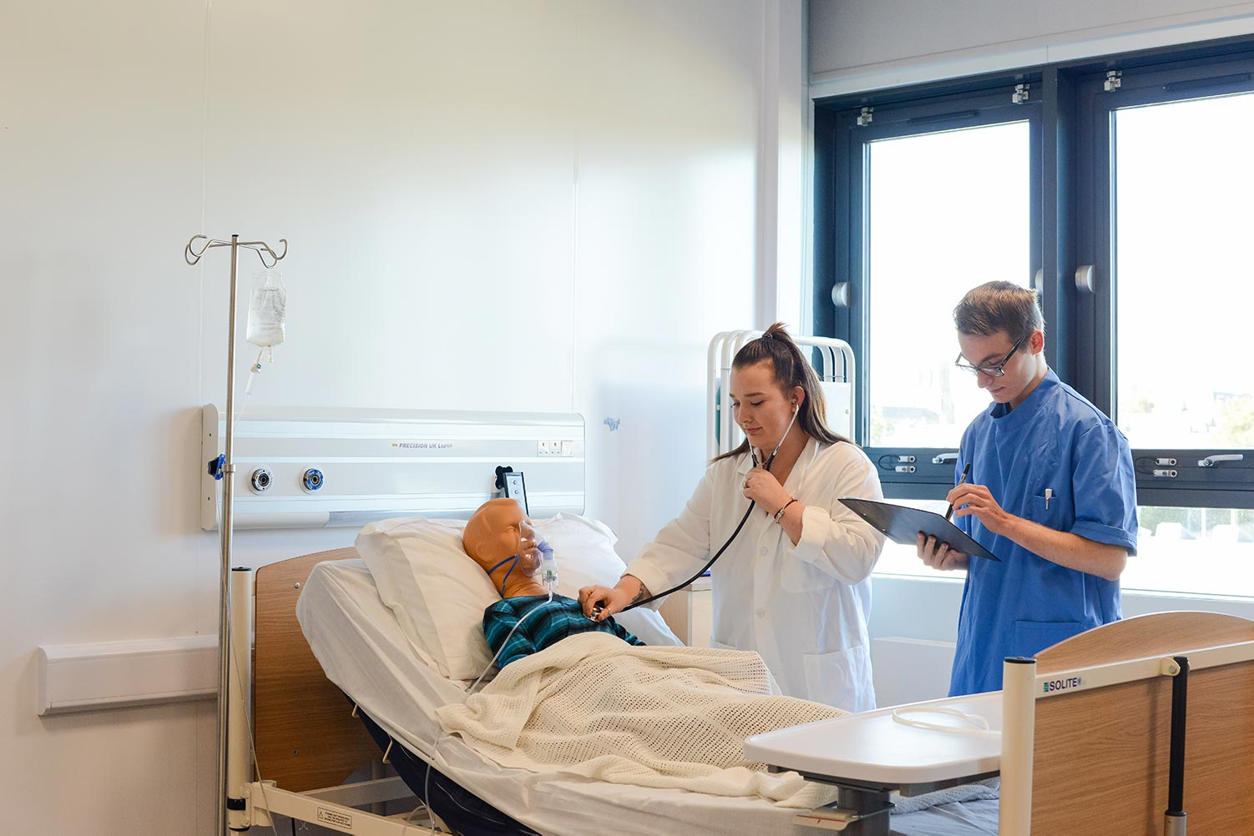
HEALTH and SOCIAL CARE
What do we mean by HEALTH CARE?
(Students work together to define the term -5 minutes)

Slide 3
Health and Social Care
Health care is the treatment of ill health and medical conditions.

Slide 4

HEALTH and SOCIAL CARE
What do we mean by Social Care?
5 minutes

Slide 5
HEALTH and SOCIAL CARE
Social care is the care and support of vulnerable people (with or without ill health and medical conditions) such as elderly people or children.
.

Slide 6
Communication in Health and Social Care
What do we mean by Communication?
5 mins.

Slide 7
Communication in Health and Social Care
Communication is the process used to exchange information
Communication is considered effective when both parties - the sender and the receiver - give the same or very similar meaning to the message being conveyed.

Slide 8
Communication in Health and Social Care
Communication in health and social care settings can be divided into two types:
Communication between health and social care workers.
Communication between the patient (and/or family members) and health and social care workers.

Slide 9
Communication in Health and Social Care
Remember: Communication within health and social care settings is considered effective when the receiver, either the patient, family member, or the health and social care worker, understands clearly the message being conveyed by the sender.

Slide 10
Communication in Health and Social Care
Why is effective communication within H&SC important?
Effective communication within health and social care settings is very important because it can have a direct, or indirect, impact on the health and social care provided, the overall wellbeing of the patient, and on the relationships with patients, family members or colleagues.

Slide 11
Communication in Health and Social Care
Many people may have difficulties in understanding information provided because of language barriers, limited literacy, physical conditions (such as brain damage) or age.

Slide 12
Communication in Health and Social Care
Admission to a nursing home, a foster care home or health facility is a stressful event that involves a noticeable change in lifestyle that requires support.
Those affected by a disease are often overwhelmed by fear for their own health and can become irritable, and therefore need reassurance from others.

Slide 13
Communication in Health and Social Care
It is important to understand that health and social care settings can be the source of anxiety and fear for patients for different reasons:
They may have worry
About their health and life.
The Distance from family and daily habits.
Noises.
Considerable limitation of personal space and privacy.
The Impersonal and cold environment.

Slide 14

Communication in Health and Social Care

Slide 15
‘Being anxious or having depression in care homes has become more prevalent. A report from the independent Mental Health Taskforce to the NHS in England stated that “40% of older people living in care homes are affected by depression”. Finding out about tests and treatment you’ll need, not seeing your family as often and the fear of the unknown are some factors that affect the way the patient feels’.
(Etherington 2020)

Slide 16
Communication in Health and Social Care
Patients usually react to this environment with the same behaviour used in any other situation of anxiety and stress, and for some individuals who are very emotional, they may need more time to decrease their anxiety to acceptable levels.

Slide 17
Communication in Health and Social Care
Knowing how to communicate effectively with patients, and learning the dynamics of interpersonal relationships is essential for health and social care workers to perform their work to the highest standard.

Slide 18
Communication in Health and Social Care
WHY IS EFFECTIVE COMMUNICATION IMPORTANT?
Effective communication enables:
The exchange of clear information and instructions on care needs.
The provision of direct (or indirect) emotional support to the patient (or family members) or colleagues.
The development of positive relationships.

Slide 19
Communication in Health and Social Care
For these reasons, to ensure efficient communication, health and social care workers must understand the difficulties that patients face in adapting to their new environment and support them using different strategies, such as:
Listening to the patients and creating some space to let them express their emotions.
Reassuring and calming patients in moments of fear.
Helping patients to stay active and facilitate connection with others, if applicable, to prevent isolation.

Slide 20
Communication in Health and Social Care
Supporting patients in this phase is key to creating a safe environment in which they are ready to pay attention to any form of clear communication related to their care and what is being done in the facility for them.

Slide 21
Communication in Health and Social Care
COMMUNICATING with Colleagues and Co-workers
In a healthcare environment communicating effectively with colleagues and co-workers is important. Poor communication skills can lead to errors such as mistakes on tests and prescribing and administering the wrong medicines.
Research by the Nursing Times, the UK’s leading healthcare magazine tells us that these mistakes cost approximately £1 billion per year (Etherington, 2020). Learning to communicate effectively with colleagues should be a top priority for a care business.

Slide 22
Communication in Health and Social Care
References
Lee, E. (2021) Effective Communication in Health and Social Care. CPD online College. Available at https://cpdonline.co.uk/knowledge-base/care/effective-communication/
Etherington, T. (2020) Effective Communication in Health and Social Care. Available at: https://www.theaccessgroup.com/en-gb/blog/hsc-effective-com…

