Slide 1
DOMESTIC ABUSE
Amanda Nobile – This presentation is a description of effective strategies available to individuals who experience domestic abuse and how these strategies support their inclusion in society - SJSS4001

Slide 2
WARNING – This presentation contains an image which some may find disturbing, please feel free to step outside if you need to do so.

Slide 3

(Saludmovil, 2017)

Slide 4
DEFINITION OF ABUSE
‘Any incident or pattern of incidents of controlling, coercive, threatening behaviour, violence or abuse between those aged 16 or over who are, or have been, intimate partners or family members regardless of gender or sexuality. The abuse can encompass, but is not limited to’:
Psychological
Physical
Sexual
Financial
Emotional (Gov.UK, 2018)

Slide 5
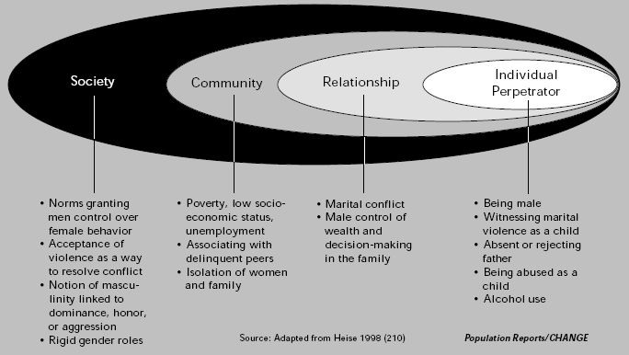
The Social-Ecological Model: A Framework for Prevention
(Heise et al, 1998)

Slide 6
Strategies for Domestic Abuse
Violence against Women, Domestic Abuse and Sexual Violence (Wales) Act 2015. (Welsh Government, 2016)
Ending violence against women and girls strategy 2016-2020. (HM Government, 2016)
Tackling Domestic Abuse: The All Wales National Strategy. (Welsh Assembly Government, 2010).

Slide 7
TYPES OF SUPPORT
Refuge Services
Outreach and Floating Support Services
Group Programmes
Children and Young People’s Services
Specialist support for Black and Minority Communities
Sexual Violence and Rape Crisis Services
Help for Domestic Abuse Perpetrators
(Welsh Women's Aid, no date)

Slide 8
MOVING FORWARD
Consultation on domestic abuse was launched on 8th March 2018.
Aims to make laws stronger to protect and support survivors.
Collaboration from survivors, frontline professionals, charities and the public.
To submit your views, available on: www.parliament.uk
Closes 31st May 2018 (Parliament.uk, no date), (Gov.UK, 2018)

Slide 9
LEGAL PROTECTION AVAILABLE
To get legal information and help with regards to criminal proceedings, family matters, debt, benefits, housing and many other areas of concern:
CALL THE WALES LIVE FEAR FREE HELPLINE FOR MEN AND WOMEN AFFECTED BY SEXUAL VIOLENCE AND DOMESTIC ABUSE.
: http://rightsofwomen.org.uk/get-information/violence-against-women-and-international-law/
(Welsh Women’s Aid, no date)

Slide 10
REFERENCES
Gov.UK, (2018). Domestic violence and abuse. Available at: https://www.gov.uk/guidance/domestic-violence-and-abuse#contents (Accessed: 18th March 2018).
Gov.UK, (2018). Domestic Abuse Bill consultation. Available at: https://www.gov.uk/government/consultations/domestic-abuse-bill-consultation (Accessed: 15th March 2018).
Heise et al, (1998). Violence Against Women: An Integrated, Ecological Framework, Violence Against Women. Available from: http://wiki.preventconnect.org/Ecological+Framework (Accessed: 17th March 2018).
HM Government, (2016). Ending Violence against Women and Girls Strategy 2016-2020. Available at: https://www.gov.uk/government/uploads/system/uploads/attachment_data/file/522166/VAWG_Strategy_FINAL_PUBLICATION_MASTER_vRB.PDF (Accessed: 15th March, 2018).

Slide 11
Parliament.UK, (no date). Draft Domestic Violence and Abuse Bill Available at: https://www.parliament.uk/business/committees/committees-a-z/joint-select/human-rights-committee/legislative-scrutiny/parliament-2017/draft-domestic-violence-and-abuse-bill-17-19/ (Accessed: 15th March 2018).
Saludmovil, (2017). Domestic violence and its effects are nothing to take lightly, here’s why. Available at: https://saludmovil.com/domestic-violence-effects-help/ (Accessed: 15th March 2018).
Welsh Assembly Government, (2010). Tackling Domestic Abuse: The All Wales National Strategy - A Joint-Agency Approach. Available at: http://www.famouspeoplerct.co.uk/professionals/all-wales-domestic-abuse-strategy[1].pdf (Accessed: 18th March, 2018).

Slide 12
Welsh Government, (2016). Violence against Women, Domestic Abuse and Sexual Violence (Wales) Act 2015. Available at: http://gov.wales/topics/people-and-communities/communities/safety/domesticabuse/?lang=en (Accessed on : 15th March, 2018).
Welsh Women's Aid, (no date), Domestic abuse and violence against women services in Wales. Available at:: http://www.welshwomensaid.org.uk/information-and-support/i-need-help/# (Accessed on: 15th March 2018).

