Slide 1
CoA (Course of Action) options on JANIS (Joint Army and Navy Information System) implementation at Primary Level Welfare

Slide 2
Agenda
Agenda
1. Introduction and Apologies
2. Background - AI report
3. Background – Non-discretionary outcomes
4. Background – CoA Development
5. CoA 1
6. CoA 2
7. CoA 3
8. Option Comparison
9. Questions?

Slide 3
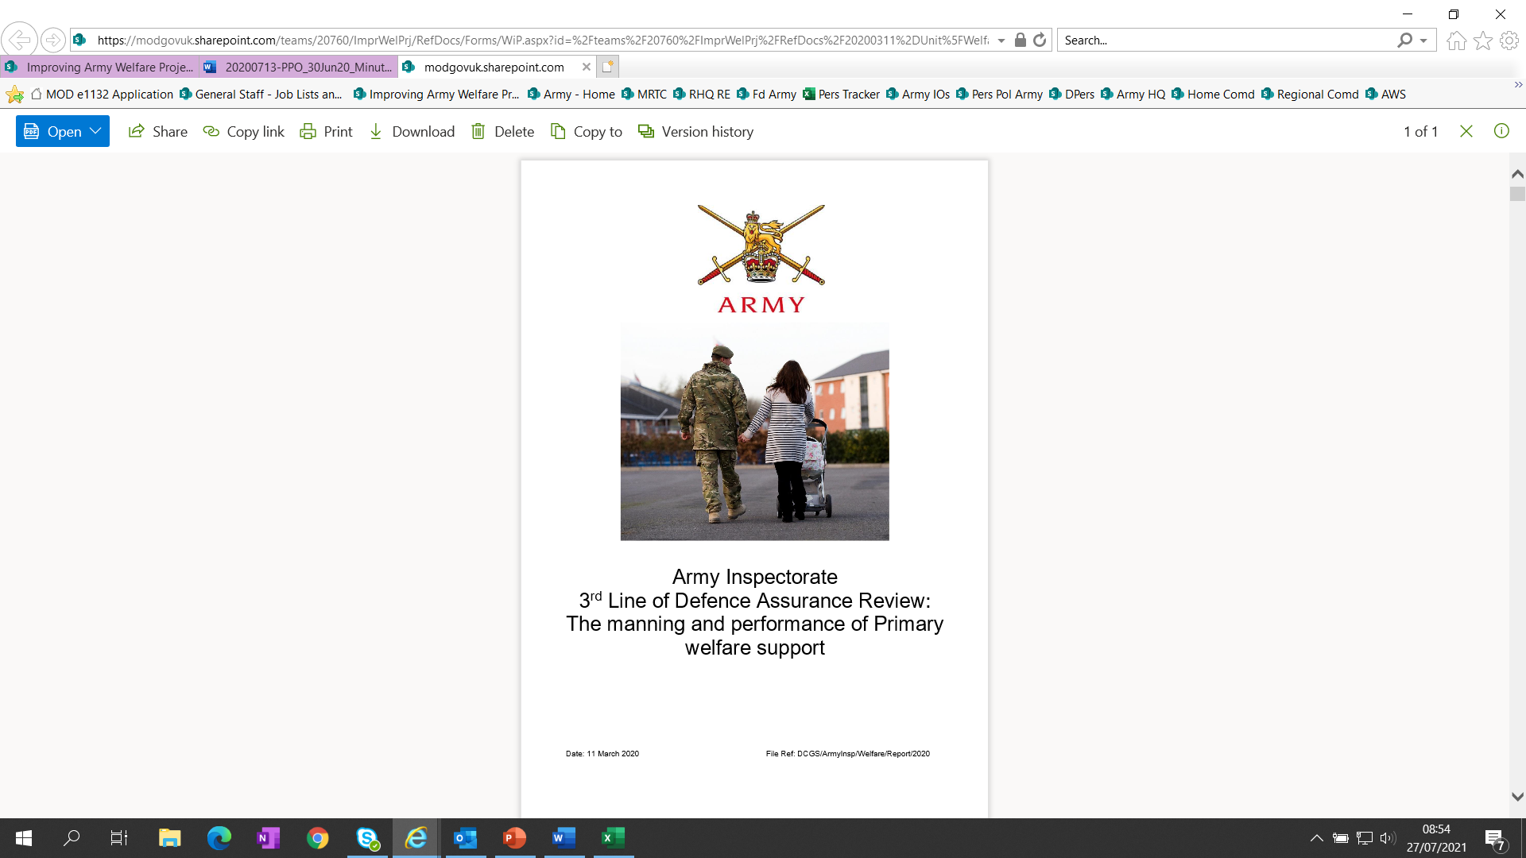
Army welfare project
BACKGROUND - AI Report
Themes:
Absence of Welfare Strategy;
Information sharing & MIS;
Confidentiality;
Selection & suitability of staff;
Training;
Other delivery models.
Latest AI Report Res Update

Slide 4



Army welfare project
BACKGROUND - Non discretionary outcomes
If we can deliver this…
Army Welfare Strategy (Ends, Ways & Means);
Enhanced C2/structure/laydown within a regionally aligned model;
Enhanced end-to-end welfare assurance mechanisms;
Increased professionalisation at all levels (personnel/training);
Contractor delivery where appropriate, efficient and effective;
Enhanced welfare MIS - link between primary/secondary;
Consistency of experience;
Enhanced support mechanisms for welfare staff (Care for Carers etc);
Enhanced welfare understanding and access for all (‘Support Well’ web page, EAP ‘light’);
Then welfare provision is transformed.

Slide 5
Army welfare project
BACKGROUND - Coa development
Stakeholder Input
Army Welfare Capstone Document
Army Inspectorate
Review
Field
Army
Regional Command
PPO Committee
DCGS
Army Welfare Steering Group
AFF
AWS
Home Command
Primary Considerations
Welfare Report Recommendations
Selous
Report
Unit Welfare Teams
Army Welfare Workers
Contracted Delivery
RPOC Personnel Support Hubs
Welfare Branding
Timings
Welfare Efficiencies
Delivery Model Options

Slide 6
COA 1
Implement JANIS pan Army without pilot, with fully live MIS (Management information system).
Personnel
No changes to current UWT (Unit Welfare Team)
Training
UWO (Unit Welfare Officer) training changes to include use of JANIS (Joint Army and Navy Information System)
Creation of a user guide for JANIS
Scoping and TNA (Training Needs Analysis) is required
Resource
No changes to military personnel
Additional 9 Civil Servants to coordinate each RPoC (Regional Points of Command)– quantifies to £297k p.a. (based on C2 grade £33k p.a. salary)
Risks
Chaos if rolled out pan Army immediately
Change management implications (Moral affected)
New system may need amendments to make fit for purpose through trial and error as no testing has been conducted
Feedback difficult to capture
Reputation/Perception; efficiency vs betterment, within the timeline of Welfare Project timeliness.

Slide 7
COA 2
Implement JANIS Pilot, with a training version of JANIS for a 6 month period, with a 3-6 month period of Data collection and build up to full Role out pan Army to follow.
Personnel
No changes to current UWT (Unit Welfare Team)
Training
UWO (Unit Welfare Officer) training changes to include use of JANIS (Joint Army and Navy Information System)
Creation of a user guide for JANIS during test-period
Scoping and TNA (Training Needs Analysis) is required
Resource
No changes to military personnel
Additional 1 Civil Servant to coordinate pilot - quantifies to £33k p.a. (rising to £297k p.a., when rolled out pan-Army, after the pilot)
Risks
Training environment of JANIS is not connected to live version
UWO collating information on two systems
AWS (Army Welfare Service) additional 1 Civil Servant capacity to effectively govern and assure the pilot scheme.

Slide 8
COA 3
Do Nothing.
Personnel
No changes to current UWT (Unit Welfare Team)
Training
No Changes to training
Resource
No changes to military or civilian personnel
No changes to cost p.a.
Risks
Reputational damage if no change is made
DPA Risks
No Betterment of current Support/ Failure to provide support where needed

Slide 9




army welfare PROJECT
Common to all approaches would be the implementation of recommendations from previous reviews of Army Welfare. Addressing issues not limited to but including; Governance and Assurance, a Management Information System, parity of access, communications. AWS Army Welfare Services) more involvement at Primary level.
JANIS Pilot Delivery option comparison
COA 1
Implement JANIS Pilot pan Army without pilot, with fully live MIS, focused at primary level and welfare coordinated under RPoC C2.
COA 2
Implement JANIS Pilot not before February 2023, with a training version of JANIS for a 6 month period, with a 3-6 month period of Data collection and build up to full Role out pan Army.
2
3
1
COA 3
Do Noting
UWT stay as they are
UWT stay as they are
UWT stays as they are
Personnel
UWO Course and JANIS user guide
Scoping carried out and TNA
UWO Course require review and TNA.
JANIS Primary User Guide development prior to pan army roll-out
No changes to training
Training
No Mil WF reduction. No change of cost p.a.
CS Uplift 9 C2 – quantified cost of £297k p.a..
No Mil WF reduction. No change of cost p.a.
CS Uplift 1 C2 – quantified cost of £33k p.a.(£297k p.a. after pilot)
No Mil or CS WF reduction. No change of cost p.a.
Resource
Chaos if rolled out pan Army immediately
Moral to change may be impacted
New system may require amendments to fit purpose
Feedback difficult to capture without pilot
Reputational/Perception; efficiency vs betterment, within the time line of Welfare Project timeliness.
Risk
Training environment of JANIS not connected to Live.
UWO collating info on 2 systems.
AWS Resources for Governance and Assurance.
Reputational damage if no change is made
DPA risks
No Betterment of current Support/ Failure to provide support where needed

Slide 10
army welfare PROJECT
AOB (Any other business)
Questions?

