Slide 1

THE INTERNAL OPERATIONS AND EXTERNAL ENVIRONMENT FOR
JET2HOLIDAYS
Presented by: 2331457, 2328613, 2215439

Slide 2
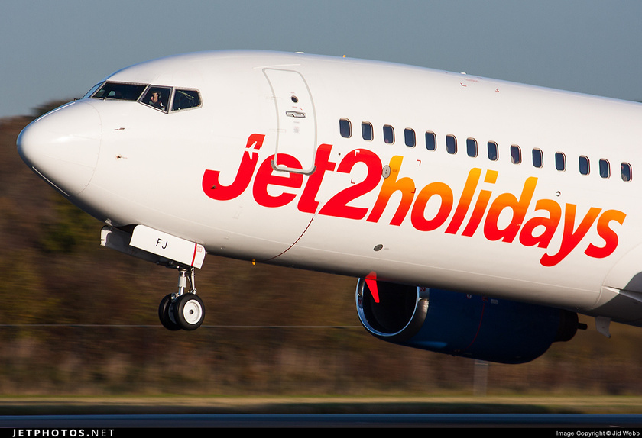
OVERVIEW
Jet2Holidays is a trading name, which is operating under Jet2.com.
It is a well-known holiday selling company in the United Kingdom,
formed to provide flight and accommodations to millions of it’s customers,
through package holidays inclusive of flights and transfers.
It is the leading holiday provider in the UK, serving millions
annually, with comprehensive packages
to over 50 destinations.

Slide 3


JET2HOLIDAYS STRUCTURE/SIZE
Over the operations’ structure, Jet2Holidays has a number of levels of organization, such as the executive
management, functional departments which include finance, marketing, human resources, operation, customer service and the regional office (Pooler, 2017)
Jet2Holidays is large-scale, as it has over 10,000 employees in different capacities.
Financially, the company reflected on its consolidated income statement, with a total
revenue of £3 billion dollars a year, and spent around a billion pounds.

Slide 4
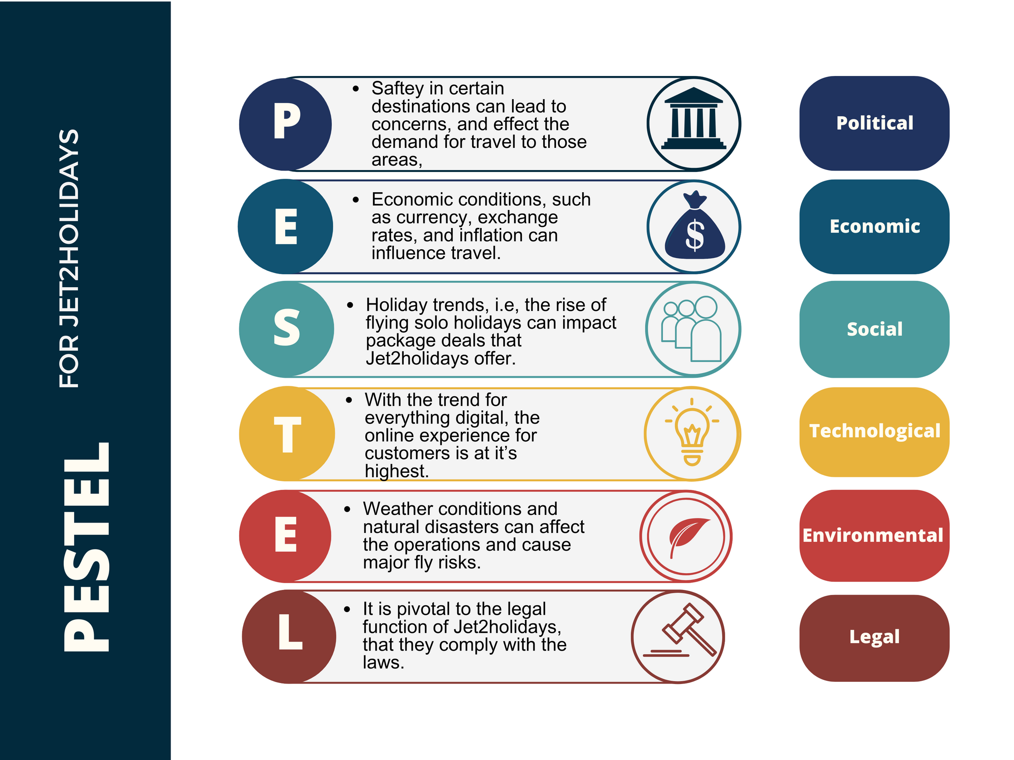
THE INTERNAL
AND
EXTERNAL
ENVIRONMENT
INFLUENCING
JET2HOLIDAYS

Slide 5

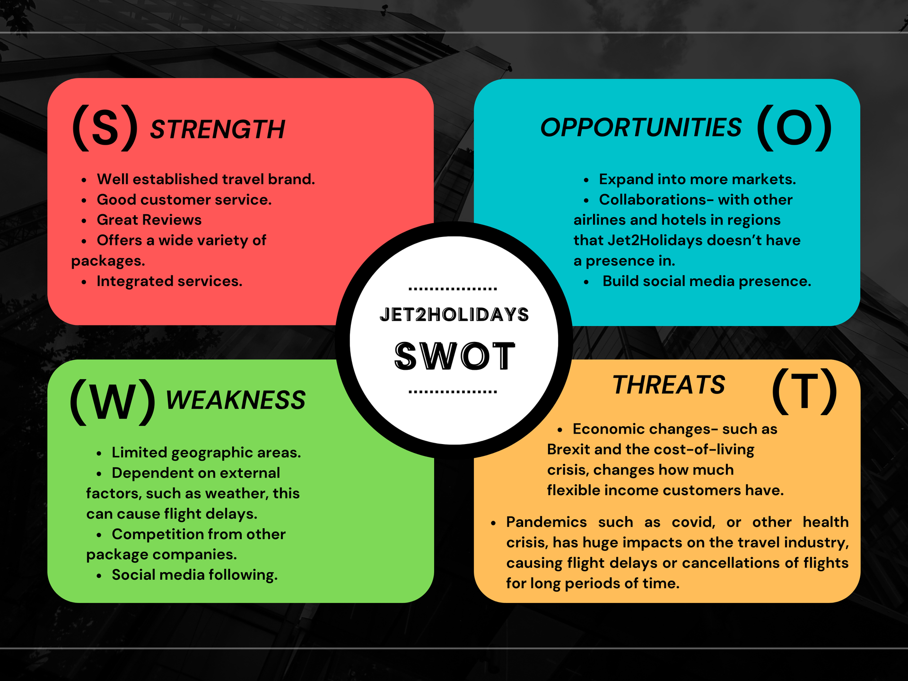

Slide 6


FUTURE STRATEGIES
  Increase social media, as this will
increase awareness.
2. Expand into more countries, and offer introductory prices.
3. Utilise influencers who have a larger following than Jet2, but align with influencers
who align with the brands motto and ethos, as
that’s where the digital age is going to improve the digital footprint.

Slide 7

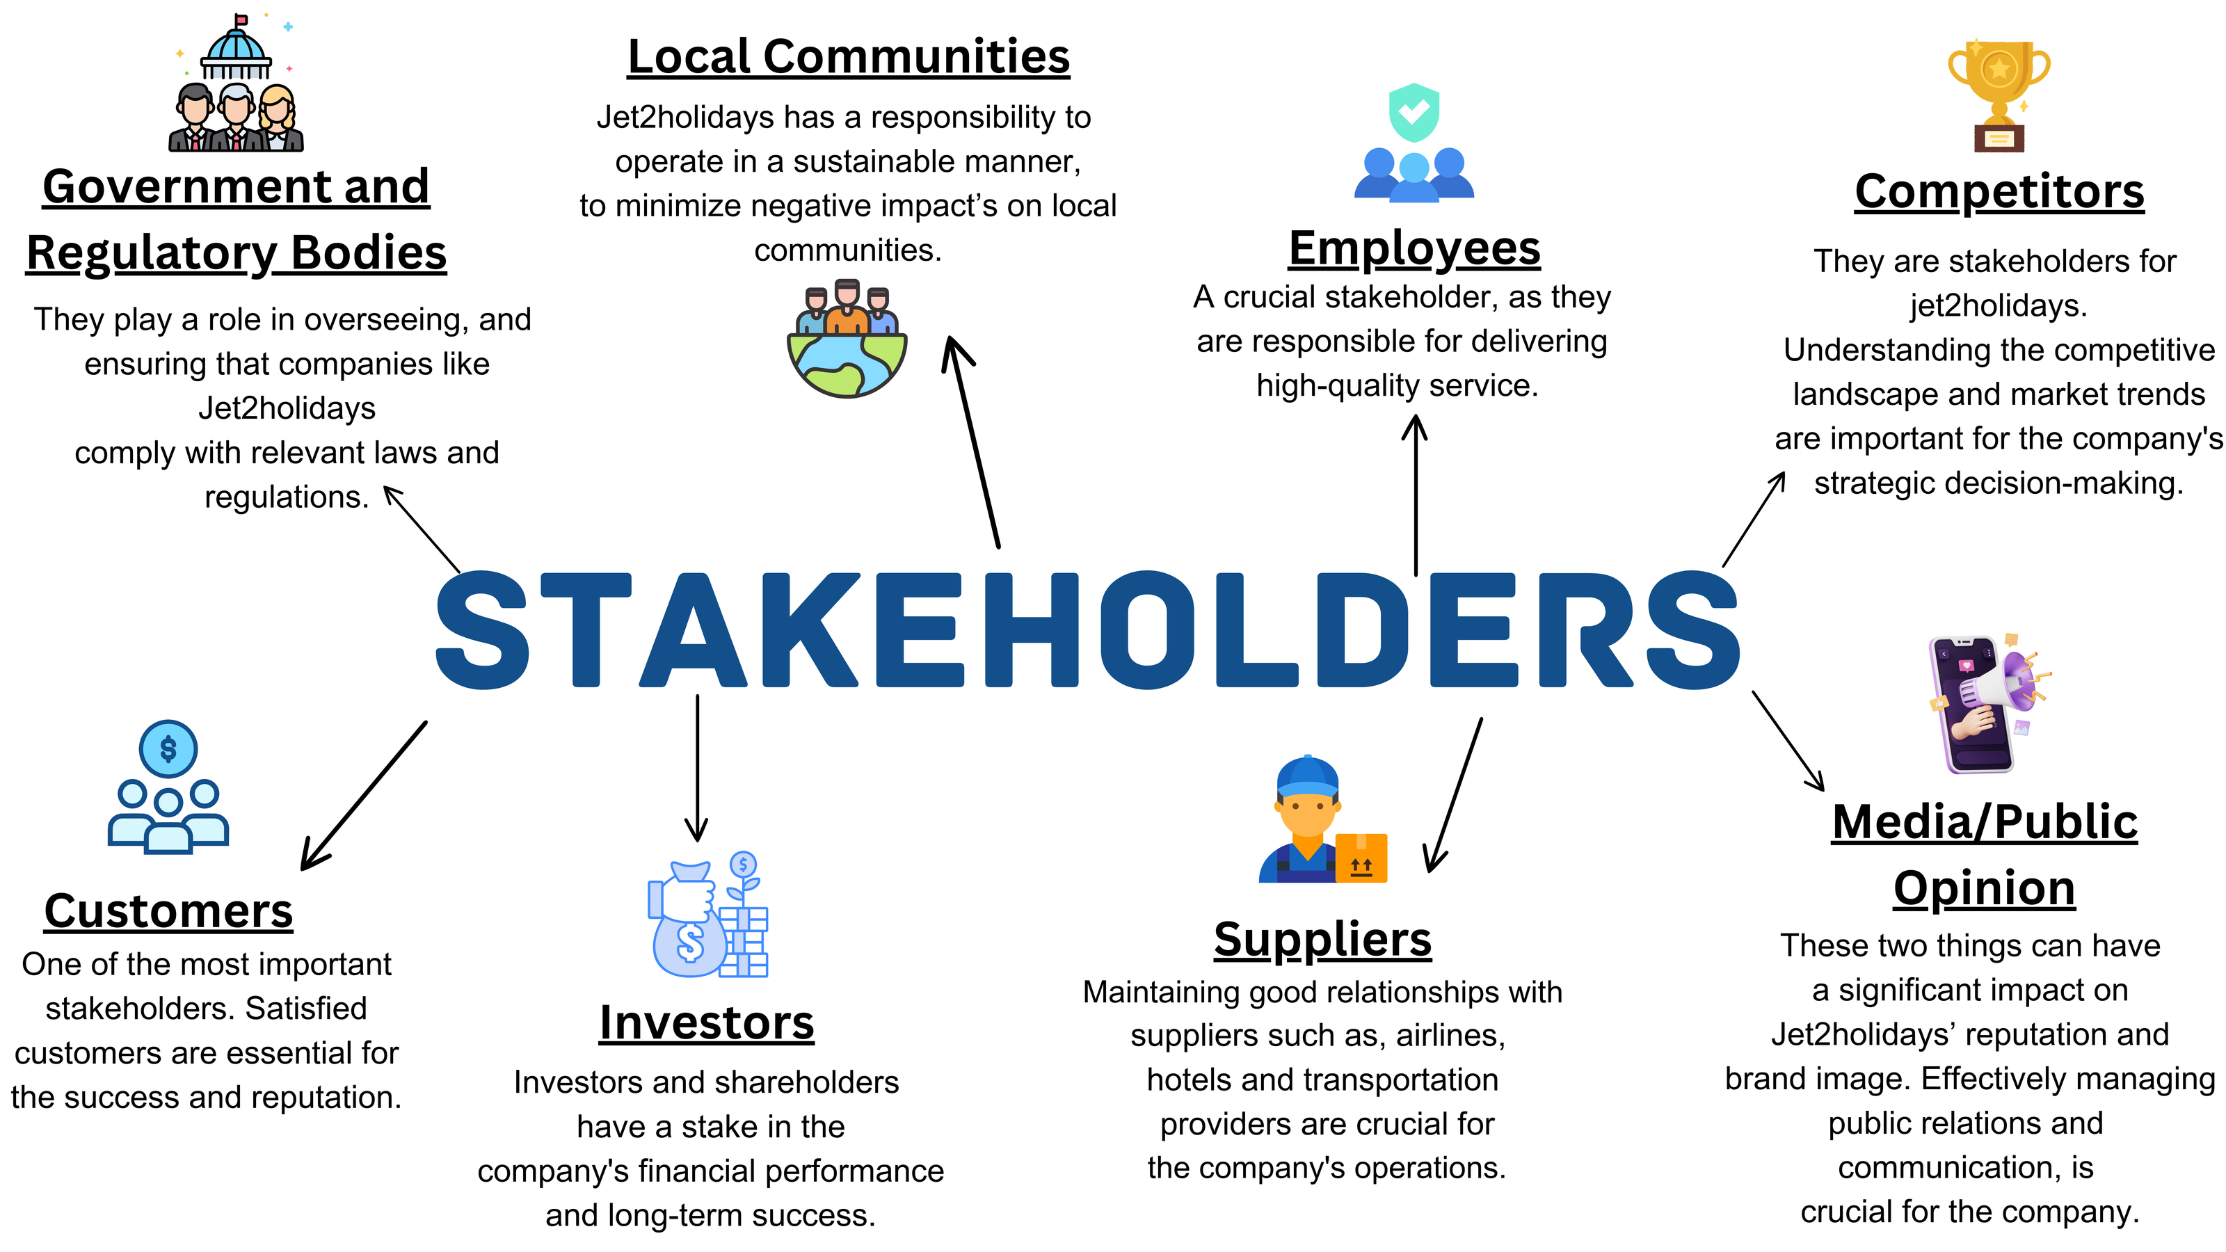


Slide 8
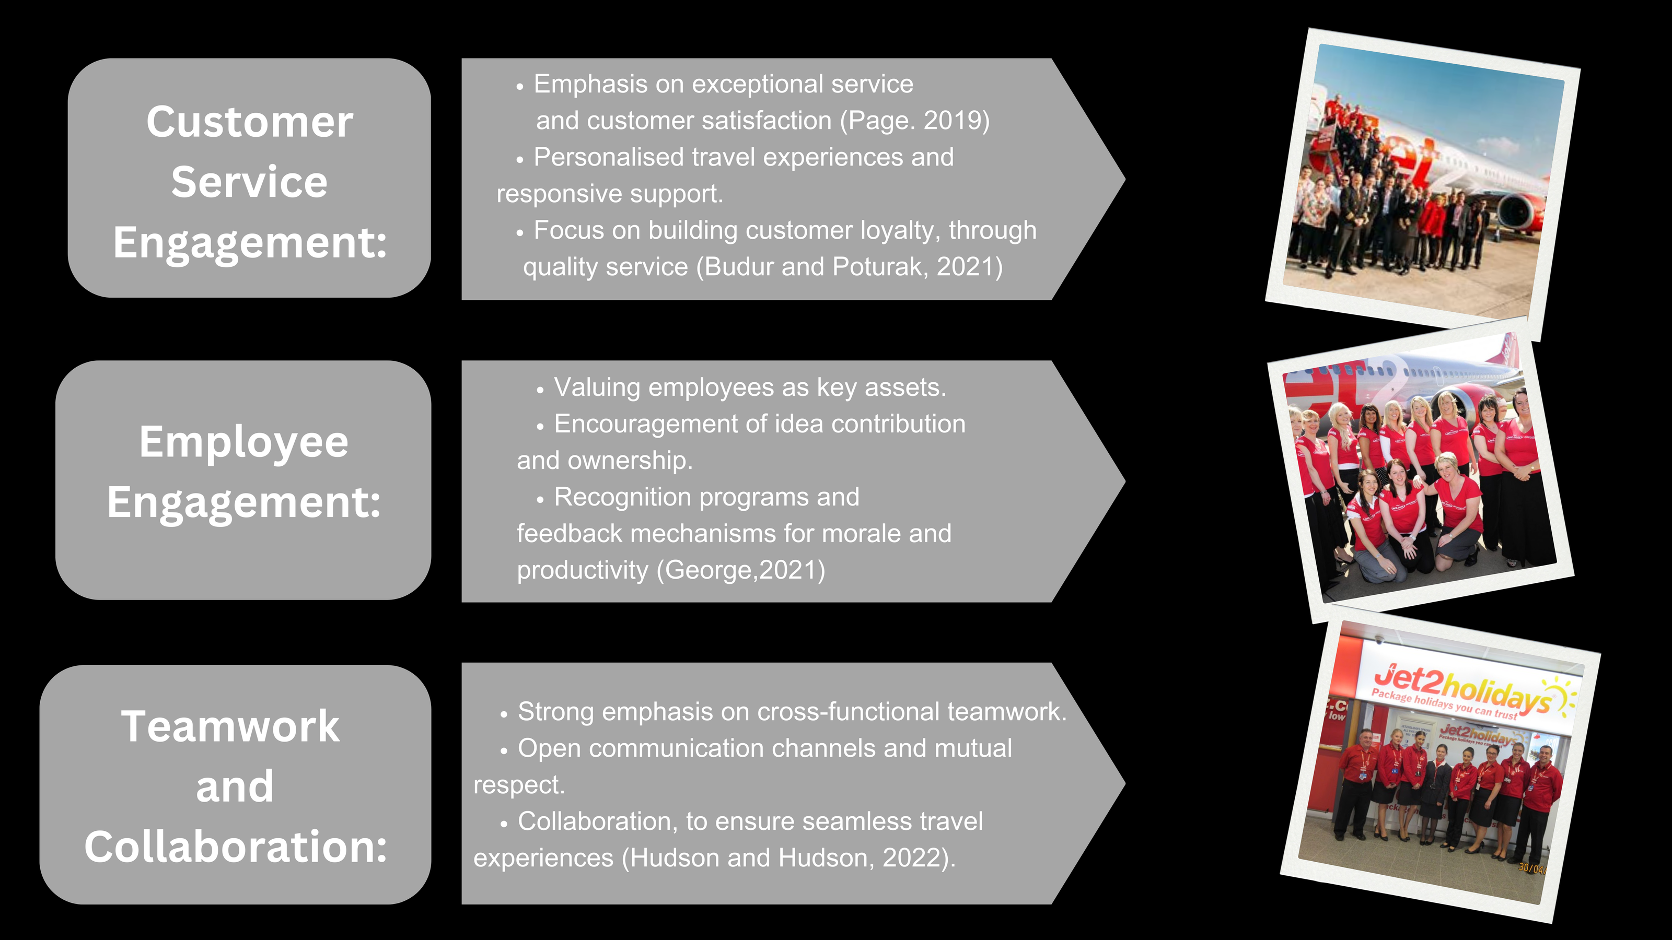

Culture

Slide 9


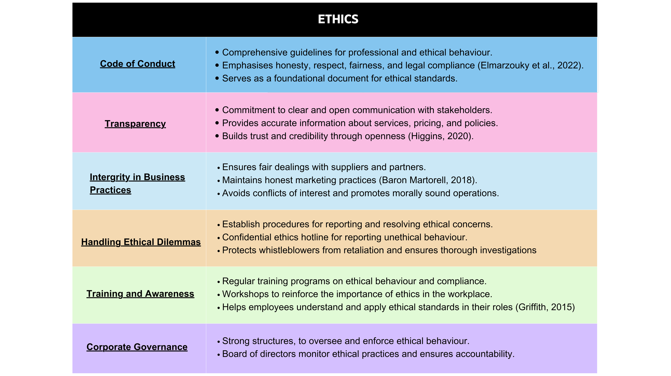

ETHICS

Slide 10

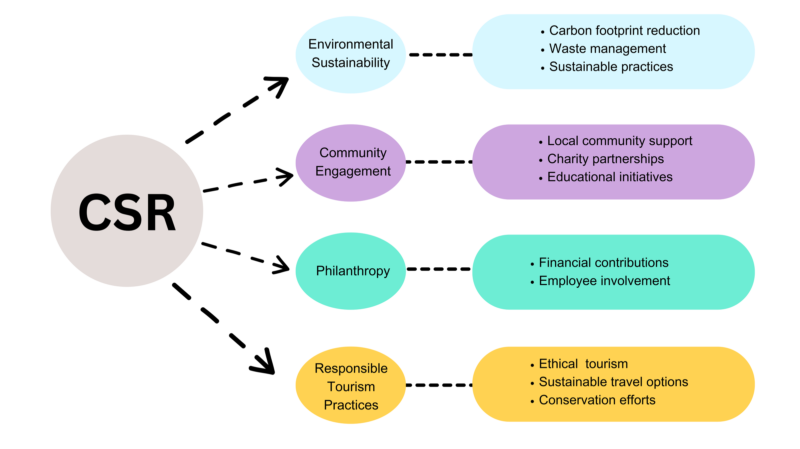
CORPORATE SOCIAL RESPONSIBILITY

Slide 11

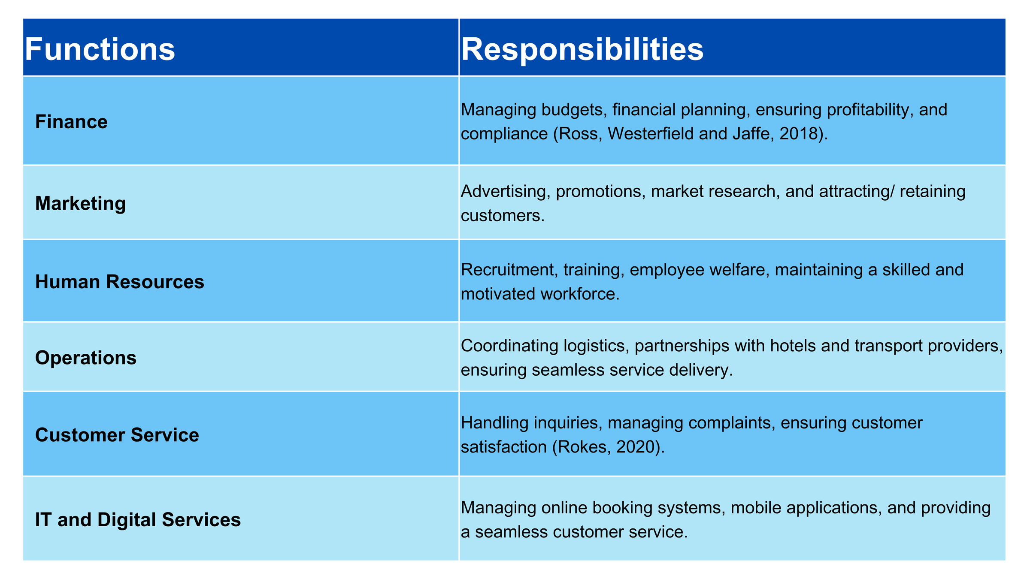

JET2HOLIDAYS FUCNTIONS

Slide 12

How Jet2holidays can operate in light of business’ environment
Jet2 holidays, one of the biggest package holiday providers, can
operate efficiently in the current business environment by
considering the following

Slide 13
Adaptability
The travel industry is subject to various external factors such as economic conditions,
geopolitical events, and health crises. A company like Jet2holidays would need to be
adaptable and flexiable in responding to these challenges.
In the travel sector, it is essential for Jet2holidays to prioritize
meeting customer expectations and creating memorable experiences to cultivate customer
loyalty. A seamless booking process and top-notch customer service are key components of a
positive customer experience.
Customer Experience
Technology Integration
By incorporating technology for online reservations, client correspondence, analytics, and
customization, Jet2holidays can enhance operational efficiency.
Partnerships and Alliances
Jet2holidays can expand its offerings and enhance package options for customers by
partnering with airlines, hotels, tour operators, and other travel providers.

Slide 14
Marketing and Branding
Implementing successful marketing tactics that showcase distinctive features,
offers, and discounts can assist Jet2holidays in attracting and retaining customers
in a competitive industry.
Risk Management
Due to uncertainties in the travel sector, it is essential for Jet2holidays to establish strong
risk management plans to address potential issues such as cancellations, natural disasters,
and geopolitical events.
Sustainability
Jet2holidays could prioritize sustainable practices and provide eco-friendly travel options
to attract customers who are environmentally conscious, as environmental issues gain more
recognition.
Regulatory Compliance
Ensuring compliance with local and international regulations concerning travel, safety,
data protection, and financial transactions is crucial for Jet2holidays to operate within the bounds
of the law and uphold trust with customers.
Considering the affect that the COVID-19 pandemic had throughout the travel
industry, its a must, that jet2holidays prioritize the health and safety protocols ensuring
the welfare of all their staff and customers.
Regulatory Compliance

Slide 15
REFERENCES
Budur, T. and Poturak, M., 2021. Employee performance and customer loyalty: Mediation effect of customer satisfaction. Middle East Journal of Management, 8(5), pp.453-474.
Baron Martorell, O., 2018 Airline marketing mix and promotion strategies.
Chapple, J (2022) JET2 UPS FOCUS ON VALUE PRODUCT TO HELP AGENTS COMBAT CLIENTS’ COST OF LIVING WORRIES. Available at: https://www.ttgmedia.com/news/jet2-ups-focus-on-value-product-to-help-agents-combat-clients-cost-of-living-worries-37137 (Accessed: 8 July 2024)
Davies, P (2021) Jet2 hit by Covid losses of up to £385m. Available at:
https://travelweekly.co.uk/news/air/jet2-hit-by-covid-losses-of-up-to-385m (Accessed: 1 July 2024)
Elmarzouky, M., Hussainey, K. and Abdelfattah, T., 2022. Do key audit matters signal corporate bankruptcy?. Journal of Accounting and Management Information Systems, 21(3), pp.315-334.
George, R., 2021. Tourism Distribution. In Marketing Tourism and Hospitality: Concepts and Cases (pp. 285-315). Cham: Springer International Publishing.
Griffith, S.J., 2015. Corporate governance in a era of compliance. Wm. & Mary L. Rev., 57, p.2075.
Halpern,N and Graham, A. (2021). Airport marketing. London, Routledge.

Slide 16
Higgins, A. ed., 2020. The Civil Procedure Rules at 20. Oxford University Press, USA.
Hudson, S. and Hudson, L., 2022. Customer service for hospitality and tourism. Goodfellow Publishers Ltd.
Jet2.com, (2022-2024) A subsidiary of Jet2 PLC. Jet2 Careers. Available at:
https://jet2careers.com/search-careers/ (Accessed 15 July 2024)
Jet2.com, (2022-2024) A subsidiary of Jet2 PLC. Jet2 Careers. HR and Legal Available at: https://jet2careers.com/careers-with-us/commercial-teams/head-office/#:~:text=In%20HR%20you'll%20work,throughout%20their%20time%20with%20us
(Accessed 14 July 2024)
Jet2 PLC (2024). Our People. Available at: https://www.jet2plc.com/en/our-people
(Accessed 14 July 2024)
Jet2.com, (2024) Jet2.com Limited - a subsidiary of Jet2 plc. Jet2.com Friendly Low Fares. Available at: https://www.jet2.com/en/destinations (Accessed 14 July 2024)
Marshall, E (2024) Jet2 holiday warning as ‘stormy conditions’ could impact UK flights. Available at:
https://www.express.co.uk/travel/articles/1885168/jet2-holiday-warning-flights-uk/amp (Accessed: 10 July 2024)
Page, S.J., 2019. Tour operating and travel retailing. In Tourism Management (pp. 245-292). Routledge.

Slide 17
Pooler, J.A. (2017). Hierarchical Organization in Society. Routledge.
Ranson, K (2024) One in four plan to cut holiday spend due to cost of living crisis, says survey. Available at:
https://www.travelgossip.co.uk/latestnews/one-in-four-plan-to-cut-holiday-spend-due-to-cost-of-living-crisis-says-survey/ (Accessed: 8 July 2024)
Roy, N (2024) Jet2 issues travel warning as bad weather in holiday hotspots set to cause delays. Available at:
https://www.bristolpost.co.uk/whats-on/whats-on-news/jet2-issues-travel-warning-bad-9379936.amp (Accessed 1 July2024)
Spengler,E.H and Klein, J (2017) Introduction to business. New York, Mcgraw-Hill.
Taylor, G (2023) Jet2 shares slump despite soaring financial performance, as boss says he will step aside. Available at:
https://www.cityam.com/jet2-profits-fly-above-pre-covidlevels-due-to-enormous-surge-in-demand/ (Accessed: 5 July 2024)
Young, S (2023) UK’s Jet2 says cost of living crisis lifts demand for package holidays. Available at:
https://www.reuters.com/business/aerospace-defense/uks-jet2-says-cost-living-crisis-lifts-demand-package-holidays-2023-07-06/ (Accessed: 5 July 2024)
Lopez-Sanchez, Y. and Pulido-Fernandez, J. I., 2019. From Sustainable Tourism to Tourism For Sustainable Development: Challenges to Tourism’s contribution to Sustainable Development Goals. International Case Studies for Hospitality, Tourism and Event Management Students and Trainees, p.37.

