Slide 1




Enterprise and Entrepreneurship
RADI'S CARS: USED CAR BUSINESS PLAN
Presented by Radi Zdravkov (Student ID: 2509210)
11 Aug 2026

Slide 2




BUSINESS OVERVIEW
Business: Radi's Cars – buying quality used cars, cleaning, and reselling for profit.
Legal Structure: Sole Trader (with future plans to transition to a Limited Company as the business grows).
Business Model: Source well-maintained vehicles, professionally clean and inspect them, then resell at a competitive price.
Founder: Radi Zdravkov – driven by a genuine passion for cars, customer service, and honest business practices.
Core Values: Honesty in every transaction, attention to detail in vehicle presentation, and excellent service at every stage of the customer journey.
FOUNDER PROFILE

Slide 3




BUSINESS IDEA & LEGAL STRUCTURE
QUALITY VEHICLES
PROFESSIONAL SERVICE
LEGAL STRUCTURE
Specialises in well-maintained used cars with strong market value. Every vehicle is carefully selected, inspected, and presented to the highest standard.
Full professional cleaning, mechanical inspection, and high-quality photos with detailed, honest adverts placed on Auto Trader and social media.
Operating as a Sole Trader for simplicity and low setup cost, with a clear plan to transition to a Limited Company as sales volume and profit grow.

Slide 4





UK USED CAR MARKET CONTEXT
1
3
Market Scale
Online Marketplace
7.81 million used cars were sold in the UK in 2025 (SMMT, 2026). There are over 34 million licensed cars on UK roads (DfT, 2025), reflecting a vast and active second-hand vehicle market with strong consumer demand.
2
Auto Trader dominates the UK's online used car marketplace, capturing approximately 75% of all online traffic. Digital platforms are now the primary route to market, making a strong online presence essential for success.
Monthly Sales
Approximately 300,000 used cars are sold every month in the UK (ONS). This consistent monthly volume highlights the resilience and scale of the used car sector, presenting a significant opportunity for small independent dealers.

Slide 5
POLITICAL
• Vehicle sales regulations require compliance with UK trading standards and licensing rules
• Consumer protection laws (Consumer Rights Act 2015) mandate accurate vehicle descriptions
• Tax obligations: Income Tax and National Insurance as a Sole Trader
• DVLA documentation requirements for every sale
• Government policies on road safety and emissions standards affect stock selection
• Inflation and rising new car prices increase demand for affordable used cars
• Higher interest rates make new car finance less accessible, boosting used car market
• Cost-of-living pressures drive buyers toward budget-friendly second-hand vehicles
• Fluctuating fuel prices influence buyer preference for fuel-efficient models
• Strong used car market: 7.81 million units sold in 2025 (SMMT, 2026)
ECONOMIC

Slide 6



PESTEL ANALYSIS – SOCIAL & TECHNOLOGICAL FACTORS
SOCIAL FACTORS
KEY INSIGHT
TECHNOLOGICAL FACTORS
Customers prefer quality, clean, and reliable used cars. Reputation and honest reviews are key to building trust and repeat business.
Trust and transparency drive purchase decisions. Professional presentation and honest descriptions set Radi's Cars apart from competitors.
Online platforms (Auto Trader, Facebook, eBay Motors) dominate sales. High-quality photos, social media presence, and vehicle history checks are essential.

Slide 7
LEGAL
• Compliance with UK vehicle sale laws and Trading Standards regulations
• Consumer Rights Act 2015: cars must be as described, fit for purpose
• Full documentation required: V5C logbook, MOT, service history
• Business insurance: public liability and stock insurance essential
• Accurate advertising to avoid misrepresentation claims
• Growing demand for fuel-efficient and low-emission vehicles
• Extending vehicle life reduces manufacturing waste and carbon footprint
• Used car sales support sustainability vs. new car production
• ULEZ and clean air zones influence buyer preferences
• Opportunity to specialise in economical, eco-friendly used cars
ENVIRONMENTAL

Slide 8




Ages 18–30: Students & First-Time Drivers
Budget-conscious buyers seeking reliable, affordable first cars. Value honest descriptions and low running costs.
TARGET MARKET
Ages 30–45: Families & Professionals
Looking for safe, spacious, well-maintained vehicles. Prioritise trust, quality presentation, and good value.
Radi's Cars serves three key customer segments, focusing on quality, affordability, and trustworthiness. Each group benefits from professional cleaning, honest descriptions, and reliable vehicles at fair prices.
Ages 45–60: Experienced Buyers
Prefer quality and reliability over price. Respond well to professional service, clean vehicles, and clear documentation.

Slide 9



MARKETING STRATEGIES
ONLINE ADVERTISING
SOCIAL MEDIA
QUALITY PRESENTATION
Auto Trader, Facebook Marketplace, and eBay Motors. Fair pricing with honest, detailed listings to attract serious buyers.
Facebook, Instagram, and TikTok with high-quality photos and videos showcasing each vehicle's condition and features.
Professional cleaning, excellent photography, and honest descriptions to build trust and stand out from competitors.

Slide 10
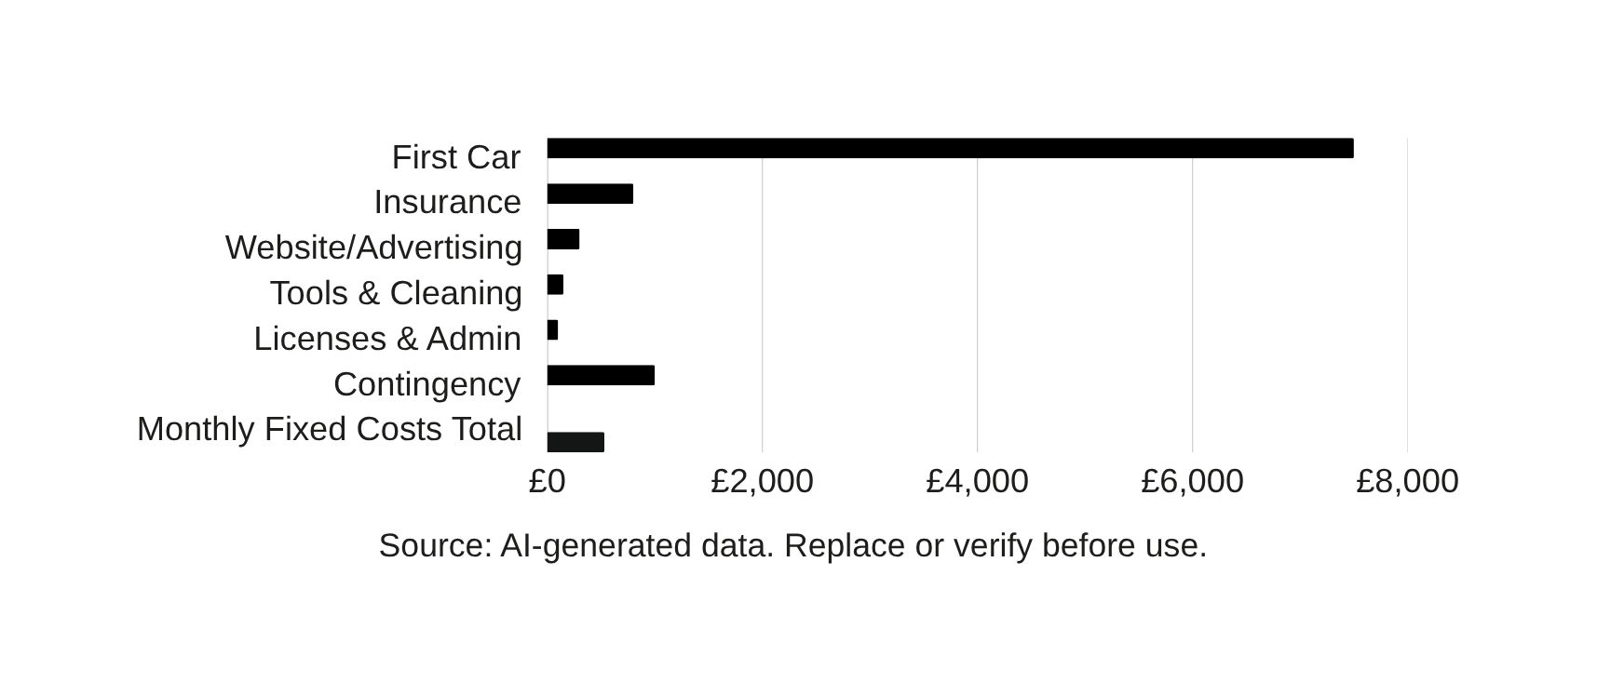


Financial Forecasts – Startup & Monthly Costs
Startup Costs – Total: £9,850
• First Car Purchase: £7,500
• Insurance: £800
• Website & Advertising: £300
• Tools & Cleaning Equipment: £150
• Licenses & Admin: £100
• Contingency Fund: £1,000
Monthly Fixed Costs – Total: £530
• Business Insurance: £200
• Online Advertising (Auto Trader etc.): £150
• Fuel & Transport: £100
• Miscellaneous Expenses: £80
Break-even achieved at approx. 1 car sold per month at £800 profit per vehicle.

Slide 11
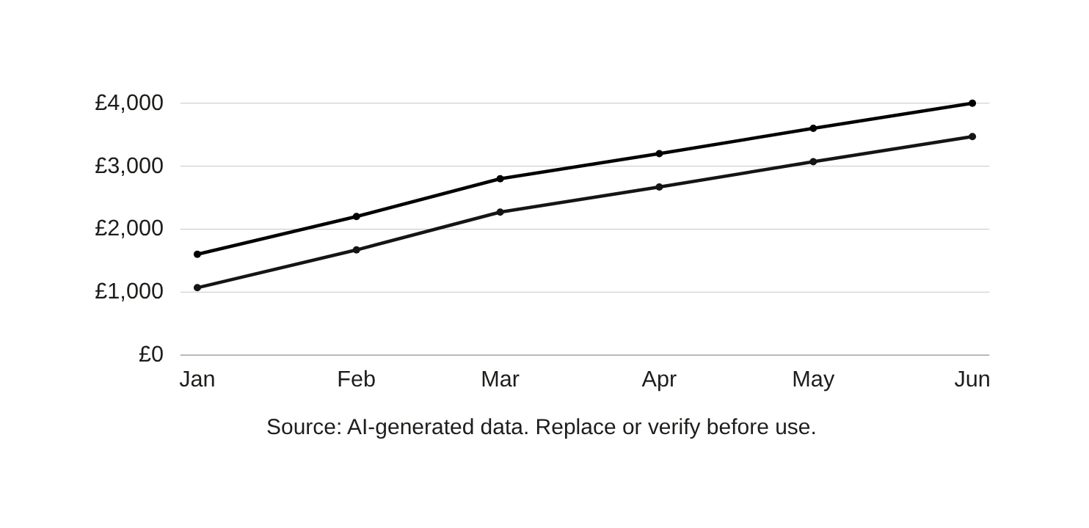
Sales Forecast & Break-even Analysis
Sales are projected to grow from 2 cars/month in Month 1 to 5 cars/month by Month 6. At an average profit of £800 per car, monthly net profit rises from £1,600 to £4,000 as the business scales.
Fixed monthly costs are £530. Break-even is achieved by selling just 1 car per month. From Month 1, the business operates profitably, with net cash flow turning strongly positive as sales volume increases.

Slide 12


Radi Zdravkov | Student ID: 2509210
THANK
YOU.
11 Aug 2026

