Slide 1
ECEY4010C
Arfer amlieithog yn y blynyddoedd cynnar
Dwyieithrwydd ac Amlieithrwydd
ECEY4010 Multilingual practice in the early years
Bilingualism and Multilingualism

Slide 2
Cynnwys
Contents
Diffinio dwyieithrwydd;
Diffinio amlieithrwydd;
Buddion;
Yr ymennydd dwyieithog;
Damcaniaeth;
Ymchwil;
Yr aseiniad.
Defining bilingualism;
Defining multilingualism;
Benefits;
The bilingual brain;
Theory;
Research;
The assignment.

Slide 3
Sgiliau Cyflogadwyedd/Trosglwyddadwy
Employability/Transferable Skills
Trefn;
Cynllunio;
Ymchwilio;
Sgiliau trafod;
Rhannu syniadau.
Organisation;
Planning;
Researching;
Discussion skills;
Idea sharing.

Slide 4
Adnoddau
Resources
PP;
Ymchwil;
Erthyglau;
Gwefannau;
Clipiau fideo.
PP;
Research;
Articles;
Websites;
Video clips.

Slide 5
Beth yw dwyieithrwydd
What is bilingualism?
Beth ydych chi’n feddwl?
What do you think?

Slide 6
Beth yw dwyieithrwydd
What is bilingualism?
Rhugl mewn 2 iaith?
Medru siarad, darllen ac ysgrifennu mewn 2 iaith?
Medru siarad iaith ond dim yn ei defnyddio?
Medru deall ond dim yn ei defnyddio?
Hyfredus mewn 1 iaith ac ychydig eiriau o’r llall?
Fluent in 2 languages?
Able to speak, read and write in 2 languages?
Able to speak a language but does not use it?
Able to understand but does not use it?
Proficient in 1 language and a few words in another?

Slide 7
Fodd bynnag…
However…
“…defining bilingualism is problematic since individuals with varying bilingual characteristics may be classified as bilingual. Definitions of bilingualism range from a minimal proficiency in two languages, to an advanced level of proficiency which allows the speaker to function and appear as a native-like speaker of two languages. A person may describe themselves as bilingual but may mean only the ability to converse and communicate orally. Others may be proficient in reading in two or more languages (or bi-literate)….To be bilingual means different things to different people.”
(NALDIC, 2011, p.1).

Slide 8
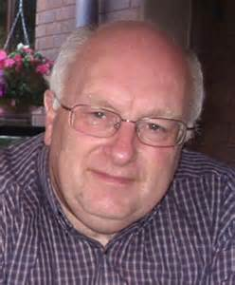
Yr Athro Colin Baker
Professor Colin Baker
Athro mewn Addysg, Prifysgol Bangor (wedi ymddeol);
Arbenigwr mewn dwyieithrwydd ac addysg ddwyieithog;
Wedi cyhoeddi 15 llyfr a dros 100 o gyhoeddiadau eraill.
Professor of Education, Bangor University (retired);
Specialises in bilingualism and bilingual education;
Published 15 books and 100 other publications.

Slide 9
Dwyieithrwydd cydamserol
Simultaneous bilingualism
Caffael dwy iaith ar yr un pryd, yn gynnar yn eu bywydau (Baker, 2011);
Cam 1 – cymysgu’r 2 iaith;
Cam 2 – gwahanu geiriau yn ôl iaith;
Cam 3 – un iaith yn dod yn fwy pwysig na’r llall (Devarakonda, 2013).
Acquiring two languages at the same time, early in life (Baker, 2011);
Stage 1 – mixes 2 languages;
Stage 2 – words are separated from each language;
Stage 3 – one language becomes more dominant than the other (Devarakonda, 2013).

Slide 10
Dwyieithrwydd dilyniannol
Sequential bilingualism
Plentyn yn caffael yr iaith gyntaf;
Yn hyfedrus yn yr ail iaith yn hwyrach;
Caffaeliad anffurfiol;
Caffaeliad ffurfiol.
Child acquires first language;
Becomes proficient in second language later;
Informal acquisition;
Formal acquisition.
(Baker, 2011)

Slide 11
Mae mwy….
There’s more….
“Types of bilingualism have been classified according to various criterion, such as degree of bilingualism (e.g., limited, partial, and proficient bilingual), balanced level (e.g., balanced and non-balanced), mastery skills of reception or of production (e.g., receptive bilingual and productive bilingual), age of language acquisition (e.g., early or late bilingual), sequence of language acquisition (e.g., simultaneous or sequential bilingual), and cognitive processing mechanism between verbal sign and mental image (e.g., coordinated bilinguals, compound bilinguals, subordinated bilinguals).”
(Chen and Padilla, 2019, p.1)

Slide 12
Newid côd
‘Codeswitching’
Cymysgu un iaith gyda’r llall
(Baker, 2011);
“a valuable linguistic tool”
(Baker, 2011: 101);
‘dull dwyieithog’
“codemixing”
(Baker, 2011).
One language is mixed with another (Baker, 2011);
“a valuable linguistic tool”
(Baker, 2011: 101);
‘bilingual mode’
‘codemixing’
(Baker, 2011).

Slide 13
Heriau o fod yn ddwyieithog
Challenges of being bilingual
Gallu gohirio caffaeliad iaith?
Dylai plant ganolbwyntio ar un iaith er mwyn osgoi dryswch?
Rhai addysgwyr yn cynghori rhieni i fagu eu plant fel pobl uniaith?
May delay language acquisition?
Children should focus on one language to avoid confusion?
Some educators advise parents to raise their children as monolinguals? (Bright and Filippi, 2019).

Slide 14
Buddion?
Benefits?
Buddion dwyieithrwydd cydamserol?
Buddion dwyieithrwydd dilyniannol?
Benefits of simultaneous bilingualism?
Benefits of sequential bilingualism?

Slide 15
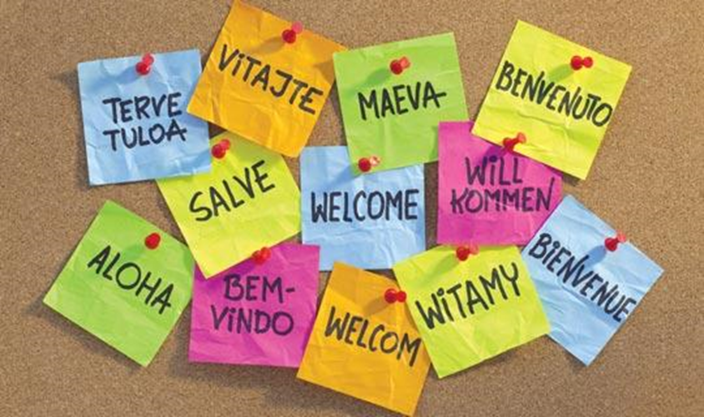
Amlieithrwydd
Multilingualism
Deall 3+ iaith;
Rhywbeth cyffredin ac yn ddigwyddiad naturiol;
Tuedd i fod ar lafar na’n lythrennol.
Understanding 3+ languages;
Usual and a natural occurrence;
Tends to be more oral than literal.

Slide 16
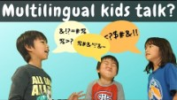
Tasg – gwyliwch y clip
Task – watch the clip
Raising Global Kids (2020) What language do multilingual kids speak to each other in? https://www.youtube.com/watch?v=RFdcn5dqOH4 [Accessed: February 25 2023].

Slide 17
Pa ganran o bobl y byd sy’n amlieithog?
What percentage of people in the world are multilingual?
Unrhyw syniadau?
Ydy’r DU/Cymru yn adlewyrchu amlieithrwydd ehangach?
Any thoughts?
Is the UK/Wales a reflection of wider multilingualism?
Notes:
17

Slide 18
Pa ganran o bobl Ewrop sy’n amlieithog?
What percentage of people in Europe are multilingual?
Ydy’r DU/Cymru yn adlewyrchu gweddill Ewrop o ran ieithoedd sy’n cael eu siarad?
Is the UK/Wales a reflection of the rest of Europe in terms of languages spoken?
Notes:
18

Slide 19
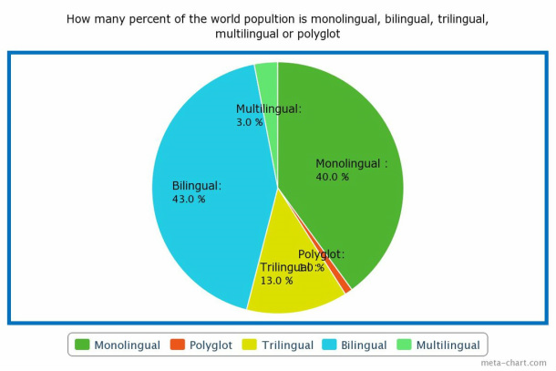
(Source: Jessica, Muna and Tanya , no date)
Notes:
19

Slide 20
Ai amlieithrwydd yw’r norm ?
Is multilingualism the norm?
Dros hanner Ewrop a’r byd yn siarad fwy nag un iaith;
Mamiaith ac iaith arall wedi eu dysgu ar yr un pryd neu mewn lleoliad blynyddoedd cynnar;
Saesneg adre- Cymraeg yn yr ysgol?
Cymraeg adre- Saesneg yn yr ysgol?
Over half Europe and the world can speak two or more languages;
Mother tongue and another language(s) learnt in parallel or learnt in early years settings;
English at home - Welsh in school?
Welsh at home – English in school?
Notes:
20

Slide 21
Ai amlieithrwydd yw’r norm ?
Is multilingualism the norm?
Mewnfudo i wlad newydd;
Gwahanol ieithoedd yn cael eu siarad adre;
Mwy nag un iaith swyddogol o fewn gwlad.
Migration to a new country;
Different languages spoken at home;
More than one official language in a country.
Notes:
21

Slide 22
Hanes
History
Pam fod rhan fwyaf o bobl yn amlieithog?
Oes rhesymau hanesyddol gallwch ystyried?
Why are most people multilingual?
Can you think of historic reasons of why/where this is the case?
Notes:
22

Slide 23
Rhesymau am amliethrwydd
Some reasons for multilingualism
Gwladychu;
Mewnfudo dros canrifoedd;
Mewnfudo diweddar;
Iaith swyddogol a ieithoedd cartref;
Ieithoedd lleiafrifol;
Gwledydd gwahanol gyda ieithoedd swyddogol gwahanol.
Colonisation;
Migration over centuries;
Recent migration;
Official language and home languages;
Minority languages;
Different countries with different official languages.
Notes:
23

Slide 24
Nid yw amlieithrwydd bob amser wedi cael ei werthfawrogi’n hanesyddol?
Multilingualism not always appreciated in historical context
Pam fod hyn?
Pam fod rhai ieithoedd fel Cymraeg wedi dirywio?
Pam fod rhai ieithoedd yn dominyddu?
Why might this be?
Why have several minority languages such as Welsh declined?
Why do some languages dominate?
Notes:
24

Slide 25
UDA/USA
Faint o ieithoedd swyddogol?
UDA oedd cenedl o sawl iaith leiafrifol ar ddechrau ei wladychu;
Collwyd llawer o ieithoedd lleiafrifol yn hanesyddol – ieithoedd First Nations wedi diflannu–oherwydd erlid a cam-drin siaradwyr;
Oherwydd ymfudo o bob cwr o Ewrop roedd sawl iaith Ewropeaidd yn cael eu addysgu;
How many official languages?
USA was a nation of several minority languages at beginning of its colonisation;
Lost many minority languages historically – Several First Nations languages are extinct –due to being banned and mistreatment of speakers;
Due to mass migration from all over Europe several European languages were spoken and taught in USA;
Notes:
25

Slide 26
UDA/USA
Daeth Saesneg i ddomineiddio oherwydd ei fod yn cael ei siarad gan y canran fwyaf;
Ieithoedd Ewropeaidd eraill wedyn yn cael eu mewn addysg;
Nifer o siaradwyr Saesneg a ieithoedd cartref eraill megis Cantoneg, Fietnameg.
English became dominant due to being spoken by majority;
Other European languages then discouraged in education;
Many speakers of English and other home languages such as Cantonese, Vietnamese.
Notes:
26

Slide 27
Ieithoedd brodorol - UDA
Indigenous languages - USA
115 iaith brodorol yn cael eu siarad yn yr UD;
2 yn iach;
34 mewn perygl mawr;
Bydd 79 yn diflannu o fewn cenhedlaeth;
99% o ieithoedd brodorol America sy’n cael eu siarad heddiw mewn perygl.
115 indigenous languages spoken in the US;
2 are healthy;
34 are in great danger;
79 will be extinct within a generation;
99% of Native American languages spoken today are in danger.
(Nagle, 2019)

Slide 28
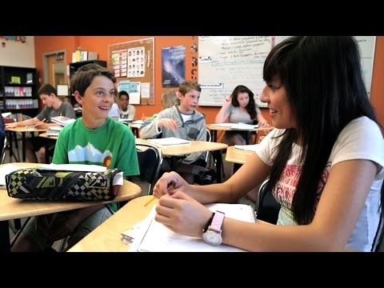
UDA/USA
Poblogaeth sylweddol yn siarad Sbaeneg
hanes
ffin gyda Lladin America a mudo diweddar
addysg drwy gyfrwng y Sbaeneg
Significant Spanish speaking population
history
borders with Latin America and recent migration
inclusion of Spanish medium education
Notes:
Video of one approach to teaching both Spanish and English
Significant Spanish speaking population due to history, borders with Latin America and recent migration- and in several states such as California/Florida inclusion of Spanish medium education
28

Slide 29
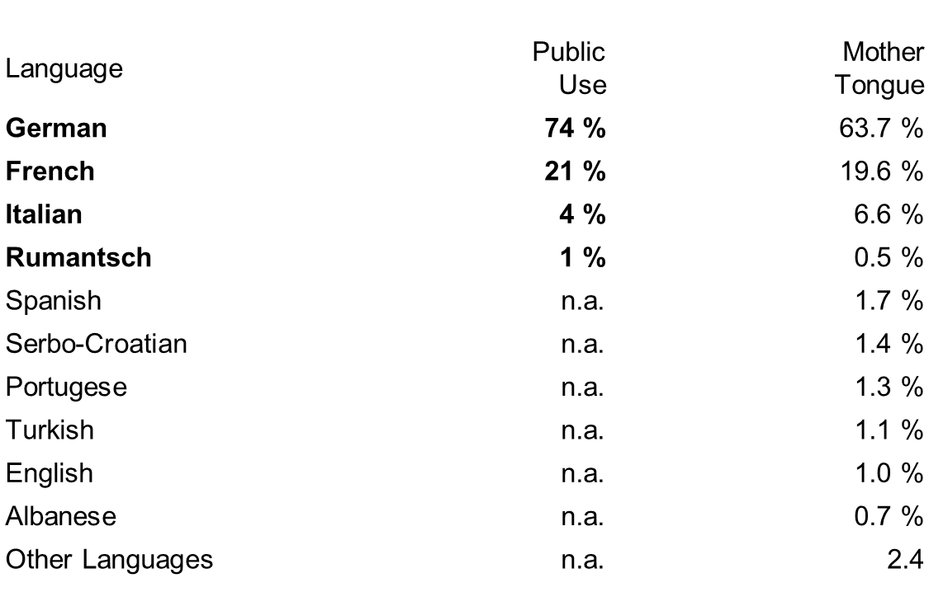
Y Swistir/Switzerland
Sawl iaith swyddogol?
How many official languages?
Notes:
29

Slide 30
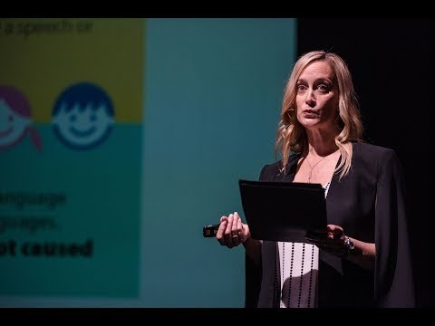
Bilingualism Matters: Myths and Facts about Early Bilingual Development — Mileidis Gort

Slide 31
Buddion cyfathrebu
Communication benefits
Mwy o bobl i gyfathrebu gyda:
Teulu;
Y gymuned;
Lleoliad – meithrinfa/ysgol;
- Cyflogaeth (yn hwyrach).
More people to communicate with:
- Family;
- Community;
- Setting – nursery/school;
- Employment (later).

Slide 32
Buddion diwylliannol
Cultural benefits
Amlddiwylliant;
Mwy o gymhwysedd cymdeithasol;
Hyblygrwydd cymdeithasol;
Mwy o goddefgarwch;
Llai o hiliaeth/rhagfarn.
Multiculturalism;
Increased social competence;
Social flexibility;
More tolerance;
Less racism/prejudice.

Slide 33
Manteision gwybyddol neu meddyliol
Cognitive or thinking advantages
Meddwl yn greadigol;
Cysyniadau o fewn geiriau;
Cyrhaeddiad o fewn y cwricwlwm;
Mwy o hyblygrwydd, hyblygrwydd meddyliol;
Creative thinking;
Word concepts;
Curriculum achievement;
Greater adaptability, mental flexibility;

Slide 34
Manteision gwybyddol neu meddyliol
Cognitive or thinking advantages
Rhesymu haniaethol uwch, yn annibynnol o iaith;
Deallusrwydd ar lafar;
Sensitifrwydd cyfathrebu uwch;
Mwy o allu i ddatrys problemau;
Higher abstract reasoning, independent of language;
Verbal intelligence;
Higher communication sensitivity;
Greater capacity to problem solve;

Slide 35
Manteision gwybyddol neu meddyliol
Cognitive or thinking advantages
Perfformiad uwch mewn canfyddiad gofodol;
Canlyniadau cadarnhaol yn ym myd mathemategol;
Y gallu i ddysgu ieithoedd ychwanegol yn cael ei hwyluso’n fawr.
Higher performance in spatial perception;
Positive consequences in the mathematical world;
The learning of additional languages is greatly facilitated.

Slide 36
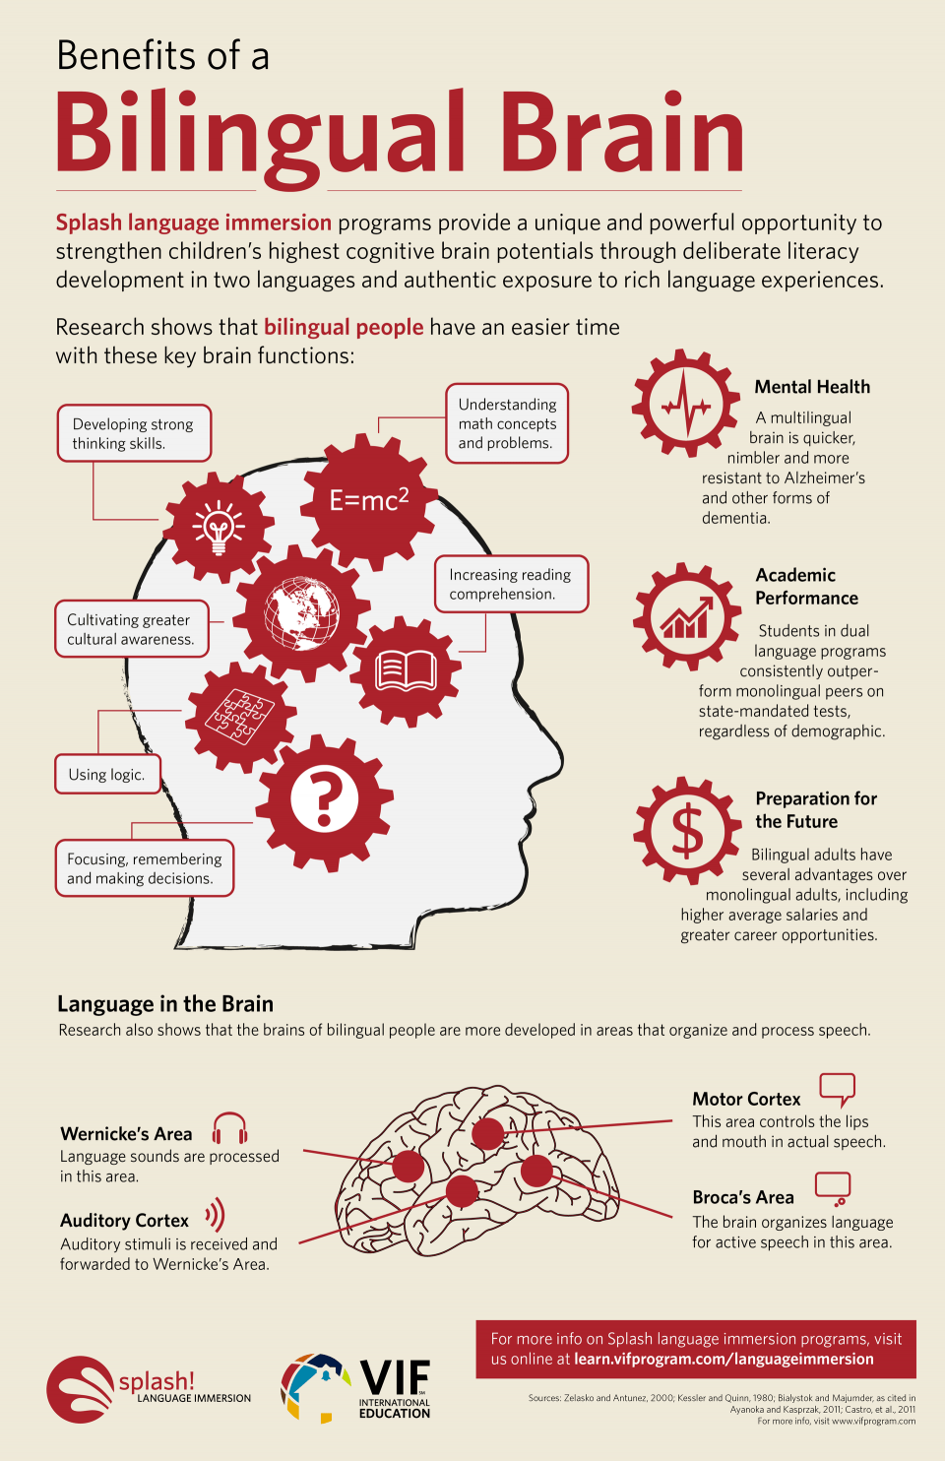
Yr ymennydd dwyieithog
The bilingual brain
Babanod newydd-anedig ddwyieithog yn medru gwahaniaethu rhwng 2 iaith oriau ar ôl genedigaeth;
Pobl ddwyieithog yn cadw mwy o freithell!
Bilingual newborns can differentiate between 2 languages hours after birth;
Bilinguals keep more grey matter!

Slide 37
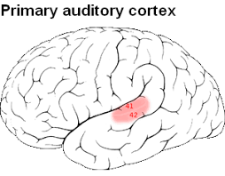
Cortecs clywedol
Auditory cortex
Prosesu gwybodaeth glywedol;
Cario negeseuon at ardal Wernicke;
Gan blant dwyieithog gwell ymwybyddiaeth ffonolegol;
Gallu gwell i ddysgu ffonemau newydd;
Aeddfedrwydd y cortecs clywedol yn gysylltiedig â dysgu iaith.
(Kuipers and Thierry, 2015)

Slide 38
Cortecs clywedol
Auditory cortex
Processes auditory information;
Carries messages to Wernicke’s area;
Bilingual children have enhanced phonological awareness;
Greater ability to learn new phonemes;
Maturation of auditory cortex linked to language learning.
(Kuipers and Thierry, 2015)

Slide 39
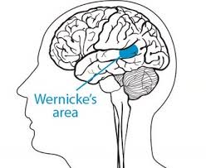
Rhan Wernicke
Wernicke’s area
Cynhyrchu a phrosesu iaith;
Dealltwriaeth;
Mae gan pobl ddwyieithog cynydd cysylltedd yn y rhan yma.
Language production and processing;
Comprehension;
Bilinguals have increased connectivity in this area.
(Hofman, 2020)

Slide 40
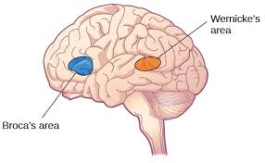
Rhan Broca
Broca’s area
Gwybodaeth o rhan Wernicke yn teithio yma;
Cyhyrau lleferydd;
Rheoli cynhyrchiad lleferydd;
Mwy o fater llwyd i'w cael yma (nag mewn pobl uniaith).
(Hofman, 2020)

Slide 41
Rhan Broca
Broca’s area
Information from Wernicke’s area travels here;
Muscles of speech;
Controls speech production;
Larger amounts of grey matter found here (than in monolinguals).
(Hofman, 2020)

Slide 42
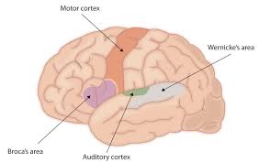
Cortecs echddygol
Motor cortex
Yn ymwneud â chynhyrchu lleferydd a chanfyddiad lleferydd;
Cynhyrchu ail iaith yn gysylltiedig â mwy o weithgaredd yn y cortecs echddygol.
Involved in speech production and speech perception;
Production of second language associated with increased activity in the motor cortex.
(Treutler and Soros, 2021)

Slide 43
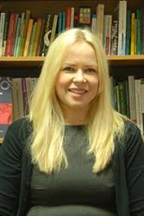
Yr Athro Enlli Thomas
Professor Enlli Thomas
Prifysgol Bangor;
Athro mewn Addysg;
Ymchwilydd.
Bangor University;
Professor in Education;
Researcher.

Slide 44
Seicoleg dwyieithrwydd
Psychology of bilingualism
Nid yw plant dwyieithog yn agored i'r ddwy iaith ym mhob cyd-destun;
Rhaid i blant 'jyglo' dwy iaith 'gyfatebol’;
Wrth ddefnyddio un iaith, rhaid iddynt anwybyddu'r llall;
Bilingual children are not exposed to both languages in all contexts;
Children have to ‘juggle’ two ‘competing’ languages;
While using one language, they have to ignore the other;
(Thomas, 2018)

Slide 45
Seicoleg dwyieithrwydd
Psychology of bilingualism
Yn aml, yn symud o un iaith i'r llall - mae'r ymennydd yn gweithio'n galed iawn!
Rhaid i ymarferwyr ystyried unigrywiaeth profiad ieithyddol bob plenty.
Often have to move from one language to another – the brain is working very hard!
Practitioners must consider the uniqueness of each child’s experiences with language.
(Thomas, 2018)

Slide 46
Agwedd
Attitude
Hyfedredd
Proficiency
Rhuglder
Fluency
Hyder
Confidence
(Thomas, 2018)

Slide 47
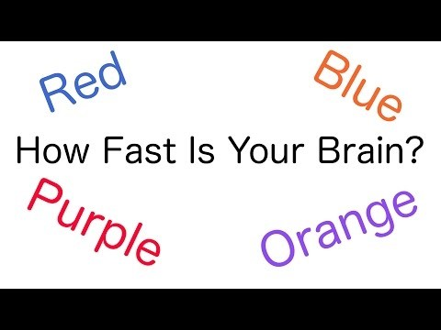
Prawf Stroop
The Stroop Test

Slide 48
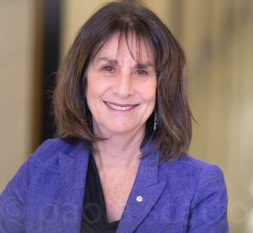
Dr Ellen Bialystok
Seicolegydd ac ymchwilydd o Ganada;
Ymchwil yn cynnwys archwiliad ar effaith dwyieithrwydd ar brosesau gwybyddol.
Canadian psychologist and researcher;
Research includes examining the effect of bilingualism on cognitive processes.

Slide 49
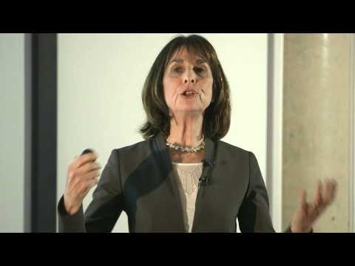
Gwybodaeth metaieithyddol
Metalinguistic knowledge
Y gallu i ddeall strwythur ynghyd ag ystyr iaith;
Ffactor allweddol yn natblygiad darllen plant ifainc.
The ability to understand the structure of language as well as the meaning;
A key factor in the development of reading in young children.

Slide 50
Buddion personol
Personal benefits
Hunan-fri uwch;
Hunaniaeth gadarnhaol;
Eich meddwl yn gweithio am hirach.
Yn hwyrach:
Adferiad cyflymach o strôc;
Oedi cychwyniad dementia.
Higher self-esteem;
Positive self-identity;
Your mind works for longer.
Later years:
Faster recovery from a stroke;
Delayed onset of dementia.

Slide 51
Yn hwyrach….Buddion economaidd a chyflogadwyedd
Later….Economic and employment benefits
Sgorio'n uwch mewn profion;
Mynediad i rwydwaith cymdeithasol ehangach;
Yn fwy tebygol o fynychu coleg/prifysgol;
'Mae'n well' gan gyflogwyr gyflogi pobl ddwyieithog/amlieithog.
Score higher in tests;
Access to wider social network;
More likely to attend college/university;
Employers ‘prefer’ to employ bilinguals/multilinguals.

Slide 52
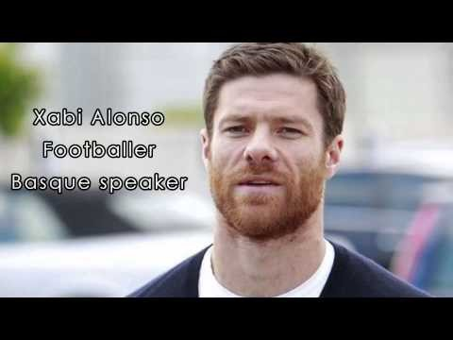
Carwch eich iaith
Love your language
NPLD (2014) Love your Language, Film by NPLD, https://www.youtube.com/watch?v=K5lfoBz_nMM [Accessed: February 17 2017].

Slide 53
Eich aseiniad…
Your assignment…
Datblygiad yr ymennydd
Brain development
Buddion dwyieithrwydd/amlieithrwydd
Benefits of bilingualism/multilingualism
Gweithgaredd
Activity
Ymchwil a damcaniaeth priodol
Relevant research and theory
Meddwl dargyfeiriol
Divergent thinking

Slide 54
Cyfeiriadau
References
Baker, C. (2011) Foundations of Bilingual Education and Bilingualism (5th ed). Clevedon: Multilingual Matters.
Baker, C. (2014) A Parents' and Teachers' Guide to Bilingualism. (4th Edition). Bristol: Multilingual Matters.
Bright, P. and Filippi, R. (2019) Editorial: Perspectives on the “Bilingual Advantage”: Challenges and Opportunities, https://www.frontiersin.org/articles/10.3389/fpsyg.2019.01346/full [Accessed: February 24 2021].
Chen, X. and Padilla, A. M. (2019) Role of Bilingualism and Biculturalism as Assets in Positive Psychology: Conceptual Dynamic GEAR Model, https://www.frontiersin.org/articles/10.3389/fpsyg.2019.02122/full [Accessed: February 24 2021].
CU Boulder School of Education (2019) Bilingualism Matters: Myths and Facts about Early Bilingual Development — Mileidis Gort, https://www.youtube.com/watch?v=i9L9-wtRjmo&t=9s [Accessed: February 24 2021].

Slide 55
Cyfeiriadau
References
Devarakonda, C. (2013) Diversity and Inclusion in Early Childhood: An Introduction. London: Sage Publications Ltd.
Edutopia (2015) Bilingual Program: Academic Content in Two Languages, https://www.youtube.com/watch?v=fyfxUZpRTGo [Accessed: February 24 2021].
Hoffman, J. and Russ, S. (2012) ‘Pretend Play, Creativity, and Emotion Regulation in Children’, Psychology of Aesthetics, Creativity, and the Arts, 6(2), pp. 175-184.
Hofman, C.(2020) A literature review examining the effects of bilingualism in individuals who stutter, https://digitalcommons.murraystate.edu/cgi/viewcontent.cgi?article=1034&context=honorstheses [Accessed: February 24 2021].
Kuipers, J. R. and Thierry, G. (2015) Bilingualism and increased attention to speech: Evidence from event-related potentials, https://www.sciencedirect.com/science/article/pii/S0093934X15001443 [Accessed: February 24 2021].

Slide 56
Cyfeiriadau
References
Nagle, R. (2019) The U.S. has spent more money erasing Native languages than saving them, https://www.hcn.org/issues/51.21-22/indigenous-affairs-the-u-s-has-spent-more-money-erasing-native-languages-than-saving-them [Accessed: February 24 2021].
NALDIC (2011) What is bilingualism? , https://www.naldic.org.uk/Resources/NALDIC/Initial%20Teacher%20Education/Documents/B1.pdf [Accessed: February 24 2021].
NPLD (2014) Love your Language, Film by NPLD, https://www.youtube.com/watch?v=K5lfoBz_nMM [Accessed: February 17 2017].
Rhys, M. and Thomas, E. M. (2013) ‘Bilingual Welsh–English children's acquisition of vocabulary and reading: implications for bilingual education,’ International Journal of Bilingual Education and Bilingualism, 16, 6, pp. 633-656.

Slide 57
Cyfeiriadau
References
Robinson, K. (2016) Divergent Thinking Ken Robinson, https://www.youtube.com/watch?v=BHMUXFdBzik [Accessed: February 25 2021].
Thomas, E. M. (2018) Cynhadledd Dwyieithrwydd Tachwedd 2018 – Bangor, https://www.youtube.com/watch?v=9LeGXUkz8LI&t=3970s [Accessed: February 25 2021].
Treutler, M. and Soros, P. (2021) Functional MRI of native and non-native speech production in sequential German-English bilinguals, https://www.biorxiv.org/content/10.1101/2021.02.18.431784v1.full [Accessed: February 24 2021].
University of Reading (2015) How bilingualism helps your brain. https://www.youtube.com/watch?v=6sDYx77hCmI [Accessed: February 25 2021].

