Slide 1
Computer Systems
Fundamentals
(ACCA4028)
Lecture - 09

Slide 2
Computer Security
By: Dr. Redhwan Al-amri

Slide 3
Objectives
Upon completion of this Chapter, you should be able to:
Describe computer security concepts.
Describe computer security terminology.
Differentiate between types of computers viruses.
Defined Vulnerability and Attacks
Defined Countermeasure.
Defined the purpose of security and Firewall.
Describe the components of Firewall.
Explain the architecture of the Firewall.

Slide 4
On Previous Lecture
We addressed the following:
Define a Network.
Describe the three types of Network
Describe Network Architecture
Discuss the Network Hardware

Slide 5
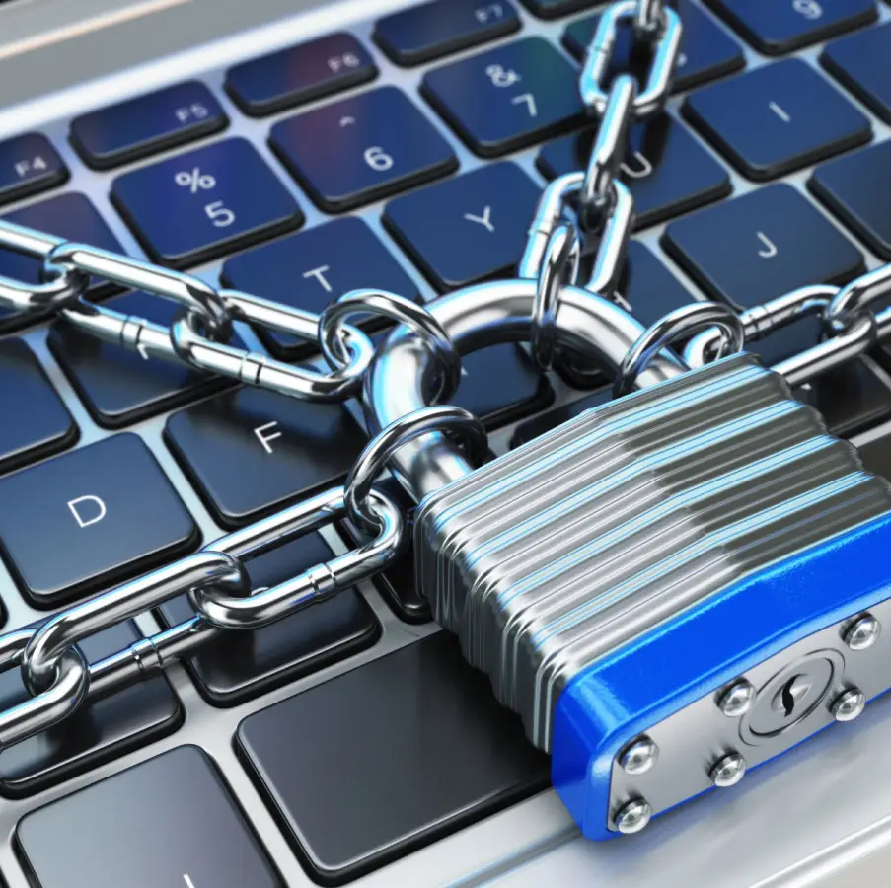
What is Computer Security?

Slide 6
What is Computer Security?
Is the protection of computer systems and networks from attack by malicious actors that may result in unauthorized information disclosure, theft of, or damage to hardware, software, or data, as well as from the disruption or misdirection of the services they provide.

Slide 7
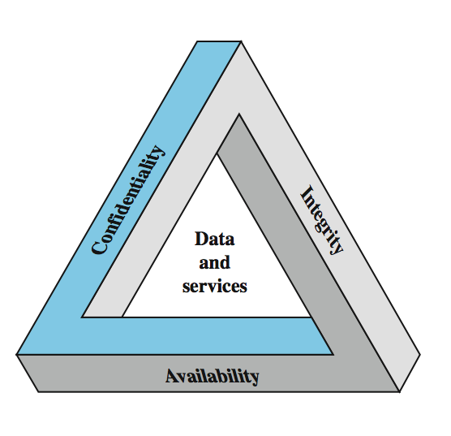
Key Security Concepts

Slide 8
Computer Security Challenges
not simple
must consider potential attacks
procedures used are advanced
involve algorithms and secret info
must decide where to deploy mechanisms
battle of wits between attacker / admin
not perceived on benefit until fails
requires regular monitoring
too often an after-thought

Slide 9
What is Computer Vulnerability?
A vulnerability is a weakness in an IT system that can be exploited by an attacker to deliver a successful attack
They can occur through flaws, features or user error, and attackers will look to exploit any of them, often combining one or more, to achieve their end goal.

Slide 10
What is Computer Attack?
Is any offensive operation that targets computer information systems, computer networks, infrastructures, personal computer devices, or smartphones.
It is also known as any kind of malicious activity that attempts to collect, disrupt, deny, degrade, or destroy information system resources or the information itself.

Slide 11
Countermeasures
Means used to deal with security attacks
  prevent
  detect
  recover
May result in new vulnerabilities
Goal is to minimize risk given the constraints

Slide 12
Threat Consequences
Unauthorized disclosure threat to confidentiality
  exposure, interception, intrusion
Deception threat to integrity
  masquerade, falsification, denial
Disruption threat to availability
  incapacitation, corruption, obstruction
Usurpation threat to system integrity
  misappropriation, misuse

Slide 13
Security Functional Requirements
Technical measures:
  access control; identification & authentication; system & communication protection; system & information integrity
Management controls and procedures:
  awareness & training; audit & accountability; certification, accreditation, & security assessments; contingency planning; maintenance; physical & environmental protection; planning; personnel security; risk assessment; systems & services acquisition
Overlapping technical and management:
  configuration management; incident response; media protection

Slide 14
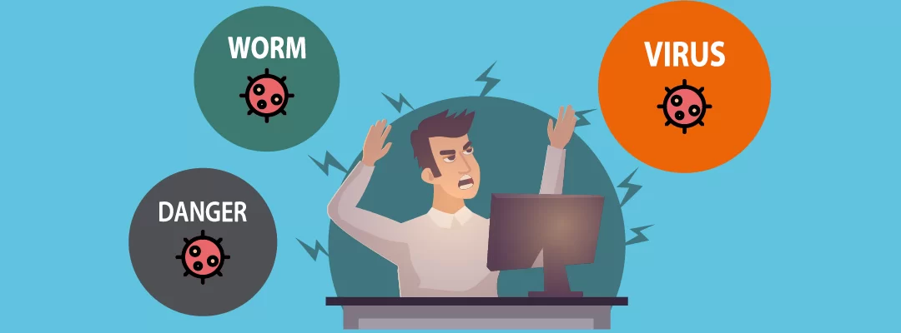
What is a Computer Virus?

Slide 15
What is a Computer Virus?
A computer virus is a malicious application which can harm devices and files and infect them for no further use.
When a virus program is executed, it replicates itself by modifying other computer programs and instead enters its own coding.
This code infects a file or program and if it spreads massively, it may ultimately result in crashing of the device.

Slide 16
How to tell if your computer is infected?
Speed of the System
Pop-up Windows
Self Execution of Programs
Log out from Accounts
Crashing of the system

Slide 17
Types of Computer Virus
Malware
Is a type of software that is written specifically to infect or harm the system on which it runs. It’s basically an umbrella term used to refer to a wide range of intrusive or disruptive types of software that can adversely affect the performance of your system.
Virus
Is a type of malware program that attaches itself to an executable program or a file and subsequently travels through other programs and files, infecting other files.
Trojan Horse
Is a malicious program that misrepresents itself and appears to be regular, harmless software. Unfortunately, this has hugely negative effects on the host computer.

Slide 18
Malware Terminology
Virus
Worm
Logic bomb
Trojan horse
Backdoor (trapdoor)
Mobile code
Auto-rooter Kit (virus generator)
Spammer and Flooder programs
Keyloggers
Rootkit
Zombie, bot

Slide 19
How to Prevent Computer Viruses?
Install antivirus software
Don’t open executable email attachments
Keep your operating system updated
Avoid questionable websites
Don’t use pirated software

Slide 20
Network Security Attacks
Classify as passive or active
Passive attacks are eavesdropping
  release of message contents
  traffic analysis
  are hard to detect so aim to prevent
Active attacks modify/fake data
  masquerade
  replay
  modification
  denial of service

Slide 21
Types of Network Attacks
Intrusion
Denial of Service
Information Theft
Stupidity

Slide 22
Types of Network Attacks
Intrusion
Monitoring of network devices - Network-based (monitors traffic) and Host-based (monitors individual computers).
Denial of Service
Belongs to a family of attack methods that have the objective of making target systems unavailable to legitimate users, e.g. overloading, flooding, crashes, sluggish performance, unusable, etc.

Slide 23
Types of Network Attacks
  Information Theft
  the attacker can passively record data communications in order to gather sensitive information that may be passing between two hosts.
  Stupidity
  unknowing giving access and information without realizing its contents, etc. - fooled, con-man, etc.

Slide 24
Types of Hackers
  Joy-riders
  Vandals
  Spies
  White Hat / Ethical Hackers

Slide 25
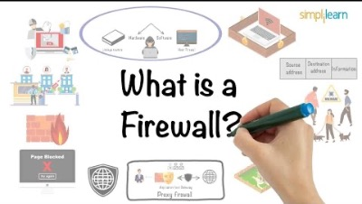
What is a Firewall?

Slide 26
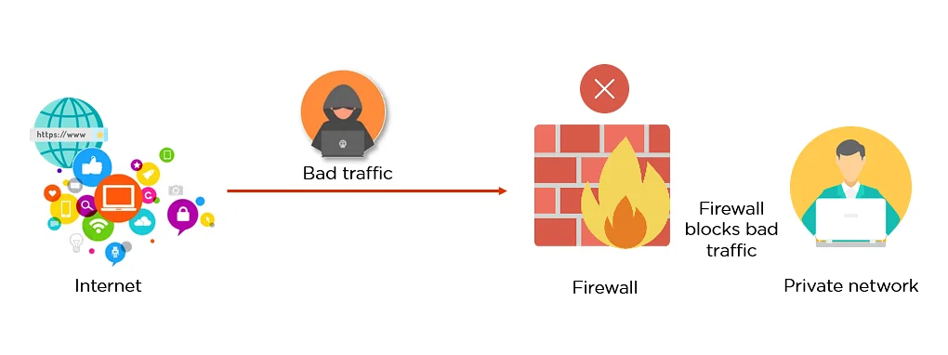
What is an Internet Firewall?
a firewall is a network security system that monitors and controls the incoming and outgoing network traffic based on predetermined security rules.

Slide 27
What is an Internet Firewall?
Prevents dangers of the Internet from spreading to your internal network
Restricts people to entering at a carefully controlled point
Prevents attackers from getting close to your other defenses
Restricts people to leaving at a carefully controlled point
All traffic coming from the Internet and going out from the internal network passes through the firewall

Slide 28
What is an Internet Firewall?
More often, a firewall is thought of as a hardware component:
    Router, host computer or combination of routers, computers and networks with appropriate software
But it’s best to look at it as a system of components designed to control access to and from your network and the outside network based on security policies in effect at your side of the network

Slide 29
What a firewall CAN do?
A firewall is a focus for security decisions
  Lets us focus all security measures on a single checkpoint.
A firewall can enforce security policy
  May allow only “approved” services to pass through, and those only within the rules set up for them.
  (use your site’s security policy to design a firewall)
A firewall can log Internet activity efficiently
A firewall can limit our exposure

Slide 30
What a firewall CAN do?
Some new functions that improve performance in addition to providing security
  caching used by network Web servers to store frequently accesses data locally, which can improve response time which will be otherwise wasted by repeated fetches of the same data
  properly configured, address translation only exposes its own network address to the outside world, enabling you to use any IP address space for the internal network
  content restriction by restricting access to known URLs

Slide 31
What a firewall CAN’T do?
A firewall can’t protect against malicious insiders
A firewall can’t protect against connections that don’t go through it
A firewall can’t protect against completely new threats
A firewall can’t protect against viruses
  Normally only scan addresses information and port numbers

Slide 32
Firewall Architecture
Packet-filtering router or host computer
Dual-homed gateway
Screened host
Screened subnet

Slide 33
Firewall Architecture Cont.
Packet-Filtering Router or Host Computer
  A network device configured with multiple interfaces and is attached to two or more networks
  Can determine that a packet is destined for a host that resides on a subnet that is directly connected to it
  A screening router is configured with a set of rules that specify which kind of network traffic is allowed to come through
  The basic method is stateless packet filtering – each packet is judged by its own merits – I.e. by the data contained in the header

Slide 34
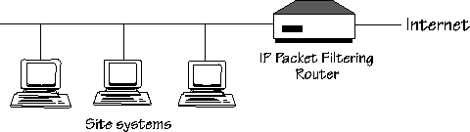
Firewall Architecture Cont.
Packet-Filtering Router or Host Computer

Slide 35
Firewall Architecture Cont.
Dual-Homed Host
  A host acts as a router between the networks it is attached to.
  Systems outside the firewall can talk to the dual-homed host
  Systems inside the firewall can talk to the dual-homed host
  But they can’t talk directly to each other!
  Able to deny/allow connections based on data content. (Packet filtering routers can’t do this)
  However, introduces additional overhead in processing
  Users need to “log-in” to the dual-homed host. This presents host security issues.

Slide 36
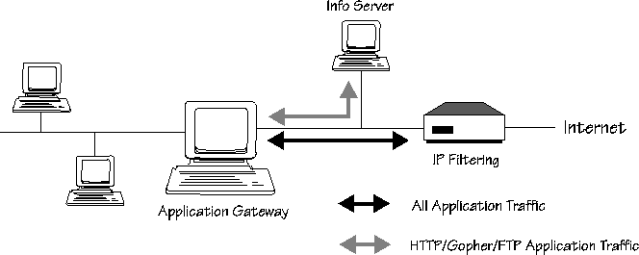
Firewall Architecture Cont.
Dual-Homed Host

Slide 37
Firewall Architecture Cont.
Screened Host
  The bastion host is only attached to the internal network.
  Primary security is provided by packet filtering
  Packet filtering is set up in such a way that the bastion host is the only host on the internal network that external hosts can talk to directly
  Also allows only certain types of connections
  Bastion host also opens allowable connections to the outside world.
  Can be mixed and matched.

Slide 38
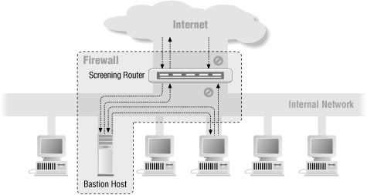
Firewall Architecture Cont.
Screened Host

Slide 39
Firewall Architecture Cont.
Screened Subnet
  Creates a “perimeter network” that further isolates the internal network from the Internet
  Normally comprise of an exterior router, a perimeter net, an interior router and a Bastion Host
  Reason: to protect the bastion host (Remember that the bastion host is the most likely machine to be attacked)
  If someone breaks into the bastion host, then the entire internal network is jeopardized!

Slide 40
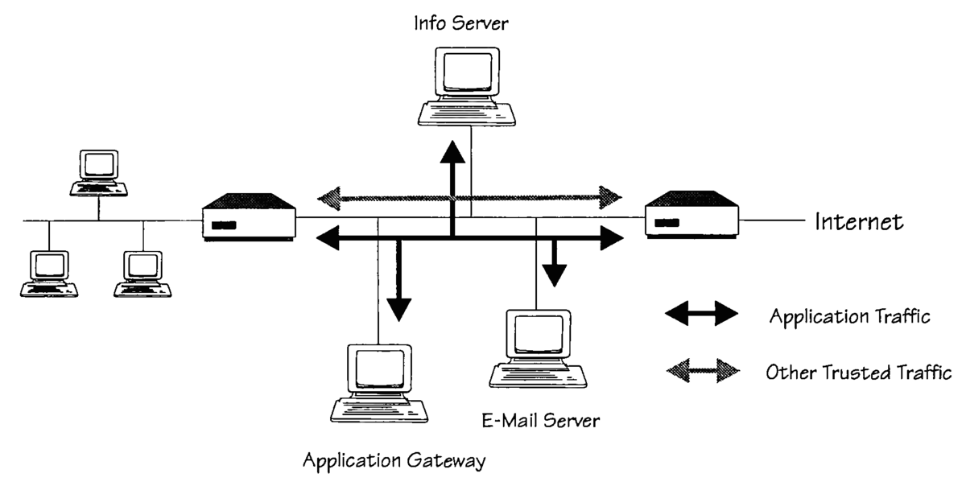
Firewall Architecture Cont.
Screened Subnet

Slide 41
Summary of Main Teaching Points
Security concepts
Terminology
functional requirements
Security architecture
Security trends
Security strategy
Computer viruses
Firewall basics,
Security and the Internet
Firewall Security Policy and Firewall design
Packet Filtering
Firewall Tools available in the Internet
Firewall Applications
Firewalls and Beyond

Slide 42

Test Your Understanding!

Slide 43
Q&A

