Slide 1

PROBLEM-SOLVING AND DECISION MAKING
Task 1 : Presentation
Student ID: 1907524
Lecturer: MD Hazmul Hasan

Slide 2

Introduction
The report is mainly based on reducing the long term absences of employees
This report helps to define long term absenteeism by focusing on Mid Cheshire hospitals
Human Resources identification is the most highlighting factor of this report
Notes:
The report is mainly based on reducing the long term absences of employees, where Human resources relating information are required to be mentioned to influence the presentation quality as well. On the other hand, in this report, the mean focusing factors are illustrated where the organisation Mid Cheshire hospitals has been taken to underline the real based data. Human resource is one of the effective factors that need to be mentioned in this report to perfectly illustrate the study quality as well.

Slide 3
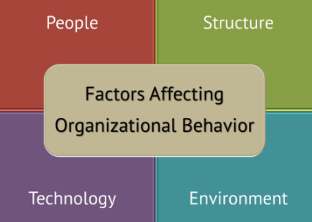
The nature and impacts of complex problems on employees and their organisation
Gross misconduct activity is one of the complex impacts that are happening with the employees of the organisation.
Communication is another problem that can be easily aroused as impacts of complex problems on employees within the organisation (Duggan et al., 2020).
Interpersonal conflicts can also happen as complex problems with the employees in Mid Cheshire hospitals (Van Der Lippe and Lippény, 2020).
Notes:
Gross misconduct activity is one of the complex impacts that are happening with the employees of the organisation. Communication and Interpersonal conflicts both are complex problems of employees in the organisation.

Slide 4
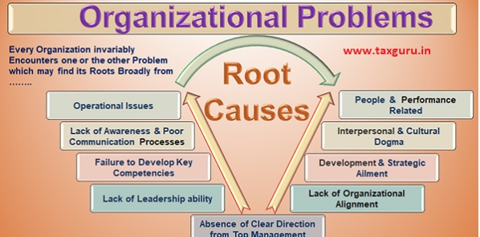
Continued….
Employee turnover rate developing issues is the most effective factor that also needs to be accounted for as complex problems
Better productivity and management process both are complexion issues that are faced by employees from the organisation (Kim et al., 2019)
Notes:
Employee turnover rate developing issues is the most effective factor that also needs to be accounted for as complex problems that are faced by the employees in the workplace. Better productivity and management process both are complexion issues that are faced by employees from the organisation

Slide 5
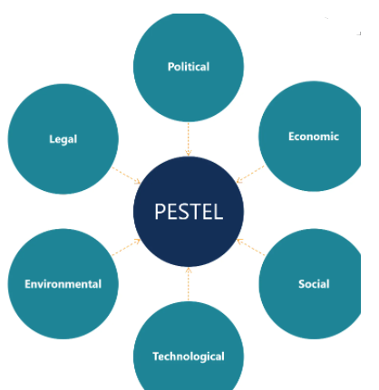
Pestle analysis of macro-environment factors contributing complex problems
Easily foreign currencies can be exchanged in the UK and poor environmental impacts aspects are enhancing the complex problems
Social issues like huge populations and multicultural activities can also enhance the complex issues in the organisation (Agbenyegah, 2019)
Notes:
Easily foreign currencies can be exchanged in the UK and poor environmental impacts are enhancing the complex problems. Social issues like huge populations and multicultural activities can also enhance the complex issues in an organisation

Slide 6
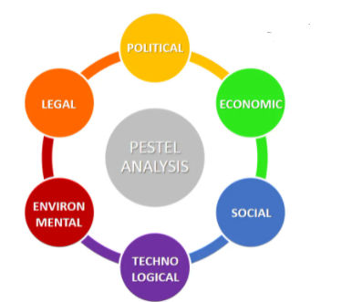
Continued…
Climate change is a major environmental issue that also can create complex issues within the workplace
Technology basing activities of employees also create impacts on their complex issues
Notes:
Climate changes are major environmental issues that also can create complex issues within the workplace. Technology-based activities of employees also create impacts on their complex issues

Slide 7
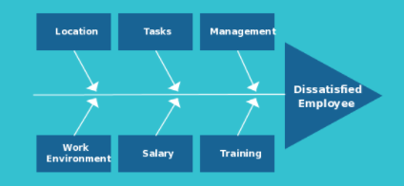
Cause and effect analysis of complex problems
Cause and effect analysis is a technique that makes findings and fixes the problems
Problem identification in the proper way along with possible causes understanding process are cause and effect analysis of complex problems (Kniffin et al., 2019)
Notes:
Cause and effect analysis is a technique that makes findings and fixes the problems
Problem identification in the proper way along with possible causes understanding process are cause and effect analysis of complex problems

Slide 8
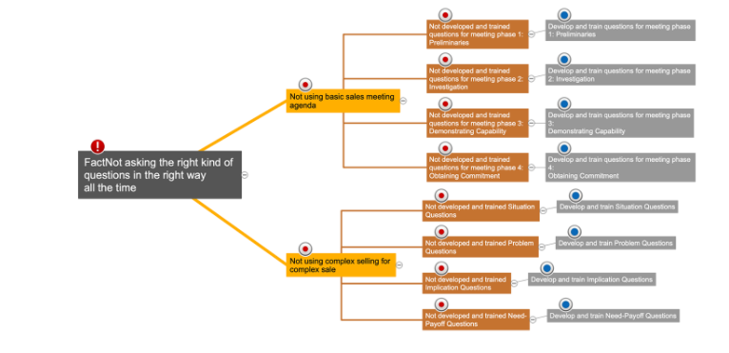
Continued…
The communication issues can be easily identified as complex problems that can easily be analysed through the counselling process
Interpersonal activities also can be analysed by reducing the conflicts between the employees' activities (Lu et al., 2020).
Notes:
The communication issues can be easily identified as complex problems that can easily analyse through the counselling process. Interpersonal activities also can be analysed by reducing the conflicts between the employees' activities

Slide 9

Evaluation of alternative solutions to absenteeism with aiming most appropriate solutions
Exploring the flexible schedules is one of the alternative solutions that are appropriate for the organisation
The return-to-work interview is another factor that also needs to be considered as an alternative solution for reducing absenteeism (Kniffin et al., 2019).
Notes:
Exploring flexible schedules is one of the alternative solutions that are appropriate for the organisation. The return-to-work interview is another factor that also needs to be considered as an alternative solution for reducing absenteeism.

Slide 10

Continued…
Recognition is one of the other alternative solutions that need to be accounted for in reducing absenteeism.
Using management tools need to be used to reduce the number of absenteeism of employees (Kim et al., 2019).
Notes:
Recognition is one of the other alternative solutions that need to be accounted for in reducing absenteeism. Using management tools need to be used to reduce the absenteeism of employees.

Slide 11

Conclusion
It can be concluded that long-term absences of employees are the big issues of the organisation that can be minimised through using strategies.
The organisation's growth is influenced by implementing alternative solutions within the organisation
Notes:
It can be concluded that long-term absences of employees are the big issues of an organisation that can be minimised through using strategies. The organisation's growth is influenced by implementing alternative solutions within the organisation

Slide 12
Reference List
Agbenyegah, G.K., (2019). Effect of financial and non-financial rewards on employee motivation in financial institution in Ghana. International Journal of Innovative Research and Development, 8(8), pp.121-130.
Duggan, J., Sherman, U., Carbery, R. and McDonnell, A., (2020). Algorithmic management and app‐work in the gig economy: A research agenda for employment relations and HRM. Human Resource Management Journal, 30(1), pp.114-132.
Kim, M., Kim, A.C.H., Newman, J.I., Ferris, G.R. and Perrewé, P.L., (2019). The antecedents and consequences of positive organizational behavior: The role of psychological capital for promoting employee well-being in sport organizations. Sport Management Review, 22(1), pp.108-125.
Kniffin, K.M., Narayanan, J., Anseel, F., Antonakis, J., Ashford, S.P., Bakker, A.B., Bamberger, P., Bapuji, H., Bhave, D.P., Choi, V.K. and Creary, S.J., (2021). COVID-19 and the workplace: Implications, issues, and insights for future research and action. American Psychologist, 76(1), p.63.
Lu, V.N., Wirtz, J., Kunz, W.H., Paluch, S., Gruber, T., Martins, A. and Patterson, P.G., (2020). Service robots, customers and service employees: what can we learn from the academic literature and where are the gaps?. Journal of Service Theory and Practice.
Van Der Lippe, T. and Lippényi, Z.,(2020). Co‐workers working from home and individual and team performance. New Technology, Work and Employment, 35(1), pp.60-79.

