Slide 1
BMSK6005 Coaching & Mentoring Skills of the Workplace
Evening Session 1

Slide 2

Review
How are you getting on?
What names/authors are you coming across with your research?
Reading and Research

Slide 3

Coaching
What is it about?

Slide 4

Kurt Lewin
Unfreeze
Change
Freeze

Slide 5
Three Core Values
Coaching
Coaches
Non-critical
Confidential
Non-judgemental

Slide 6
Three Core Values
Coaching Aim
Realise client’s potential
Raise client’s awareness of behaviours
Less of what’s not working
More of what is working
What’s new, that could work
Non-critical
Coaching
Coaches
Non-judgemental
Confidential

Slide 7

Starting Point
Greater Awareness
Self-examination
Env
I
ronment
Behaviour
Competence
Self
Image
Beliefs/
Values/
Attitudes
State
Env
I
ronment
√
X
Your Reality
Use all senses

Slide 8

Self-Image
No matter what you want to achieve, your self-image will govern whether you reach it or not
If you believe you can or believe you can’t, you’re right (Henry Ford)
Possible to improve the
coachee’s self-image
– therefore achieving
their, and your, goals
Not a finite quota of
self–confidence, A mix of nature/
nurture and how we behave and
what we focus on will help build a
positive self-image

Slide 9

Ethics Framework
.....a standpoint from which to decide whether a particular behaviour is right or wrong.....
…one ‘true’ right/wrong is impossible for everyone all the time…
…need something else…
‘Values and Personal Ethics’
Ethics
Based on beliefs and Values
Principles about the world
Personal/Professional
Integrity
Acting according to values
Don’t change for expediency
Compromise only for good reason – e.g. transport

Slide 10

Ethics
Distinguish
What we ought to do from what we ought not to do
Ethics V Law
Law too ‘blunt’ for complex ethical dilemmas
Ethics V religious beliefs
No guidance for non-believers
Multicultural society
Conflicting ethical standpoints – law can’t cover all

Slide 11
Value of an Ethical Framework to Coaching
Worldwide – largely unregulated
Problems if competent and ‘serious’ about the work
No one definition of coaching
No one set of competencies
No standards to compare practices
EMCC and others attempting some regulation and quality standards more credibility - consistency – competence
Provide protection for the client/coachee
Number of ‘nominalisations’ (abstract nouns like competence, professionalism, context, boundaries, integrity – broken down into specific actions the coach needs to take to embody the values in work
Guaranteeing a level of service or recourse to complaints procedure
Act with integrity – clearly stating what you will do and doing it
Credibility

Slide 12
Ethics & Supervision
Most ethical approaches
Supervision
  Standard procedure professions with a strong psychological focus
  Counselling,
  Psychotherapy,
  Psychology
  Social work
Where the personality, needs, desires and attitudes of the practitioner have a strong impact on their relationship with their clients
Need to be aware of how you are impacting on, and influencing, the coaching relationship

Slide 13
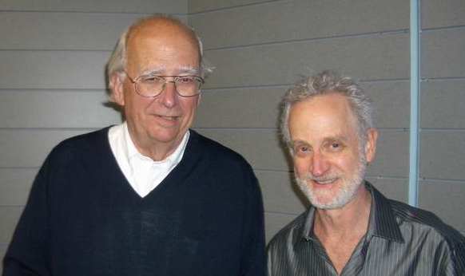
JOHARI Window
Known
by self
Unknown
by self
ASK
1
2
Known by
others
OPEN
AREA
feedback
BLIND
AREA
TELL
Self-disclosure
Shared
Dis-
covery
Others observations
Unknown
by others
HIDDEN
AREA
UNKNOWN
AREA
Self-discovery
4
3

Slide 14
GROW Model
GROW
Compel attention
Focus on precision/detail
Feedback loop
What the client wants to focus on?
Topic
Will
Goal
What will the client do?
What the client wants to happen?
Options
Reality
What could the client do?
What is happening now?

Slide 15

GROW
Goal
What is the aim of the discussion?
What do you want to achieve in the long term?
What does success look like to you?
How much personal control or influence do you have over your goal?
What would be a milestone along the way?
By when do you want to achieve it?
Is that positive, challenging and obtainable?
How will you measure it?

Slide 16

GROW
Reality
What is happening right now (what, when, etc.)
Who is directly and indirectly involved?
If things aren’t going well, who else gets drawn in?
If things aren’t going well, what happens to you?
What about the others involved, what happens to them?
What have you done about this so far - what results?
How often have you tried?
What is missing in this situation?
What is stopping you finding a way forward?

Slide 17

GROW
Options
What options do you have for steps to resolve this?
What else might you do?
What would someone who handles this issue really well do?
If you had more time, what else might you try?
If you had less time, what would you try?
Imagine that you had more energy and confidence – what would you try then?
If the constraints identified earlier were removed – what could you do then?
What should you do?
What are the costs and benefits of this?

Slide 18

GROW
Will
What option or options do you choose?
To what extent does this meet all of your objectives?
What are your criteria and measurement for success?
When, precisely will you start and finish each action stop?
What could hinder you taking these steps?
What will you do to eliminate these internal/external factors?
Who needs to know what you plans are?
What support do you need, and from whom?
What could I do to support you?
What commitment on a scale of 1-10 do you have for taking these agreed actions?
What prevents this from being 10?
What could you do or alter to raise your commitment to a 10?
Is there anything you want to talk about now?

Slide 19
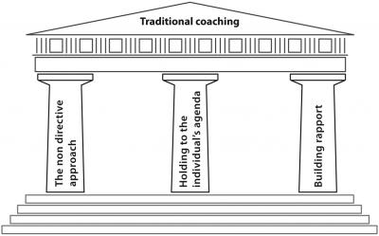
Notes:
THE NON DIRECTIVE APPROACH
Is the non directive approach the only way eg just letting the coachee respond to questioning by the coach
Is it OK to direct if the coachee get stuck and is not thinking deeper. Should more directive questions be used to kick start their thinking?
The coachee may have the ideas but not the confidence to voice them
HOLIDING TO THE INDIVIDUALS’S AGENDA
Just sticking to the coachee agenda might let them avoid issues, focus on irrelevancies or self obsession and avoid uncomfortable issues (ZOUD zone of uncomfortable debate).
Does this avoid the need of the sponsoring organisation?
Should it be linked to the organisations goal – specially if they are paying for it?
Building rapport
Does this limit the coach if they cannot entre the ZOUD ?
Does this ignore what might be the elephant in the room if the coach does not push the coachee because of concerns of not developing the rapport?

Slide 20
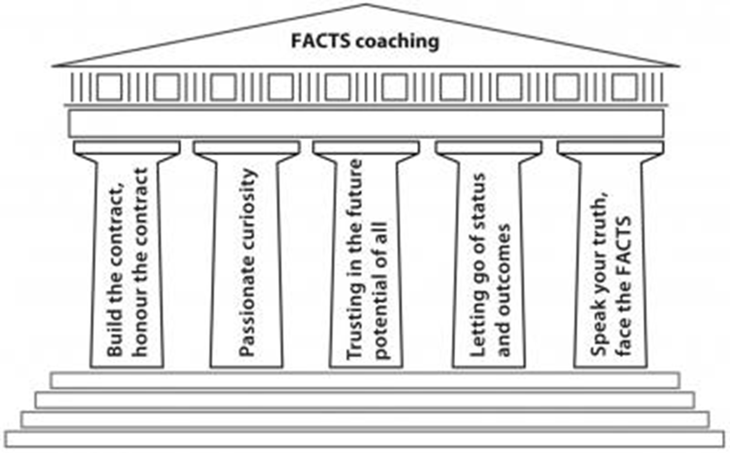
Build the contract, honour the contract
Passionate curiosity
Trust in the future potential of all
Letting go of status and outcomes
Speak your truth, face the facts

Slide 21
FACTS
Feedback
Accountability
Courageous Goals
Tension
Systems Thinking

Slide 22
FACTS
Non-sequential approach
Five equal cornerstones
A way to approach the GROW model
Add depth

Slide 23
GROW & FACTS
 | F | A | C | T | S
G | xx | x | xx | x | x
R | xx | x | x | x | xx
O | xx | x | x | xx | x
W | xx | xx | x | x | x

Slide 24
Build the contract, honour the contract
Coaching contracts need to be specific if they are to be honoured and include:
  No. of sessions & their duration
  Cancellation arrangements
  Ethical standards
  Confidentiality
  Boundaries
  Arrangements for ending and evaluation
  Make coaching agreements like covenants

Slide 25

Passionate curiosity
Passionate people care and curious people are interested and want to find out more
A passionately curious coach will ask and listen to understand

Slide 26

Trust in the future potential of all
Believe in the coachee's greatness
The role of a coach is to see potential where no one else sees it

Slide 27
Letting go of status and outcomes
The coach is in service of the coachee and sponsoring organisation
The coach must let go of power and status
Effective coaches do not need to know the answer

Slide 28

Speak your truth, face the facts
Speaking our truth and facing the facts will represent a key enabler
Give the coachee permission to practice direct and honest communication.

Slide 29
Reference
Blakey, J and Day, I. (2012). The core principle of Challenging Coaching- [online] Trainingzone.co.uk. Available from: http://www.trainingzone.co.uk/topic/coaching/core-principles-challenging-coaching-pt2/175349. [Accessed 1 March 2015]

Slide 30

Summary
Take 5 minutes to reflect upon tonight – what have you learnt?
Any key areas you want to research further?
What can help you with your assignment?
What can help you in your career?

