Slide 1
Sustainability in Hospitality: Net-Zero Carbon Operations
Conference
Denis Daniel Dinu

Slide 2
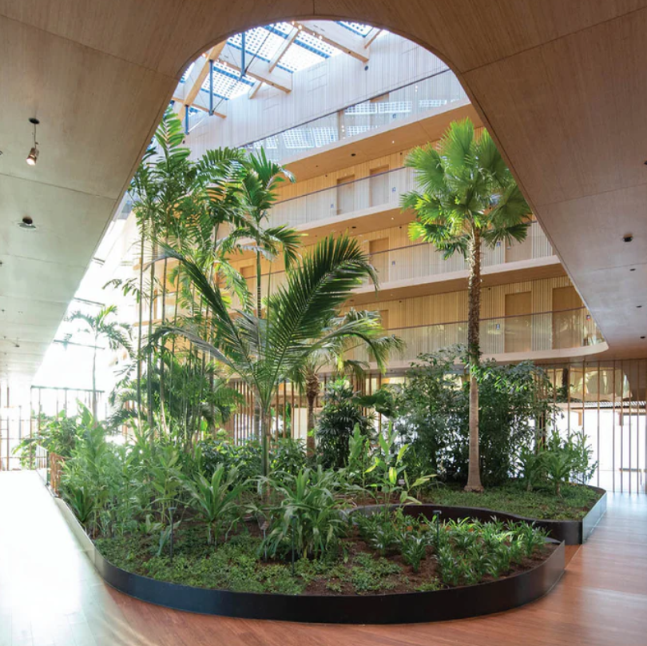
Sustainability in Hospitality
Introduction
Industry Background
Literature Review - Key Theories
Sustainable Energy Management
Waste Management and Circular Economy
Water Conservation
Sustainable Sourcing and Ethical Supply Chains
PESTEL Analysis – Political & Economic Factors
Case Study - Marriott’s Sustainability Journey
Challenges & Barriers
Recommendations
Conclusion
References

Slide 3

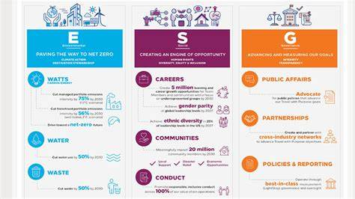

Marriott, Hilton, and The Green House Hotel examples of green practices
Hilton
Green House Hotel

Slide 4
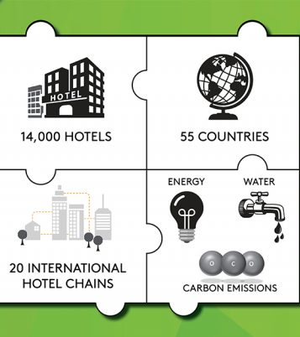
Hotels account for about 1% of world carbon emissions, which emphasises the crucial need of sustainability in running operations.
Growing customer choices for environmentally friendly travel call for urgent sustainability projects inside hotel operations.
Emphasising sustainability not only improves competitive advantage but also fits with world emission reduction goals.

Slide 5

Energy management is a crucial hospitality sustainability concern. Hotels need a lot of energy for heating, cooling, and lighting. LEED-certified buildings, smart thermostats, and motion-sensor lighting save energy.
Case studies show Marriott and Hilton cut energy use by investing in solar and wind power. Work must continue towards 100% renewable energy and carbon reduction.

Slide 6


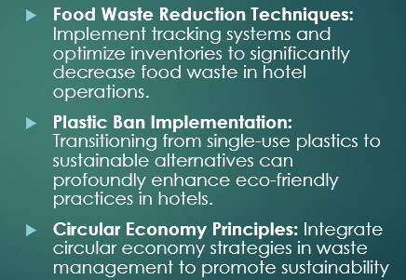
Waste Management & Circular Economy
Waste management is crucial to sustainability. Hotels produce tonnes of food, plastic, and trash daily. Industry leaders are implementing food waste tracking, composting, and single-use plastic bans to address this.
Premier Inn uses zero-plastic, and Hilton uses AI-powered food waste monitoring to minimise waste by 50%. These examples demonstrate how sustainability may reduce costs and improve efficiency.

Slide 7

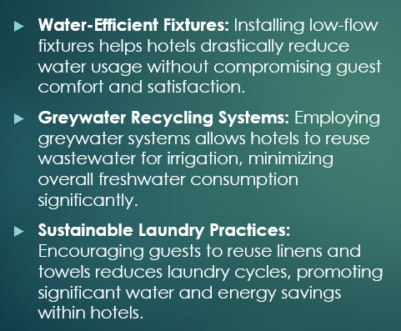




Water Conservation
Robinson & Patel (2024)

Slide 8
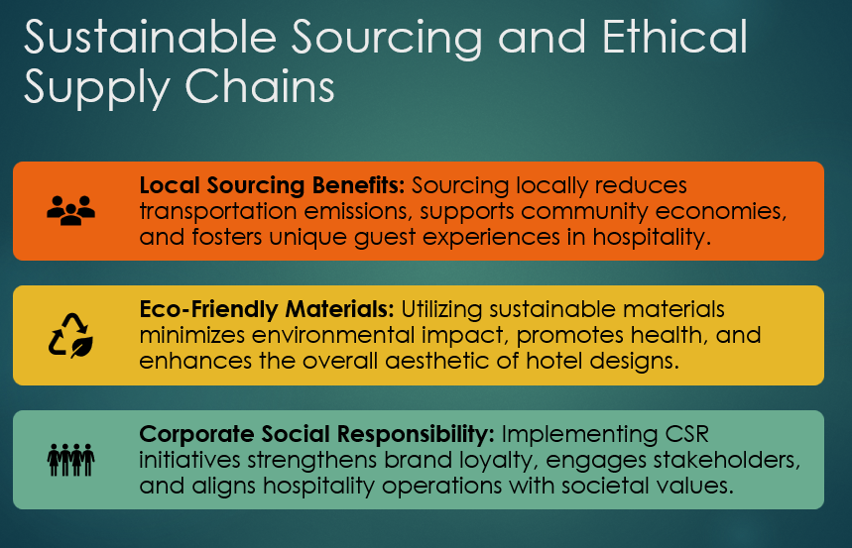

Slide 9

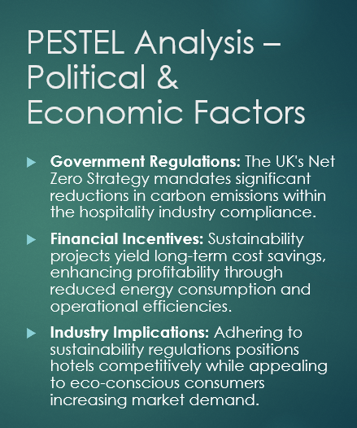

Slide 10
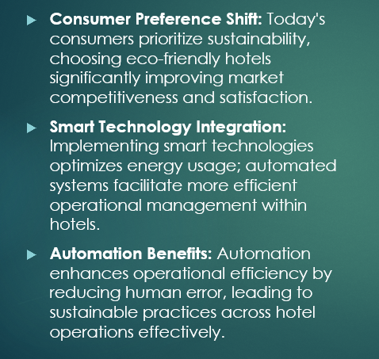
PESTEL Analysis – Social & Technological Factors

Slide 11
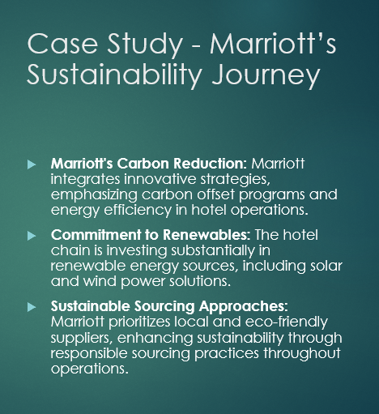


Slide 12
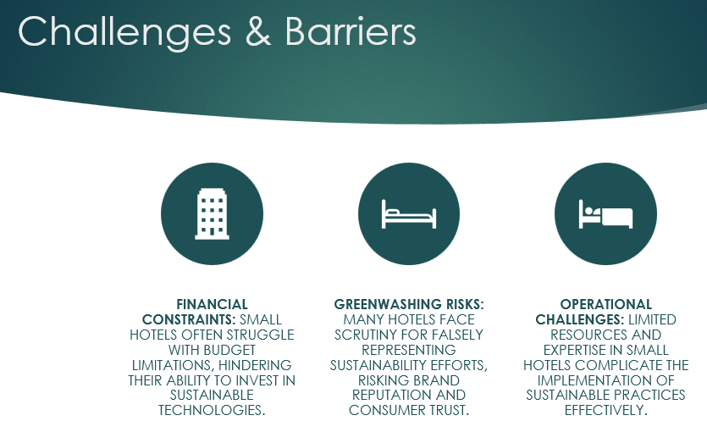

Slide 13
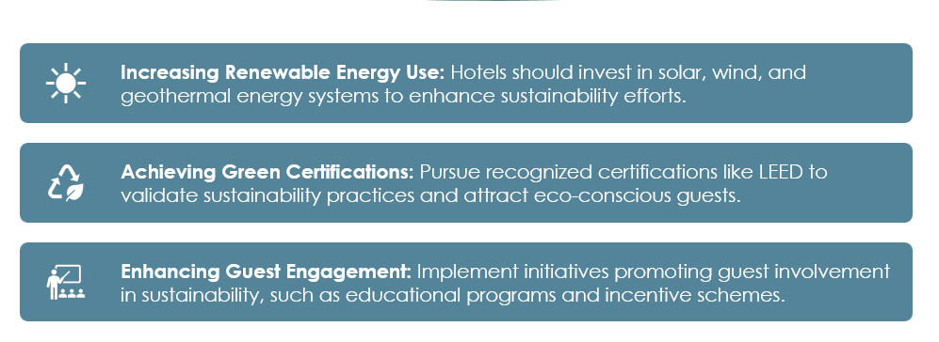
Future Recommendations
Smith & Brown (2023)

Slide 14

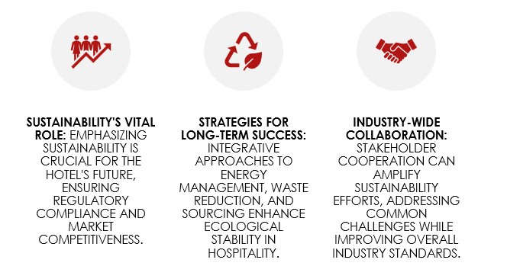
Conclusion

Slide 15
References:
Davis, M., Green, L. & Anderson, P. (2022) Sustainable Food Practices in Hospitality. London: Routledge.
Evans, J. & Morgan, R. (2024) Corporate Social Responsibility in Tourism and Hospitality. Oxford: Oxford University Press.
Greenly (n.d.) Carbon Footprint. [Online]. Available at: https://greenly.earth/en-gb/carbon-footprint [Accessed: 24 February 2025].
Hilton (2020) Hilton LightStay: Driving Sustainability and Corporate Responsibility. Available at: https://esg.hilton.com [Accessed 07 Feb 2025].
Hilton (2024) Sustainability Report. Available at: https://esg.hilton.com [Accessed 07 Feb 2025].
Jones, P. & Comfort, D. (2020) ‘The circular economy and the hospitality and tourism industry’, International Journal of Contemporary Hospitality Management, 32(3), pp. 901-918.
Marriott International (2024) Marriott’s Sustainability and Social Impact. Available at: https://serve360.marriott.com [Accessed 07 Feb 2025].
Mousavi, S. S., Rahimi, R. & Okumus, F. (2017) ‘Energy management in hotels: A case study approach’, Journal of Hospitality and Tourism Research, 41(4), pp. 471-489.
Parker, S. (2023) Green Certifications and the Future of Hospitality. Cambridge: Cambridge University Press.
Pereira, R., Teixeira, J. & Silva, F. (2014) ‘Solar energy solutions for hotels: Case studies and recommendations’, Renewable Energy in Tourism, 18(2), pp. 99-112.
Robinson, A. & Patel, K. (2024) ‘Water conservation in hotels: A review of best practices’, Sustainable Tourism Journal, 9(1), pp. 47-62.
Robinson, A., Evans, J. & Morgan, R. (2024) ‘The role of smart technology in sustainable hotel management’, Hospitality Technology Review, 7(2), pp. 121-139.
Sharma, V. (2023) ‘Weak vs. strong sustainability: Examining the contradictions in the hospitality sector’, International Journal of Hospitality and Tourism Sustainability, 11(3), pp. 98-114.
Smith, J. & Brown, P. (2023) ‘Energy efficiency and smart technology in hotels’, Hospitality and Environment Review, 15(2), pp. 62-78.
Tanveer, M.I., Yusliza, M.Y. & Fawehinmi, O. (2024) ‘Green HRM and hospitality industry: Challenges and barriers in adopting environmentally friendly practices’, Journal of Hospitality and Tourism Insights, 8(1), pp. 20-38.
Thompson, C. (2023) Sustainable Water Management in Tourism. London: Palgrave Macmillan.
Travel and Tour World (n.d.) Discover Marriott's sustainability journey in the new Serve 360 report [Online]. Available at: https://www.travelandtourworld.com/news/article/discover-marriotts-sustainability-journey-in-the-new-serve-360-report/ (Accessed: 24 February 2025).
TripAdvisor (2024) the-beautyful-icelandic [photograph]. Available at: https://dynamic-media-cdn.tripadvisor.com/media/photo-o/1d/75/9c/c7/the-beautyful-icelandic.jpg (Accessed: 24 February 2025).
UK Hospitality (2023) Environmental Sustainability Commitment – UK Hospitality. Available at: https://www.ukhospitality.org.uk [Accessed 09 Feb 2025].
Williams, D. (2024) Renewable Energy in Hospitality: Trends and Challenges. Oxford: Wiley.

