Slide 1


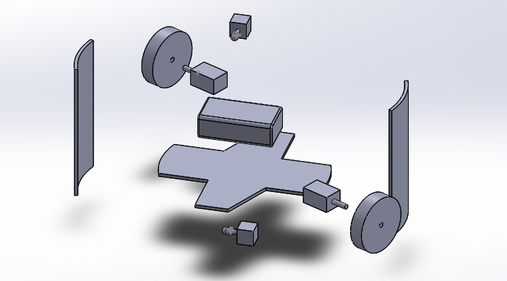
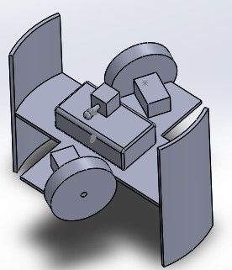



Pipe Crawler Final Design Proposal
Group C – Aidan.C, Ewan.C, Kyle.C, Raoul.C
School of Engineering
UWTSD
Figure 2 : Deconstructed view of final design proposal
The Brief
The brief was given to our group , to design and build a mechanical machine capable of climbing a 105mm diameter pipe. Not only this but it must also be capable of a controlled descent, and carry an increasing load.
The Specification
Throughout the design process, our group has stuck to a self made specification, prioritising everything that we believed would make our pipe crawler successful.
Table 1 : A design specification produced by our group.
Design Proposal
Our final design proposal:
Figure 1 : A constructed design proposal using SolidWorks.
The final design is a joint contribution from all member of the team and features a minimal amount of parts:
1 x ‘x’ style chassis
2 x Stabilising arms
2 x 160rpm Motors
2 x tough-hub rubber wheels
2 x on-on switches
1 x 9V battery
1 x aluminium hook
The design was chosen for its easy manufacturing processes, and is made from lightweight materials, thus allowing the design the room to perform with the increasing load as intended.
Material Choices:
Reason for material choice:
Polycarbonate
Extremely good strength:weight ratio.
The material is very workable, allowing for easy manufacture.
Tough-hub wheels
Lightweight.
Rubberized outer edge providing extra grip.
Motors
Small, but high power output.
Torque and RPM more than effective with the lightweight design.
The Team
In alphabetical order;
Aidan Chapman
Team Role: Team Leader and design integrator.
Ewan Carter
Team Role: Electronics and components.
Kyle Cummings
Team Role: Materials, costing and video editor.
Raoul Chappell
Team Role: SolidWorks designer.
Design point | Details | Priority (in order 1-5 | Does the final proposal conform?
Weight | The design should be as lightweight as possible to allow for the motor to propel the increasing load. | 1 | Yes. The prototype does conform, as the design is small and lightweight, with minimal resources being used.
Size | The design must fit inside a tube of 105mm diameter, with enough grip to hold inside. | 5 | Yes. The design fits perfectly inside the tube, with plenty of traction from the tyres.
Motors | The motors must have enough power to carry the design and the increasing load up the pipe. | 4 | The Crawler has successfully managed to carry itself up the tube in testing.
Materials | The design must not exceed the £25 budget, however the materials must of suitable quality for the project | 3 | All materials and parts ordered have behaved as expected, and the design came in significantly under budget
Traction | The wheels must provide enough grip for the crawler to be able to ascend the pipe | 3
School of Engineering

