Slide 1

Business Plan
Business Name:
SpiceFusion Fast Food
Student:
Petar Artyuhov
Student ID: 2123090
Lecturer Name:
David Jenkins

Slide 2
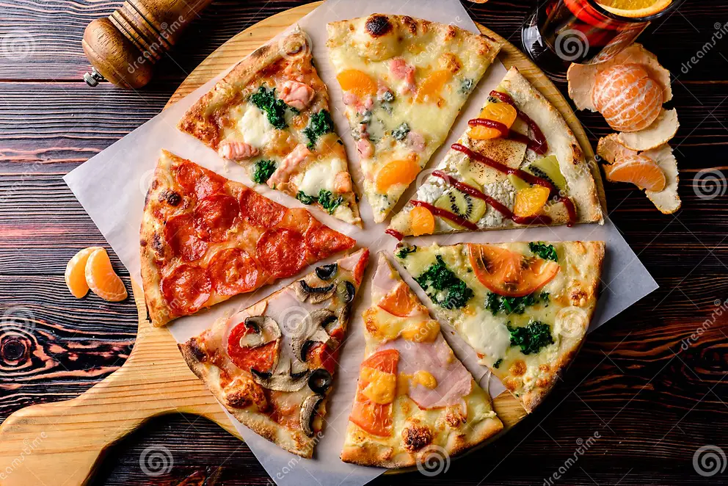
Business Idea
A start-up business is referred to as a newly introduced business that is typically placed in the early stages of development. New venture creation pursues innovative ideas that allow it to connect with high potential.¹
SpiceFusion – innovative UK-based fast food chain focused on take away and delivery of fusion pizzas made by combining spices and ingredients from different countries and regions, for example:
Thai-Mexican
Italian-Indian
Vietnamese-French
- Any other combination that the client likes
Source:
www.dreamstime.com

Slide 3
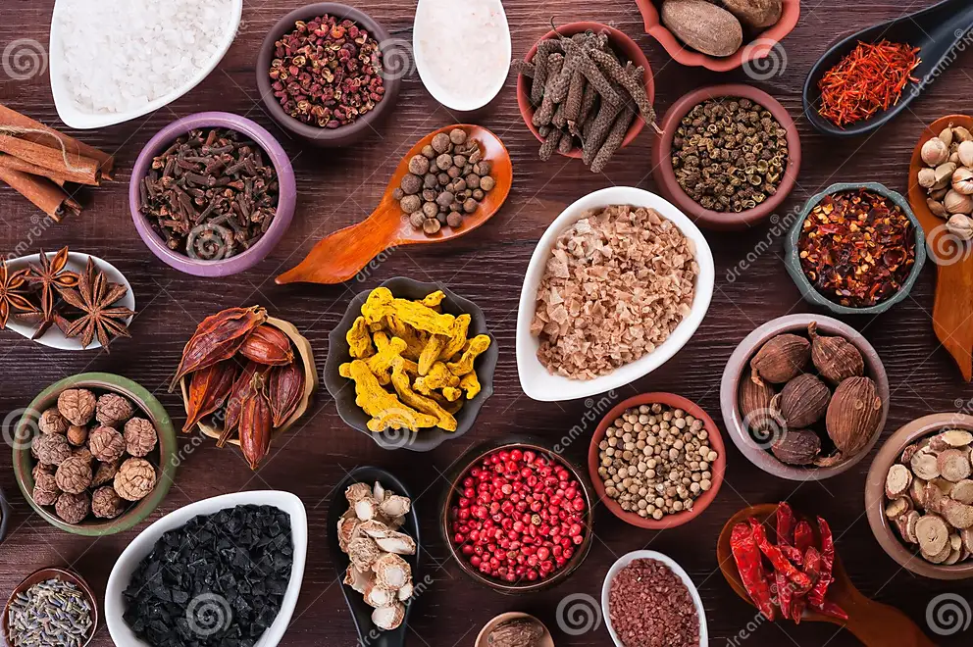
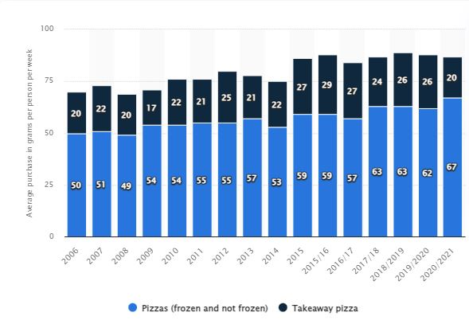
Business Idea (Cont’d)
Company features:
Use of tandoori chicken and Indian spices on pizza
Use of sushi rice, herbal sauces, tacos
Huge variety of toppings and seasonings
App-based orders
Source:
www.dreamstime.com
As per the report (Wunsch, 2023) of 2020/2021, an average of 88 grams of pizza is consumed per person per week in the UK. ²
Figure 1: Average rate of purchase of pizza per person per week in the UK. (Source: Wunsch, 2023)

Slide 4
Legal Format
Table 1: Advantages and disadvantages
(Source: Self-created)
Legal structures | Advantages | Disadvantages
Private company | Separate legal entity Control over ownership | Limited access to capital Difficulty in attracting talents
Limited liability partnership | Flexibility of income decision | No perpetual existence
Sole proprietorship | Owns all profits Start-up cost is low Privacy level is maximum | May be unable to retain high-calibre employees
SpiceFusion will use the sole proprietorship format because it is simple and with low start-up cost.
As opined by Khurana et al. (2020) the sole proprietorship is one of the simple legal formats of business where an individual is responsible for all aspects.³
Table 1: Advantages and disadvantages
(Source: Self-created)

Slide 5
Company management
SpiceFusion will operate with a centralised management structure.
Staff requirement: 10-12 employees kitchen staff
Owner responsibilities:
  Develop a strategic plan
  Source raw material
  Menu selection
  Financial management
  Online + offline marketing
  HR management
In words of Hrabal et al. (2021), a centralised management structure indicates the owner has complete control over staff and others to manipulate business activities to reach high level of competence.⁴

Slide 6
Usp and reasons for starting business
SpiceFusion Unique Selling Point:
Innovative pizza design with fusion of international flavours at a great price
Reasons for starting business:
Financial independence
Business niche opportunity
Get knowledge and experience in running a business

Slide 7
Investment required
Initial investment required: 25000£
Start-up Costs:
6-month property rental: 3600£ (600£/month)
3-months salary for 3 people: 10800£ (1200£/month/person)
6-month Administrative Costs (Legal & Accounting): 600£
3-months Products buying: 3000£
6-months Marketing: 2400£
Cash & other expenses: 4600£
Total: 25000£

Slide 8
competition
Positioning
Product:
Indian Pizza Fusion, Thai-Mexican Fusion, Italian-Indian Fusion, Vietnamese-French Fusion
Price:
Affordable pricing strategy
Place:
Online platforms, own app, website, social networks
Promotion:
Youtube, Facebook, Instagram
High quality
Just
Eat
SpiceFusion
Food Hub
High price
Low price
Eat Clean Me
Low quality

Slide 9
THANK YOU!
☺
Any questions?

Slide 10
Reference list:
1. Hrabal, M., Tuček, D., Molnár, V. and Fedorko, G., 2021. The human factor in business process management: modelling competencies of BPM roles. Business Process Management Journal, 27(1), pp.275-305.
2. Khurana, I., Krichevskiy, D., Dempster, G. and Stimpson, S., 2020. Institutions, entrepreneurial adaptation, and the legal form of the organisation. Journal of Entrepreneurship and Public Policy, 10(2), pp.261-283
3. Taylor, D., King, R., and Smith, D., 2019, Management controls, heterarchy, and innovation: a case study of a start-up company., Accounting, Auditing & Accountability Journal, 32(6), pp. 1636 – 1661
4. Wunsch, N.-G. (2023) Pizza: Weekly consumption in the UK 2020/2021, Statista
Available at:
https://www.statista.com/statistics/284481/weekly-household-consumption-of-pizza-in-the-united-kingdom-uk/ (Accessed: July 13th 2023).

