Slide 1


Slide 2

Financial Performance Management
Managing Human Resources

Slide 3
Overview
Human resources and accounting
The cost of labour
Relevant cost of labour

Slide 4
Human resources and accounting
It is through human resources that the production of goods and services takes place
‘personnel management is essentially about the management of people in a way that improves organizational effectiveness’
  Armstrong (1995)
Notes:
Resource = people
Need to maximise the return on resource

Slide 5
Labour & accounting
In accounting terms, people are treated as labour: a resource that is consumed – therefore an expense rather than an asset - either directly in producing goods or services, or indirectly as a business overhead
Businesses value human resources but do not value them for accounting purposes
Notes:
Value of human resources:
Recruitment
Training
Knowledge / skills
Experience (the application of knowledge and skills)
Motivation
Loyalty
Contacts e.g. sales contacts, customers, good relations with suppliers, etc.
None of these assets/values are recognised in the financial statements (except as a cost in the P&L salaries/wages)
They should be long term assets??

Slide 6
Labour & accounting
A longer term view may include recruitment and training costs
Labour is traditionally a variable cost
Arguments for labour to be an fixed cost:
Recruitment costs,
Training up
Ongoing training / CPE
Employment rights
Long term contracts
Notes:
As a variable cost, will be part of the costing of production/provision of services…..
But they tend to stay > 1 year (compare to Fixed Assets)

Slide 7
Cost of labour
Cost per unit of production:
  Salary + oncost = total employment cost
  Divided by productive time = labour cost per hour
  or:
  Divided by production = labour cost per unit of production
Notes:
Oncost = non salary costs e.g. NIC, Pensions, health insurance, taxes.
Be aware of less-visible costs e.g. annual leave, sick leave, equipment downtimes, etc.----non-productive time.

Slide 8
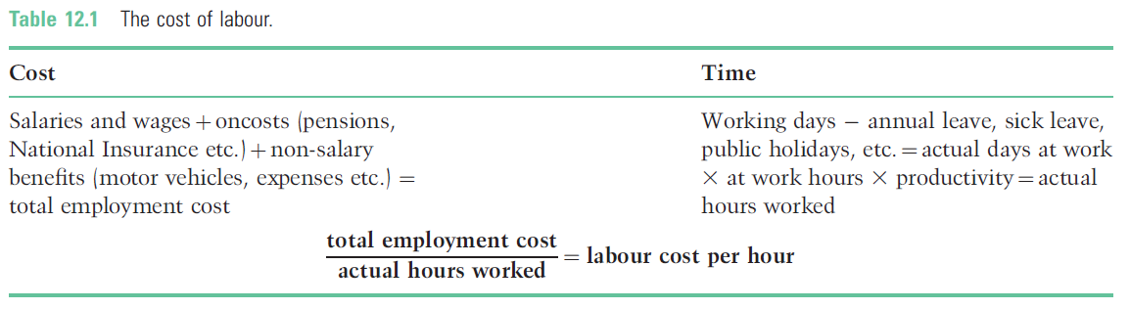
Cost of labour

Slide 9
Illustration: cost of labour
Total employment cost per
working day = £39,700/227
= £174.89 per day
If employee works 8 hours and is 80% productive the cost per hour worked is £27.33
(£174.89/(8x80%))
Notes:
These are the costs to the business.

Slide 10
Relevant cost of labour
Full capacity: the relevant cost could be the additional labour costs (e.g. casual labour or overtime) which may have to be incurred, or the opportunity cost following from the inability to sell product/ services or the cost of diverting labour from alternative work
Spare capacity: if there is surplus labour which will be paid whether a particular decision is taken or not, the labour cost is irrelevant to the decision

Slide 11
Relevant cost of labour
Notes:
Page 232 example.
Hours Hourly labour cost
Partners 120 £60
Managers 350 £45
Support 150 £20
The accounting system would record the costs of the project as £25,950
The relevant costs are £38,000 ignores Partners time as they would be idle if project not taken, however must include the lost revenue from an opportunity turned away if project is done instead.

Slide 12
Redundancy and its alternatives
One of the first business responses to a downturn in profits is to make staff redundant.
Although the redundancy payments will be recognised as a business cost, there is a substantial social cost, not reflected in the financial reports of a business.
These social costs will be borne by the redundant employee, while the financial burden of unemployment benefits may be borne by the taxpayer.
This short-term concern with reducing labour cost often ignores the long term investment in skills and the potential for cost improvement that can arise from a better understanding of business processes
Notes:
The alternatives are to understand and improve the costs, and invest in retaining valuable staff for the longer term benefit of the company.
Social benefits too.

Slide 13
Key points
Labour costs and their accounting treatment
Cost of labour
  Cost per hour, cost per unit of production
Relevant costs
Labour as a long term investment; costs borne by the organization or society

Slide 14

Summary
Take 5 minutes to reflect upon today’s presentation – what have you learnt?
Any key areas you want to research further?
What can help you with in your life?
What can help you in your career?
Engage with your tutor on the topics

