Slide 1
Health and Wellbeing – Outdoor PA / Exercise
SHSS5070
Week 6
Alison Connaughton

Slide 2
Definitions of Health…
The term health is generally taken to incorporate physical health, mental or emotional health, social health, spiritual health, lifestyle and functionality (Pretty and Pencheon, 2016).
WHO health definition (1948)…still widely cited and accepted:
‘health is a state of complete physical, mental and social (individual) well-being, and not merely the absence of disease or infirmity’.

Slide 3
Well-being is…
A positive physical, social and mental state; it is not just the absence of pain, discomfort and incapacity.
Requires that basic needs are met, that individuals have a sense of purpose, that they feel able to achieve important personal goals and participate in society.
  Pencheon (2012); ONS (2013)
SDT – basic needs theory
  Competence
  Autonomy
  Relatedness

Slide 4
Fundamental Principles for health
Health is a fundamental right for all people, communities and environments.
Health is multi-dimensional and interconnected.
To achieve health means much more than people having access to medical health services and making healthy lifestyle choices.
Health status is determined just as much by social, economic and environmental factors as by individual health and lifestyle choices and medical advances.
However…..

Slide 5
Inequalities in Health
When it comes to achieving health, some people and communities are disadvantaged due to inequitable access to the resources and conditions that promote health.
Opportunities for the health of people and communities at local, national and global levels are distributed unequally according to factors such as:
  the socio-economic status (income, education, occupation)
  social support structures
  the degree of control, power and autonomy
  age
  gender
  geography
  culture and language
  What do we mean by this?

Slide 6
Well-being in modern societies (Pretty & Pencheon, 2016)
Ancient Greeks – associated healing and wellbeing with being away from settlements.
Healing temples on hilltops – light, water, wind and aromatics from pine forests.
Assumed that well-being emerged from natural places (Hart, 1965; Gesler, 1993; Koenig, 2000)
Now recognised that natural and social contexts of individuals is a key determinant of well being.
  Protection from stressors and improving resilience and recovery (Sternberg, 2009)

Slide 7
Advances in health care and treatment…
Mortality rates fallen / average lifespans are extending.
Mean life expectancy worldwide has risen from 56.0 – 70.4 years (since the 1960’s) Unicef (2012)
New wave of health and well-being problems in modern societies has emerged.
  Changing lifestyles and the environments that shape these (CMO, 2013)
Affluence does not necessarily link to increased well-being
Q. What are the issues associated with affluent societies?

Slide 8
Issues
(Hossain et al., 2007; Pretty et al., 2015)
High levels of material consumption
Abundant food and calories
Lower incidence of PA
Shifting demographic – increased elderly population (support implications?)
Fractured community and family structures
Growing inequality (food banks as the norm)
Fewer pro-social behaviours
Unchanged levels of average life satisfaction

Slide 9
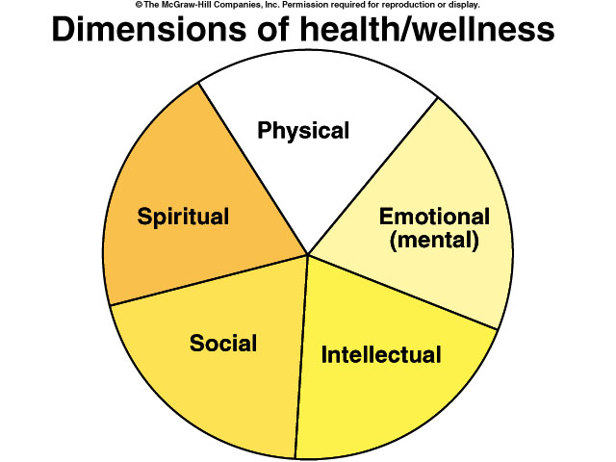
Health and Wellness are
Multi-Dimensional
Wellness is the positive component of good health
Health and Wellness include multiple dimensions or components
Notes:
5
Wellness is multidimensional. Being fit is not enough to be well.

Slide 10
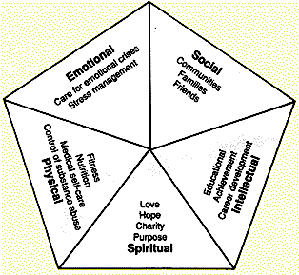
5 Dimensions of health

Slide 11
The Dimensions of Health and Wellness
-
+
Depressed
Emotional-Mental
Happy
Ignorant
Intellectual
Informed
Physical
Fit
Unfit
Lonely
Social
Involved
Unfulfilled
Spiritual
Fulfilled
Negative
Total Outlook
Positive
Notes:
8
This chart examines each of the dimensions in greater detail.
On the emotional scale a person can be either happy or depressed. On the intellectual scale a person can be informed or ignorant. On the physical scale a person could be fit or unfit, on the social scale a person could be involved or lonely and on the spiritual scale a person could be fulfilled or unfulfilled.
Outlook in life can have a major influence on quality of life. People who are “well” typically have a positive outlook on life.

Slide 12
Healthy People
a dynamic and sustainable state of physical, intellectual, social, emotional, and ethical well-being.
each person is multi-dimensional and each dimension contributes to the total health of the whole person.
levels of well-being in each dimension are interdependent, constantly changing and interacting

Slide 13
Treatment vs. Promotion
Wellness
Health
Promotion
Disease
Prevention
Disease
Disease/Illness
Treatment
Notes:
6
This figure contrasts disease treatment w/ health promotion.
The typical medical model is oriented towards disease treatment. People get sick and then go to the doctor. A step better than this is to prevent disease before it occurs. Better still is the Wellness philosophy which is based on health promotion. By adopting positive health behaviors there is a reduced chance of becoming ill and requiring treatment.
A shocking statistic is that our government currently spends 97% of our health care expenses are spent on treatment and prevention. Only 3% for health promotion. (an analogy is not getting the oil changed in your car and then spending money on a new engine).

Slide 14
Healthy Natural Environments
a dynamic and sustainable state of ecological well-being.
natural environments are made up of various elements, systems and processes, all of which are interdependent, changing and interacting.

Slide 15
Health in the Outdoors
The physical health of the individual
The social-emotional health of the individual
The intellectual-spiritual health of
the individual.
The physical health of the community
The social-emotional health of the community
The intellectual-cultural-ethical health of the community
The bio-ecological health of the natural environment
The physical health of the natural environment

Slide 16

Physical Activity
Physical activity impacts health, wellness and fitness
Notes:
2
Physical Activity impacts health, wellness and fitness.

Slide 17
Task: Physiological and Psychological Benefits of Physical Activity
As applied to the outdoors…
E.g. Pretty & Barton (2010) found that getting outside and moving for as little as 5 minutes at a time improved both mood and self esteem…(meta analysis of 10 studies).
In general
  Physical benefits
  Psychological benefits

