Slide 1
Preparing for Success in HE (BMHP4028)
Presentation:
Activity

Slide 2
In this session we will…..
Explore:
The key features of Job Ads.
Allow time for:
Group work on your group task

Slide 3
Group Task
Task
In your allocated group, you will work together to:
Choose a specific job role,
Design a job advertisement for the job role.
Include all the key information required.
Present your job ad as either a poster, presentation or video.
Share your finished job ad with your peers and receive feedback. (during week 8 session)
Provide feedback on the job ads created by other groups. (during week 8 session)
Notes:
Explain to students that this is a compulsory task that will allow them to collect feedback that is required for the Task 3- Reflective report.
Allocate groups. Lecturers to have autonomy over group sizes and organisation.

Slide 4
Work as a team to decide which job role you will design a job ad for.
Notes:
Allow groups to spend some time decide which job role they will design an ad for.

Slide 5
Key Features of Job Ad
Employer Name
Job title
Description of the role.
Details of qualifications and skills required,
Information relating to benefits and pay.
Application deadline.
Notes:
Run through the key features of a typical job advertisement – explain that some ads will contain extensive information and others will contain very brief details. As a group, students will need to decide how much detail to include. Signpost students to the job websites that were visited during last week’s lecture for ideas. Explain that the job ad produced by the group must not be copied and pasted from an existing job advertisement.

Slide 6


Presenting your work to your peers
In week 8 each group will present their finished job ad to their peers.
Each group must also explain:
  Why you chose the job you did.
  Where you found the relevant info
  How you worked together.
Your finished work
Notes:
Explain to students that the job ad needs to be created during the allocated time of the week 7 lecture, avoid allow students to leave early without sharing evidence of their work. The week 8 presentation of their work, can be done as a verbal explanation without any additional visual input or groups can make a short presentation on ppt or flip chart paper – all group members should speak during the presentation of their work. These brief presentations in week 8 will probably last 5mins max for each group.

Slide 7
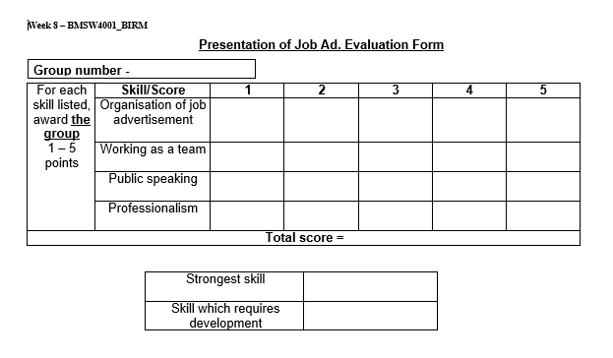
The evaluation form
Each group will be evaluated by their peers, this is vital feedback for you to develop your reflective report.
Notes:
Explain that this evaluation form will be used in week 8 by the groups to evaluate each of the job ad/presentation produced. Highlight that the ‘Skills which requires development’ will be needed in your Task 2 – Reflective report, as it needs to be incorporated into their PDP – Restrict to one evaluation form per group, for example, Group 1 should get 1 form from group 2, 1 from group 3, and 1 from group 4.

Slide 8
Group work
The remainder of the session will be focused on working as a group to prepare your Job Ad.
Notes:
Each group should design a job ad and practice how they will present it to the rest of the class in next weeks session.
Remind students that groups can present their job ad as either a poster, presentation or video. – Encourage creativity ☺

Slide 9

Next session…..
Group Presentations
Notes:
Explain that each group with present their job ads to the rest of the class.

