Slide 1
Module Name : Signals and System
Module Code : ACDA4009
Topic : Exercise - Signals
Lecture : 6
Lecture By,
Mrs. Jenifer Prince Devaraj,
Lecturer - Embedded Electronics,
Faculty of Applied Computing,
UWTSD
Email:j.prince-devaraj@uwtsd.ac.uk

Slide 2
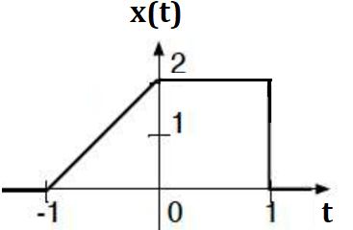
Exercise - Signals
Exercise 1
Find the Odd and Even Signals for the Plot given below
ACDA4009 – Signals and System

Slide 3
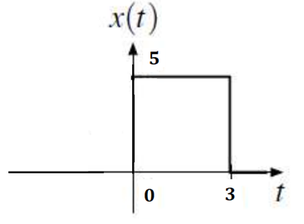
Exercise - Signals
Exercise 2
Calculate the Energy of the signal for the plot given below.
ACDA4009 – Signals and System

Slide 4
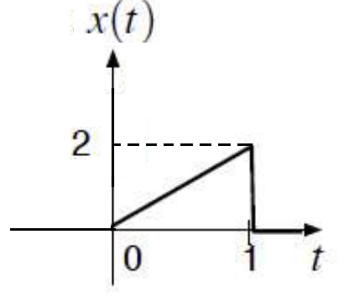
Exercise - Signals
Exercise 3
Calculate the Energy of the signal for the plot given below.
ACDA4009 – Signals and System

Slide 5
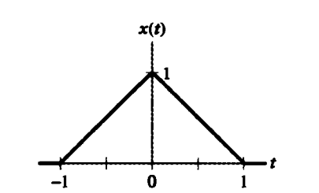
Exercise - Signals
Exercise 4
For the triangular pulse x(t) shown below, sketch the time scaling for each of the following derived from x(t)
x(2t)
x(2t+1)
x(2t)+x(2t+1)
ACDA4009 – Signals and System

Slide 6
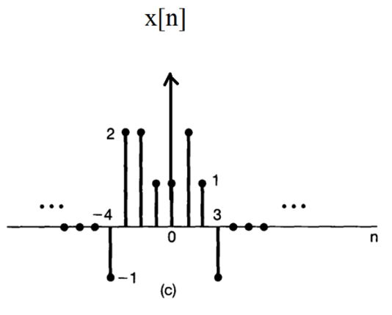
Exercise - Signals
Exercise 5
ACDA4009 – Signals and System

Slide 7
Thank You

