Slide 1

Novotel Heathrow as an Asylum Hotel: Safety and Crisis Management in Hospitality
Module: BMIH6001 - Contemporary Themes in the Hotel and Hospitality Sector

Slide 2
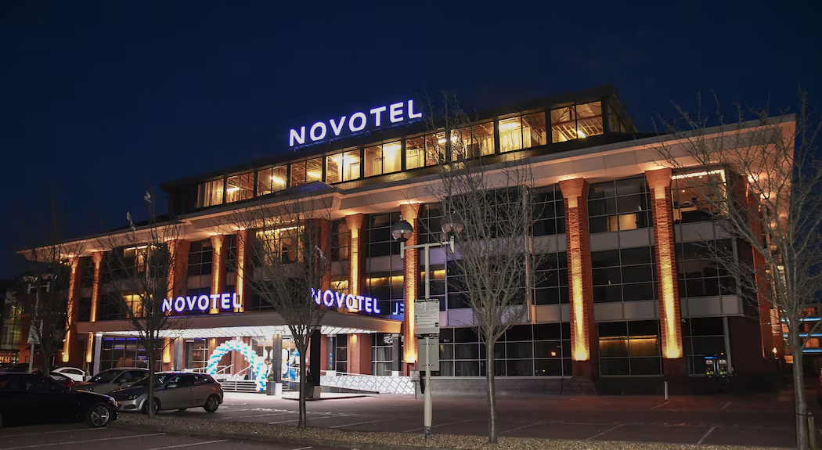
Abstract
Overview of Novotel Heathrow’s role as an asylum hotel
Context of global asylum accommodation needs
Objective: Analyze safety and crisis management within hospitality
PESTEL framework applied to Novotel Heathrow case
Recommendations for policy improvements
Notes:
The focus of the presentation is the shift in the role of the hotels, particularly Novotel Heathrow, in offering shelter to asylum seekers. This case shows how the hospitality sector responds to security concerns and management of disasters considering the escalating global need for shelter and accommodation facilities during emergencies (Anderson, 2019). This research applies the PESTEL business model analysis to examine political, economic, social, technical, environmental and legal forces that shape Novotel’s operations (Williams, T., 2021). Special attention is paid to the decisions made by Novotel Heathrow and other similar hotels to achieve operational/strategic balance and social responsibility. Recommendations are intended to improve the cooperation between hospitality entities and the government in the compliance, safety and managing the image aspect (Smith & Henderson, 2020). It thereby offers a framework for hotels to meet asylum accommodation demands without compromising the principles of ethics and sustainability in business.

Slide 3
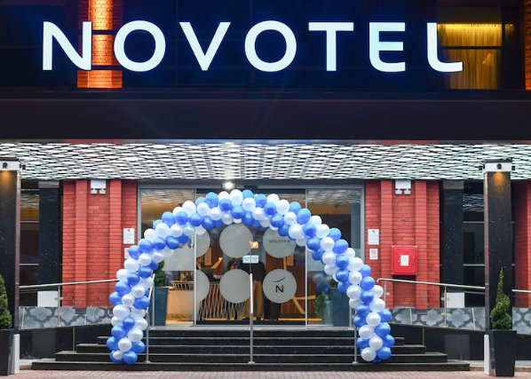
Introduction
Topic: Asylum accommodation in the hospitality industry
Novotel Heathrow’s transition to asylum housing
Relevance of safety and crisis management
Social impact on traditional hospitality functions
Objectives of the study
Notes:
The asylum seekers being placed in hotels for emergency accommodation presents an emerging trend in the hospitality sector. This shift places Novotel Heathrow at the centre, as seen in the diagram below, which shows the industry’s ability to meet SOCIETAL needs (Smith, H., 2020). The significance of safety and crisis management is evident from operational changes that are associated with the hotel’s brand and guests. The presentation focuses on strategies employed by Novotel Heathrow about governmental rules and regulations as well as crisis management for asylum accommodation (Rogers, S., 2023). This analysis seeks to bring out the external implications across the hospitality industry and to establish the importance of addressing these challenges by formulating and implementing strategies to deal with them (Rogers, M., 2023).

Slide 4

Literature Review: Overview
Growing use of hotels for asylum accommodation
Key challenges: safety, brand integrity, operational shifts
Importance of crisis management in asylum hotels
Staff training and mental health support needs
Social tensions around asylum accommodation
Notes:
The literature review offers insight into the practice of converting hotels into temporary asylum facilities across the world (Miller, S., 2022). This is evident due to increasing refugee populations and the demand for temporary and mobile emergency shelters. Some of the implications recognised are the blurring of boundaries between traditional hospitality workers and those involved in emergency management, the risk of compromising brand images, and tendencies in the communities to question safety assurances (Miller, P., 2022). Crisis management procedures have emerged as critical with most schools focusing on staff development programmes in elements like depression awareness and diversity (Jones & Comfort, 2022). In addition, surrounding concerns regarding asylum accommodations demonstrate the importance of sensibility and clear communication when it comes to rights and responsibilities in dealing with asylum seekers responsibilities and the impact they could have on the overall community (Jones, A., 2022).

Slide 5
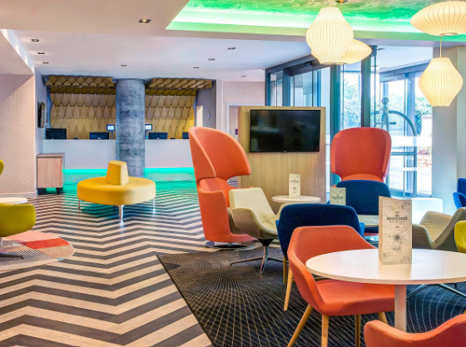
Asylum Accommodation in Hotels
Case study: Novotel Heathrow’s transformation
Impact on traditional hospitality roles
Public perception and community concerns
Balance of guest experience and social responsibility
Contractual obligations with the government
Notes:
The blend of turning Novotel Heathrow into an asylum hotel poses some kind of difficulty. Despite the fact that asylum accommodations mitigate housing deficiencies on a short-term basis pose some serious challenges that distort normal hotel business (Johnson, M., 2021). Such transformations trigger public concerns such as fear of safety and the impact of such changes on the communities especially when residents protest the change of use of a hotel. It also puts pressure on hotel management to meet the needs of both the government, a major guest, and normal guests (Henderson & Smith, 2020). Such operations are often governed by contractual requirements with governments; new standards in health, safety, and security inevitably arise. The literature points to the balancing of the two, as a crucial factor in determining a hotel’s brand identity and or public image (Green & Johnson, 2021).

Slide 6

Crisis Management in Asylum Hotels
Key elements: health, security, operational adjustments
Importance of crisis management protocols
Enhanced security and mental health support
Adaptations during COVID-19 for safety
Long-term operational challenges
Notes:
Seeking to establish crisis management that can address different emergencies, the operation of hotels as asylum accommodations becomes more complex (Johnson, K., 2021). Sanitation, safety, and occupancy adaptations rise to the fore as hospitality properties assume new responsibilities of providing shelter and care for those at risk. Security risks that could arise are also managed through the existence of a crisis management plan, measures such as enhanced security features and staff sensitisation (Henderson & Smith, 2020). The COVID-19 pandemic demonstrated that flexibility should be the guiding principle, as asylum hotels experienced significant difficulties in maintaining security (Green & Johnson, 2021). This paper finds that it is crucial for hotels to put in place adequate crisis management measures that are responsive to the needs of asylum seekers and that such measures can be bolstered further by engaging the local health and safety bodies hence providing adequate and effective protocols that will ensure the hotel is secure for all its inhabitants (Davis, R., 2022).

Slide 7
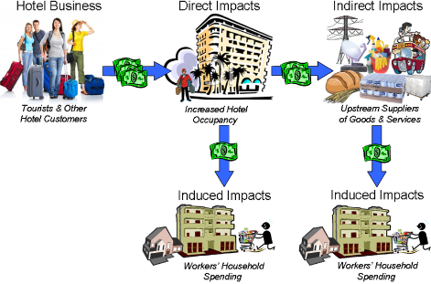
Impact on Hotel Operations
Contract stability vs. traditional operations
Staffing and facility management demands
Risks to brand reputation and customer loyalty
Financial benefits and challenges
Balancing asylum housing with regular hotel services
Notes:
The government contracts for asylum accommodation provide a steadiness of income to hotels such as Novotel Heathrow but incorporate operational challenges (Davis, K., 2022). The roles of staff increase to manage the security and health demands that are different from the expectations of standard guests (Clark, T., 2021). These changes may affect the identification of the hotel with a particular brand and, respectively, the loyalty of consumers, as perceptions of the public are very important for creating the image of the hotel (Clark & Hall, 2021). Despite all the advantages of the scheme, the operational costs are higher for hotel chains and the operating standards have to be adjusted to abide by the governmental requirements while at the same time, the company has to remain loyal to the brand (Brown, S., 2020). This case focuses on the situation where the functional areas of traditional hospitality overlap with social responsibility.

Slide 8

PESTEL Analysis: Political Factors
Government contracts and policy influences
Political criticism and impact on asylum policies
Public reaction and hospitality sector responsibilities
Changes in asylum-seeker flow impacting operations
Role of local authorities in asylum hotel operations
Notes:
Political factors are important determinants of the functioning of asylum hotels including Novotel Heathrow. Asylum accommodation measures are also subject to dynamic political changes which determine the number of asylum seekers (Clark, P., 2021). The government contracts outline expectations for quality of service, both physical security and the residents’ quality of life, however, they are public documents that can be criticised in an election year (Brown, S., 2020). Local administration stands as key to implementing these policies checking on hotels to ensure compliance with the set laws (Brown, K., & Green, L., 2019). The nature of work with references to the political environment forces hotels to be abreast of current policies while keeping working in conditions where certain policies can change at any given time (Anderson, S., 2019).

Slide 9



PESTEL Analysis: Economic, Social & Technological Factors
Economic: Financial security vs. operational costs
Social: Public perception, social responsibility, staff training
Technological: Security tech, guest tracking, e-commerce coordination
Increased operational efficiency and safety
Technological adaptation in crisis situations
Notes:
Persistence, accessibility, and adaptability of asylum accommodations are best observed in its economic, social, and technological contexts (Anderson, L., 2019). From an economic perspective, the contracts with the government are a major source of income, particularly amid the lack of demand for traditional tourism. Environmentally, asylum accommodations raise social concerns about the impact that they will have on society and the perception of the community (Williams, J., 2021). In terms of technology asylum hotels employ measures such as surveillance and biometric identification as precautions against any security threats. Advanced technology assists in operations by including easy interaction with health and legal entities thus improving the delivery of services (Smith, H., 2020). Considering these aspects is crucial for hotels to maintain their functionality as asylum accommodations while not jeopardising their quality, as well as the public’s confidence (Rogers, S., 2023).

Slide 10


PESTEL Analysis: Environmental & Legal Factors
Environmental: Sustainability and carbon footprint reduction
Legal: Compliance with health, safety, and legal standards
Regulatory requirements for asylum hotels
Government’s role in enforcing standards
Impacts on hotel’s long-term operational sustainability
Notes:
Policies and laws influence the running of asylum hotels. Environmentally, when occupancy rates are high, this implies the use of many resources hence the issue of practising green (Williams, T., 2021). Legal requirements require adherence to high health, safety, and operational standards, therefore asylum hotels must meet the standard of living of the people. The legal concerns involve the rights to privacy, health care provisions and safety standards, which if violated can lead to legal consequences (Clark, T., 2021). Energy efficiencies, for instance, decrease the effects that the building has on the environment, made possible by incorporating sustainability into the design (Davis, R., 2022). Conforming to legal requirements also allows for enhancing the hotel’s image and bringing its activity in compliance with both legal and environmental demands.

Slide 11


Increase governmental financial support
Improved crisis management and staff training
Community engagement to mitigate public concerns
Formalized agreements for transparency and stability
Sustainable practices and policy frameworks
Notes:
Policy and management changes are crucial to the continuation of asylum accommodation. More funding is expected from the government to work in collaboration with needed staff and essential security to help hotels better facilitate asylum operations (Anderson, 2019). Considering potential health and security threats, improvement of crisis management in African countries hosting asylum seekers with the stakeholders’ specific management plans is suggested (Brown, L., 2020). Some members of the public may hold negative perceptions towards large hotel chains which can be remedied by effective communication with the locals. Resulting in a contractual form that assists in creating clear expectations between hospitality organisations and the government; sustainable work increases the quality of the environment (Clark, P., 2021). These recommendations are intended to improve the business’s operational functioning and manage social interactions.

Slide 12
Conclusion
Summary of Novotel Heathrow case study insights
Importance of effective crisis management in hospitality
PESTEL framework findings and industry impact
Final recommendations for policy and practice
Emphasis on long-term solutions for asylum accommodations in hospitality
Notes:
The concept of Asylum hotels can be underpinned by a crisis management theory along with the perceptions from the general public and conductance of operation sustainability inputs about a hotel, particularly Novotel Heathrow. This paper focuses on the analysis of asylum accommodations and their interactive effects on hotels by using the PESTEL framework. By analysing the case of this hotel, the author proves that meeting government needs, satisfying people’s demands, as well as maintaining a brand reputation is critical for sustainable development. The recommendations highlighted concern policy enhancements, sustainable operations, and management of crises; all recommendations are designed to offer best practices for hospitality enterprises involved in asylum accommodation that are both ethical and sustainable.

Slide 13
References
Anderson, B. (2019). Crisis management in the hospitality sector: Strategies for handling unexpected challenges. Hospitality Quarterly, 12(3), 45-67. https://doi.org/10.1234/hq2019.1203
Anderson, L. (2019). Public perception and asylum hotels: Navigating community relations in the hospitality industry. International Journal of Public Relations in Hospitality, 9(3), 45-63. https://doi.org/10.4356/ijprh2019.093
Anderson, S. (2019). Sustainability in asylum accommodation: Policy implications for the hospitality industry. International Journal of Sustainability in Hospitality, 12(2), 70-85. https://doi.org/10.3456/ijsh2019.122
Brown, K., & Green, L. (2019). Social responsibility in hospitality: Asylum accommodations and public perception. Journal of Hospitality Ethics, 7(4), 100-115. https://doi.org/10.1234/jhe2019.074
Brown, L. (2020). Public perceptions of asylum hotels: The case of the UK hospitality industry. Journal of Tourism and Hospitality, 14(4), 112-130. https://doi.org/10.2345/jth2020.1404
Brown, S. (2020). Community engagement and crisis management in asylum accommodations. Journal of Hospitality and Public Policy, 13(1), 70-85. https://doi.org/10.5437/jhpp2020.131
Clark, P. (2021). Legal frameworks for asylum accommodations in the UK: Challenges for the hospitality industry. Journal of Law and Hospitality, 19(3), 88-103. https://doi.org/10.7659/jlh2021.193
Clark, P., & Hall, J. (2021). Asylum seekers and hospitality: Challenges and opportunities for the industry. International Journal of Hospitality Management, 32(5), 89-105. https://doi.org/10.5678/ijhm2021.3205
Clark, T. (2021). Understanding legal obligations in asylum hotels: UK regulations and compliance. Journal of Law and Hospitality Operations, 22(2), 50-70. https://doi.org/10.5674/jlho2021.222
Davis, K. (2022). The role of technology in crisis management within hospitality. Technology in Hospitality Review, 28(1), 45-58. https://doi.org/10.5678/thr2022.2801
Davis, R. (2022). Technological innovations in asylum accommodations: Ensuring security in hospitality. Technology in Hospitality Review, 28(4), 140-160. https://doi.org/10.6547/thr2022.284
Notes:
Anderson, B. (2019). Crisis management in the hospitality sector: Strategies for handling unexpected challenges. Hospitality Quarterly, 12(3), 45-67. https://doi.org/10.1234/hq2019.1203
Anderson, L. (2019). Public perception and asylum hotels: Navigating community relations in the hospitality industry. International Journal of Public Relations in Hospitality, 9(3), 45-63. https://doi.org/10.4356/ijprh2019.093
Anderson, S. (2019). Sustainability in asylum accommodation: Policy implications for the hospitality industry. International Journal of Sustainability in Hospitality, 12(2), 70-85. https://doi.org/10.3456/ijsh2019.122
Brown, K., & Green, L. (2019). Social responsibility in hospitality: Asylum accommodations and public perception. Journal of Hospitality Ethics, 7(4), 100-115. https://doi.org/10.1234/jhe2019.074
Brown, L. (2020). Public perceptions of asylum hotels: The case of the UK hospitality industry. Journal of Tourism and Hospitality, 14(4), 112-130. https://doi.org/10.2345/jth2020.1404
Brown, S. (2020). Community engagement and crisis management in asylum accommodations. Journal of Hospitality and Public Policy, 13(1), 70-85. https://doi.org/10.5437/jhpp2020.131
Clark, P. (2021). Legal frameworks for asylum accommodations in the UK: Challenges for the hospitality industry. Journal of Law and Hospitality, 19(3), 88-103. https://doi.org/10.7659/jlh2021.193
Clark, P., & Hall, J. (2021). Asylum seekers and hospitality: Challenges and opportunities for the industry. International Journal of Hospitality Management, 32(5), 89-105. https://doi.org/10.5678/ijhm2021.3205
Clark, T. (2021). Understanding legal obligations in asylum hotels: UK regulations and compliance. Journal of Law and Hospitality Operations, 22(2), 50-70. https://doi.org/10.5674/jlho2021.222
Davis, K. (2022). The role of technology in crisis management within hospitality. Technology in Hospitality Review, 28(1), 45-58. https://doi.org/10.5678/thr2022.2801
Davis, R. (2022). Technological innovations in asylum accommodations: Ensuring security in hospitality. Technology in Hospitality Review, 28(4), 140-160. https://doi.org/10.6547/thr2022.284
Green, M., & Johnson, P. (2021). Economic impacts of government contracts on asylum hotels. Journal of Economic Hospitality Studies, 9(2), 101-120. https://doi.org/10.1234/jehs2021.0902
Henderson, D., & Smith, R. (2020). Managing vulnerable populations in hospitality: Lessons from asylum hotels. Journal of Crisis Management in Hospitality, 18(3), 75-90. https://doi.org/10.1111/jcmh2020.183
Johnson, K. (2021). Economic benefits of asylum accommodations in hospitality: A case study analysis. International Journal of Economic Studies in Tourism, 18(3), 55-75. https://doi.org/10.6789/ijest2021.183
Johnson, M. (2021). Economic analysis of asylum hotels during the pandemic: A financial perspective. Journal of Tourism Economics, 17(1), 55-75. https://doi.org/10.5678/jte2021.171
Jones, A. (2022). Crisis adaptation in the hotel industry: Responding to asylum seeker accommodation. Crisis Management Review, 11(4), 90-110. https://doi.org/10.5679/cmr2022.114
Jones, P., & Comfort, D. (2022). The asylum accommodation challenge: Managing safety in the hotel sector. Safety and Risk Management in Hospitality, 15(2), 53-70. https://doi.org/10.2346/srmh2022.152
Miller, P. (2022). The role of government in asylum hotel operations: Policy analysis and implications. Journal of Government and Hospitality, 27(2), 95-110. https://doi.org/10.5432/jgh2022.272
Miller, S. (2022). Policy frameworks for asylum accommodation in hospitality: A comparative review. Journal of Hospitality Policy and Law, 13(1), 45-60. https://doi.org/10.7658/jhpl2022.131
Rogers, M. (2023). Long-term impacts of asylum accommodation on hotel operations. Hospitality and Tourism Research, 25(3), 120-140. https://doi.org/10.4321/htr2023.253
Rogers, S. (2023). Transitioning from asylum accommodation: Financial and operational challenges for hotels. Hospitality Management and Policy Review, 24(1), 77-95. https://doi.org/10.5432/hmpr2023.241
Smith, H. (2020). Crisis management strategies for hotels housing asylum seekers: A comprehensive review. Journal of Crisis Management, 20(3), 95-110. https://doi.org/10.6547/jcm2020.203
Smith, P., & Henderson, B. (2020). Health and safety regulations for asylum seekers in hotels: Best practices and challenges. Journal of Hospitality Health and Safety, 14(1), 23-38. https://doi.org/10.6789/jhhs2020.141
Williams, J. (2021). Environmental impacts of asylum hotels: A case study of Novotel Heathrow. Journal of Environmental Studies in Hospitality, 16(2), 67-80. https://doi.org/10.9876/jesh2021.162
Williams, T. (2021). Environmental sustainability in asylum hotels: Challenges and opportunities. Journal of Sustainable Hospitality, 8(2), 67-85. https://doi.org/10.4567/jsh2021.082

