Slide 1

Bmgm 5005- kfc retention of employees

Slide 2
Info list
Introduction
Pestle
Revenue
Enviromental and issues
Swat
Retention
Issues
Comparisons
Trends
Recommendations
Conclusion
Reference list

Slide 3

A impact of kfc its finger lickin interesting

Slide 4
Introduction of Kentucky fried chicken
Kfc was founded on the 20th of march 1930
Kentucky fried chicken is a worldwide establishment that is globally known for fast food KFC (2022).
They have given work to countless people and is near to hundreds of thousands of working employees
Kentucky fried chicken has a vast amount of job roles on offer which adds more fluididty to the jobs people can apply for

Slide 5
Kfc was founded by a man called colonel sanders who started selling fried chicken during the great depression of America and his spice blend became the foundation and slogan of his brand . The brand started to expand drastically through the 1950s and was one of the first ever businesses to go global YUM (2024).
Colonel sanders even after dying has stayed at the epicentre of the brands logo and also having the slogan of its finger licking good from it being one of the first global finger foods it shows that sticking to his beliefs caused his buiness to grow to what it is today

Slide 6
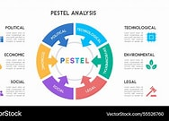
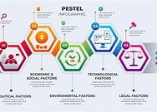
What is pestle

Slide 7

Political factors
Kfc is located in 145 countries this means that they have to be well adjusted to all the different countries polices on food and health standards
Trade and supply chains stability , due to political instability sometimes there are tariffs on things like chicken grains and spices things that are imported can disrupt there supply chain
Coperation taxes are varied in different countriesd aswell which can lead to different pricing in different areas of the world

Slide 8

145 countries
A big part of kfc is the fact it has adapted to so many different cultures
In India for example they use lots of different vegetable dishes which shows adaption for the more vegetarian aspects of Indian culture
In the uk they have many different spice levels compared to usa due to people not wanting to sign a waver out of ego for overbearing slice
China and other Asian culters have rice dishes and soups to cater to them which shows the adaptation to understand diets
This leads to more settlement in culture and localization which helps improve comfartability and also drastically improves sales for there business

Slide 9
Where does kfc get the most revenue ?

Slide 10
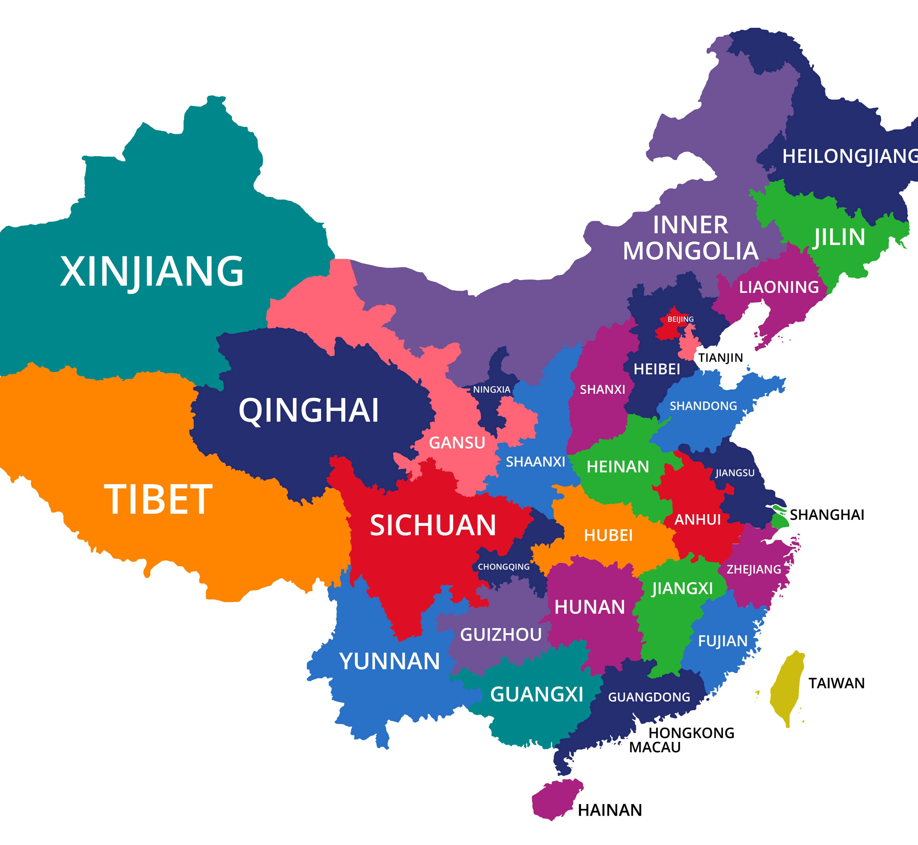
China
China – china brought in a gargantuan 9.5 billion US dollars in 2022 which is more than uk and america for a little insight 9.5 billion dollars is 64,808,050,000 chinese yuan which is astonishing (Kuo, 2013).

Slide 11
Economic factors of kfc
Employment cost this varies as minimum wage and labour laws differentiate globally impacting the brands expenditures
Inflation and ingredients the rising cost of chicken grain and cooking oil significantly affect kfcs profits
Global economic health the economic fluctuations of different countries influence income and demand for fast food as people may get pushed to have more affordable food if they are struggling for money

Slide 12
Social factors of kentucky
Changing of lifestyles drives for more convenience driven work busy work schedules and less time for home cooked meals causes a big demand for fast and easy and this is where kfc starts to blossom as its extremely convenient and benefits from this culture

Slide 13
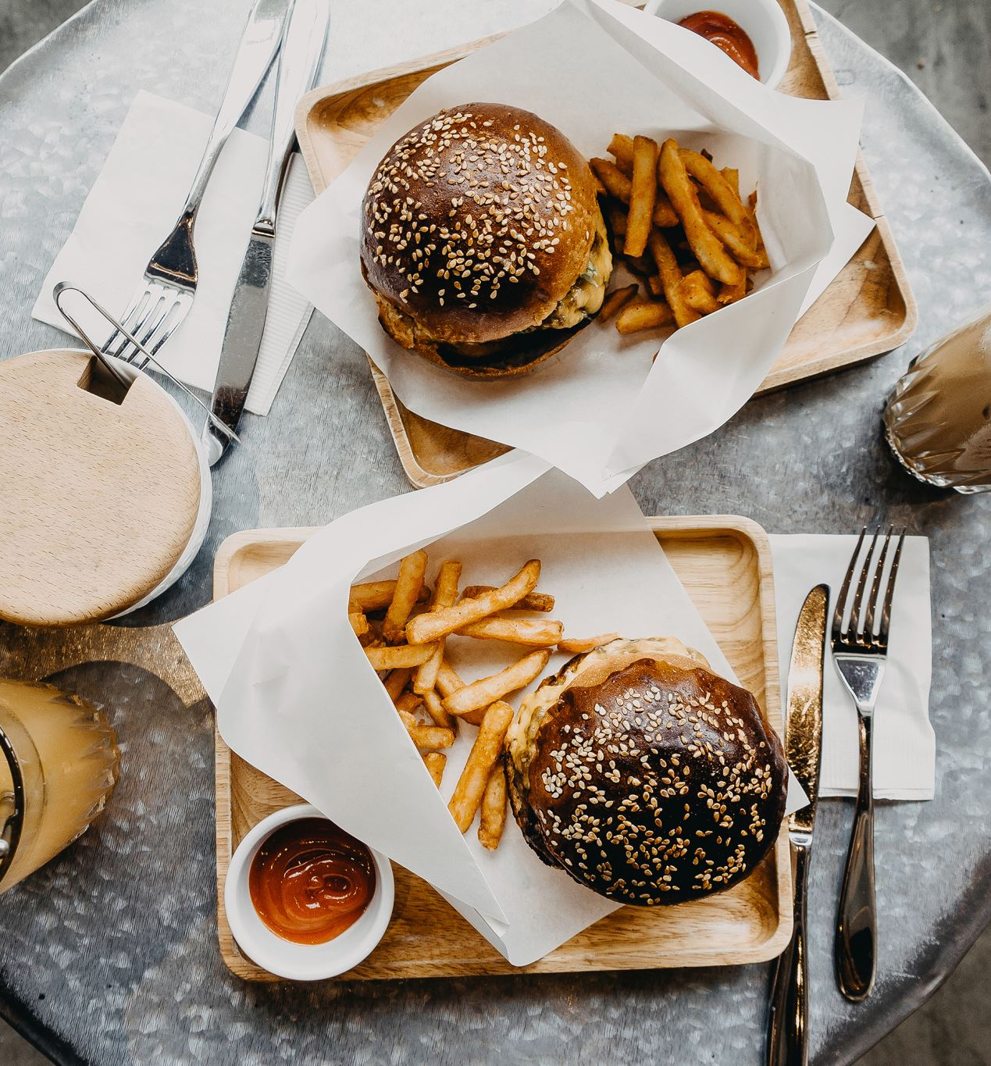
Fast food is usually tied to being easy or social occasions from group meals with families or just young people in general as late night culture is very benevolent in generation z as it is affordable to younger people or lower income adults and is kept to a certain standard (Frue, 2019).

Slide 14
What does on the go culture bring
Although there are many positives to this on the go culture there are many issues striving from health awareness
There has been a rising concern about obesity in the uk and globally and this has caused some hesitation with fast food consumption . Many hindrances have come to kfc from it being highly calorific deep fried food where competition like mcdonalds have started pushing for grilled /more health based options
It also started to be pushed to show the nutritional value and calorie
They also re evaluated the thought process behind the size of things for example kfc used to have a mighty bucket for one which had 20 pieces now its only 11 which is a drastic change but also gives more benefit to adjusting to healthy options

Slide 15
Social
With kfc there are many different opinions and attitudes towards there brand
A lot of people conclude that it good for the factors of being fast food that is accessible and affordable compared to some competitors
But a lot of people percieve it as unhealthy eating with highlyu proccessed ingredients and low to bad ethical sourcing of produce

Slide 16

What is visible from this is social media plays a large part in the shaping and direction of the brands image from either side of good or bad this leads into the ethicality of their brand
Ethical concerns become a big pillar in the production of kfc as there are many questions into the animal welfare and quality of the meat they use
Whether they are environmental sustainable as in a lot of their global stores they still use palm oils which are incredibly damaging to the rainforest diversity as it pushes monoculture onto a more mainstream setting
And due to them being in 145 countries there are many stipulations about worker conditions in there less economically developed countries which may unethical in the sense of over working or pay

Slide 17

Technological
The brand has major adjustments to keeping up to date with technological changes including ai integration and added digital self service ordering system checkouts and innovative ways of improving there operational aspects which has a positive affect to there operational efficacy overall and also improving customer satisfaction
Due to the competition of brands like McDonalds or burger king pushing foawrd to a more technological standpolint of service it has shown there dedication to not be left behind by other buisnesses and brands that are trying to modernize

Slide 18
Legislations
Due to the brand being in over 145 countries the legislations for each country could/are very different but one of the main legislations tnat are upheld by kfc is there uk modern slavery act of 2015 which requires many companies to release a modern slavery statement to help prevent modern day slavery and human trafficing in the buisness or supply chains and take vigorous steps to uphold this and have taken steps to complying/ achieving 100 percent of SEDEX administration (Chris, 2026)

Slide 19
What is sedex
This is the act and company that are responsible for managing the suppliers ethical data to sharing ethical supply chain data it helps organizations to manage and share info about the labour standards or the health and wellbeing and even the enviromental impact the company brings. Sedex promotes transparency and responsible sourcing that is used to manage a ethical pratice effectively (LRQA, 2025) . This helps buisnesses evaluate and identify areas for improvement .

Slide 20
Enviromental
Kfc while trying to be environmentally positive they have a lot of controversy whether it comes to providing sustainably sourced chicken to aiding in the sales of mono culture affecting and causing deforestation (Monica, 2024).
While the environment of the people side is on the growth a lot of the detremental effects of there copmpany comes from the nature aspect of there brand

Slide 21
Palm oil contreversy
Kfc has had many issues when it comesx to the oil they use in there brand and from them being in 145 countries some laws are more lax on the factor of using palm oil in there buisness .palm oil is one of the main leaders of deforestastion in the planets rainforests as they are using the land to produce large scale monocultures which are a area of land which only have one specific thing growing (mongabay, 2026). This means that the destruction of habitat leads to issues with environmental and bioderversity based sustainability

Slide 22

Retention
The retention rate of their brand is a big issue of concern for there buisness as it ranks in the bottom 20% of brands its size in its ability to maintain staff and quality employees . This indicates a need for improvement in employees retention rate and strategies .
50% of employees say that kfc is doing what it needs to do to maintain retention while the other 50% says that they are considering new employment (Leslee, 2025).
There employement strategies are vigorous recruitment and training schemes and displaying and showing advanced buisness software . These all aim to maximise employee potential

Slide 23
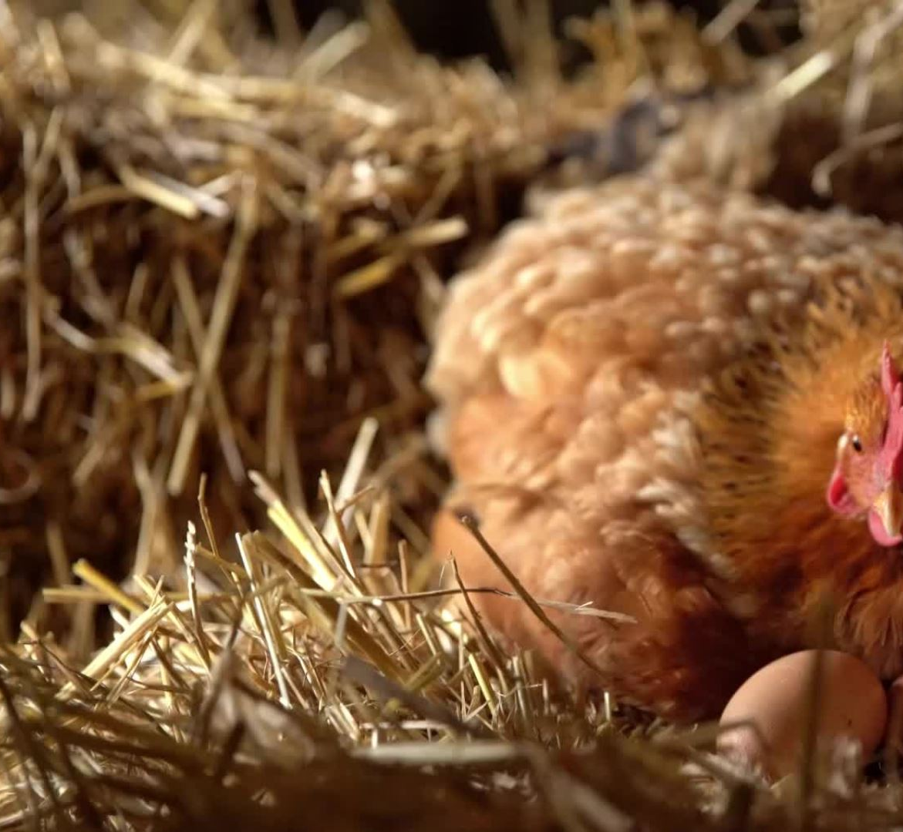
The sourcing of proteins
The sourcing of proteins for kfc have also had a lot of controversy due to the fact of the chickens they use as there has been a lot of issues with the use of fast growing chickens (verywell, 2019).
Major restaurant chains , including kfc , have ditched a commitment to improve chicken sourcing standards in the uk as poultry demand soars (bbc,2026)

Slide 24

SWAT
A swat analysis is a strategical planning tool that buisnesses use to plan and evaluate a organizations strengths weaknesses along with external opportunities and issues that may come about (CIPD, 2025).

Slide 25

Strengths and weaknesses
Strengths
– strong brand recognition globally
Unique products and product offerings
Globally known with a stern presence
Menu innovation
Weakness
Many health concerns with dietary issues
Limited product diversity
Operational and workforce issues
Environmental concerns
Slow responses to market trends (jurevicius, 2021).

Slide 26
Opportunities and threats
Opportunities
.Growth to other countries
.Strong position in emerging companies
.Kfcs revenue gives room for innovation
.Diversification (Team, 2025).
Issues
Competitve pressure
Health and dietary trends
Ethical concerns-waste
Economic risks

Slide 27

Issues
Kfc has many issues with there overall retention rate and from research it has shown that a lot of employees there do not feel seen or heard for any issues that might arise for them which results in a high retention rate of there brand (Aithor, 2024). It is seen while they train there employees well it is visible that there is low engagement with the staff themself with the work they are doing
Kahn model

Slide 28
The kahn model
William kahn implemented this model in 1990 defining what was key to harnessing employee engagment with organization members for the roles they play in there job .this comes down to people being able to express themselves mentally/cognitively , physically and emotionally during there role as these play a apart in engagement (Meskelis, 2017).
This model explains the employee engagement through 3 different conditions which are meaningfullness , safety , and availability that determine how fully individuals and employees are into there work and the roles they have
It emphaziss that engagement is not consistent and that employees may fluctuate with there levels of engagement depending on the situation and even down to personal issues or factors

Slide 29
The big 3 of kahn
Meaningfullness – employees need to feel valuable and purposeful in there job role .when people think that they are valued from there contributions and matter to the organizatioon they are more likely to put more effort into there role and give more energy
Safety- employees need to feel that they are safe to express things from emotion to mental things without fear of a negative reaction or consequence . A supportive enviroment allows people to open up and have trust in the place they work
Availability – employees have mental , physical and emotional resources to engage there all into work .this even includes things like energy , focus and the work related or non work related constraints that might come into there lifes (Romford, 2022).

Slide 30
Compare to other brands
Looking at other chain brands it high level of issues when researching the retention of other brands for example mcdonalds has also many issues with the retention of employees but mcdonalds uses a reward system for engagement with staff which pushes people to engage more (KFC, 2025) .
With entry level roles of mcdonalds they look at around 25/45% turnover of staff which is fairly low this is down to the flexibility of there brand for workers and the support of cultures there brand mainains with empathic leadership being crucial for them to keep staff
They have a wide variety of flexibility standards and drive for the ability of staff being able to pick their working patterns to reduce lack of engagement

Slide 31

Leadership style
Looking at kfcs brand it is visible there is a big merge between hieratical and holacracy style management which in theory sounds good but from this there could be a divide in the hieratical system as people may not want to be ordered (EudBirdie, 2022).

Slide 32
References
Aithor (2024). KFC Operational Problem In The United Kingdom. aithor.com. Available at: https://aithor.com/essay-examples/kfc-operational-problem-in-the-united-kingdom. Accessed May 10 2026.
Briggs, F. (2026). KFC targets growing Gen Z drinks market with the launch of new ‘Kwench by KFC’ range. Retail Times. Available at: https://retailtimes.co.uk /kfc-targets-growing-gen-z-drinks-market-with-the-launch-of-new-kwench-by-kfc-range/ Accessed 10 May 2026.
Chris (2026). KFC has chickened out on welfare promises. The Ecologist. Available at: https://theecologist.org/2026/apr/21/kfc-has-chickened-out-welfare-promises. Accessed May 10 2026.
CIPD (2025). SWOT Analysis. CIPD. Available at: https://www.cipd.org/uk/knowledge/factsheets/swot-analysis-factsheet/. Accessed may 9 2026.
Edraw Team (2020). Detailed PESTEL Analysis of KFC | EdrawMax Online. EdrawMax. Available at: https://edrawmax.wondershare.com/pestel/kfc-pestel-analysis.html. Accessed May 10 2026.
EduBirdie (2022). Leadership And Organizational Culture Of KFC - Free Essay Example - Edubirdie. Edubirdie. Available at: https://hub.edubirdie.com/examples/leadership-and-organizational-culture-of-kfc/. Accessed May 10 2026.

Slide 33
Reference
Frue, K. (2019). PESTEL Analysis of KFC. [online] PESTLE Analysis. Available at: https://pestleanalysis.com/pestel-analysis-of-kfc/. Accessed 9 May 2026.
Jurevicius, O. (2021). KFC SWOT Analysis - SM Insight. Strategic Management Insight. Available at: https://strategicmanagementinsight.com/swot-analyses/kfc-swot-analysis/. Accessed 10 May 2026.
KFC (2022). KFC - The Colonel’s Story - The Life of Harland Sanders. www.kfc.co.uk. Available at: https://www.kfc.co.uk/colonels-story. Accessed 9 May 2026.
KFC (2025). KFC vs McDonald’s. Comparably. Available at: https://www.comparably.com/competitors/kfc-vs-mcdonalds. Accessed 9 May 2026
Kuo, L. (2013). KFC makes most of its money in China, and now that’s a big problem. Quartz. Available at: https://qz.com/77471/kfc-makes-most-of-its-money-in-china-and-now-thats-a-big-problem. Accessed 9 May 2026.
Leslee (2025). [Solved] KFCs HR retention strategies have helped the company retain its - Human Resource Management (BCOMHON HRM) - Studocu. [online] Studocu. Available at: https://www.studocu.com/en-za/messages/question/14210111/kfcs-hr-retention-strategies-have-helped-the-company-retain-its-top-talent-ensuring-that-it-has-a Accessed 10 May 2026.

Slide 34
Reference
Lrqa (2025). About Sedex: Promoting Ethical Supply Chains | LRQA UK. LRQA. Available at: https://www.lrqa.com/en-gb/about-sedex/. Accessed 10 May 2026.
Meskelis, S. (2017). Figure 2.2. Kahn (1990) Model of Employee Engagement. ResearchGate. Available at: https://www.researchgate.net/figure/Kahn-1990-Model-of-Employee-Engagement_fig2_326262753. Accessed 9 May 2026.
Mongabay (2026). KFC dumps palm oil due to health, environmental concerns. Mongabay Environmental News. Available at: https://news.mongabay.com/2011/04/kfc-dumps-palm-oil-due-to-health-environmental-concerns/. Accessed 10 May 2026.
Monica, I., Majesty, S., Wang, D., Chrisderry, C. and Kent, J. (2024). Analysis of the Influence of the External Environment on KFC. Jurnal Ilmu Manajemen Profitability, 8(1), pp.32–40. doi: https://doi.org/10.26618/profitability.v8i1.14043. Accessed 10 May 2026.
Romford, J. (2022). Kahn’s 3 Dimensions of Employee Engagement – A Complete Guide. AgilityPortal. Available at: https://agilityportal.io/blog/dimensions-of-employee-engagement. Accessed 9 May 2026.

Slide 35
Reference
Team, M.S. (2025). KFC SWOT Analysis - Key Strengths & Weaknesses. [online] MBA Skool. Available at: https://www.mbaskool.com/swot-analysis/food-and-beverages/585-kfc.html
Accessed 9 May 2026
.
Verywell (2019). What to Order at KFC. [online] Verywell Fit. Available at: https://www.verywellfit.com/kfc-meals-for-500-calories-or-less-3495327. Accessed 9 May 2026.
Yum! (2024). KFC. [online] Yum.com. Available at
https://www.yum.com/wps/portal/yumbrands/Yumbrands/company/our-brands/kfc.
accessed 10 May 2026.

