Slide 1
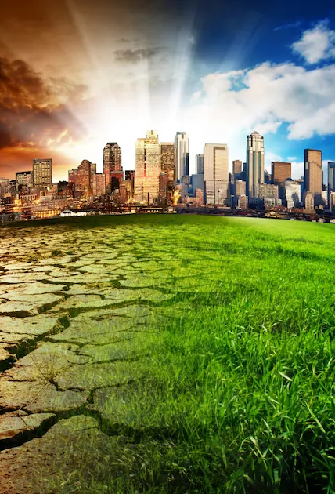
14/10/2024
ACNA4004:
Lecture 3
Contemporary Environmental Issues and the response to them
Dr Alisdair Cunningham
Senior Lecturer
2024 / 2025
14/10/2024
Slide 1 / 25

Slide 2

Module ACNA4004: 2024 / 2025 Recap
14/10/2024
For billions of years, changes on the Earth were driven by natural processes, such as erosion and abrasion by wind, water, and ice, as well as tectonic processes.
Mankind has a more significant impact on Earth system processes than any other single species
Exponential population rise, enabled by advances in agriculture and technology, have resulted in correlated acceleration of impacts to the natural environment
This period of accelerated change is being labelled as the Anthropocene
The Earth is at a crucial stage and requires action to enable positive change
A. Cunningham Lecture 3: Contemporary Environmental Topic
Slide 2 / 24

Slide 3
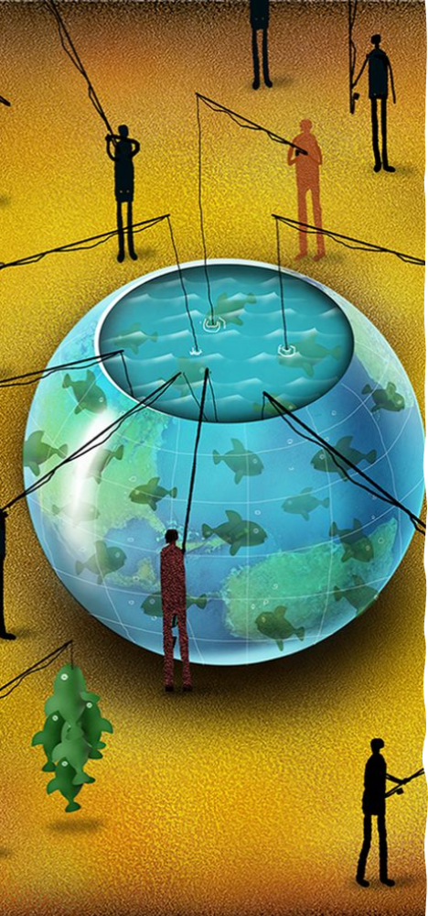
Module ACNA4004: 2024 / 2025 Contemporary Environmental Topic
14/10/2024
Activity: Using the below Padlet link, populate the world map with examples of your contemporary environmental topic of choice.
Specifically:
Research an example of the issue (disturbance, pollution, incident) associated with your contemporary topic of choice
Record the location on the Padlet map
Document the details of the impacts to the environment
Document the social and / or economic impacts (if any)
Describe the response to the issue (mitigation)
Determine the level of governance (who is responding / what level)
How is success being measured? What evidence?
A. Cunningham Lecture 3: Contemporary Environmental Topic
Slide 3 / 25

Slide 4
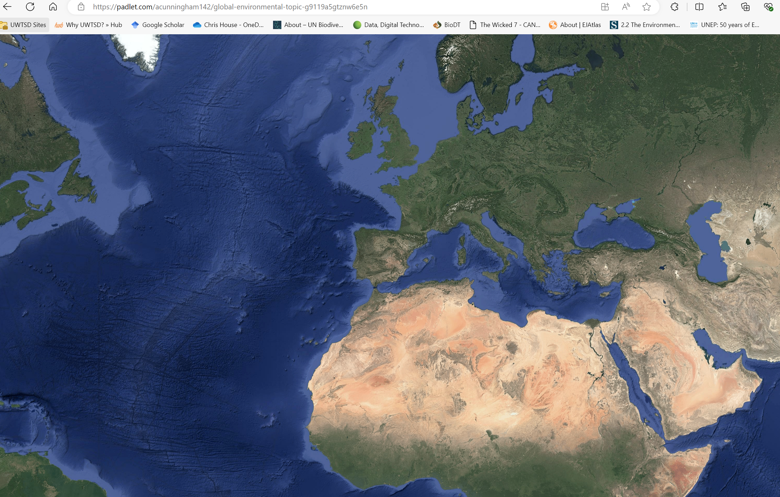
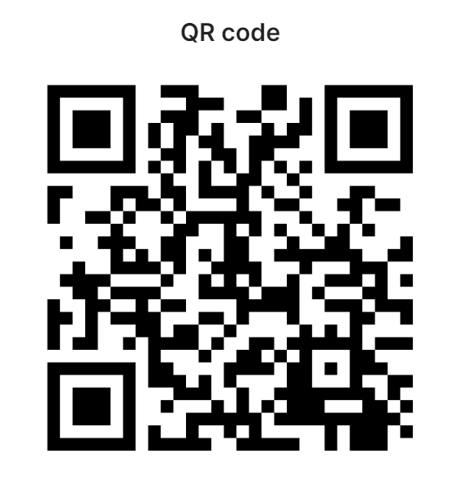
Module ACNA4004: 2024 / 2025 Contemporary Environmental Topic
14/10/2024
Activity: Using the below Padlet link, populate the world map with examples of your contemporary environmental topic of choice.
https://padlet.com/acunningham142/global-environmental-topic-g9119a5gtznw6e5n
A. Cunningham Lecture 3: Contemporary Environmental Topic
Slide 4 / 25

Slide 5
Module ACNA4004: 2024 / 2025 Next Session
14/10/2024
The next lecture will cover:
Historic Challenges (and the response to them)
Suggested activities:
  Identify a source of contemporary environmental news / discussion / research (podcast / news article / journal etc.)
    Present your chosen media at the next lecture
  Pick a contemporary environmental issue (from the Anthropocene) you would like covered in the lecture series
    You may be asked to present this to the group
    It may also support research for your chosen assignment
A. Cunningham Lecture 3: Contemporary Environmental Topic
Slide 5 / 25

Slide 6
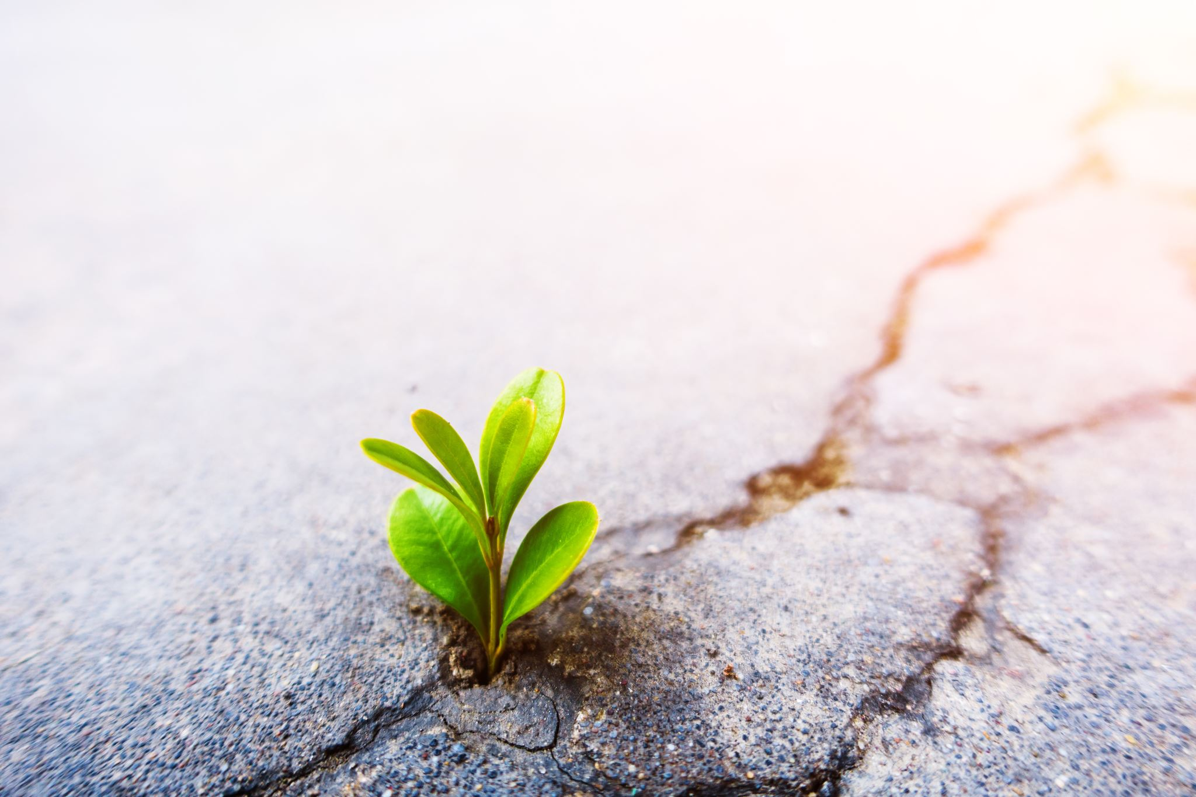
Module ACNA4004: 2024 / 2025 Questions
14/10/2024
Any questions?
Please contact via:
Email: a.cunningham@uwtsd.ac.uk
Teams: “ACNA4004 Contemporary Challenges 2024/35_GRP”
ACNA4004 Contemporary Challenges 2024/35_GRP | General | Microsoft Teams
A. Cunningham Lecture 3: Contemporary Environmental Topic
Slide 6 / 25

