Slide 1
OME Electromagnetic Radiation
Lecture 5
Propagation of Electromagnetic Radiation

Slide 2
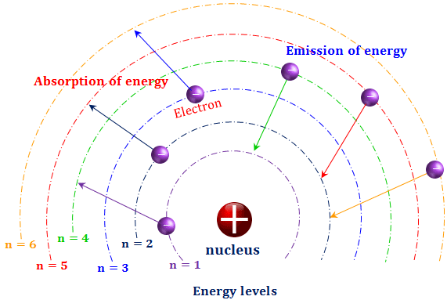
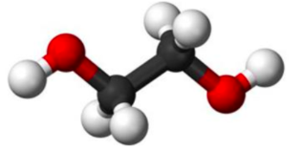
Absorption
In absorption, the frequency of the incoming radiation will transfer energy to the absorbing substance though interactions with electrons. (In light, absorption takes place when the frequency is at or near the energy levels of the electrons absorbing substance. In infra-red, absorption takes place when the frequency is at or near the bond vibrational frequencies, and in radio waves, the electric field will cause electrons to migrate across a conductor.

Slide 3
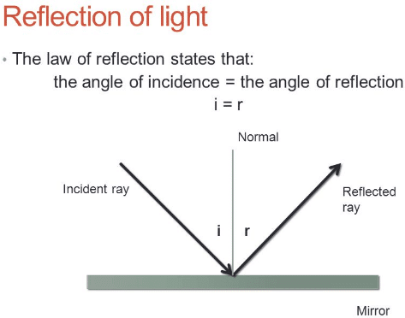
Reflection

Slide 4
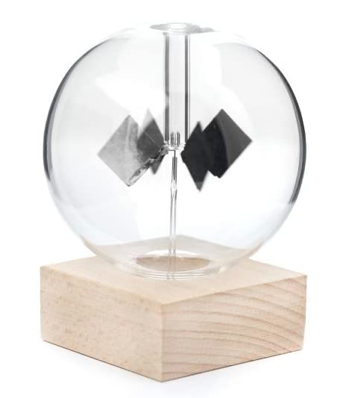
Solar radiometer - reflection?

Slide 5
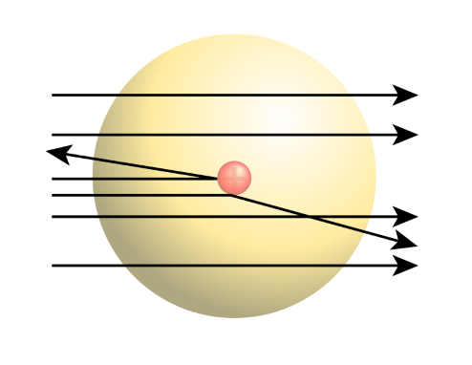
Transmission
(Rayleigh scattering)

Slide 6

Diffraction

Slide 7
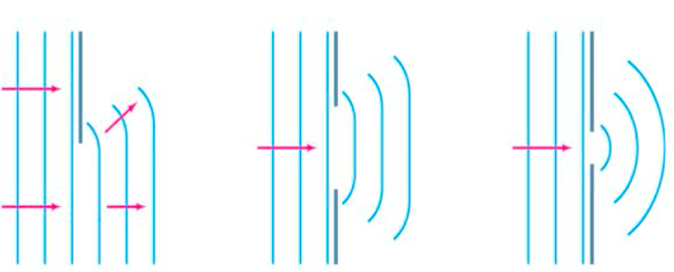
Diffraction

Slide 8
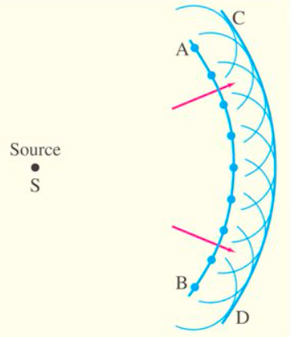
Diffraction
Huygen’s Principle: Every point on a wave front acts as a point source; the wavefront as it develops is tangent to their envelop.

Slide 9
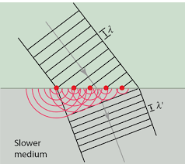
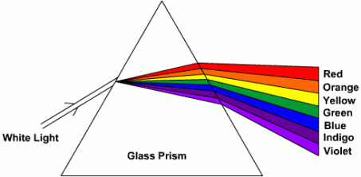
Refraction or dispersion
Snell’s Law
Also, red light travels faster than blue in glass.

Slide 10
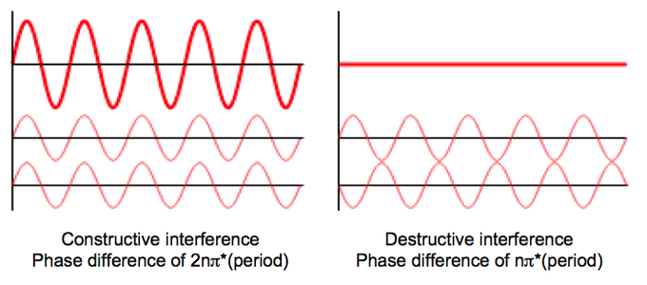
Interference
The combination of two or more electromagnetic waveforms to form a resultant wave in which the displacement is either reinforced or cancelled.
Identical wavelengths

Slide 11
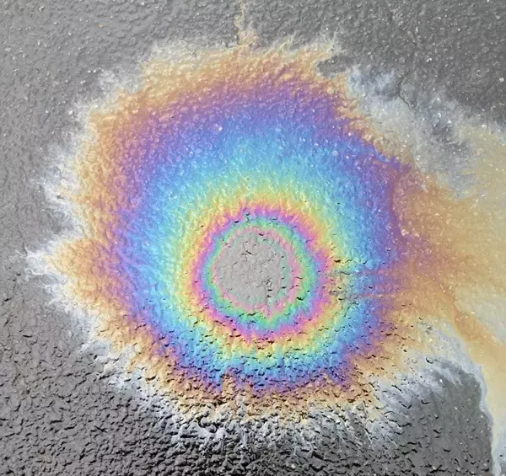
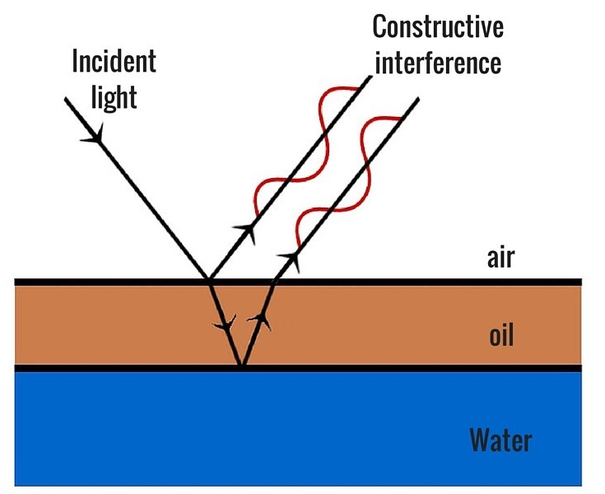
Interference
The combination of two or more electromagnetic waveforms to form a resultant wave in which the displacement is either reinforced or cancelled.

Slide 12
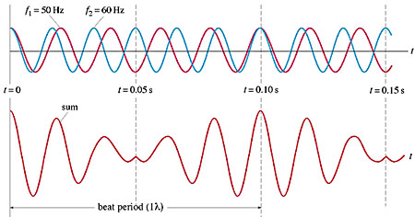
Interference – beats
Tone gen app

Slide 13
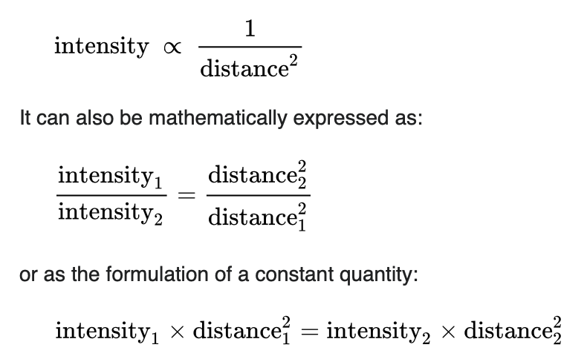
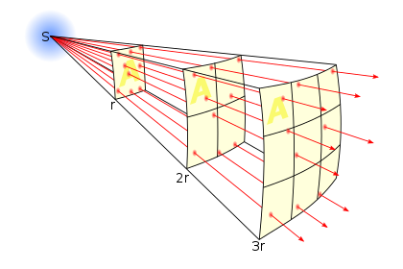
Attenuation
Inverse square law

Slide 14
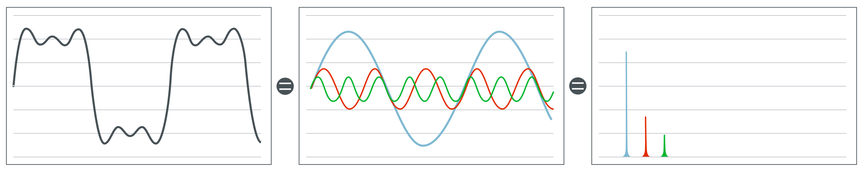
Approximation to binary digital signal
Signal in time domain
Signal in frequency domain

Slide 15
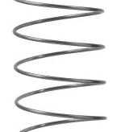
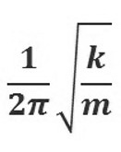
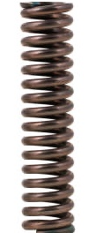
Impedance mismatch
compression wave
f ∝

Slide 16
Impedance mismatch
no load
compression wave
compression wave
overload

Slide 17
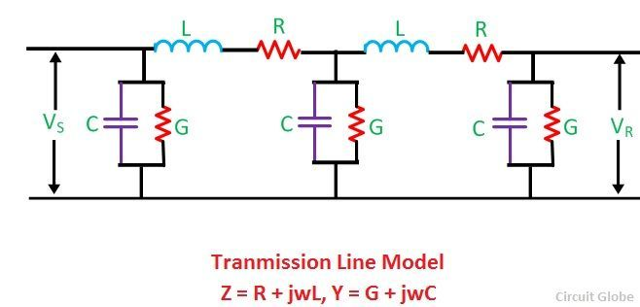
Transmission line theory

Slide 18
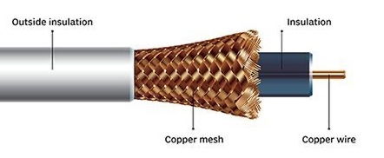
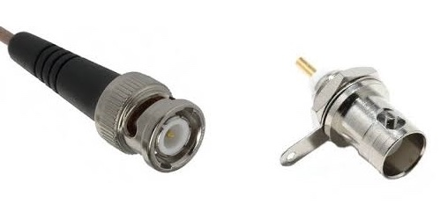
Coax cable
The characteristic impedance (Z₀) of a cable can be calculated by
Z₀ = √( L / C ) Ohms
Where ...
L = inductance in Henrys
C = capacitance in Farads
Radio frequency coax always has a designated impedance, most commonly 50 ohms or 75 ohms. 50Ω coax is standard for radio transmitters and receivers, laboratory equipment (for example almost all oscilloscopes are fitted with 50Ω BNC connectors).

Slide 19
Coax cable – velocity factor
Coaxial cable specifications often include the velocity factor, which is typically between 60% and 90%. A cable with a velocity factor of 70% means that the signal travels at 0.7 times the speed of light or 2.1 ∙ 10^8 m/sec. The velocity factor is directly related to the permittivity of the transmission line.

Slide 20
Skin effect
Skin effect causes high frequency signals to concentrate on the outside of the conductor, and the inner section becomes (almost) irrelevant. Some HF coax for fixed installations will use an inner copper tube rather than twisted wires, because the centre part of the conductor serves no real purpose.

Slide 21
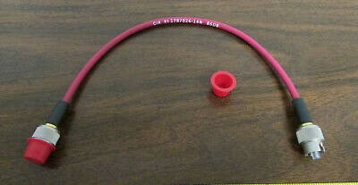
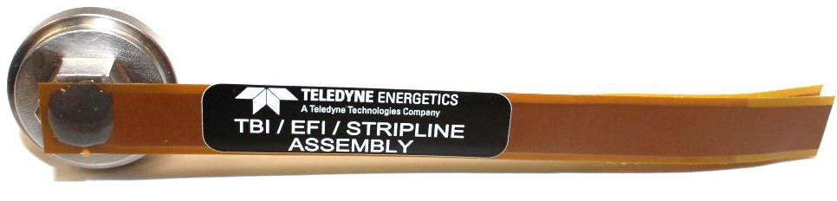
EBW and EFI detonator coax and stripline

