Slide 1
DESIGN THINKING IN HR
Julie Hayward

Slide 2
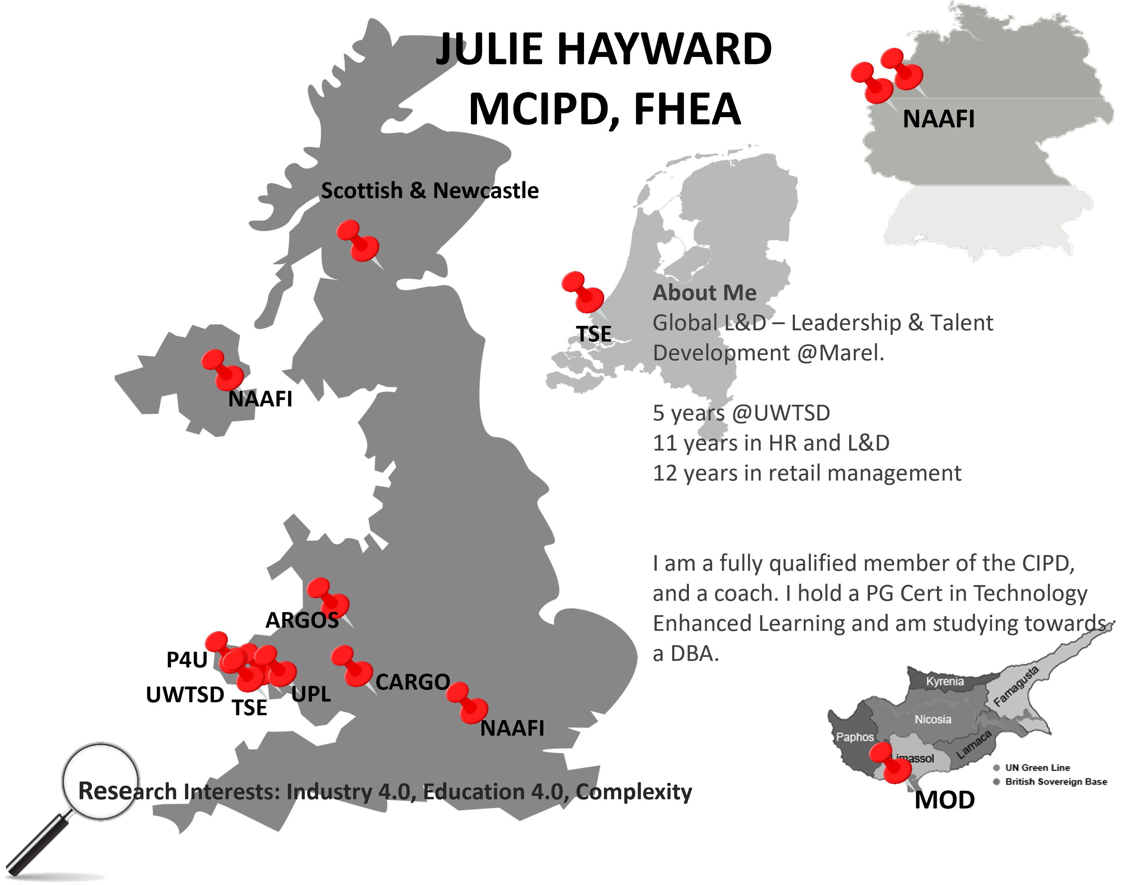

INTRODUCTIONS

Slide 3
Learning Outcomes
At the end of this session you will be able to:
Recognise the utility of using design thinking to solve HR problems.
Describe the different applications of the design thinking process.
Name the phases in the process and the activities that take place at each stage.
Apply design thinking to HR problems in your organisation.

Slide 4
Group Task
In groups of 4/5 answer the following question:
What do you already know about Design Thinking and what it is used for?

Slide 5
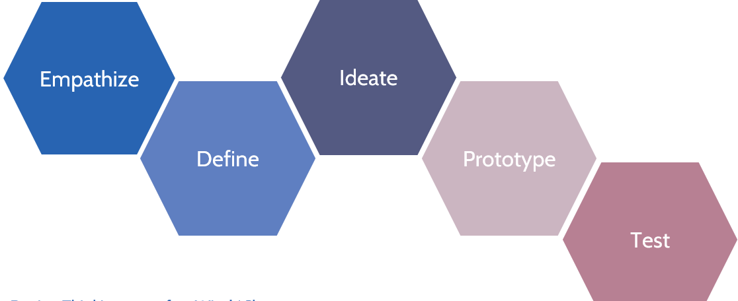
What is Design Thinking?
Design Thinking is a useful concept for identifying solutions to problems in a systematic way. Over recent decades, it has become crucial to develop and refine skills which allow us to understand and act on rapid changes in our environment and behaviour. The world has become increasingly interconnected and complex, and design thinking offers a means to grapple with all this change in a more human-centric manner (Interaction Design Foundation, 2020)

Slide 6
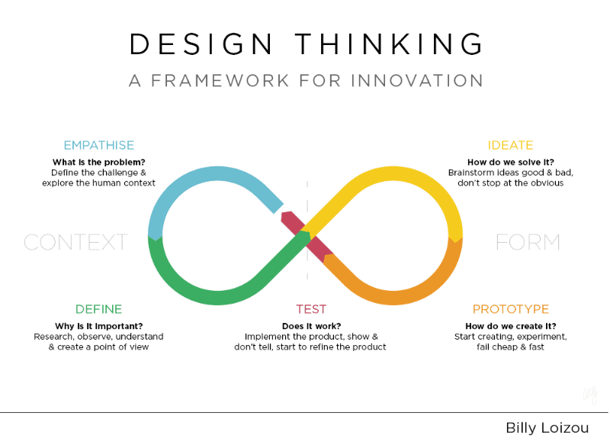
How Design Thinking Is Disrupting HR
“Design Thinking casts HR in a new role. It transforms HR from a “process developer” into an “experience architect.” It empowers HR to reimagine every aspect of work: the physical environment; how people meet and interact; how managers spend their time; and how companies select, train, engage, and evaluate people” (Josh Bersin)

Slide 7
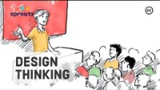
VIDEO

Slide 8
Group Task
“Design thinking HR case study”
Review the allocated case study and capture the key points.
Make a 5 minute presentation of your findings to share with the rest of the class.
Notes:
Cisco, IBM, Deutche Telecom

Slide 9

CHART SLIDE
20XX
Chart Title
Paragraph Title
Maximincto od essi sime voluptati ipis maximus.
Liquatem voluptatur, con plabo. Ut que dUm quiae cus sus event velibus.
Rate conseris ma as dolupta idis aut apicide ruptatio.
Et expedis eossimpere mod mostinihil mo et.
Puditecte enimilluptae laboreri odi santotam as seque cor autem con restiistia volo.

Slide 10
How do you solve an HR problem?
The application of the design thinking phases.
Select one of the problems that HR are typically asked to solve.
First ask:
  Do we have the right team to solve this problem?
  How could we improve the diversity of the team to get a better perspective on the problem?
Only once you have the right team in place should you start with the DT process.
Next we are going to apply each phase to the problem you have selected.

Slide 11
Stage 1: Empathise
Research Your Users' Needs
The first stage of the design thinking process allows you to gain an empathetic understanding of the problem you’re trying to solve, typically through user research.
Empathy is crucial to a human-centred design process like design thinking because it allows you to set aside your own assumptions about the world and gain real insight into users and their needs.
The idea is to gain insights into what they need, what they want, how they behave, feel, and think, and why they demonstrate such behaviours, feelings, and thoughts when interacting with products in a real-world setting. Follow the link to find out more about how to action the empathy phase:
https://www.interaction-design.org/literature/article/stage-1-in-the-design-thinking-process-empathise-with-your-users
DT can also help us to overcome bias:
onlinelibrary.wiley.com/doi/full/10.1111/jpim.12163?casa_token=6y7m5q0uF-8AAAAA%3Avt4F4I9-gOP6PsB57uZKcks0Me2X7PV9qartQgU51GNKVldJ54SUaVlvMwsr0V7F5t6lXFtb8gL4NgZk

Slide 12
Stage 2: Define
State Your Users' Needs and Problems
In the Define stage, you accumulate the information you created and gathered during the Empathise stage. You analyse your observations and synthesise them to define the core problems you and your team have identified so far.
You should always seek to define the problem statement in a human-centred manner as you do this. Follow the link for more on how to write a problem statement.
https://www.interaction-design.org/literature/article/stage-2-in-the-design-thinking-process-define-the-problem-and-interpret-the-results

Slide 13
Stage 3: Ideate
Challenge Assumptions and Create Ideas
Designers are ready to generate ideas as they reach the third stage of design thinking. The solid background of knowledge from the first two phases means you can start to “think outside the box”, look for alternative ways to view the problem and identify innovative solutions to the problem statement you’ve created.
Find out more about how to run a successful ideation session: https://www.interaction-design.org/literature/article/what-is-ideation-and-how-to-prepare-for-ideation-sessions

Slide 14

Poll – what type of mindset is required?

Slide 15

An Ideation Mindset
Did you identify...?
Open, divergent-thinking
Non-judgemental
Trust
Imagination
Empathy
Collaboration
Freedom
Courage
Idea generation is often stopped by people self-censoring ideas or judging themselves too harshly too early. You need to be willing to keep bringing ideas forward, rather than hanging on for that one genius moment.

Slide 16

The Wisdom of Crowds
Wisdom of the crowd is a theory that assumes large crowds are collectively smarter than individual experts.
The notion that a group’s judgement can be surprisingly good is generally traced back to an observation by Charles Darwin’s cousin Francis Galton in 1907.
Galton pointed out that the average of all the entries in a ‘guess the weight of the ox’ competition at a country fair was amazingly accurate – beating not only most of the individual guesses but also those of alleged cattle experts. This is the essence of the wisdom of crowds: their average judgement converges on the right solution (Ball, 2014).
https://www.bbc.com/future/article/20140708-when-crowd-wisdom-goes-wrong

Slide 17

Testing Wisdom of the Crowd

Slide 18

Vote First, Then Discuss
How could this technique be used to facilitate a more effective ideation session?
What would be the benefits of Vote First, Then Discuss?

Slide 19
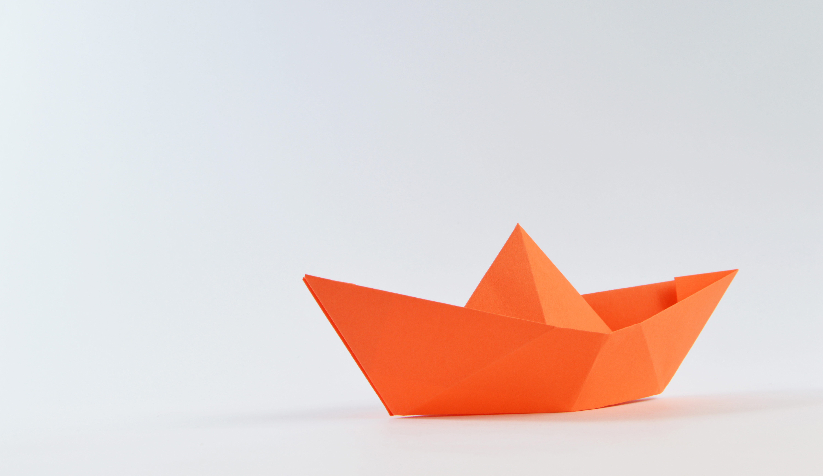
Stage 4: Prototype
Start to Create Solutions
This is an experimental phase, and the aim is to identify the best possible solution for each of the problems identified during the first three stages. Design teams will produce a number of inexpensive, scaled-down versions of the product/service (or specific features ) to investigate the problem solutions generated in the previous stage. This is sometimes called an MVP (minimum viable product)
Learn about common prototype methods: https://www.interaction-design.org/literature/article/prototyping-learn-eight-common-methods-and-best-practices

Slide 20

Stage 5: Test
Try Your Solutions Out
Designers or evaluators rigorously test the complete product using the best solutions identified in the Prototype phase. This is the final phase of the model but, in an iterative process such as design thinking, the results generated are often used to redefine one or more further problems. Designers can then choose to return to previous stages in the process to make further iterations, alterations and refinements to rule out alternative solution.
https://www.interaction-design.org/literature/article/stage-2-in-the-design-thinking-process-define-the-problem-and-interpret-the-results

Slide 21

Further Reading
Change By Design – Tim Brown
The Design Thinking Play Book – Lerwick, Link & Leifer
Creative Confidence – David & Tom Kelly

Slide 22
THANK YOU & GOOD LUCK

