Slide 1
Psychology for Health and Social Care
LCHS4010
Lesson 09: Applying Psychology at Workplace

Slide 2
Objectives:
By the end of today’s session learners will be able to:
Identify personal strengths/needs to be an effective team player.
Explore common challenges influencing effective teamworking in health and social care settings.
Learn how to apply psychological principles to manage conflicts in the workplace.
Practice how to be mindful and compassionate at workplace.

Slide 3
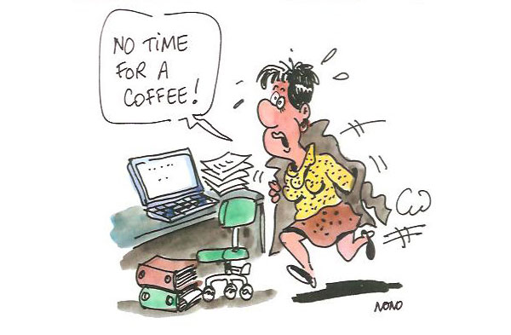
How do You perform at Workplace? https://www.youtube.com/watch?v=ryk9lVInCNs

Slide 4

What is team dynamics?

Slide 5
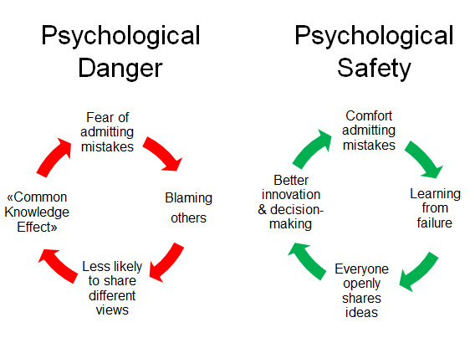
Team work is all about…

Slide 6
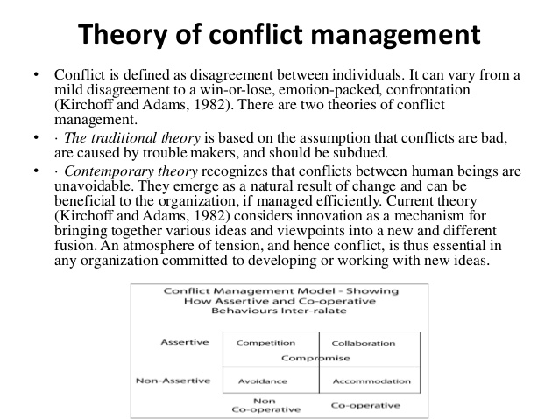

Slide 7
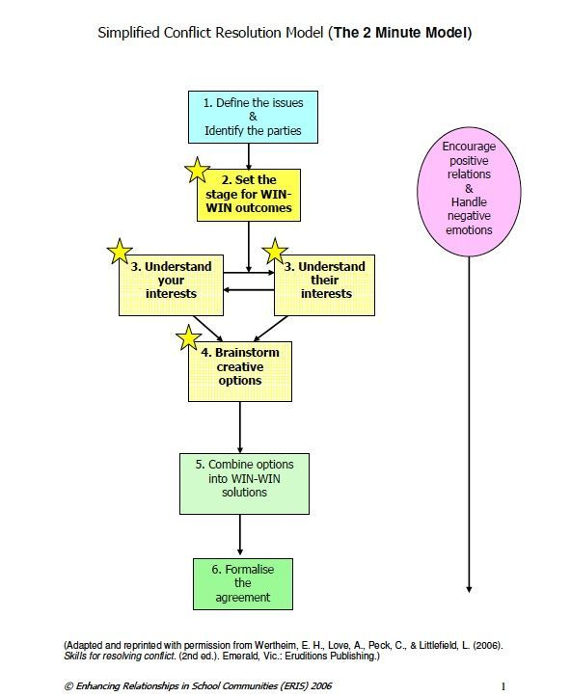
Conflict Management

Slide 8

Self-Compassion

Slide 9
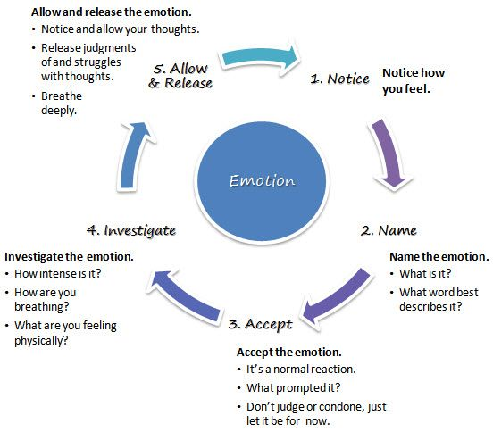
Mindfulness at Workplace

Slide 10
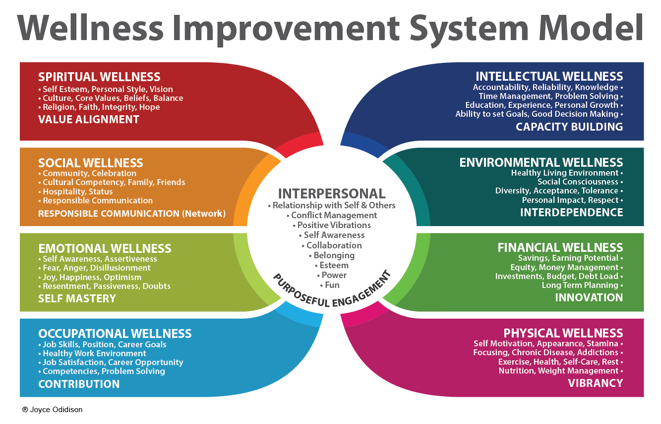

Slide 11
Watch the video on mindfulness and reflect on how you can apply psychological ideas of positive psychology and mindfulness at your workplace to be more efficient and compassionate to others.
https://youtu.be/jEGccysw_zo

Slide 12
References
Raab, K. (2014) ‘Mindfulness, Self-Compassion, and Empathy Among Health Care Professionals: A Review of the Literature’, Journal of Health Care Chaplaincy, 20 (3), pp.95-108, DOI: 10.1080/08854726.2014.913876

