Slide 1
Enterprise and Entrepreneurship – LCM4006
Individual Business Plan Presentation
Business Idea: SafeBike Hub
Student: Nika Vlasova (2416718)
Lecturer: Andry Rakotovololona
Weekend Group 7

Slide 2
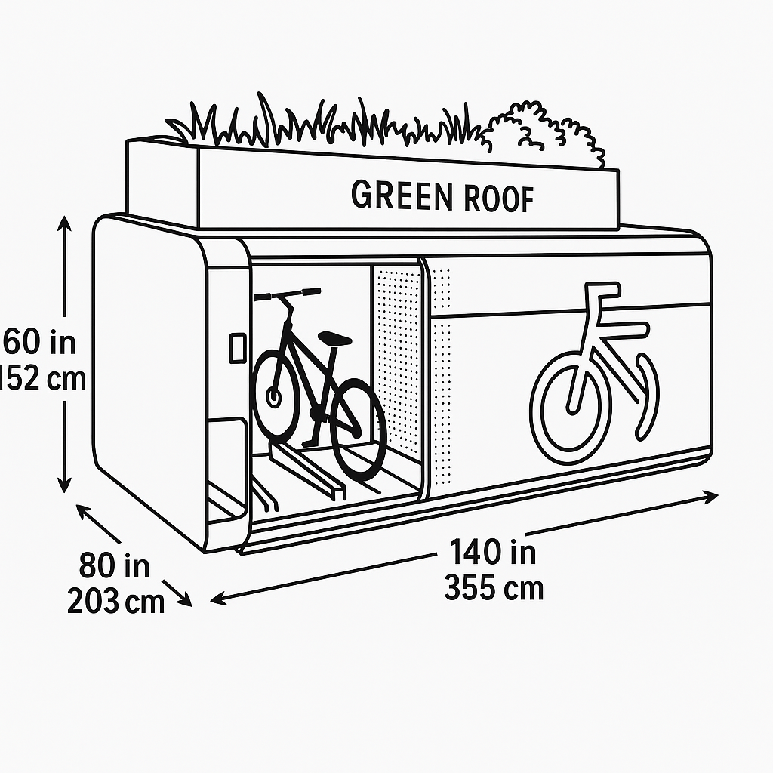
Business Overview
SafeBike Hub
Business Name: SafeBike Hub
Purpose: Secure and affordable bicycle storage for London cyclists
Concept:
Network of lockable metal bike boxes
Accessed through a mobile app
Users book, pay, and open boxes via QR code
Management Structure:
Founder → Operations → Technical Support → Marketing → Customer Service

Slide 3
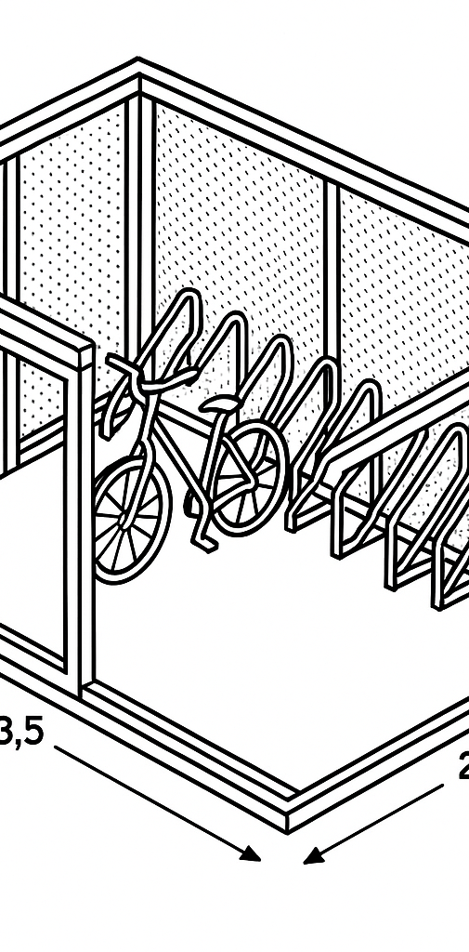
Products & Services
1. Street Metal Boxes
Main product
Stores up to 10 bikes
Reinforced steel, hidden hinges, ground anchors
Affordable and ideal for universities, stations & residential areas
Automated Premium Boxes
For high-value bikes and e-bikes
1 bike per unit
QR access, sensors, internal camera
Located in High value areas

Slide 4

Business Objectives (SMART)
Specific: Install 10 street boxes & 2 automated boxes in Year 1
Measurable: 300 regular users within 6 months
Achievable: Mobile app developed in first 3 months
Realistic: Moderate costs, strong demand
Time-Bound: Break-even in 10–12 months

Slide 5

Market Analysis
Growing demand for secure bike parking
More Londoners cycle (cost, health, convenience)
Demand high near:
  Universities
  Offices & business districts
  Train stations
  Residential areas
  Target Customers:
Students
Office workers
Delivery riders
Owners of expensive bikes
Commuters combining cycling + public transport
Competitive Advantage:
More secure than street racks
More affordable than private indoor parking

Slide 6
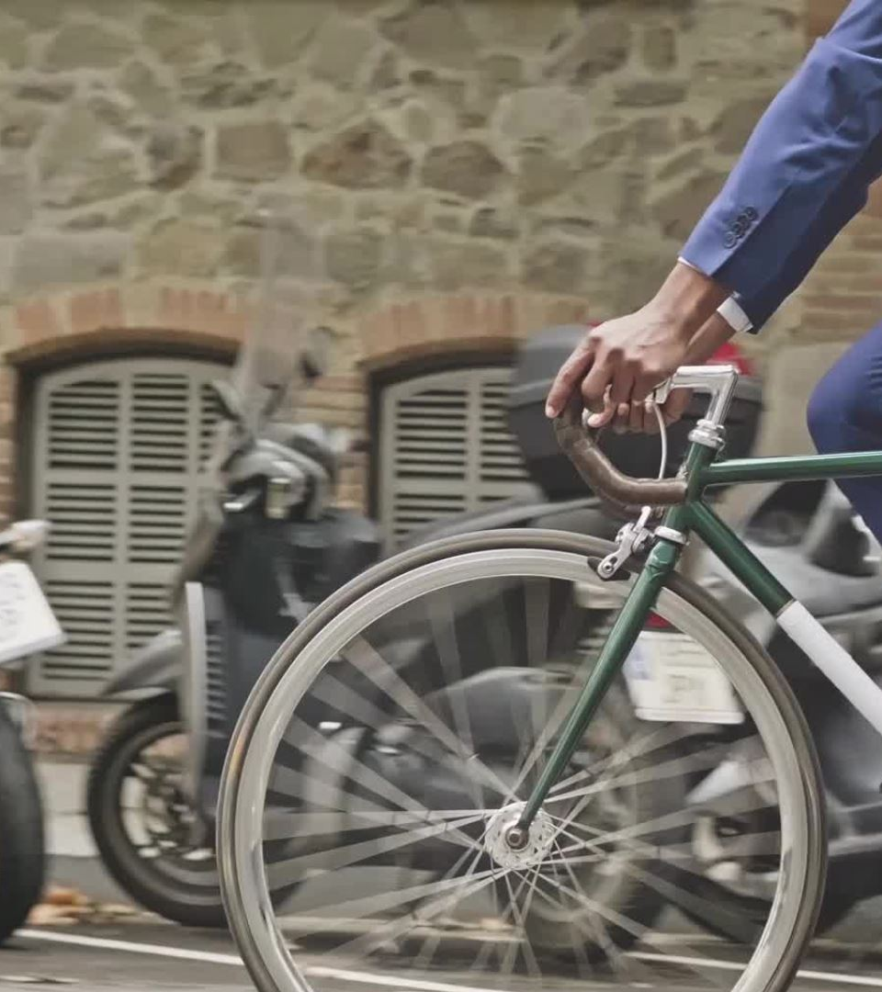
PESTEL Analysis
Political: London supports cycling; councils approve bike storage projects.
Economic: Rising transport costs push people to cycle.
Social: Cycling popular for health, fitness, commuting.
Technological: QR access, sensors, cameras, mobile apps.
Environmental: Supports green travel and reduces emissions.
Legal: Council permissions required; GDPR for app data.

Slide 7

Marketing Strategies (4Ps)
Product:
Secure, convenient bike storage (street & premium options)
Price:
£1.50–£2/hour (street boxes)
£3–£4/hour (automated boxes)
Monthly subscriptions £40–£60
Place:
Near tube stations, universities, busy streets, parks & offices
Promotion:
Social media ads
Partnerships with bike shops
University collaborations
Posters on cycling routes

Slide 8

Management & Operations
Team:
Founder (overall management)
Technical worker (installation/repairs)
Marketing assistant
Customer support via app
Operations:
Month 1: Permissions
Month 2: Install 8 street boxes
Month 3: Install automated boxes & launch app
Month 4: Marketing campaign
Month 6: Performance review

Slide 9

Total Required Funding: £16,000
Breakdown:
£4,000 — 8 street boxes
£5,000 — 2 automated boxes
£4,000 — mobile app development
£800 — permissions & registration
£1,500 — marketing
£700 — other

Slide 10
Financial Forecast
Income Forecast:
Months 1–3: £750–£1,000/month
Months 4–6: £1,500–£1,800/month
Months 7–12: £2,500–£3,000/month
Monthly Costs:
Maintenance — £500
Space rental — £300
Marketing — £100
Misc — £50
Total monthly costs: £950
Break-Even Point:
10–12 months

Slide 11

Expansion Plan
Increase street boxes to 20+ in London
Add more premium boxes in central zones
Introduce solar-powered features
University & shopping centre partnerships
New membership plans and group discounts

Slide 12

Thank you for listening!
Questions?

