Slide 1

module name :LCLM4006enterprise and entrepreneurship
Business Presentation component 2 student name : salomea dragusin student id : 2438370 lecture : mazen joureih

Slide 2
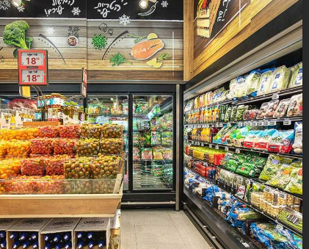
Overview of the Business Idea
Overview of the Business Idea
Business Concept
A neighbourhood mini‑market in Romania offering groceries, snacks, drinks, fresh bread, dairy, fruits, vegetables, and household goods. Cited: “The proposed business is a neighbourhood minimarket… offering a wide range of essential daily products.”
Unique Selling Points
Fresh local Romanian products
Competitive pricing
Clean, modern store layout
Extended opening hours Cited: “A key focus will be sourcing fresh local products… The store will operate with extended opening hours.”
Management Structure & Legal Format
Operates as an SRL (Romanian limited liability company)
Simple structure: Owner as Administrator + 1–2 employees Cited: “The mini‑market will operate as a Societate cu Răspundere Limitată… The management structure will be simple.”

Slide 3
Customer Problems
Customers lack convenient shopping options Many people don’t have time for long supermarket trips and need a quick, nearby place to buy daily essentials.
Difficulty finding fresh, local products Shoppers prefer Romanian fruits, vegetables, and bread, but many neighbourhood shops don’t offer consistently fresh or local goods.
Limited store hours in existing small shops Traditional corner shops often close early, making it hard for people with busy schedules to shop when they need to.
No single place to handle everyday tasks Customers must visit multiple locations for mobile top‑ups, bill payments, and prepaid utilities, which wastes time.
Poor shopping experience in many local stores Some neighbourhood shops are cluttered, outdated, or lack friendly customer service, leading to frustration and low satisfaction.
The Solution
Our mini‑market provides a simple, effective solution to the everyday problems customers face:
Convenient, fast access to essential products A nearby store offering groceries, fresh bread, dairy, fruits, vegetables, snacks, and household items — all in one place.
Fresh, high‑quality local products We source from Romanian suppliers to offer fresher, more trusted goods than typical neighbourhood shops.
Extended opening hours Early mornings, late evenings, and weekend availability make shopping easier for busy customers.
A one‑stop shop for daily tasks Services such as mobile top‑ups, bill payments, and prepaid utilities save customers time and extra trips.
A clean, modern, friendly shopping environment A well‑organised store layout and excellent customer service create a pleasant and reliable shopping experience.

Slide 4
Key External Factors (PESTEL)
Political
Romania has a stable political environment that supports small business development, with government programmes encouraging entrepreneurship (European Commission, 2023).
The mini‑market must comply with strict food safety and hygiene regulations (Romanian Government, 2021).
Economic
Rising inflation and increased living costs affect both customers and business expenses (Eurostat, 2023).
Despite this, demand for essential goods remains stable because food and household items are necessities (Kotler & Armstrong, 2020).
Social
Romanian consumers prefer neighbourhood shops for convenience, speed, and a familiar environment (Nielsen, 2020).
Fresh local products and friendly service are highly valued by customers (Keller, 2013).

Slide 5
Two Major Marketing Strategies
1. Local Promotion
The mini‑market will use flyers, posters, and word‑of‑mouth to attract nearby residents.
These methods work well in small communities where personal recommendations are highly trusted (Burns, 2016).
A clean, organised, and welcoming store environment will encourage repeat visits and build customer loyalty (Bitner, 1992).
Fresh products will be clearly displayed to make shopping quick and convenient (Keller, 2013).
2. Social Media Marketing
The business will maintain a basic Facebook page to share opening hours, special offers, and new products (Chaffey et al., 2020).
Social media visibility is important because many customers search online for nearby shops and reviews (Statista, 2023).
Regular posts will help the store stay visible in the community and attract younger, digitally active customers.

Slide 6
CONCLUSION
The proposed neighbourhood mini‑market presents a solid and practical business opportunity tailored to the everyday needs of Romanian consumers. By combining essential daily products with fresh local goods, competitive pricing, and a clean, modern shopping environment, the store is positioned to become a trusted and convenient destination within the community. Its extended opening hours further enhance accessibility, ensuring customers can rely on the mini‑market throughout the day.
Operating as an SRL with a simple management structure—led by the owner‑administrator and supported by a small team—keeps operations efficient and cost‑effective. This lean approach allows the business to focus on delivering quality service, maintaining strong supplier relationships, and adapting quickly to customer preferences.
Overall, the mini‑market’s clear value proposition, community‑oriented approach, and streamlined operational model create a strong foundation for long‑term sustainability and growth within the local retail landscape.

Slide 7
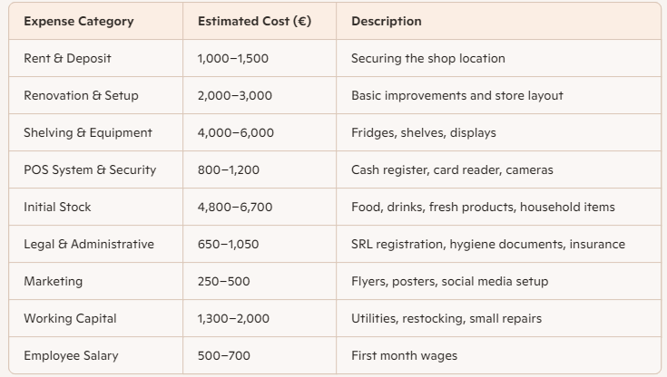
Funding Sources
Personal savings to reduce reliance on borrowing
Small bank loan to support equipment and stock purchases
Optional support from government programmes, EU funds, or family contributions (“Personal savings… A small bank loan… Optional support such as government programmes.”)

Slide 8
References
Bitner, M.J. (1992) Servicescapes: The impact of physical surroundings on customers and employees. Journal of Marketing, 56(2), pp. 57–71.
Burns, P. (2016) Entrepreneurship and Small Business. 4th edn. London: Palgrave Macmillan.
Chaffey, D. et al. (2020) Digital Marketing. 8th edn. Harlow: Pearson.
European Commission (2023) Support for SMEs. Available at: https://europa.eu
Eurostat (2023) Inflation and Cost of Living Statistics – Romania. Luxembourg: Eurostat.
Government of Romania (2023) Business registration and SRL requirements. Available at: https://www.onrc.ro
Keller, K. (2013) Strategic Brand Management. 4th edn. Harlow: Pearson.
Kotler, P. and Armstrong, G. (2020) Principles of Marketing. 18th edn. Harlow: Pearson.
Nielsen (2020) Shopper Trends in Central and Eastern Europe. Copenhagen: Nielsen.
OECD (2022) Entrepreneurship and SME Policy Review: Romania. Paris: OECD Publishing.
Romanian Government (2021) Food Safety and Hygiene Regulations. Bucharest: Government of Romania.

