Slide 1
Methods we are thinking of using

Slide 2
We are considering a range of methods…
Interviews
Questionnaires
Interventions
Lets spend some time focusing on these methods and issues we need to consider in relation to them …..

Slide 3

Interviews

Slide 4


Why do we use interviews ?
Research is exploratory and concerned with the meanings people attach to certain phenomena
Participants are likely to be open to talking and enjoy it
We can gather information about a person’s knowledge, values, preferences and attitudes
It can be a good way to follow up issues discovered in other methods

Slide 5

We use interviews when….
The research objectives are based upon understanding experiences, opinions, attitudes, values and processes
There is a need to attain highly personalised views and perspectives
We need to explore in more depth by so can ask probing questions
Respondents may have difficulties with written language

Slide 6
Some examples of types of interviews
Type of interview | Method
Structured | Use pre-prepared questionnaires and standardized questions
Semi-structured | Interviewer has a list of issues and questions to be covered, but may not deal with all of them in each interview
Non-Directive | Used to explore an issue or topic in depth and questions are not, generally, pre-planned
Focused | Based upon the respondent’s subjective responses to a known situation in which they have been involved
Informal Conversation | Relies on the spontaneous generation of questions as the interview progresses
Problem-Centred | Combines an open approach with minimal interview structuring in the first phase of the interview, followed by a second semi-structured phase
Notes:
The list of types of interviews depends on what book you read, but here are some examples of the different types that you will come across. This list is from Gray 2015 p. 385.
Cohen et al 2011 have more detailed descriptions of interview types in chapter 21.

Slide 7
When interviewing try to…
Use interview techniques that build rapport and trust so they can respond comfortably
Prompt informants to illustrate and expand on their initial responses
Ensure that the interview process is sufficiently long for subjects to be explored in depth
Construct interviewing schedules that contain questions drawn from literature and pilot work

Slide 8

When interviewing be careful to avoid…
Departures from the interviewing instructions
Poor maintenance of rapport with the respondents
Altering factual questions
Rephrasing of attitude questions
Careless prompting
Biased probes
Asking questions out of sequence
Biased recording of answers
Notes:
Beware of interview bias and avoid these..

Slide 9
Quality Indicators for your interviews
Consistency
Accuracy
Neutrality
Notes:
Try to ensure that your interviews maintain consistency try to be the same with all your interviewees and cover the same main key questions or topics.
Be accurate in your recording and transcribing
Maintain neutrality

Slide 10
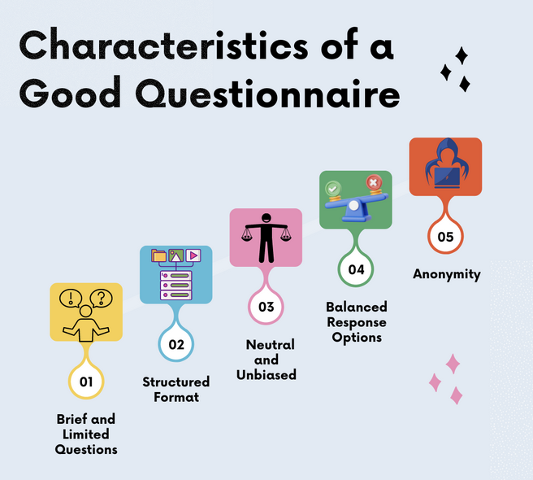
Questionnaires
A series of questions in a rationale order
Used in research and marketing
How will it be sent out?

Slide 11
Pros and cons of questionnaires
Cheap and easy to use
Can be anonymous
Not influenced
Low response rate
Language barriers
Not understanding the questions

Slide 12
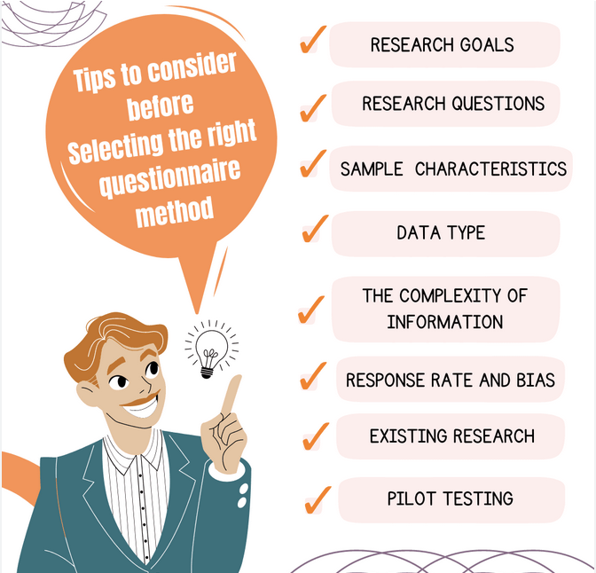
Consider
What are the objectives of the questionnaire?
What questions do you need to ask to answer the research objectives?
How will you construct the questionnaire?
Make sure your questions are relevant and you need to know the answer of the question
Make sure participants can / have the ability to answer the questions
Be Aware of jargon that the participants wont understand
TEST it out - pilot your questionnaire …

Slide 13

Types of questions
Open ended questions …collect longer answers, can be qualitative, can tell you more, but can be off point.
Closed questions….quicker to complete restricted answers, but also ensure related to the research objectives

Slide 14

Intervention design
Need to identify the participants and how they are selected for the intervention – purposive sampling, convenience sampling ?
Research design? Control or no control?
Pre - post test design?
Intervention needs to be clearly articulated.
Instruments for data collection?
Statistical analysis to see impact ?

