Slide 1
Community Development
Health Campaigns

Slide 2
Contents
Community
Meanings
Characteristics
Current Community issues

Slide 3
Community
What communities do you belong to?
How do you know they are a community?
In groups write one sentence to describe a community

Slide 4
Definition
A group of people living in the same place or having a particular characteristic in common
A particular area or place considered together with its inhabitants

Slide 5
Characteristics
How many of the 9 protected characteristics can you name?

Slide 6
Equalities Act 2010
Age
Disability
Gender reassignment
Marriage and civil partnership
Pregnancy and maternity
Race
Religion and belief
Sex
Sexual orientation

Slide 7
Differences
Race
Ethnicity
Culture
Community
How could you tell ...?

Slide 8
Answer
Race – biological only (DNA / genetics)
Ethnicity – Categorisation of races and cultures
Culture - beliefs, social norms, and material traits of a racial, religious, or social group, macro
Community – interests, geography, one or few shared characteristic, micro

Slide 9
Your aim
To create an event which raises awareness of an issue within THIS community
Linked to a vulnerable community group
A specific disorder or disability
A geographically Swansea based problem
Ideas?

Slide 10
Vulnerable Community:
Swansea and West Wales
Children and young people / Older person
Women
Disabilities (behavioural, mental, physical)
Ethnic minorities
Travellers
Prisoners
Health care service users
Unemployed/NEETS
Homeless
Rurally isolated
Deprived
Drugs

Slide 11
Current Community Issues
Raising awareness of issues on the welsh government agenda

Slide 12
ACEs
Radicalisation
CSE
Human Trafficking
Cultural issues eg FGM
Well-being of Future Generations Act
Current Issues
Notes:
What are the drivers for organisations and staff in safeguarding in Wales currently?
ACEs
Social Services and Well-being (Wales) Act 2014
Violence against Women, Domestic Abuse and Sexual Violence Act 2015
Child Sexual Exploitation
Human Trafficking
Radicalisation
Cultural issues inc FGM
Well-being of Future Generations (Wales) Act 2015

Slide 13
What are ACEs?
ACEs are stressful experiences occurring during childhood that directly harm a child
Any stressful experience which affects the environment in which they live

Slide 14
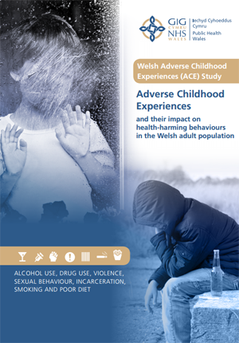
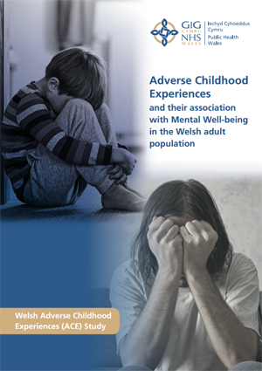
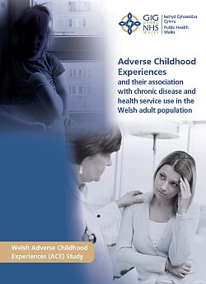
Adverse Childhood Experiences (ACEs)
Notes:
In 2015 Public Health Wales undertook the first national survey exploring the prevalence and health impact of ACEs among adults in Wales. Approx 2000 people aged 18-69 from across Wales were interviewed.
3 reports have been produced from the original study outlining the impact of ACEs on adults including the risks of developing health harming behaviours; effect on mental well-being in adulthood and the association with chronic disease development and health service use in adulthood.

Slide 15
Domestic Abuse
Domestic abuse is defined by the Home Office as:
‘Any incident of threatening behaviour, violence or abuse (psychological, physical, sexual, financial or emotional) between adults who are or have been intimate partners or family members, regardless of gender or sexuality‘.
The main characteristic of domestic abuse is that the behaviour is intentional and is calculated to exercise power and control within a relationship.
Domestic abuse occurs across society regardless of age, gender, race, sexuality, wealth and geography.
Coercive control has now been categorised as a form of domestic abuse

Slide 16

Radicalisation
Prevent is part of the UK’s counter-terrorism strategy, preventing people from becoming involved in or supporting terrorism
Section 26 of the Counter-terrorism and Security Act 2015 places a duty on certain bodies (including the NHS) to have due regard to the need to prevent people from being drawn into terrorism.
Prevent strategy has 3 specific strategic objectives:-
Respond to the ideological challenge of terrorism and the threat we face from those who promote it
Prevent people from being drawn into terrorism and ensure that they are given appropriate advice and support
Work with sectors and institutions where there are risks of radicalisation that we need to address.

Slide 17
Child Sexual Exploitation
Child sexual exploitation (CSE) is a type of sexual abuse in which children are sexually exploited for money, power or status.
The coercion or manipulation of children and young people into taking part in sexual activities
It is a form of sexual abuse involving an exchange of payment for sex e.g. Money, drugs, alcohol, mobile phones, cigarettes, place to stay etc.
The grooming process renders the child/young person powerless to recognise the exploitive nature of the relationships and therefore are unable to give informed consent for sex.
Some children and young people are trafficked into or within the UK for the purpose of sexual exploitation
Notes:
Risk factors
Official definition of child sexual exploitation
Sexual exploitation of children and young people under 18 involves exploitative situations, contexts and relationships where young people (or a third person or persons) receive 'something' (e.g. food, accommodation, drugs, alcohol, cigarettes, affection, gifts, money) as a result of them performing, and/or another or others performing on them, sexual activities. Child sexual exploitation can occur through the use of technology without the child's immediate recognition; for example being persuaded to post sexual images on the Internet/mobile phones without immediate payment or gain. In all cases, those exploiting the child/young person have power over them by virtue of their age, gender, intellect, physical strength and/or economic or other resources. Violence, coercion and intimidation are common, involvement in exploitative relationships being characterised in the main by the child or young person's limited availability of choice resulting from their social/economic and/or emotional vulnerability.

Slide 18
Models of Abuse
CSE
Organised crime networks
Peer to peer or gang associated
Older partner model
Informal networks
Occurring around transport hubs

Slide 19
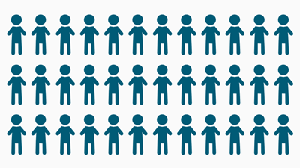
Over 2,400 children were victims of sexual exploitation in gangs and groups from August 2010 to October 2011
Source: Berelowitz, S. et al (2012) “I thought I was the only one. The only one in the world.” The Office of the Children’s Commissioner’s inquiry in to child sexual exploitation in gangs and groups: interim report London: Office of the Children’s Commissioner.

Slide 20
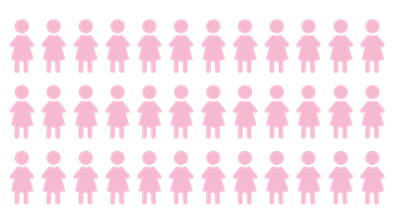
Over 230 children were trafficked for sexual exploitation in 2014
Source: National Crime Agency (2014) NCA strategic assessment: the nature and scale of human trafficking in 2013.

Slide 21
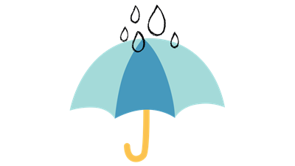
The most common reasons for children to be trafficked are sexual exploitation and criminal exploitation
Source: National Crime Agency (2015) NCA strategic assessment: the nature and scale of human trafficking in 2014

Slide 22
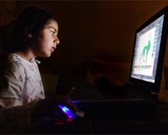




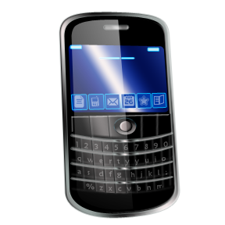




Internet, Social Networking,
Chat rooms, phones
Internet Watch Foundation (IWF) www.iwf.org.uk
Child Exploitation and Online Protection (CEOP) www.ceop.gov.uk
Sexting
Social networking, chat rooms or chat areas on websites are a great way to stay in touch and meet people...however...
Notes:
IWF are an independent charity and is the UK hotline for reporting online criminal content and also work internationally to remove online images and videos of child sexual abuse
CEOP is a law enforcement agency, which is full of useful information on internet safety for young people

Slide 23
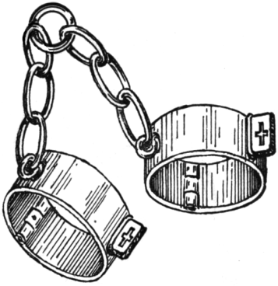
Human Trafficking
(Modern Day Slavery)
Human Trafficking is the movement of a person from one place to another into conditions of exploitation, using deception, coercion, the abuse of power or the abuse of someone’s vulnerability.
There are 3 constituent elements:-
Movement
Control
Purpose
If you suspect slavery is happening phone the police or the helpline 0800 0121 700
Notes:
Movement:- recruitment, transportation, transfer, harbouring or receipt of persons.
Control:- threat, use of force, coercion, abduction, fraud, deception, abuse of power or vulnerability, or the giving of payments or benefits to a person in control of the victim
The Purpose:- exploitation of a person, which included prostitution and other sexual exploitation, forced labour, slavery or similar practices, and the removal of organs.
Concerns that an individual is also a vulnerable adult the adult protection process may apply depending on the circumstances.
Different types of slavery can include:
Forced labour:- victims are forced to work against their will, often working very long hours for little or no pay in dire conditions under verbal or physical threats of violence to them or their families. This can also include sexual exploitation of adults or children, working in nail bars and agricultural working
Debt bondage:-victims are forced to work to pay off debts that realistically they never will be able to. Low wages and increased debts mean not only that they cannot ever hope to pay off the loan, but the debt may be passed down to their children
Criminal exploitation:- Victims are often controlled and maltreated and forced into crimes such as cannabis cultivation or pick pocketing against their will
Domestic servitude:- victims are forced to carry out housework and domestic chores in private households with little or no pay, restricted movement, very little or no free time and minimal privacy, often sleeping where they work
www.modernslavery.co.uk

Slide 24
Cultural Issues…
Honour based violence violence inflicted upon another individual in the name of ‘honour’
Forced Marriages: no faith supports forcing someone to marry without their consent. This should not be confused with arranged marriages between consenting adults. UK Forced Marriage Unit: 1500 cases dealt with last year, 29% involved minors, the youngest of these was five years old and some related to adults with disabilities.
Under-age Marriages: in Wales, a young person cannot legally marry until they are 16 years old or more.
Female Genital Mutilation: this is against the law yet we know that for some it is considered both a religious and cultural requirement. It is also illegal for someone to arrange for a child to go abroad with the intention of having her circumcised.
Ritualistic Abuse: some faiths believe that spirits can possess children, the elderly and the disabled. The use of any physical violence to get rid of the spirit is never condoned and people can be prosecuted even if they meant to help the person.

Slide 25
Female Genital Mutilation
FGM is perceived in the UK as a form of child abuse, or violence against women
It is medically unnecessary, extremely painful and poses severe health risks
It has been illegal since 2003 which also extends to acts performed outside of the UK
The age at which such procedures are performed vary from a few days old to just before marriage
It is estimated that 7,400 women in the UK have been subjected to FGM and 7,00 girls under the age of 16 are at risk

Slide 26
Female Genital Mutilation Act 2003
Makes it an offence to perform any Female Genital Mutilation procedure.
The Act makes it a criminal offence to take a girl out of the country for that purpose or to arrange it.
Penalty is 14 years imprisonment
No prosecutions yet.
NSPCC have launched a free 24 hour helpline on 0800 028 3550
fgmhelp@nspcc.org.uk

Slide 27
Serious Crime Act 2015
As part of the Serious Crime Act, in October 2015 there came into force the FGM mandatory reporting duty which requires health and social care professionals and teachers in England and Wales to report known cases of FGM in under 18 year olds to the police.

Slide 28
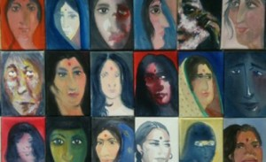
Honour Based Violence
Honour Based Violence or crime is an act explained by the abused as being committed in order to protect or defend the honour of the family/community. The victims are usually but not exclusively young females
www.iwrko.org.uk

Slide 29
These crimes include:
Domestic/ sexual violence. Forced marriage. Social rejection.
Controlling and abusive practices carried out by the family/community members.
Assault, imprisonment and murder (honour killings).
More than 12 women are killed every year in this country in the name of honour.
UK estimate that a minimum of 5000 women world wide each year are killed in the name of honour.
New research by IKWRO has found that more than 2800 incidents of ‘honour’ based violence were reported to police across the UK last year.

Slide 30
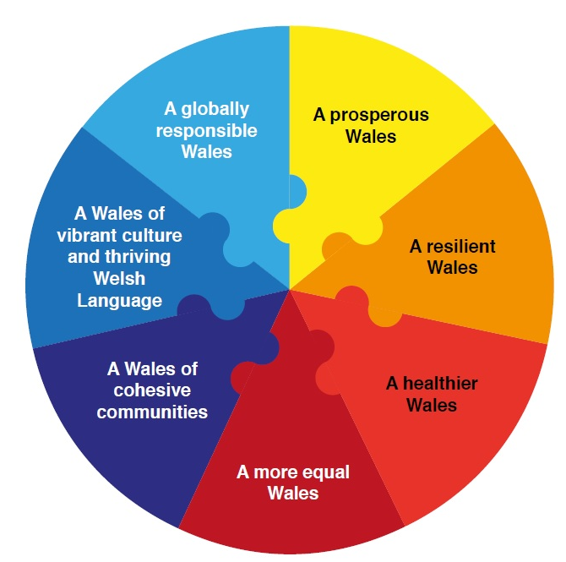
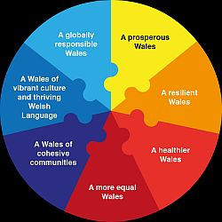
Well-being of Future Generations (Wales) Act 2015
Notes:
The Well-being of Future Generations (Wales) Act is about improving the social, economic, environmental and cultural well-being of Wales.
It makes public bodies think more about the long term, work better with people and communities and each other, look to prevent problems and take a more joined up approach.
Safeguarding our population runs through each of the Act’s goals. Some are more obvious such as ensuring a healthier Wales whereby people’s physical and mental well being is maximised and in which choices and behaviours that benefit future health are understood., but if we protect and safeguard individuals from abuse and neglect they will be able to be more integrated into society helping to achieve the other goals.

Slide 31
Activity
Select any of the previous issues
If time and money were no object, what techniques could be employed to raise awareness or funds to help this issue?
Which agencies would be involved?
What potential barriers can you spot?

