Slide 1
Group Members Student Number
1.Andrei Florin Stefan 2027355
2.Penka Pavlinova Ruseva 2029255
3.Georgin Alexandru Gogoase 2026827
Module Code and Title: LCBB4000, Academic Skills
Lecturer’s Name: Dr Eric Osei
Assignment Title: Main Activities of Range Rover Company
Date: 23rd July 2021

Slide 2
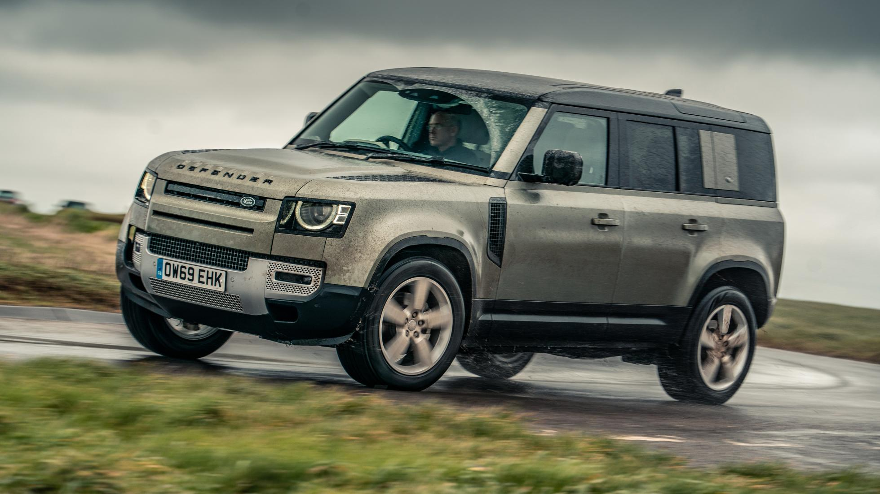
GROUP MEMBER 1
Introduction
Range Rover is a 4x4 automobile manufactured by Land Rover- a sub brand of Jaguar Land Rover
The Range Rover series is currently in its 4th generation, having been introduced in 1970 by British Leyland
The car line is produced by the famous British brand Land Rover
The original Range Rover-Range Rover Sport, Range Rover Velar, and Range Rover Evoque-are among the cars in the range
The latter are often abbreviated as Velar and Evoque
(Piddock, 2018)
Notes:
The Land Rover Range Rover (often referred to as the Range Rover) is a 4x4 automobile manufactured by Land Rover, a marque and sub-brand of Jaguar Land Rover. British Leyland introduced the Range Rover series in 1970, and it is currently in its fourth generation. The Rover Company (creator of the Land Rover brand) was exploring a more extensive version than the Land Rover Series in 1951 when Gordon Bashford created the Rover P4-based two-wheel-drive "Road Rover" prototype (Piddock, 2018). The term Range Rover refers to a car line produced by the famous British brand Land Rover, one of the brands that comprise parent company Jaguar Land Rover, operated by Indian manufacturer Tata Motors. The original Range Rover, Range Rover Sport, Range Rover Velar, and Range Rover Evoque are among the cars in the range. The latter two are often abbreviated as Velar and Evoque.

Slide 3
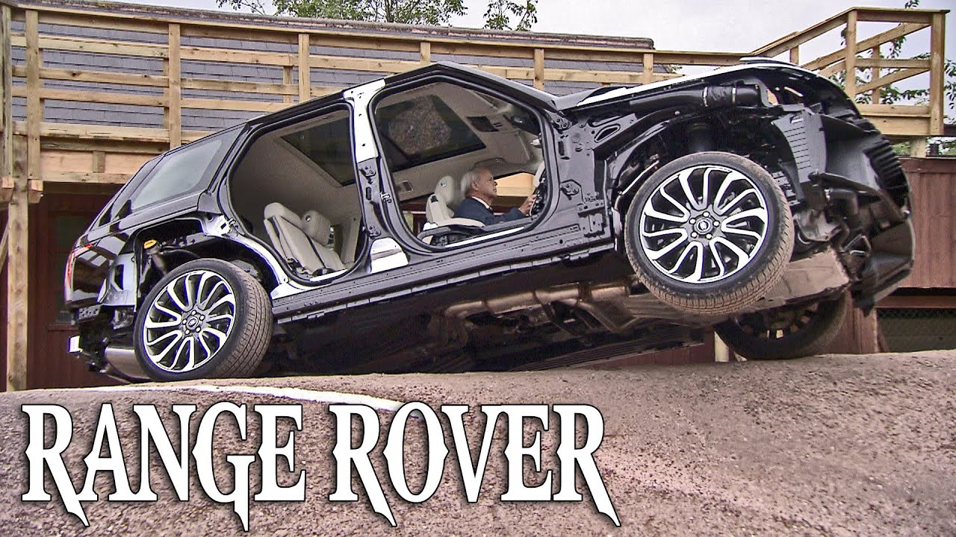
Introduction
The present structure is perplexing-although has long been the standard for Land Rover
The first Land Rover was introduced in 1948 as part of the Rover Brand
This was followed by the first Range Rover brand in 1979
Ultimately, the Rover brand was acquired by British Leyland and renamed Rover Triumph
Land Rover was split off as its own subsidiary business when BL went bankrupt and was nationalized
In 1986, British Leyland renamed the Rover Group before becoming private again in 1988 and rebranding Rover.
(Piddock, 2018).
Notes:
The present structure is perplexing, but that has long been the standard for Land Rover. The first Land Rover was introduced in 1948 as part of the Rover brand, followed by the first Range Rover in 1970. Rover was ultimately acquired by British Leyland and renamed Rover Triumph. Land Rover was split off as its own subsidiary business when BL went bankrupt and was nationalized (Piddock, 2018). In 1986, British Leyland renamed the Rover Group before becoming private again in 1988 and rebranding Rover.

Slide 4
Introduction
BMW acquired Rover in 1994, while Land Rover was sold to Ford in 2000 (which also purchased Jaguar)
In 2008, Ford sold both Land Rover and Jaguar to Tata Motors
This resulted to the Jaguar Land Rover division that still exists today
The Range Rover began as a relatively primary off-road vehicle before developing into the luxury SUV range that is marketed today
Despite the luxury, most Range Rover versions remain very competent off-road
(Hull, 2018)
Notes:
BMW then acquired Rover in 1994, and Land Rover was sold to Ford in 2000 (which also purchased Jaguar). In 2008, Ford sold both Land Rover and Jaguar to Tata Motors, establishing the Jaguar Land Rover division that still exists today (Hull, 2018). The Range Rover began as a relatively primary off-road vehicle before developing into the luxury SUV range that is marketed today. Notwithstanding the added luxury, most Range Rover versions remain very competent off-road.

Slide 5
GROUP MEMBER 2
Company Activities since its inception
Jaguar Land Rover Automotive PLC designs, develops, produces, markets, and distributes cars under the Jaguar and Land Rover brand names and the Range Rover brand
The Land Rover is the biggest automotive company in the UK
It is an affiliate of India's most profitable automotive company, Tata Motors
Headquarters are in Whitley, Coventry, England
Tata Motors purchased Jaguar Land Rover from Ford Motor Company in 2008
Jaguar Land Rover India and Chery Jaguar Land Rover are two subsidiaries of Jaguar Land Rover
Jaguar Land Rover was formed in 2002 due to a merger of Jaguar Cars and Land Rover by Ford Motor Company
(Hazell, 2012)
Notes:
Jaguar Land Rover Automotive PLC is a British multinational company that designs, develops, produces, markets, and distributes cars under the Jaguar and Land Rover brand names and the Range Rover brand. Jaguar Land Rover is the biggest automotive company in the United Kingdom, with origins in two of the most potent vehicle brands: Jaguar and Land Rover (Hazell, 2012). Jaguar Land Rover Automotive PLC is currently in operation and is a well-known affiliate of India's most profitable automotive company, Tata Motors. Its headquarters are in Whitley, Coventry, England. Tata Motors purchased Jaguar Land Rover from Ford Motor Company in 2008. Jaguar Land Rover India and Chery Jaguar Land Rover are two subsidiaries of Jaguar Land Rover. Jaguar Land Rover was formed in 2002 due to a merger of Jaguar Cars and Land Rover by Ford Motor Company (Hazell, 2012).

Slide 6
Company Activities
5 out of 6 Jaguar Land Rover Automotive PLC’s are located in United Kingdom, while one is located in India
Well-known jaguar models include:
    Jaguar XJ (luxury car),
    Jaguar XF (executive car),
    Jaguar F-Type Qorts car), and
    Jaguar XK (Grand Tourer)
At the same time, Land Rover sells Land Rover Freelander, Land Rover Defender, Land Rover Discovery, Range Rover, Range Rover Sport, and Range Rover Evoque
Currently, the Jaguar Land Rover Automotive PLC has employed over 26,000 people from all over the world
The employee work in y chains, dealership, and marketing fields
(Hazell, 2012)
Notes:
Five of Jaguar Land Rover Automotive PLC's six central R&D, production, and assembly sites are located in the United Kingdom, while one is located in India. Jaguar XJ (luxury car), Jaguar XF (executive car), Jaguar F-Type Qorts car), and Jaguar XK (Grand Tourer) are the most well-known Jaguar models. At the same time, Land Rover sells Land Rover Freelander, Land Rover Defender, Land Rover Discovery, Range Rover, Range Rover Sport, and Range Rover Evoque. Jaguar Land Rover Automotive PLC currently employs over 26,000 people from all over the world. In various areas, y chain, dealership, and marketing field (Hazell, 2012). This was abandoned in 1958, and the concept remained dormant until 1966 when designers Spen King and Bashford began developing a redesigned model. The first Range Rover concept (number plate SYE 157F) was constructed in 1967, with the iconic Range Rover form evident but a modified front grille and headlight arrangement. The Range Rover's design was completed in 1969. Between 1969 and 1970, twenty-six Velar-badged technical research cars were constructed and licensed with the number plates YVB151H through YVB177H ((Hull, 2018).

Slide 7
Company Activities
The first Range Rover concept (number plate SYE 157F) was constructed in 1967
The Range Rover's design was completed in 1969
Between 1969 and 1970, 26 Velar-badged technical research cars were constructed and licensed with the number plates YVB151H through YVB177H
YVB 153H is said to have been the first car off the assembly line
It had chassis number 3 and was needed for advertising purposes
The name Velar means "to veil or conceal"
Geof Miller-a Range Rover design specialist-utilized the identity as a trick to register pre-production Range Rovers
The business was based in London and manufactured 40 pre-production cars between 1967 and 1970
(Piddock, 2018)
Notes:
Despite having chassis number three, YVB 153H is said to have been the first car off the assembly line since an automobile in that colour was desperately needed for advertising. (The Range Rover chassis no. 1 was a green version with the registration "YVB 151H," and it is currently on display at the Huddersfield Land Rover Centre in Huddersfield, West Yorkshire.) The name Velar was taken from the Italian word "velare," which means "to veil or conceal." Geof Miller, a Range Rover design specialist, utilized the identity as a ruse to register pre-production Range Rovers. The Velar business was based in London and manufactured 40 pre-production cars between 1967 and 1970 (Hull, 2018). The majority of these Velar pre-production cars have been found and preserved. Since the first Range Rover was produced, the company has continued to produce new models of these vehicles and have remained the best selling in the world.

Slide 8
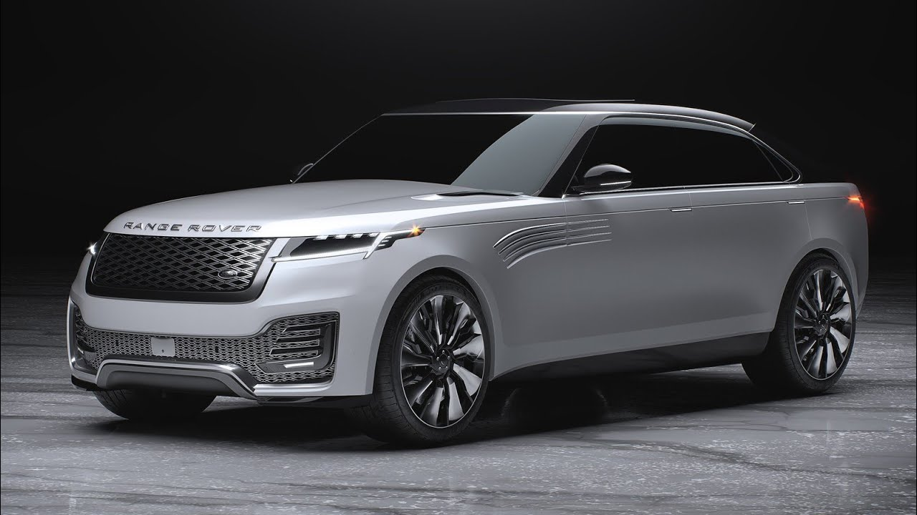
GROUP MEMBER 3
What to Expect in Future
Going into the future, Range Rover seeks to explore technologies that track the driver’s health
There is need to install medical-grade sensors in the driver's seat and steering wheel
The sensors will track the driver's heart rate and breathing rate while driving
Changes in breathing and heart rates would suggest there is danger, and the vehicle can easily be brought to safe halt with the help of self-driving technology
Communication of the car’s GPS location with emergency responders may also be an additional expansion
Notes:
With driver protection a priority in the design of all Range Rover cars, the future car technologies team may explore methods to track the individual's health behind the wheel. One option to explore is installing medical-grade sensors in the driver's seat and steering wheel, which track the driver's heart rate and breathing rate while driving. Observing these vital indicators means that a rapid change in respiration or heart rate, which may indicate danger, may be used in conjunction with self-driving technology to bring the vehicle to a safe halt in the case of a health emergency. Communicating the car's Gps location with emergency responders may also be an additional expansion of testing and possible future inclusion to Range Rover's in-car technology.

Slide 9
Going into the Future
Range Rover can consider starting to manufacture top of the class motorcycles for bike lovers
This will attract a wide range of individuals who have hard trust for Range Rover products
The pricing of these bikes can be done the same way as companies such as BMWs
Notes:
Range Rover can consider starting to manufacture top of the class motorcycles for a target market that loves bikes. This will increase its target market because it will attract a wide range of individuals who have hard trust for Range Rover products. These bikes can be priced per the current bikes from companies like BMW, thus fitting in the market perfectly.

Slide 10
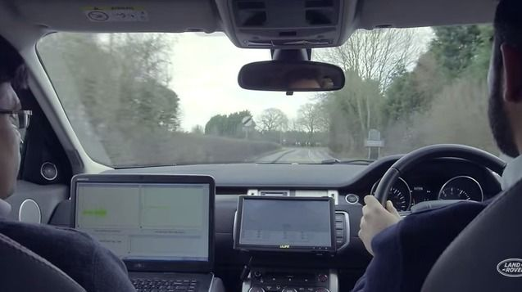
Going into the Future
Pothole Alert Technology
Advanced sensors installed in the tires and beneath the car detect potholes
Range Rover will need to improve this technology by adding advanced forward-looking stereo digital cameras to analyse the road ahead
When a car hits a pothole, its position data may be relayed to other Range Rovers through Connected Car technology
Notes:
Potholes are an inevitable part of our driving experience, but we believe that with Pothole Alert Technology, this will be a thing of the past. Advanced sensors installed in the tires and beneath the car detect potholes and change the suspension in milliseconds. The future goal may be to improve this technology by adding advanced forward-looking stereo digital cameras to analyse the road ahead. The goal is to integrate this sensory system with self-driving technology in the vehicle to safely steer itself around a pothole it senses in the road ahead. When a car hits a pothole, its position data may be relayed to other Range Rovers through Connected Car technology. Other Land Rover drivers will be alerted on potholes in plenty of time by sharing this information, enabling them to avoid them. Another use for this information is to share it with local governments, providing them with up-to-date data on the incidence and position of potholes.

Slide 11
Reference List
Hazell, P., 2012. A very British SUV: How Land Rover used sport, competition and notions of adventure to reinvent the utility four-wheel drive.
Hull, N., 2018. Land Rover Design: 70 Years of Success. Veloce Publishing.
Piddock, C., 2018. Range Rover SV Autobiography LWB. Carson-Dellosa Publishing.

