Slide 1
MERITOCRACY: ASPIRATIONS AND EDUCATION IN RWANDA.
SARA NORRIS 1501215

Slide 2
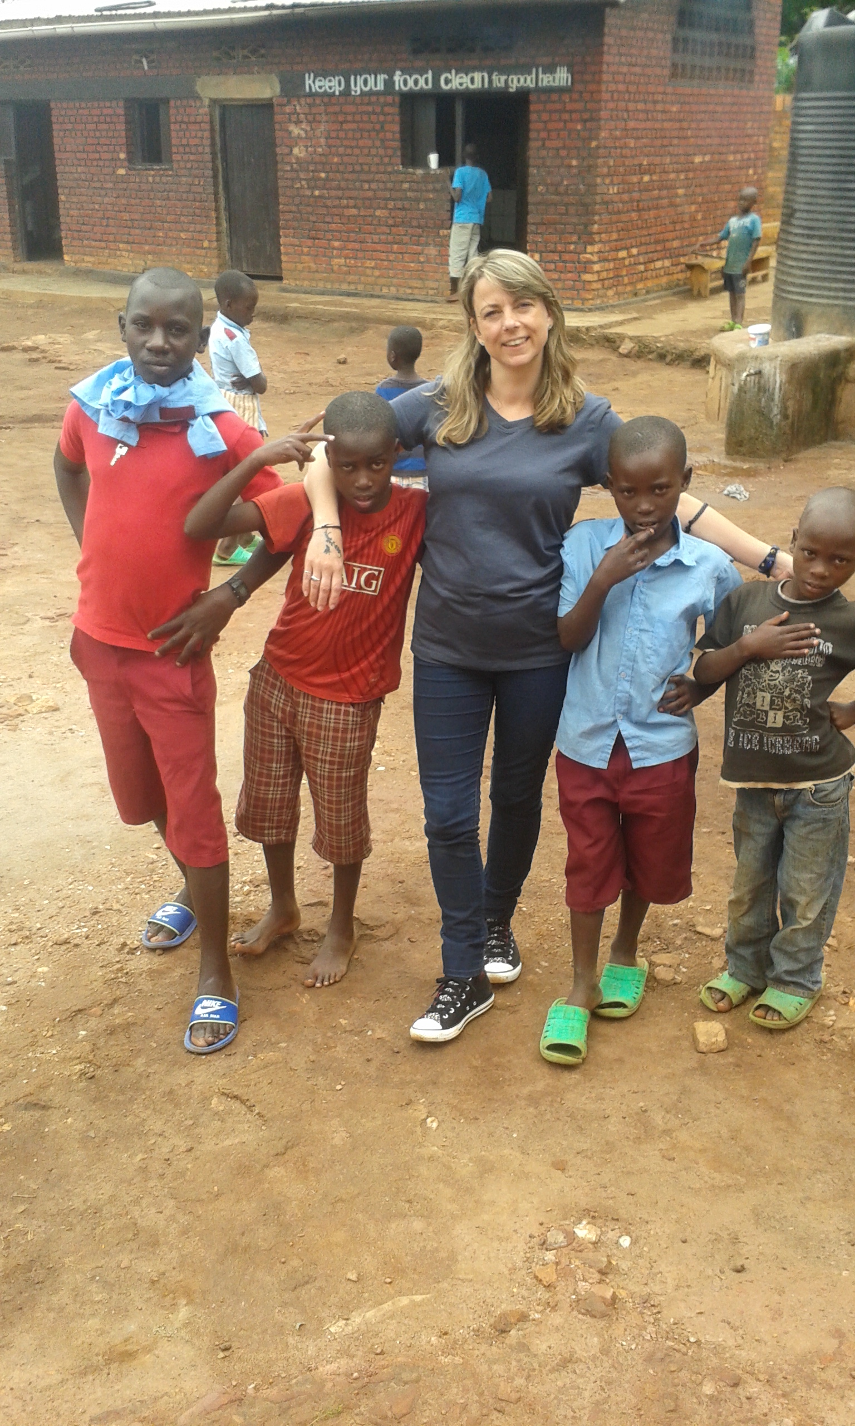
RESEARCH SITE.
Kayonza, in the Eastern Province of Rwanda.
Research was conducted over two periods.
First of which was in the spring for a month.
Second was for a fortnight in the summer.

Slide 3
Dissertation.
I have approached my dissertation from a Neo-Marxist perspective, utilising the ethnographic data collected in conjunction with the neo-liberalist compelled concept of meritocracy, this dominant Global North ideology has been instated as the corner stone of Rwanda’s new economic policy, successfully disseminated through the schooling system and is now reflected in the aspirations and discourse adopted by the children I encountered during my research period. However, utilising the original theory on meritocracy, and the uneven playing field I am able to demonstrate that despite aspirations to achieve many children will in fact never be presented with the opportunities to gain success in the first place.

Slide 4
LITERATURE REVIEW: KEY THEORISTS.
The basis of my dissertation came from the concept of Meritocracy a theory based upon socialist origins which was contorted to herald a neo-liberal principle based upon a hierarchy of merit, demonstrated in Jo Littler’s (2018) radical left wing expose Against Meritocracy: Culture, power and myths of mobility. Utilising this theory I was able to combine it with other Neo-Marxist studies most notably Willis’ (1978) Learning to labour and Mallona’s (2005) article: Factory, Family and Neighbourhood: The political Economy of Informal Labour in Sheffield. This highlighted how the principle of equality is dependent on the active role of the welfare state, Esping-Andersen’s (1990) The Three Worlds of Welfare Capitalism provided vital information on this perspective.

Slide 5
RWANDA. (Storey 1999.)
SUBSISTENCE FARMING: LIVING ON LESS THAN AN ACRE.
POPULATION DENSITY.
SOIL DEPLETION.
CASH CROPPING.
STRUCTURAL ADJUSTMENT POLICY.
COLLAPSE IN INFRASTRUCTURE.

Slide 6
Moving towards a neo-liberal state: The creation of a class structure.
With the removal of the terminology and concept of ethnicity from Rwandan society, a new system of stratification was implemented.
Elite class.
Middle class.
Poor.
Vulnerable.

Slide 7
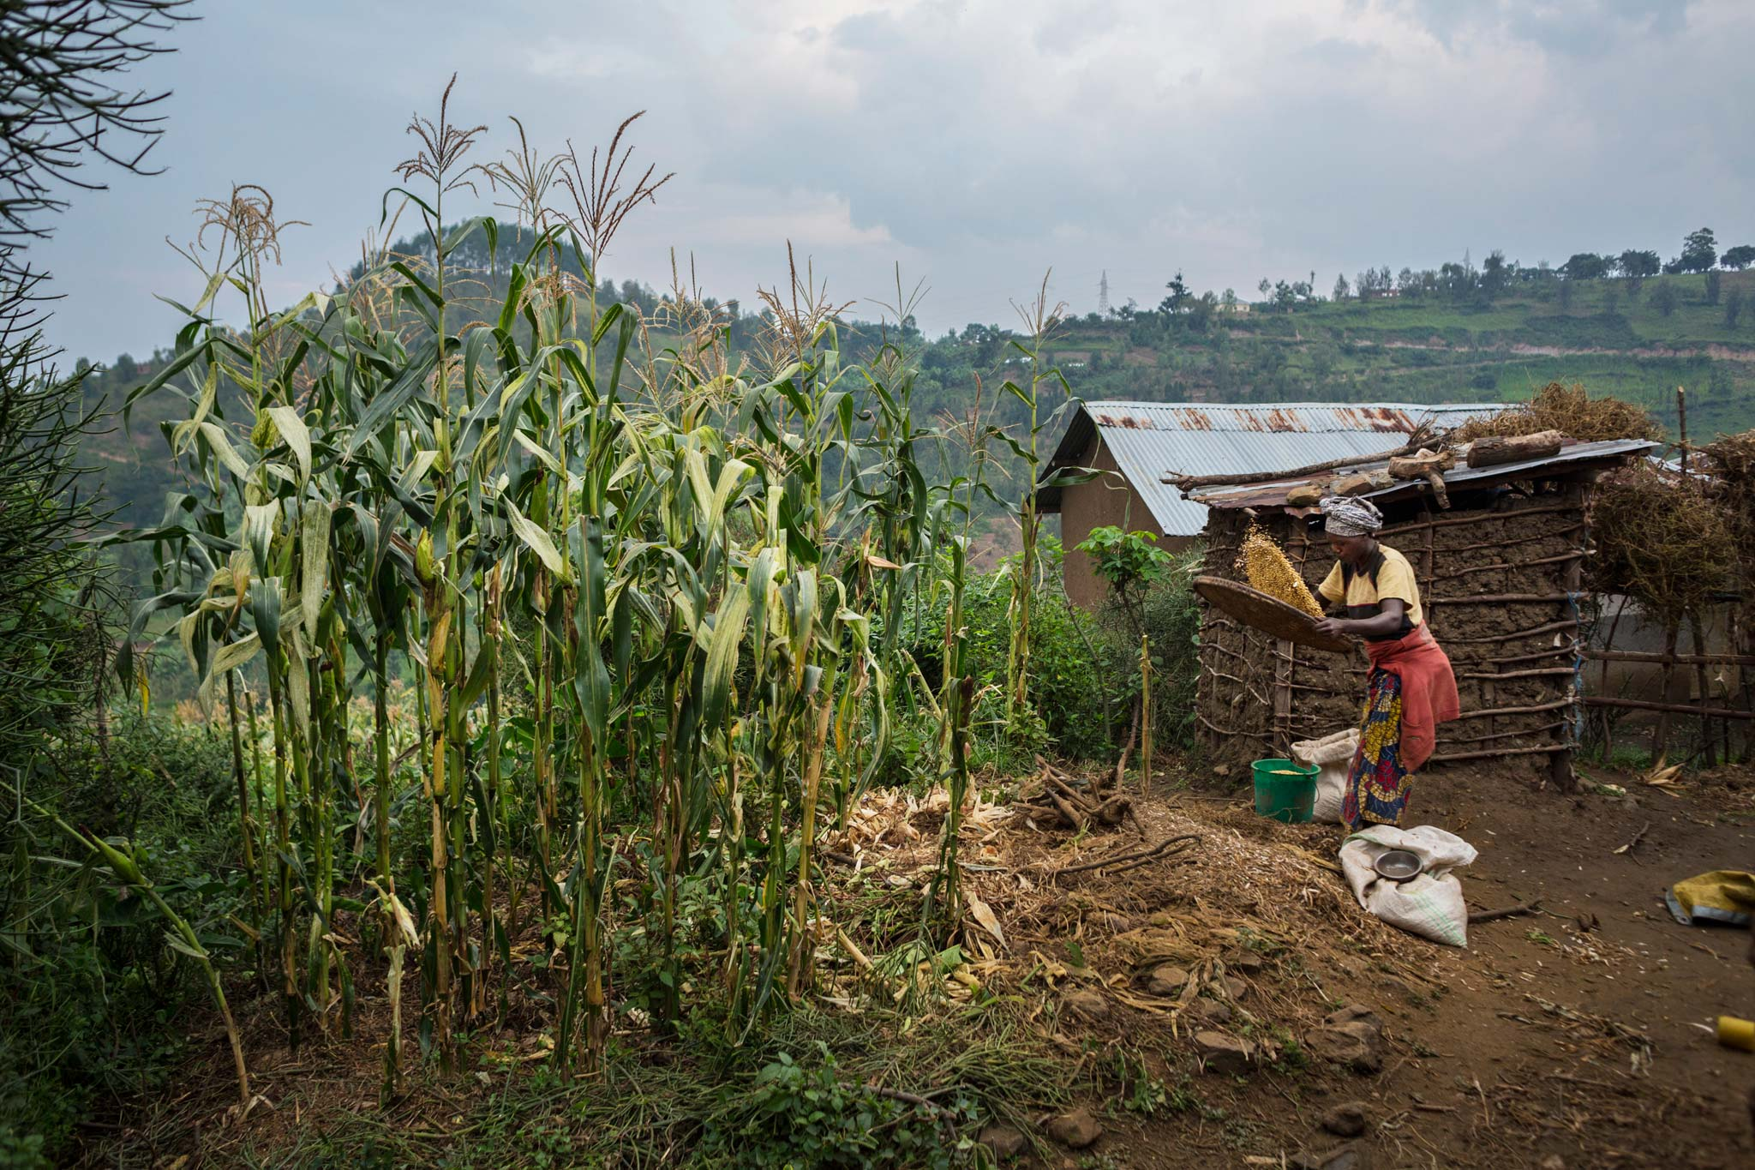
NEO-LIBERAL IDEOLOGIES. (RWANDA VISION 2020)
RWANDA HAS DECIDED TO IMPLEMENT MEASURES WHEREBY IT MOVES AWAY FROM BEING A SUBSISTENCE ECONOMY AND DEVELOPS ITS SECONDARY AND TERTIARY SECTORS.
Image 2, courtesy of National geographic.com

Slide 8

THE CONCEPT OF MERITOCRACY. Alan Fox, McNamee & Miller 2009, Littler 2018.
HARD WORK EQUALS SUCCESS AND SECURITY.
ASPIRATIONS.
DISSEMINATION OF POLITICAL IDEOLOGY.
Image 3, courtesy of tigrayblogspot.com

Slide 9
EDUCATION IN RWANDA. (Williams et al 2014)
COMPULSORY EDUCATION, THE TWELVE YEARS OF EDUCATION.
FREE EDUCATION?
PAYING FOR PTA: THE VOLUNTARY CONTRIBUTION YOU MUST PAY FOR YOUR CHILDS EDUCATION.
POORER DISTRICTS PAY LESS PTA, TEACHERS MUST EAT TOO.
NO SCHOOL UNIFORM, NO ADMITTANCE.
BUYING BOOKS AND PAYING FOR EXAMS.
18 AND STILL IN PRIMARY ONE.

Slide 10
LEVEL PLAYING FIELD? PLUTOCRATIZATION. (WILLIAMS ET AL 2014, PAUL WILLIS 1978 AND THE CCCS.)
MIDDLE CLASS KIDS AND PRIVATE SCHOOLING.
COMPLETING SECONDARY EDUCATION.
UNIVERSITIES: FEES AND DREAMS.
STRUCTURAL VIOLENCE OF POVERTY.
PAUL WILLIS, LEARNING TO LABOUR.

Slide 11
INVESTMENT IN YOUTH. BOURDIEU & PASSERON (1977).
THE CONCEPT OF CULTURAL CAPITAL.
BEYOND ECONOMIC INVESTMENT.
CAN YOU READ WITH ME?
SOCIAL CONNECTIONS.

Slide 12
FINAL ARGUMENT.
MALLONA (2005)
MEILLASSOUX (1975)
DEMONSTRATING HOW RWANDA’s RELUCTANCE TO FINACIALLY COMMIT TO STATE WELFARE THAT IS NOT BOUND PURELY TO SOCIAL INSURANCE OR POVERTY PREVENTION STRATEGIES BASED UPON A COMMUNITY MODEL AKIN TO THE TRADITIONAL POOR LAWS IN FACT IS HINDERING RWANDA DEVELOPING INTO A MORE EQUAL AND LESS HIERARCHAL SOCIETY.

Slide 13
REFERENCES.
Bourdieu, P. & J. Passeron (1977) Reproduction in Education, society and culture. London: Sage.
countrymeters.info/en/rwanda/ Accessed 23/01/2018.
Esping-Anderson, G.(1990) The Three Worlds of Welfare Capitalism. Cambridge: Polity Press.
Littler, J. (2018) Against Meritocracy: Culture, Power and Myths of Mobility. London: Routledge.
Mallona, M. (2005) Factory, Family and Neighbourhood: The Political Economy of Informal Labour in Sheffield. Journal of the Royal Anthropological Institute. Vol.11, no 3 527-548.
McNamee, S. & R, Miller (2009) The Meritocracy myth. Lanham: Rowham and Littlefield.
Meillassoux, C. (1975) Maidens, Meal and Money. Cambridge: Cambridge University Press.
Rwanda vision 2020 https://collaboration.worldbank.orgs/docs/DOC.21237
Storey, A. (1999) Economics and Ethnic Conflict in Rwanda: Structural Adjustment. Development Policy Review. 17, 43-63.
Williams, T., P. Abbott & A, Mupenzi (2014) Education at our Schools is not free. Compare: A Journal of Comparative and International Education, DOI 10.1080/03057925.2014.938611
Willis, P. (1977) Learning to Labour: How Working Class kids get Working Class Jobs. London: Routledge.

Slide 14
Images
1. Image Rwanda, Authors own 2017.
2. Image Climbing to success. Tigray.blogspot.com.
3. Image National Geographic Farms. Midtownblogger.blogspot.com

