Slide 1

GROUP PROJECT
0

Slide 2

COMMUNICATION FAILURES AT FLIGHT FOODS LTD: ANALYSIS & SOLUTIONS
TUTOR - LLOYD BEHARRY
GROUP MEMBERS:
01
• ANDRIANA CHEMODUROVA – 2441784
• OLHA YATSYNA – 2441936
• BLAGA NAYDENOVA – 2424541
• IHOR VYNNYCHUK – 2440578

Slide 3

OVERVIEW
Today we will cover:
  Introduction – Andriana (Slide 4)
  Barrier and Solution 1 (Language & Cultural Misunderstanding) – Olha (Slides 5–6)
  Barrier and Solution 2 (Weak Leadership & Role Modelling) – Blaga (Slides 7–8)
  Barrier and Solution 3 (Information Flow Breakdown) – Andriana (Slides 9–10)
  Barrier and Solution 4 (Noise & Physical Environment) – Ihor (Slides 11–12)
  Conclusion & References – Ihor (Slides 13–14)
02

Slide 4
INTRODUCTION
Flight Foods Ltd is a medium-sized company that produces ready-made meals for airlines.
Recently, the company has been losing clients because of complaints about food quality, safety issues, and poor communication inside the factory.
The workforce consists of people from five different cultural groups with limited English skills, which creates major communication barriers.
This presentation identifies these barriers and suggests practical solutions.
03

Slide 5

BARRIER 1 OLHA: LANGUAGE & CULTURAL MISUNDERSTANDING
PROBLEMS:
• Limited English proficiency
• Misinterpreted hygiene instructions
• Repeated mistakes
04
THEORY LINK: SEMANTIC NOISE DISRUPTS MESSAGE DECODING (SHANNON & WEAVER, 1949)
Evidence: Clear language is essential for safe food production (FSA, 2022)

Slide 6

SOLUTION 1 OLHA: IMPROVE COMMUNICATION PRACTICES
ACTIONS:
• Conduct briefings in a quiet area
• Use repeat-back method
• Implement daily structured briefings
• Encourage questions without fear
05
SUPPORTED BY: STRUCTURED COMMUNICATION REDUCES ERRORS (ACAS, 2023)

Slide 7

BARRIER 2 BLAGA: WEAK LEADERSHIP & ROLE MODELLING
PROBLEMS:
• Manager ignores hygiene rules
• Workers copy incorrect behaviour
• Low clarity and trust
06
THEORY LINK: MESSAGE CREDIBILITY DEPENDS ON THE “SOURCE” (BERLO, 1960)
EVIDENCE: LEADERSHIP BEHAVIOUR SHAPES COMMUNICATION CULTURE (KEYTON, 2011)

Slide 8

SOLUTION 2 BLAGA: STRENGTHEN LEADERSHIP & CONSISTENCY
ACTIONS:
• Manager must model correct behaviour
• Leadership and hygiene training
• Consistent enforcement of standards
• Supervisors demonstrate best practice
07
SUPPORTED BY: LEADERSHIP CONSISTENCY IMPROVES COMMUNICATION (CIPD, 2023; KEYTON, 2011)

Slide 9

BARRIER 3 ANDRIANA: INFORMATION FLOW BREAKDOWN
PROBLEMS:
• No structured communication system
• Inconsistent instructions
• Workers rely on guessing
08
THEORY LINK: MISSING COMMUNICATION CHANNELS CREATE TECHNICAL NOISE (SHANNON & WEAVER, 1949)
EVIDENCE: UNCLEAR INSTRUCTIONS REDUCE JOB PERFORMANCE (GAMBLE & GAMBLE, 2013)

Slide 10
SOLUTION 3 ANDRIANA: IMPROVE INFORMATION FLOW
ACTIONS:
• Standardise communication channels
• Provide written guidelines and diagrams
• Supervisors check understanding regularly
• Introduce a staff feedback logbook
09
SUPPORTED BY: CLEAR COMMUNICATION SYSTEMS IMPROVE TEAM COORDINATION (ADLER ET AL., 2018; CIPD, 2023)

Slide 11

BARRIER 4 IHOR: NOISE & PHYSICAL ENVIRONMENT
PROBLEMS:
• Old machinery causes Noise which can affect communication
• Gary Talks to his workers wherever they are
• No effective feedback loop
10
THEORY LINK: UNDERSTANDING REQUIRES TWO-WAY FEEDBACK (SCHRAMM, 1954)
Evidence: Workplace noise increases communication errors (HSE, 2023)

Slide 12

SOLUTION 4 IHOR: SUPPORT LANGUAGE & CULTURE NEEDS
ACTIONS:
• Provide translated hygiene instructions
• Use visual and colour-coded posters
• Use illustrated step-by-step guides
• Provide short video-based training
11
SUPPORTED BY: VISUAL MATERIALS IMPROVE COMPREHENSION (FSA, 2022; ADLER ET AL., 2018)

Slide 13
CONCLUSION
• Flight Foods faces four key communication barriers
• Theories explain the causes of message failure
• Evidence-based solutions can improve leadership, clarity, and hygiene
• Implementing these changes will support safer and more consistent operations
12

Slide 14
REFERENCES (HARVARD STYLE)
ACAS (2023) Improving Workplace Communication. Available at: https://www.acas.org.uk (Accessed: 24 November 2025).
Adler, R.B., Rosenfeld, L.B. and Proctor, R.F. (2018) Interplay: The Process of Interpersonal Communication. 14th edn. Oxford: Oxford University Press.
Berlo, D.K. (1960) The Process of Communication: An Introduction to Theory and Practice. New York: Holt, Rinehart and Winston.
CIPD (2023) Effective Employee Communication. Available at: https://www.cipd.co.uk (Accessed: 24 November 2025).
Food Standards Agency (FSA) (2022) Food Hygiene Regulations and Staff Training Requirements. Available at: https://www.food.gov.uk (Accessed: 24 November 2025).
Gamble, T. and Gamble, M. (2013) Interpersonal Communication: Building Connections Together. 2nd edn. London: SAGE.
Health and Safety Executive (HSE) (2023) Noise at Work: Guidance for Employers. Available at: https://www.hse.gov.uk/noise (Accessed: 24 November 2025).
Keyton, J. (2011) Communication and Organizational Culture. Thousand Oaks: SAGE.
Schramm, W. (1954) ‘How Communication Works’, in Schramm, W. (ed.) The Process and Effects of Communication. Urbana: University of Illinois Press, pp. 3–26.
Shannon, C.E. and Weaver, W. (1949) The Mathematical Theory of Communication. Urbana: University of Illinois Press.
Tubbs, S.L. and Moss, S. (2008) Human Communication: Principles and Contexts. 12th edn. Boston: McGraw-Hill.
University of Wales Trinity Saint David (2025) Flight Foods Ltd Case Study. LCLM4003 Component 2 Assessment Brief.
13

Slide 15



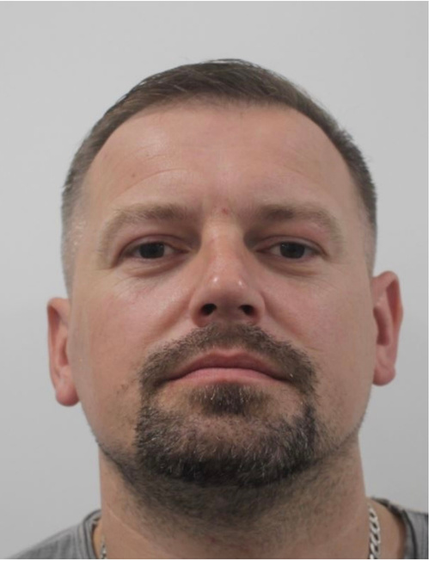
OUR TEAM
Andriana Chemodurova
Olha Yatsyna
Blaga Naydenova
Ihor Vynnychuk

Slide 16

THANK YOU

