Slide 1
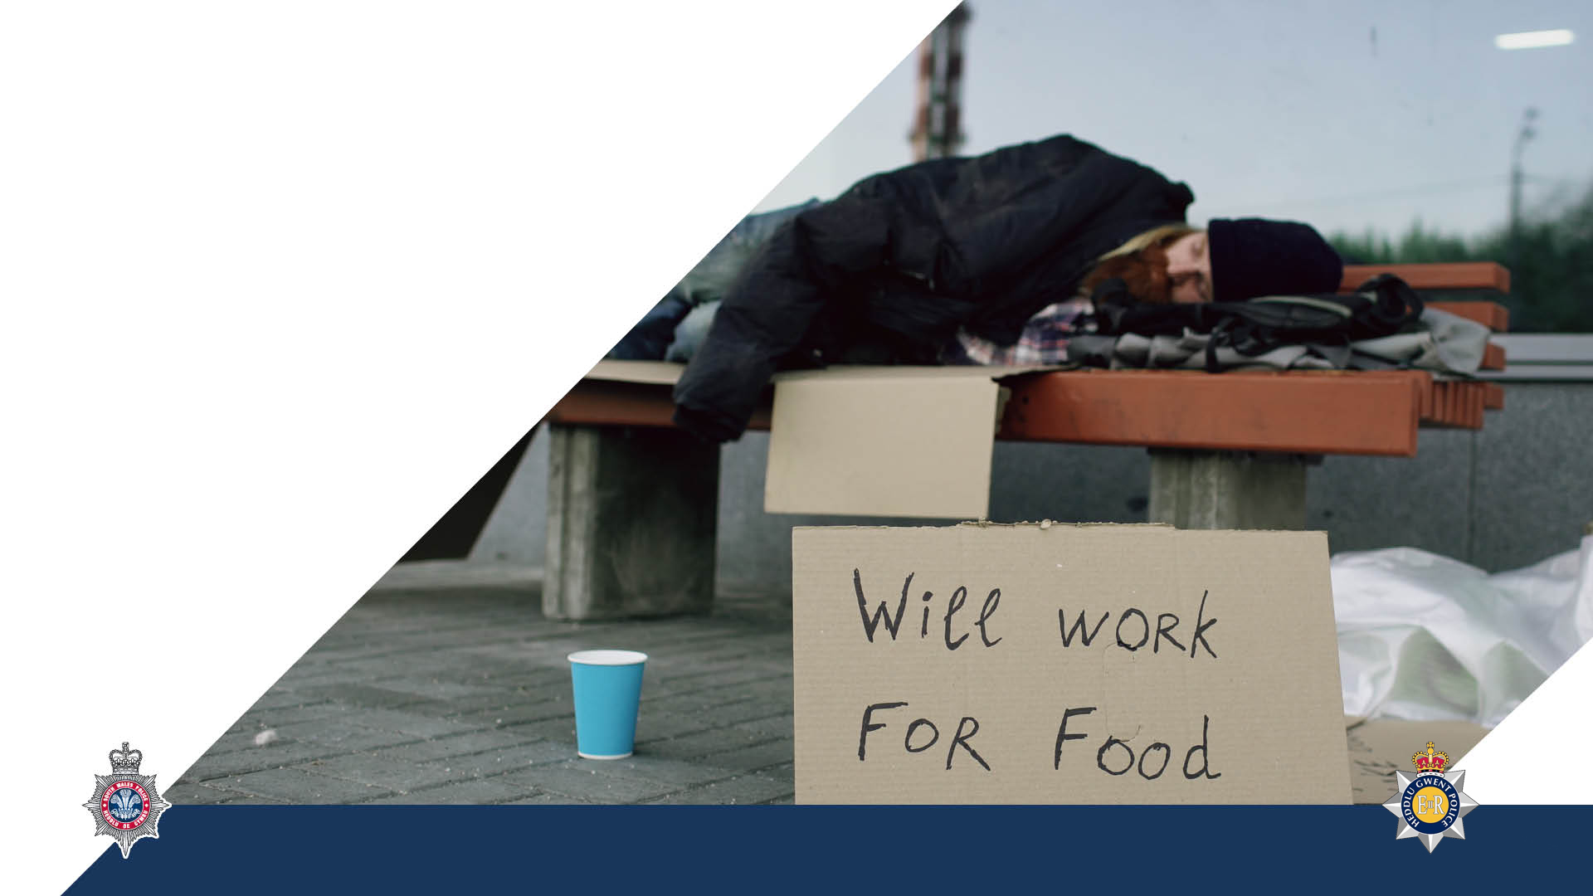

Hate Crime & Racially/Religiously Aggravated Offences
Speaker
Notes:
**** Health warning *** Some of the content discussed may be emotive for some of the students. Trainers to give a health warning, which is appropriate for their forces.
By the end of this lesson, you will be able to:
State the differences between a Hate Crime & Hate incident.
Explain why particular members of society might be subject to hate/prejudice.
Describe the impact Hate Crime/Hate Incidents might have on victims
Outline the initial police response to Hate Crime/Hate Incidents
Discuss key definitions and legislation associated with Hate Crime, Hate Incidents and Racial/Religious aggravated offences.

Slide 2

Hate Incident
Any incident, which may or may not constitute a criminal offence, perceived by the victim or any other person as being motivated by prejudice or hate.
ANYONE CAN BE A VICTIM OF A HATE INCIDENT
Notes:
State:
The police and Crown Prosecution Service have agreed a common definition of hate incidents. (Click)
This means that if someone believes something is a hate incident it should be recorded as such. It is possible that the reporting officer may be the only person that perceives such a motivation.
All police forces record hate incidents based on these five personal characteristics.
Sexual orientation/perceived sexual orientation
Transgender/perceived transgender
Race/perceived race
Religion/perceived religion
Disability/perceived disability
Some police forces also record hate incidents based on other personal characteristics such as age.
It is important to note that prejudicial behaviour towards a social group can be based on a wide range of identifying factors, not exclusively those mentioned above.
Examples – ASB (throwing fireworks) throwing mud against someone’s house wall, posting litter through letterbox, persistent knock door run etc.
What must be made clear is that evidence of an offence is not required in order for an allegation of a hate incident to be recorded. THE PERCEPTION THAT A HATE INCIDENT HAS OCCURRED ON THE PART OF ANYONE IS ALL THAT IS REQUIRED.

Slide 3
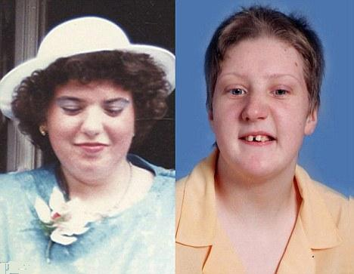
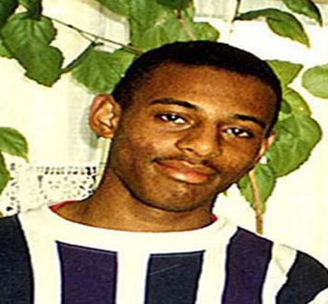
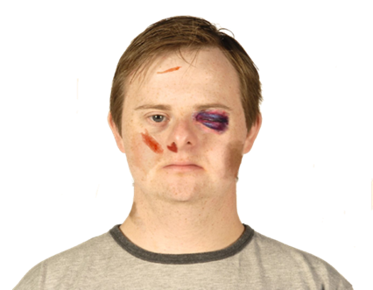
Hate Crime
Any hate incident, which constitutes a criminal offence, perceived by the victim or any other person as being motivated by prejudice or hate.
ANYONE CAN BE A VICTIM OF A HATE CRIME

Slide 4
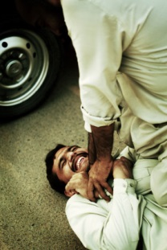
Hate Motivation
Hate crimes and incidents are taken to mean any crime or incident where the perpetrator’s hostility toward or prejudice against an identifiable group of people is a factor in determining who is victimised.
Notes:
This is a broad and inclusive definition.
A victim does not have to be a member of the group it is the offender’s perception that will make someone ‘part of a group’.

Slide 5

Identifiable Groups
Sexual Orientation or perceived Sexual Orientation
Transgender or perceived Transgender
Race or perceived Race
Religion or perceived Religion
Disability or perceived Disability

Slide 6
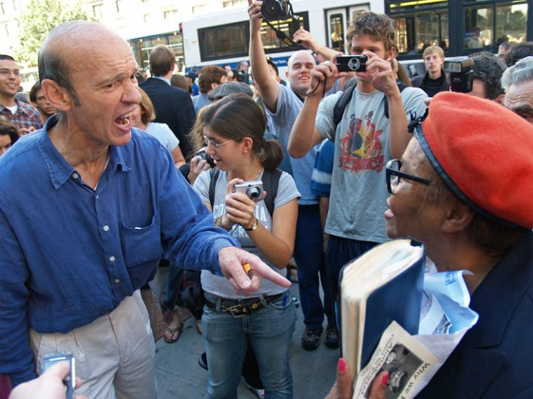
Hostility
‘ill-will, ill-feeling, spite, contempt, prejudice, unfriendliness, antagonism, resentment and dislike’

Slide 7
Police Action when dealing with Hate Motivated Incidents
All incidents of hate must be documented as these often lead towards hate crimes, and evidence of previous activity by an alleged offender is excellent evidence to put before a court.
Requirement by the Home Office for the reporting and recording of all hate crimes and incidents.

Slide 8
Impact on Victims
Notes:
Trainer to pose question to students and record answers on wipe board

Slide 9
Impact on Victims
Isolation
Fear
Feeling of difference
Mistrust
Shock
Bewilderment
Notes:
Trainer to pose question to students and record answers on wipe board

Slide 10
Should We Treat Everyone the Same?
Notes:
Trainer to pose question to students and discuss answers provided.
Trainer to discuss the idea of treating everyone the same.
Is this always appropriate or should we treat people according to their needs?
What about the public perception?
What would they expect?

Slide 11
Hate Incidents and Hate Crime
The notion of ‘treating everyone the same’ is not appropriate:
As Police Officers it is our duty to recognise the vulnerable groups within our communities who are likely to be victimised.
Notes:
The notion of ‘treating everyone the same’ is not appropriate:
As Police Officers it is our duty to recognise the vulnerable groups within our communities who are likely to be victimised.
We must ensure they receive the standard of policing that is appropriate to their particular circumstances.
This may involve extra protection, extra preventative measures, additional support for victims or careful liaison to ensure that all sections of the relevant group are consulted.

Slide 12
Hate Incidents and Hate Crime
It is important that victims of hate crime/incidents are offered support from very early on. Other agencies that can assist include:
  Victim Support
  Local Authority Probation Service
  Housing Department
  Local Education Authority
  Social Services
  Safeguarding Children Board
  Crown Prosecution Service
  Primary Care Trusts
  Voluntary Community Groups
  Race Equality Councils (R.E,Cs)
Notes:
The notion of ‘treating everyone the same’ is not appropriate:
As Police Officers it is our duty to recognise the vulnerable groups within our communities who are likely to be victimised.
We must ensure they receive the standard of policing that is appropriate to their particular circumstances.
This may involve extra protection, extra preventative measures, additional support for victims or careful liaison to ensure that all sections of the relevant group are consulted.

Slide 13

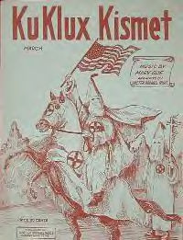
Racially & Religiously Aggravated Offences
Notes:
The definition of these aggravated offences was enacted under the Crime and Disorder Act 1998 which created a number of specific offences of racially aggravated crime, based on offences of Wounding, Assault, Criminal Damage, Public Order (harassment and threatening/abusive behaviour).

Slide 14
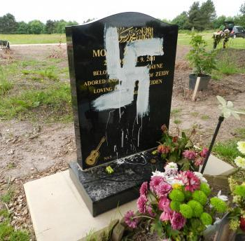
Racially & Religiously Aggravated Offences
An offence is racially or religiously aggravated if,
at the time of committing, or immediately before or after doing so,
the offender demonstrates towards the victim hostility
based on the victim’s membership or presumed membership of a racial or religious group or
The offence is motivated (wholly or partly) by hostility towards members of a racial or religious group based on their membership of that group.
Section 28 Crime and Disorder Act 1998
Notes:
The definition of these aggravated offences was enacted under the Crime and Disorder Act 1998 which created a number of specific offences of racially aggravated crime, based on offences of Wounding, Assault, Criminal Damage, Public Order (harassment and threatening/abusive behaviour).
Monitoring had indicated that these types of crime were those most commonly experienced by victims of racial violence or harassment.
The Act was amended by the Anti-Terrorism Crime and Security Act 2001. It extended the scope of the Crime and Disorder Act by creating a new specific religiously aggravated offence – Harassment, and applying the same sentencing duty to all other offences where there is evidence of religious aggravation.
The Act was amended further by the Protection of Freedoms Act 2012, which created a new specific offence of stalking and it also created racially and religiously aggravated versions of these offences.
Membership – in relation to a racial or religious group, includes association with members of that group
Presumed – means presumed by the offender

Slide 15

Racial Groups
A group of persons defined by reference to race, colour, nationality (including citizenship) or ethnic or national origins.
Sec. 28(4) Crime and Disorder Act 1998
Notes:
The definition of these aggravated offences was enacted under the Crime and Disorder Act 1998 which created a number of specific offences of racially aggravated crime, based on offences of Wounding, Assault, Criminal Damage, Public Order (harassment and threatening/abusive behaviour).

Slide 16




Religious Groups
A group of persons defined by reference to religious belief
or lack of religious belief.
Sec. 28(4) Crime and Disorder Act 1998

Slide 17
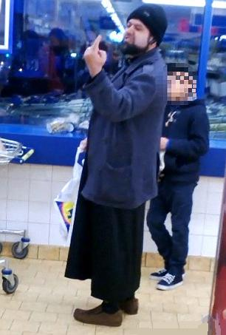
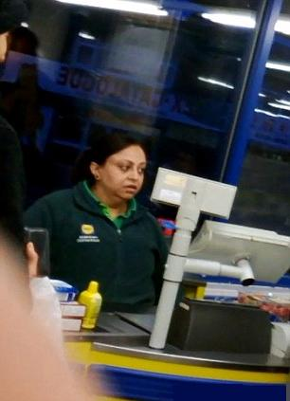
Racially & Religiously Aggravated Offences
Assaults
  Common Assault
  Actual Bodily Harm
  Wounding or Grievous Bodily Harm
Criminal Damage:
  ‘Simple’ Criminal Damage
Public Order:
  Causing Harassment, Alarm or Distress
  Causing Fear or Provocation of Violence
  Intentional Harassment, Alarm or Distress
Stalking & Harassment:
  Stalking & Harassment
  Putting People in Fear of Violence
Notes:
The offences you can see are defined as being racially aggravated under Sections 28 to 32 of the Crime and Disorder Act 1998 and should be charged as the aggravated offences created by the Crime & Disorder Act, If found guilty the offender will automatically receive higher sentencing.
All other offences should be charged as the offence committed for example the Theft Act 1968, and any racially or religious aggravation added to the file so that sentence can be increased if the courts feel this is appropriate,
The pictures you can see are from an incident in Birmingham, where a female Lidl store assistant abused a customer because she thought he was Muslim.
Witnesses said the man got into an argument with the cashier in front of other customers because he did not know that carrier bags in the supermarket had to be be paid for.
The cashier repeatedly swore at the man while customers watched, and she described him as an ‘arrogant Muslim’. She even addressed him as ‘Mohammed’.
He made a comment about the way she was speaking to him and she just exploded shouting ‘I was having a good day until I saw your f***ing face.’ Shoppers heard her screeching: ‘Go on, you Muslim, die.’

Slide 18
Racially & Religiously Aggravated Offences: Penalties
Assaults:
Sec 20 - Malicious wounding or grievous bodily harm
Summary 6 months imprisonment or fine, Indictment – 7 yrs
Sec 47 – Actual bodily harm
Summary 6 months imprisonment or fine, Indictment – 7 yrs
Common assault
Summary 6 months imprisonment or fine, Indictment – 2 yrs
Notes:
The definition of these aggravated offences was enacted under the Crime and Disorder Act 1998 which created a number of specific offences of racially aggravated crime, based on offences of Wounding, Assault, Criminal Damage, Public Order (harassment and threatening/abusive behaviour).
Section 29 of the Crime and Disorder Act 1998 provides three racially or religiously aggravated assault offences committed where an assault meets the racial or religious aggravation test in section 28.
29(1) A person is guilty of an offence under this section if he commits -
(a) an offence under section 20 of the Offences Against the Person Act 1861 (malicious wounding or grievous bodily harm);
(b) an offence under section 47 of that Act (actual bodily harm); or
(c) common assault,
which is racially or religiously aggravated for the purposes of this section.
- Did this happen Kamil?

Slide 19
Comparison
Offence: | Non-Racially Aggravated: | Racially Aggravated:
Common Assault: | 6 months imprisonment | 2 years imprisonment
Actual Bodily Harm: | 5 years imprisonment | 7 years imprisonment
Grievous Bodily Harm: | 5 years imprisonment | 7 years imprisonment

Slide 20
Racially & Religiously Aggravated Offences: Penalties
Criminal Damage:
Summary 6 months imprisonment and/or fine, Indictment – 14 years
Public Order – Sec.4 Fear or provocation of violence
Summary 6 months imprisonment and/or fine, Indictment – 2 years
Public Order – Sec 4A Intentional harassment, alarm or distress
Summary 6 months imprisonment and/or fine, Indictment – 2 years
Public Order – Sec 5 Harassment, alarm or distress
Summary 6 months imprisonment and/or fine

Slide 21
Racially & Religiously Aggravated Offences: Penalties
Harassment – Sec.32(1) Crime & Disorder Act 1998
Sec.2 or 2A - Offences of harassment and stalking
Summary 6 months imprisonment and/or fine, Indictment – 2 years
Sec.4 or 4A - Harassment with fear of violence and stalking involving fear of violence or serious alarm or distress
Summary 6 months imprisonment and/or fine, Indictment – 7 years

Slide 22
Racial & Religious Hatred 2006
Notes:
Racial & Religious Hatred Act 2006
An Act to make provision about offences involving stirring up hatred against persons on racial or religious grounds.
The Public Order Act 1986 is amended in accordance with the Schedule to this Act, which creates offences involving stirring up hatred against persons on racial and religious grounds.

Slide 23
Racial & Religious Hatred
A person who:
  Uses threatening, abusive or insulting words or behaviour or
displays any written material which is threatening, abusive or insulting
is guilty of an offence if
  he intends thereby to stir up racial hatred or
  having regard to all the circumstances racial hatred is likely to be stirred up thereby
Contrary to: Section 18 Public Order Act 1986
Notes:
Threatening" includes verbal and physical threats, and also violent conduct; "abusive" means using degrading or reviling language; "insulting" has been held to mean scorning, especially if insolent or contemptuous. It does not mean behaviour which might give rise to irritation or resentment (e.g. running onto a tennis court at Wimbledon blowing a whistle and stopping the game
The term ‘displays' is not defined by the Act itself. The word should therefore be given its natural meaning as defined by the Oxford dictionary - display means a visual presentation, the action,or act of displaying or exhibiting to view or the presentation of printed matter in such a way as to make it visually prominent.
written material
includes any sign or other visible representation. (see note below).
Note
Common sense dictates that the words be given their natural meanings. 'Visible representation' is defined by the Oxford Dictionary as a reproduced image or likeness, visible to the eye. This should include electronic forms of representation such as television displays and computer monitor images, as well as the more permanent forms such as photographs etc.
In criminal law 'intent' is often an element of the offence. It is known in law as 'mens rea', which is Latin for 'guilty mind'. Intention is not defined but has to be proved. It can be proved by drawing on two sources of information or by a combination of both:
1) By admissions made by the defendant in interview with reference to his state of mind at the time of commission of the offence and his answers to questions with regard to his actions and intentions at the time of the offence.
2) By inference from the circumstances the offence, any evidence from witnesses, the defendant's actions and property found on him or in his control, such as a motor vehicle for transporting property.
To prove intent, an officer needs to take all this into account, the important thing is that he has to prove the defendant's state of mind at the time.
When looking at these facts, a jury must look at the circumstances and decide whether the defendant would have intended or foreseen the results which occurred, which is a subjective test.
Section 17 of the Public Order Act 1986 defines 'racial hatred' for the purposes of Part III of the Act (sections 17 to 29). 17 In this Part racial hatred means hatred against a group of persons defined by reference to colour, race, nationality (including citizenship) or ethnic or national origins.
Notes
(i) 'Racial hatred' in Part III of the Public Order Act 1986 includes hatred manifested in Great Britain but directed against a racial or religious group outside Great Britain.

Slide 24
Racial & Religious Hatred
A person who:
  Publishes or distributes any written material which is threatening, abusive or insulting
is guilty of an offence if
  he intends thereby to stir up racial hatred or
  having regard to all the circumstances racial hatred is likely to be stirred up thereby
Contrary to: Section 19 Public Order Act 1986
Notes:
Either Way
SUMMARY: Six months imprisonment and / or a fine.
INDICTMENT: Seven years imprisonment and / or a fine.
Consent of Attorney-General required for prosecution
Note that the points to prove are exactly the same as those in the Sec 18 offence covered previously.
In proceedings for an offence under this section it is a defence for an accused who is not shown to have intended to stir up racial hatred to prove that he was not aware of the content of the material and did not suspect, and had no reason to suspect, that it was threatening, abusive or insulting.
References in this part to the publication and distribution of written material are to its publication or distribution to the public or a section of the public.
Note
It must be proved that there was a publication or distribution to the public or to a section of the public.

Slide 25

Racially & Religiously Aggravated Offences
Kamil’s story
Notes:
The definition of these aggravated offences was enacted under the Crime and Disorder Act 1998 which created a number of specific offences of racially aggravated crime, based on offences of Wounding, Assault, Criminal Damage, Public Order (harassment and threatening/abusive behaviour).
The number of hate crimes in England and Wales has increased by 29%, according to Home Office statistics.
There were 80,393 offences in 2016-17, compared with 62,518 in 2015-16, the largest increase since the Home Office began recording figures in 2011-12.
https://www.youtube.com/watch?v=kYqJ_zuMhEc

Slide 26

Notes:
Racial & Religious Hatred Act 2006
An Act to make provision about offences involving stirring up hatred against persons on racial or religious grounds.
he Public Order Act 1986 is amended in accordance with the Schedule to this Act, which creates offences involving stirring up hatred against persons on racial and religious grounds.

