Slide 1
Peer and
Self Assessment:
A Guide
Sources:
http://nationalstrategies.standards.dcsf.gov.uk/node/18700
http://www.ukcle.ac.uk/resources/assessment/group.html
http://www.sedl.org/pubs/tl05/images/icons.gif
www.nsead.org/downloads/Art_Peer_Assessment_example.doc

Slide 2
Contents
Introduction
Guide
Summary
Slides to drop into lessons
Bonus!

Slide 3
Peer and
Self Assessment: A Guide
Peer assessment and self-assessment is much more than children marking their own or each other's work. To improve learning, it must be an activity that engages children with the quality of their work and helps them reflect on how to improve it.
Peer assessment enables children to give each other valuable feedback so they learn from and support each other. It adds a valuable dimension to learning: the opportunity to talk, discuss, explain and challenge each other enables children to achieve beyond what they can learn unaided.
Peer assessment helps develop self-assessment, which promotes independent learning, helping children to take increasing responsibility for their own progress
From http://nationalstrategies.standards.dcsf.gov.uk/node/18700
Return to Contents

Slide 4
“Students can perform a variety of assessment tasks in ways which both save the tutor's time and bring educational benefits, especially the development of their own judgement skills.”
(Rust (2001) p10)
Return to Contents

Slide 5
Don’t be scared to not mark their books.
Look to mark about 25% of work and use this to set specific, focussed targets
Peer assessment should make up the rest of the marking.
Return to Contents

Slide 6
Now for
the guide
Return to Contents

Slide 7
plan peer assessment and self-assessment opportunities, for example with 'pair and share' opportunities during class questioning
1
Return to Contents

Slide 8
2
explain the intended learning outcomes behind each task and how they relate to the learning objectives, while ensuring that children are aware of the opportunities that learning presents (there may be opportunities to extend the learning for the more able children, or to relate to specific children's interests)
Return to Contents

Slide 9
3
provide children with clear success criteria to help them assess the quality of their work
Return to Contents

Slide 10
4
train children over time to assess their own work and the work of others, and develop an appropriate language
Return to Contents

Slide 11
5
give children opportunities in lessons to discuss and reflect on problem-solving and reasoning strategies, comparing and evaluating approaches
Return to Contents

Slide 12
6
frequently and consistently encourage children's self-reflection on their learning and guide children to identify their next steps
Return to Contents

Slide 13
One more time
Plan peer and self-assessment opportunities
Link outcomes to learning objectives
Provide clear success criteria
Train children to develop an appropriate assessment language
Provide opportunities to discuss and reflect
Guide children in self-reflection
Return to Contents

Slide 14
Examples of good practice
'Find one example you are really proud of and circle it. Tell the person next to you why you are pleased with it.'
‘Decide with your talk partner which of the success criteria you have been most successful with and which one needs help or could be taken even further.'
(After whole-class sharing for a minute or two) 'You have three minutes to identify two places where you think you have done this well and read them to your partner.'
'You have five minutes to find one place where you could improve. Write your improvement at the bottom of your work.'
'Look back at the problems you have solved today. Where were you successful? What approach did you take?
Return to Contents

Slide 15
Here are some slides
you can drop into
your lessons
Return to Contents

Slide 16
Why have mark schemes?
Uniformity - So that everyone knows they are working to the same criteria
Judgement - To help explain what is good and what could be improved
Communication - To help everyone understand what is expected, what has been achieved and what can be improved
Return to Contents

Slide 17
So what is peer and
self-assessment?
Think of a time when you have made a judgement about something you or someone else has done.
THINK PAIR SHARE
Now share it in pairs
Peer and self-assessment is all about making judgements of your own work and the work of others.
Return to Contents

Slide 18
Peer and self-assessment is all about making judgements of your own work and the work of others.
You should –
Identify what has been done well
Explain why it has been done well
Then...
iii) Identify what could be improved
iv) Explain how it could be improved
Return to Contents

Slide 19
Return to Contents
Comments should always be about the learning
If you say: It is well presented
It is neat
It is colourful
This does not help explain to the person why the work is good or can be improved. Always make it about the learning!

Slide 20
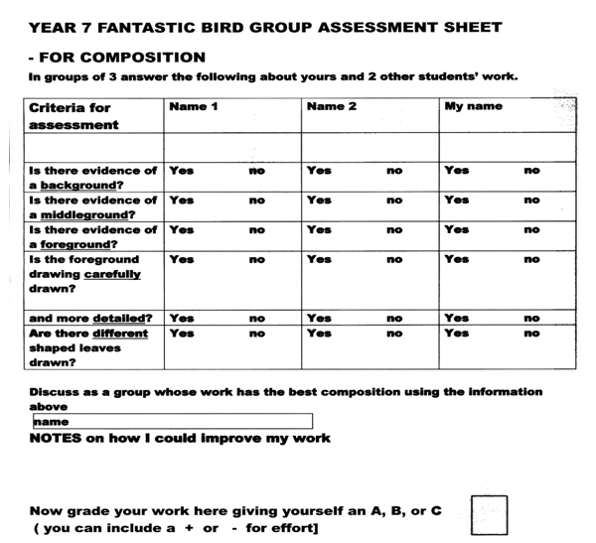
Return to Contents
Example of peer assessment from www.nsead.org/downloads/Art_Peer_Assessment_example.doc

Slide 21
Find Out More
http://nationalstrategies.standards.dcsf.gov.uk/node/18700
http://www.qub.ac.uk/directorates/AcademicStudentAffairs/CentreforEducationalDevelopment/Resources/PeerandSelfAssessment/
http://video.google.com/videoplay?docid=-2041806810929460474#
(Paul Black describes peer and self-assessment)
http://www.ltscotland.org.uk/video/s/selfandpeerassessmentdylanwiliam.asp
(Dylan William on peer and self-assessment)
http://www.qcda.gov.uk/4334.aspx
http://www.ltscotland.org.uk/assess/index.asp

