Slide 1
Ethical Hacking
Lecture 3-4
Lecturer: Assoc. Professor Carlene Campbell
Email: carlene.campbell@uwtsd.ac.uk
Website: https://www.knowledgewithprofit.com

Slide 2
This lecture will look at:
Footprinting and Reconnaissance
  Footprinting Concepts
  Footprinting through Search Engines
  Footprinting through Internet Research Services
  Footprinting through Social Networking Sites
  Use Different Techniques for Whois Footprinting
  Use Different Techniques for DNS Footprinting
  Use Different Techniques for Network and Email Footprinting
  Footprinting through Social Engineering
  Automate Footprinting Tasks using Advanced Tools and AI
  Explain Footprinting Countermeasures

Slide 3
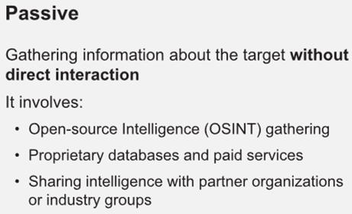
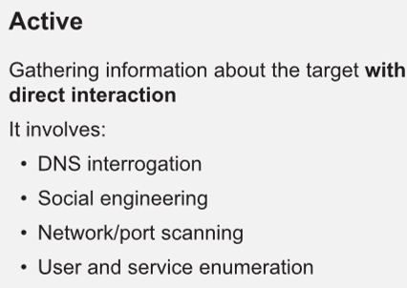
Reconnaissance
Reconnaissance (also known as footprinting) refers to the preparatory phase where an attacker seeks to gather as much information as possible about a target of evaluation prior to launching an attack
Types of Reconnaissance:
Notes:
Explain Footprinting Concepts Objective

Slide 4
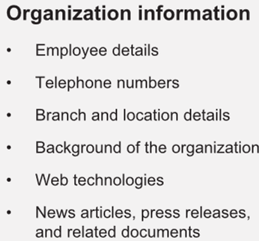
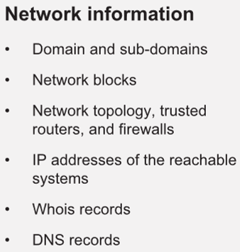
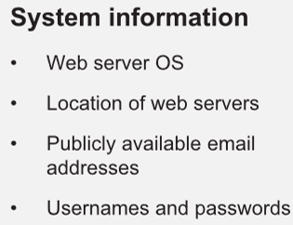
Information Obtained in Footprinting
Notes:
The major objectives of footprinting include collecting the network information, system information, and organizational information of the target. By conducting footprinting across different network levels, you can gain information such as network blocks, specific IP addresses, employee details, and so on. Such information can help attackers in gaining access to sensitive data or performing various attacks on the target network.

Slide 5
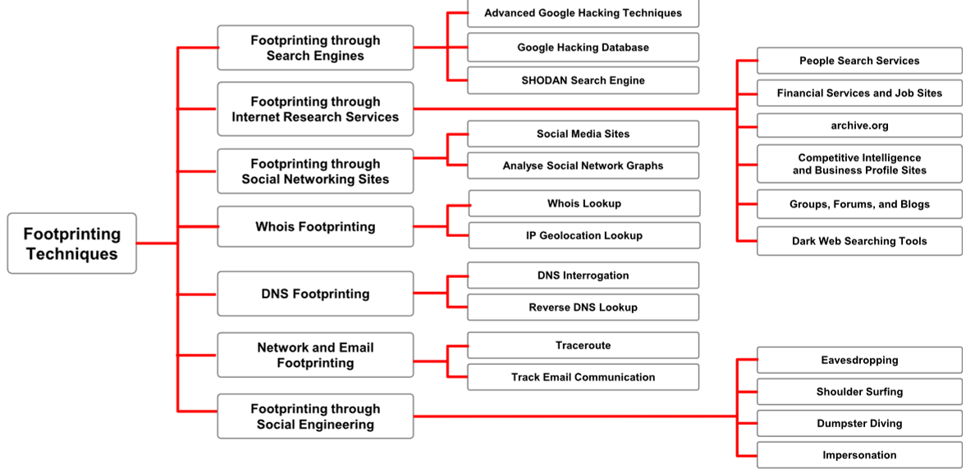
Footprinting Methodology
Notes:
Now that you are familiar with footprinting concepts and potential threats, we will discuss the footprinting methodology. The footprinting methodology is a procedure for collecting information about a target organization from all available sources. It involves gathering information about a target organization, such as URLs, locations, establishment details, number of employees, specific range of domain names, contact information, and other related information. Attackers collect this information from publicly accessible sources such as search engines, social networking sites, Whois databases, and so on. The diagram given below illustrates the common techniques used to collect information about the target organization from different sources.

Slide 6
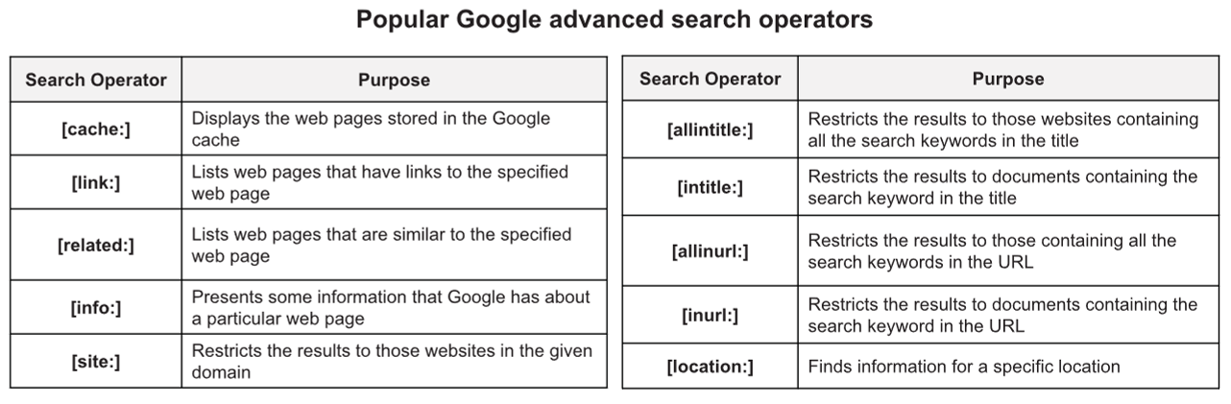
Footprinting Using Advanced Google Hacking Techniques
Attackers use search engines to extract information about a target, such as employed technology platforms, employee details, login pages, and intranet portals, which help the attacker to perform social engineering and other types of advanced system attacks
Google hacking refers to the use of advanced Google search operators for creating complex search queries to extract sensitive or hidden information that helps attackers find vulnerable targets

Slide 7
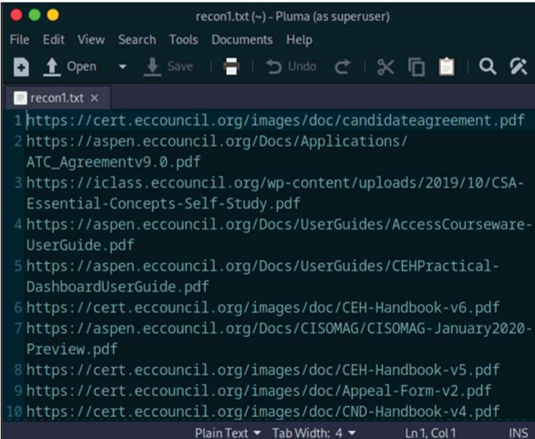
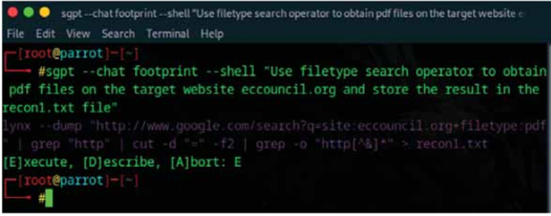
Footprinting Using Advanced Google Hacking Techniques with AI
An attacker can also leverage AI-powered ChatGPT or other generative AI technology to perform this task by using an appropriate prompt such as:
  “Use filetype search operator to obtain pdf files on the target website eccouncil.org and store the result in the recon1.txt file”

Slide 8
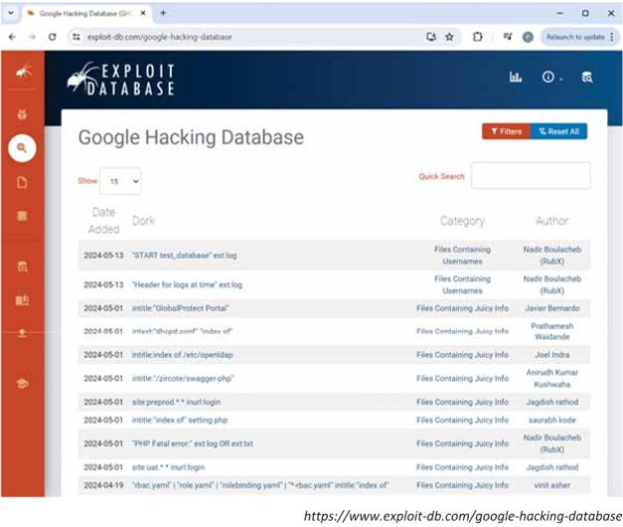
Google Hacking Database
The Google Hacking Database (GHDB) is an authoritative source for querying the ever-widening reach of the Google search engine
Attackers use Google dorks in Google advanced search operators to extract sensitive information about their target, such as exposed files, directories, and devices that could be exploited, vulnerable servers, error messages, sensitive files, login pages, and websites

Slide 9
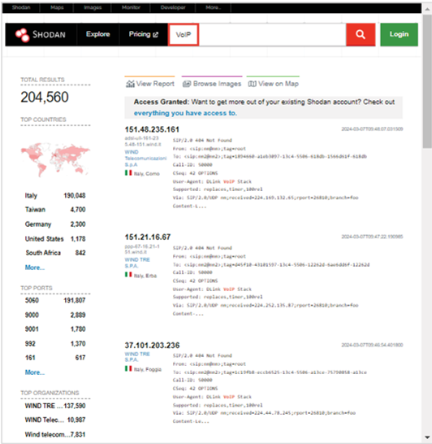
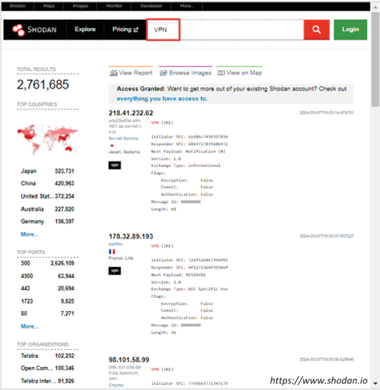
Footprinting through SHODAN Search Engine
Notes:
Shodan is a search engine that enables attackers to perform footprinting at various levels. It is used to detect devices and networks with vulnerabilities. A search in Shodan for VoIP and VPN footprinting can deliver various results, which will help gather VPN-and VoIP-related information. The screenshots show some of the VPN and VoIP footprinting search results obtained through Shodan:

Slide 10
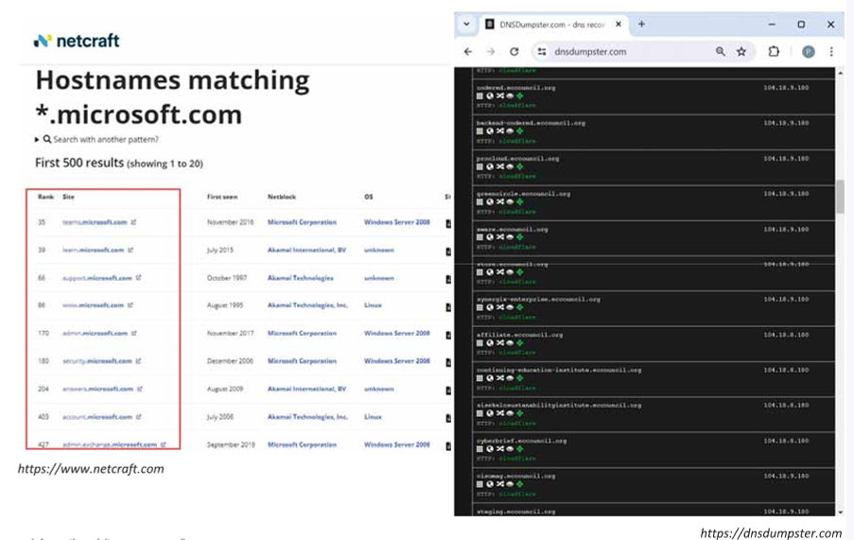
Finding a Company’s Top-Level Domains (TLDs) and Sub-domains
Search for the target company’s external URL in a search engine, such as Google and Bing
Sub-domains provide an insight into different departments and business units in an organization
You may find a company’s sub-domains by trial and error method or using a service such as https://www.netcraft.com
You can use the DNSdumpster tool, which can discover hosts related to a domain
Notes:
Demonstrate Footprinting through Internet Research Services

Slide 11
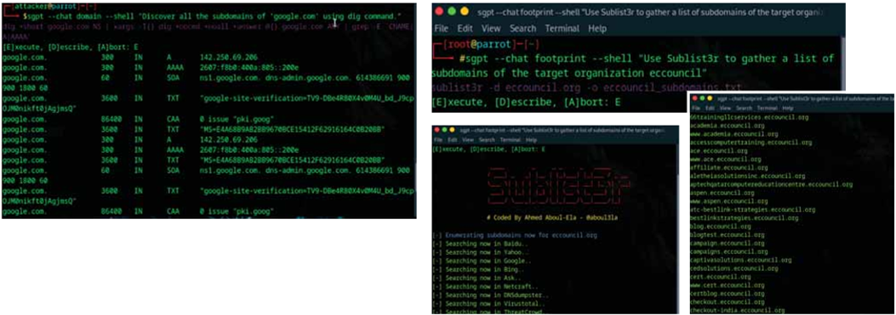
Finding a Company’s Top-Level Domains (TLDs) and Sub-domains with AI
An attacker can also leverage AI-powered ChatGPT or other generative AI technology to perform this task by using appropriate prompts such as:
“Discover all the subdomains of ‘google.com’ using dig command”
“Use Sublist3r to gather a list of subdomains of the target organization eccouncil”

Slide 12
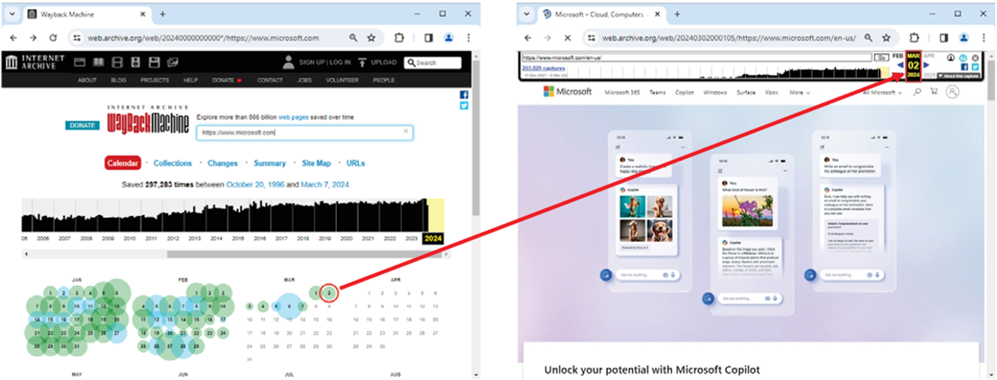
Extracting Website Information from https://archive.org
Internet Archive’s Wayback Machine allows one to visit archived versions of websites
Attackers can use tools such as Photon to retrieve archived URLs of the target website from archive.org

Slide 13
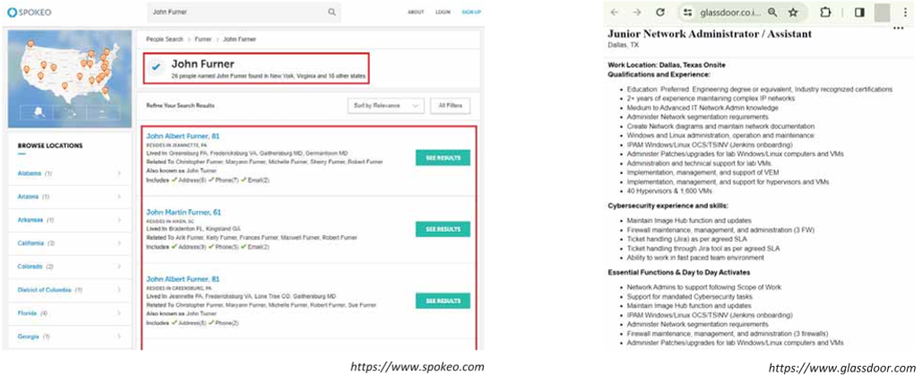
Footprinting through People Search Services and Job Sites
People search services, such as Spokeo, Intelius, and pipl can provide critical information about a person or an organization, including location, emails, websites, blogs, contacts, important dates, address, etc.
Job sites such as Dice, LinkedIn, and Glassdoor can reveal details about a company's infrastructure, potentially aiding attackers in identifying vulnerabilities within the target's IT environment

Slide 14
Dark Web Footprinting
Dark web or Darknet
The dark web or Darknet is a deeper layer of the online cyberspace, that enables anyone to navigate anonymously without being traced
Attackers use dark web searching tools, such as Tor Browser and ExoneraTor, to gather confidential information about the target
Attackers can also use advanced search parameters to refine searches in the Dark Web to find specific data
TOR Browser
It is used to access the dark web where it acts as a default VPN for the user and bounces the network IP address through several servers before interacting with the web
Notes:
https://www.torproject.org

Slide 15
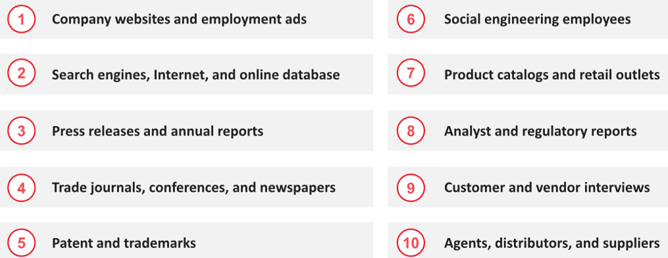
Competitive Intelligence Gathering
Competitive intelligence gathering is the process of identifying, gathering, analyzing, verifying, and using information about your competitors from resources, such as the Internet
Competitive intelligence is non-interfering and subtle in nature
Sources of Competitive Intelligence

Slide 16
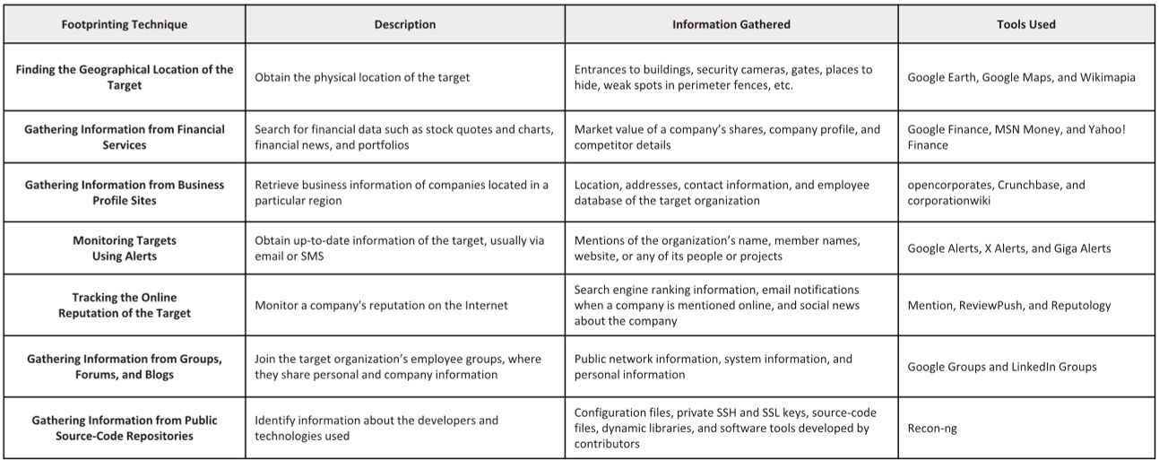
Other Techniques for Footprinting through Internet Research Services

Slide 17
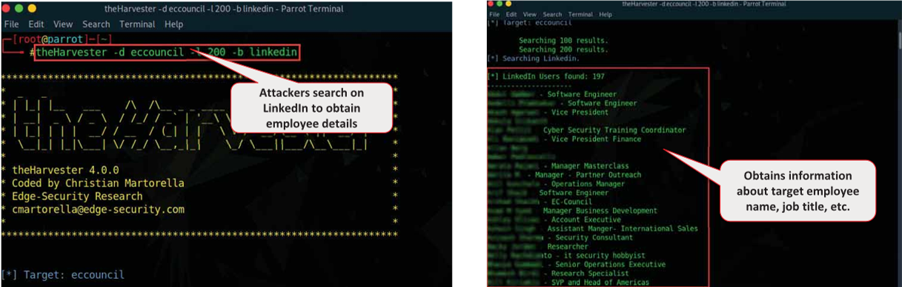
Gathering Information from LinkedIn
Attackers use theHarvester tool to perform enumeration on LinkedIn and find employees of the target company along with their job titles
Attackers can use this information to gather more information, such as current location and educational qualifications, and perform social engineering or other kinds of attacks
https://github.com
Notes:
Demonstrate Footprinting through Social Networking Sites

Slide 18
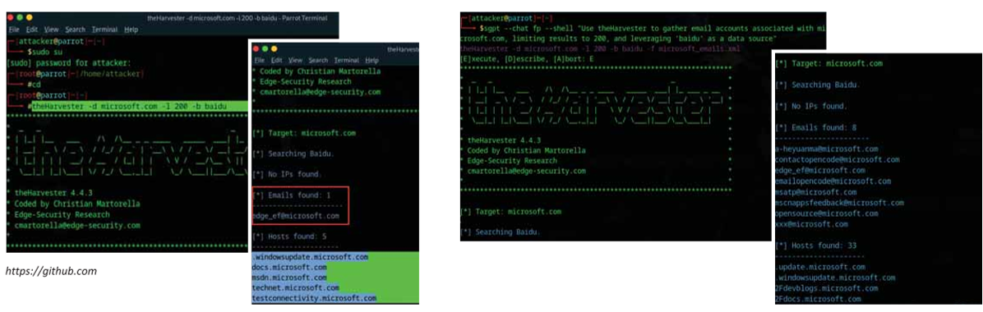
Harvesting Email Lists with AI
Attackers use automated tools such as theHarvester and Email Spider to collect publicly available email addresses of the target organization that helps them perform social engineering and brute-force attacks
An attacker can also leverage AI-powered ChatGPT or other generative AI technology to perform this task by using an appropriate prompt such as “Use theHarvester to gather email accounts associated with microsoft.com, limiting results to 200, and leveraging 'baidu' as a data source”

Slide 19
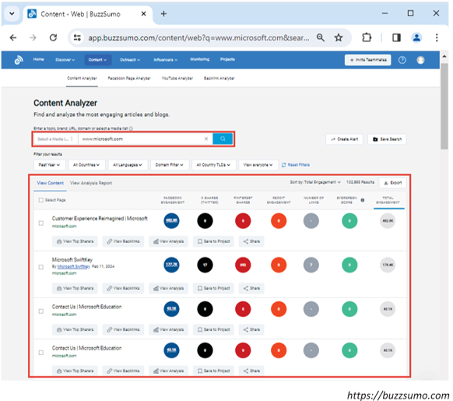
Analyzing Target Social Media Presence
Attackers track social media sites using BuzzSumo, Google Trend, Hashatit, etc. to discover most shared content using hashtags or keywords, track accounts and URLs, email addresses, etc.
Attackers use this information to perform phishing, social engineering, and other types of attacks
BuzzSumo’s advanced social search engine finds the most shared content for a topic, author or a domain

Slide 20
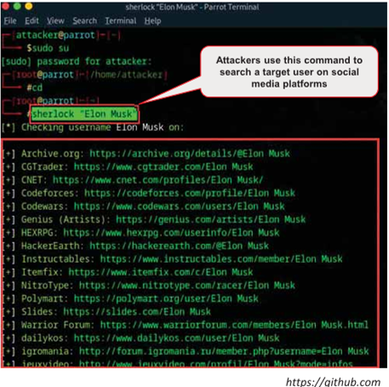
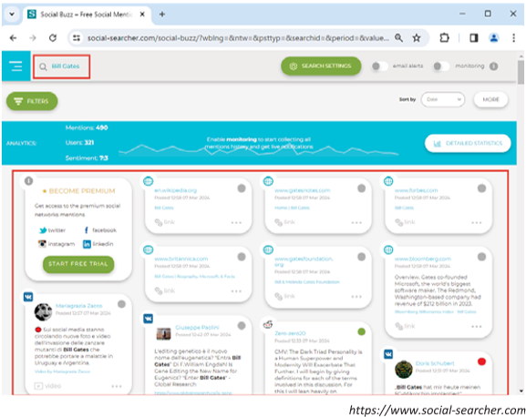
Tools for Footprinting through Social Networking Sites
Sherlock tool is used to search a vast number of social networking sites for a target username
Social Searcher allows you to search for content in social networks in real-time and provides deep analytics data

Slide 21
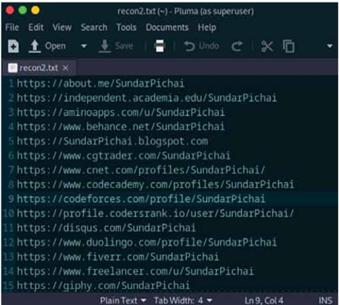
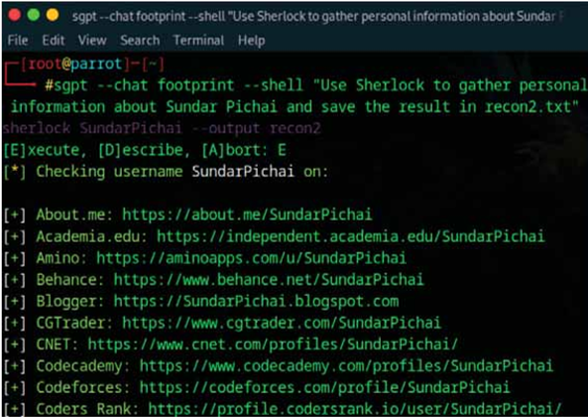
Footprinting through Social Networking Sites with AI
An attacker can also leverage AI-powered ChatGPT or other generative AI technology to perform this task by using an appropriate prompt such as:
  “Use Sherlock to gather personal information about Sundar Pichai and save the result in recon2.txt”

Slide 22
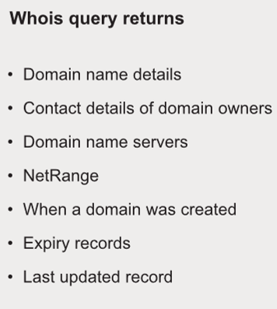
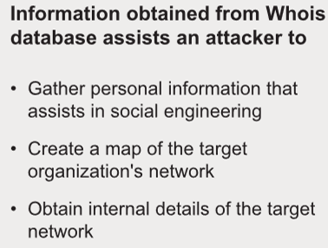
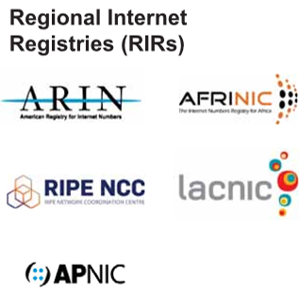
Whois Lookup
Whois databases are maintained by Regional Internet Registries and contain personal information of domain owners
Notes:
Use Different Techniques for Whois Footprinting
Whois Lookup

Slide 23
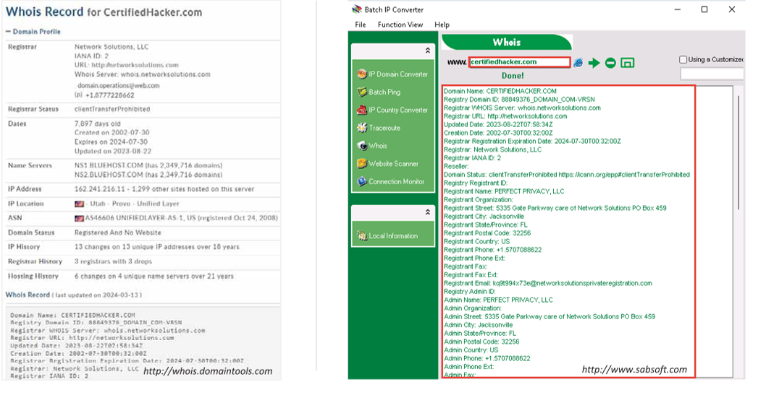
Whois Lookup (Cont’d)

Slide 24
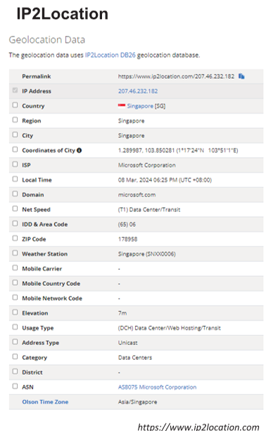
Finding IP Geolocation Information
IP geolocation helps to identify information, such as country, region/state, city, ZIP/postal code, time zone, connection speed, ISP (hosting company), domain name, IDD country code, area code, mobile carrier, and elevation
IP geolocation lookup tools, such as IP2Location and IP Location Finder, help to collect IP geolocation information about the target, which in turn helps attackers in launching social engineering attacks, such as spamming and phishing

Slide 25
Take a break
We’ll rejoin in 10 minutes

Slide 26
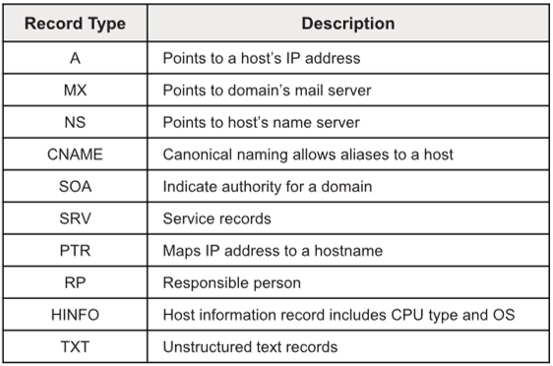
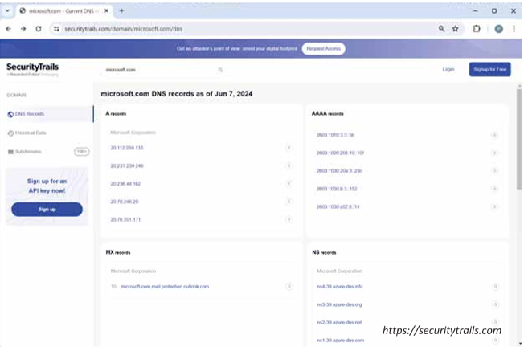
Extracting DNS Information
DNS records provide important information about the location and types of servers
Attackers can gather DNS information to determine key hosts in the network and can perform social engineering attacks
Attackers query DNS servers using DNS interrogation tools, such as SecurityTrails, Fierce, DNSChecker, and zdns, to retrieve the record structure that contains information about the target DNS
Notes:
Use Different Techniques for DNS Footprinting

Slide 27
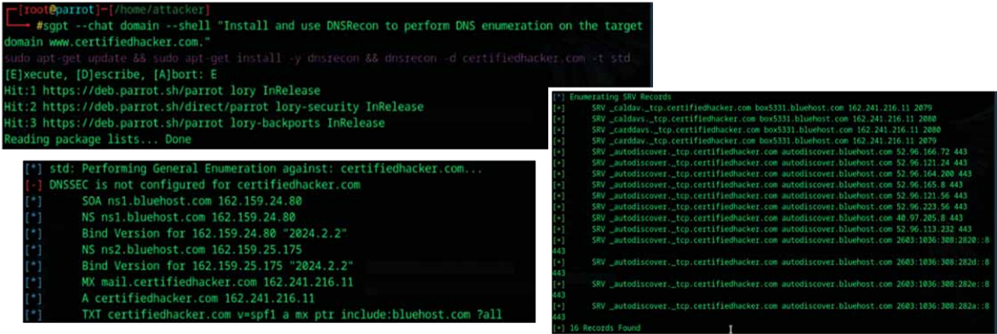
DNS Lookup with AI
An attacker can also leverage AI-powered ChatGPT or other generative AI technology to perform this task by using an appropriate prompt such as
  “Install and use DNSRecon to perform DNS enumeration on the target domain www.certifiedhacker.com”

Slide 28
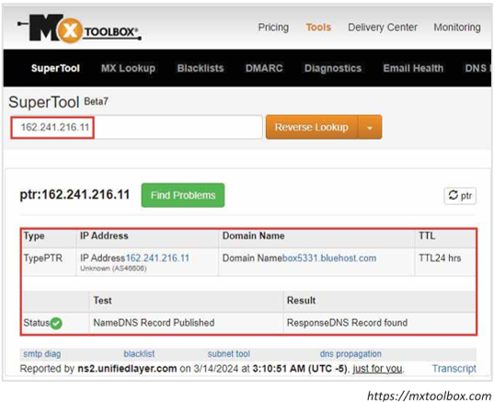
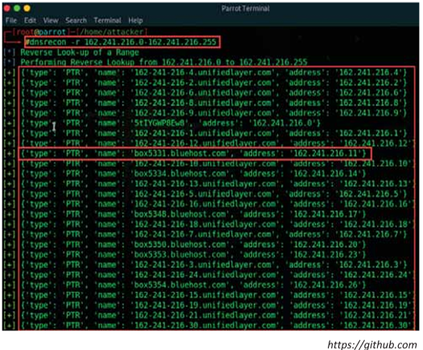
Reverse DNS Lookup
Attackers perform a reverse DNS lookup on IP ranges in an attempt to locate a DNS PTR record for those IP addresses
Attackers use various tools, such as DNSRecon and Reverse Lookup to perform the reverse DNS lookup on the target host

Slide 29
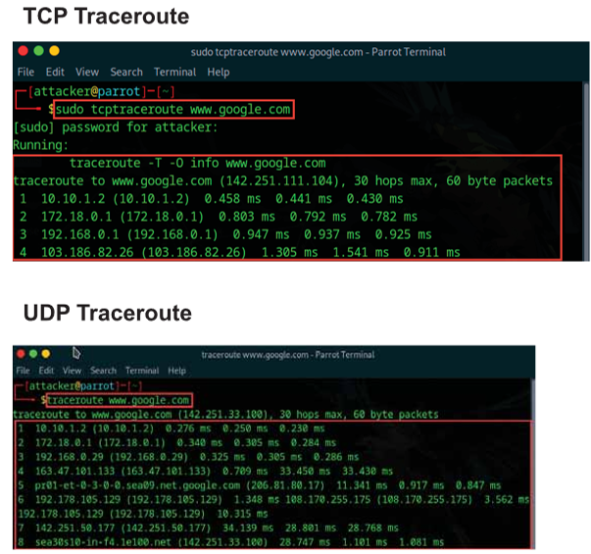
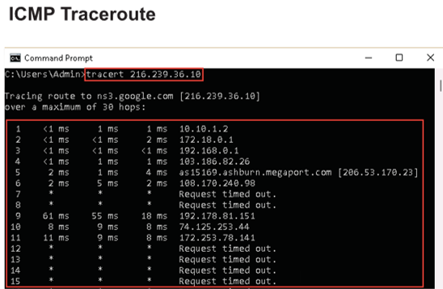
Use Different Techniques for Network and Email Footprinting
Traceroute programs work on the concept of ICMP protocol and use the TTL field in the header of ICMP packets to discover the routers on the path to a target host
Notes:
Use Different Techniques for Network and Email Footprinting

Slide 30
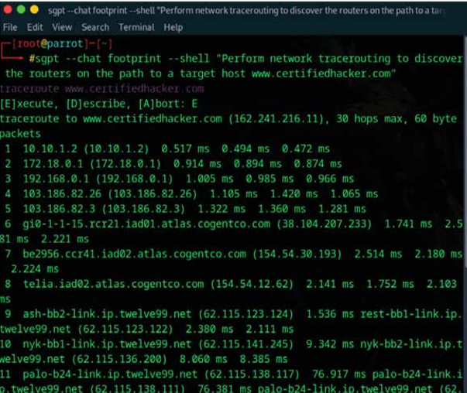
Traceroute with AI
An attacker can also leverage AI-powered ChatGPT or other generative AI technology to perform this task by using an appropriate prompt such as
  “Perform network tracerouting to discover the routers on the path to a target host www.certifiedhacker.com”

Slide 31
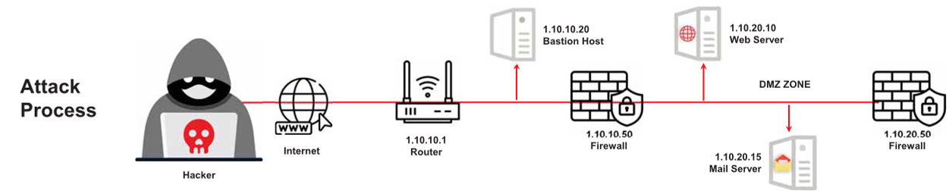
Traceroute Analysis
Attackers execute traceroute to find the IP addresses of intermediate devices such as routers and firewalls present between a source and its destination
For example, after running several traceroutes, an attacker might obtain the following information:
  traceroute 1.10.10.20, second to last hop is 1.10.10.1
  traceroute 1.10.20.10, third to last hop is 1.10.10.1
  traceroute 1.10.20.10, second to last hop is 1.10.10.50
  traceroute 1.10.20.15, third to last hop is 1.10.10.1
  traceroute 1.10.20.15, second to last hop is 1.10.10.50
By compiling this information, attackers can identify the intermediate devices or hosts in the path to the target network

Slide 32
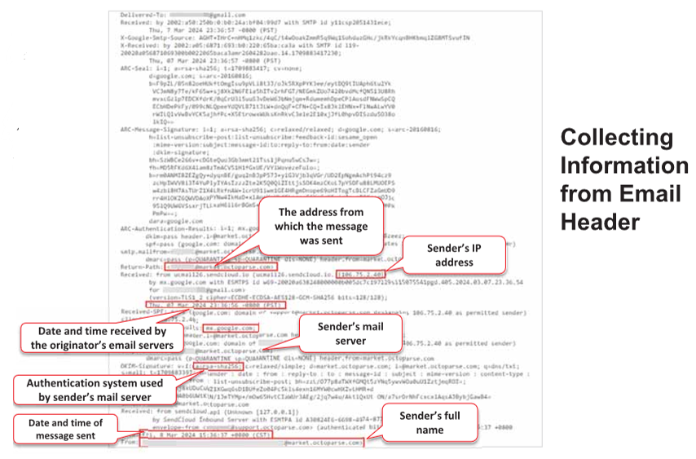
Tracking Email Communications
Email tracking is used to monitor the delivery of emails to an intended recipient
Attackers track emails to gather information about a target recipient, such as IP addresses, geolocation, browser and OS details, to build a hacking strategy and perform social engineering and other attacks

Slide 33
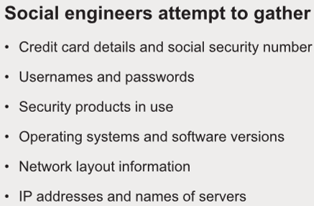
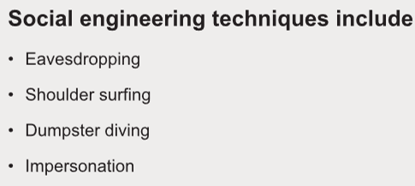
Footprinting through Social Engineering
Social engineering is an art of exploiting human behaviour to extract confidential information
Social engineers depend on the fact that people are unaware of their valuable information and are careless about protecting it
Notes:
Demonstrate Footprinting through Social Engineering

Slide 34
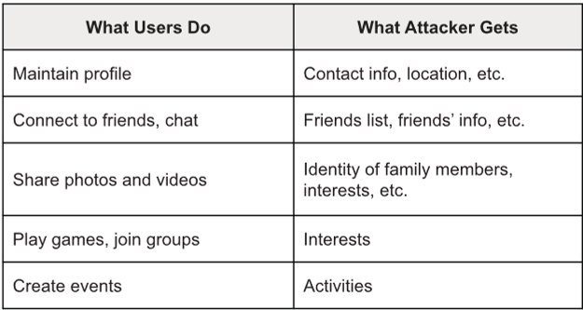
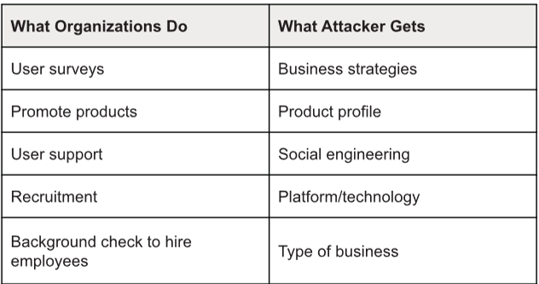
Collecting Information through Social Engineering on Social Networking Sites
Attackers use social engineering tricks to gather sensitive information from social networking websites
Attackers create a fake profile and then use the false identity to lure employees into revealing their sensitive information
Attackers collect information about the employees’ interests and tricks them into revealing more information

Slide 35
Collecting Information Using Eavesdropping, Shoulder Surfing, Dumpster Diving, and Impersonation
Eavesdropping
  Unauthorized listening of conversations or reading of messages
  It is the interception of any form of communication, such as audio, video, or text
Shoulder Surfing
  Secretly observing the target to gather critical information, such as passwords, personal identification number, account numbers, and credit card information
Dumpster Diving
  Looking for treasure in someone else's trash
  It involves the collection of phone bills, contact information, financial information, operations-related information, etc. from the target company’s trash bins, printer trash bins, user desk for sticky notes, etc.
Impersonation
  Pretending to be a legitimate or authorized person and using the phone or other communication medium to mislead targets and trick them into revealing information

Slide 36
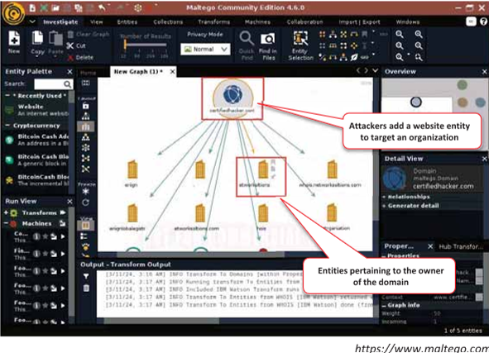
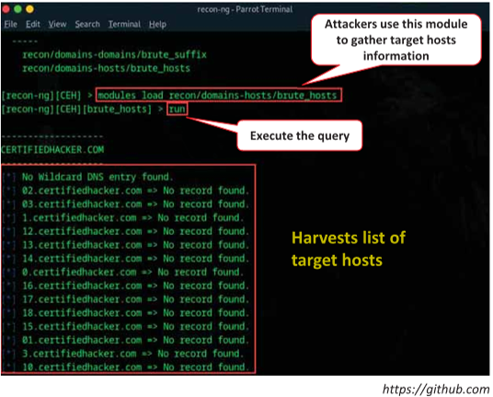
Footprinting Tools: Maltego and Recon-ng
Maltego can be used to determine the relationships and real world links between people, groups of people, organizations, websites, Internet infrastructure, documents, etc.
Recon-ng is a Web Reconnaissance framework with independent modules and database interaction, which provides an environment in which open source, web-based reconnaissance can be conducted
Notes:
Automate Footprinting Tasks using Advanced Tools and AI

Slide 37
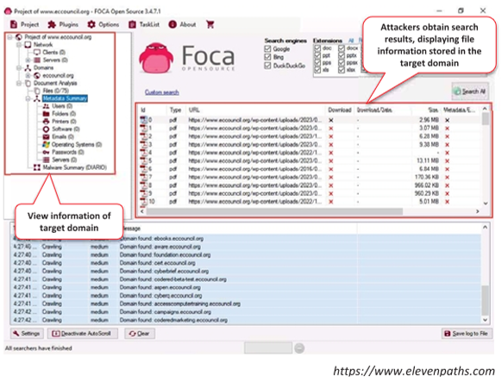
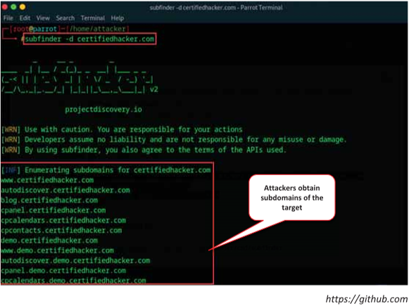
Footprinting Tools: FOCA and subfinder
FOCA (Fingerprinting Organizations with Collected Archives) is a tool used mainly to find metadata and hidden information in the documents it scans
subfinder is a subdomain discovery tool that helps attackers find valid subdomains for websites

Slide 38
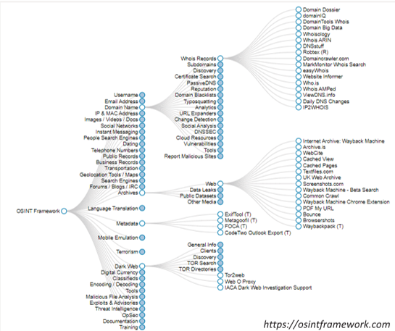
Footprinting Tools: OSINT Framework
OSINT Framework is an open source intelligence gathering framework that is focused on gathering information from free tools or resources
It provides a simple web interface that lists various OSINT tools arranged by categories and is shown as OSINT tree structure on the web interface
Tools listed includes the following indicators:
  (T) - Indicates a link to a tool that must be installed and run locally
  (D) - Google Dork
  (R) - Requires registration
  (M) - Indicates a URL that contains the search term and the URL itself must be edited manually

Slide 39
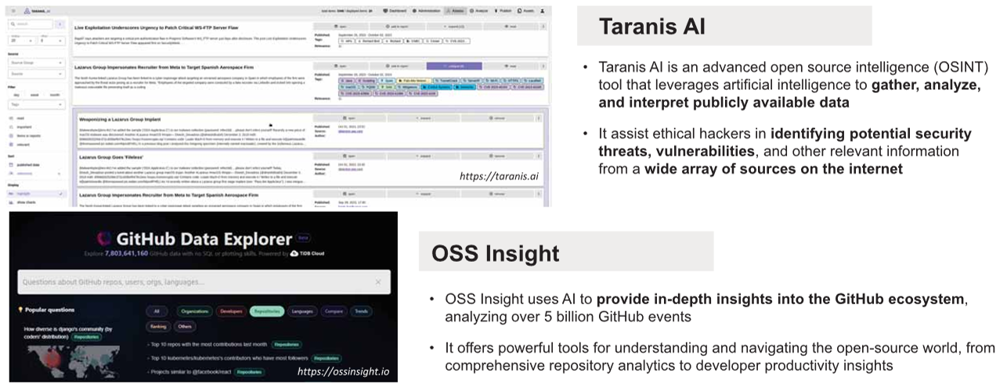
AI-Powered OSINT Tools

Slide 40

Create and Run Custom Python Script to Automate Footprinting Tasks with AI
An attacker can also leverage AI-powered ChatGPT or other generative AI technology to automate various footprinting tasks by creating a custom Python script that will run automatically and fetch the desired result. They can use appropriate prompts to create custom scripts, such as the one below:
  “Develop a Python script which will accept domain name www.microsoft.com as input and execute a series of website footprinting commands, including DNS lookups, WHOIS records retrieval, email enumeration, and more, to gather information about the target domain

Slide 41
Footprinting Countermeasures
Restrict the employees’ access to social networking sites from the organization’s network
Configure web servers to avoid information leakage
Educate employees to use pseudonyms on blogs, groups, and forums
Do not reveal critical information in press releases, annual reports, product catalogues, etc.
Limit the amount of information published on a website or the Internet
Use footprinting techniques to discover and remove any sensitive information that is publicly available
Prevent search engines from caching a web page and use anonymous registration services
Notes:
Explain Footprinting Countermeasures

Slide 42

Footprinting Countermeasures (Cont’d)

Slide 43
Questions?

Slide 44
References
M. T Whitman, H. J. Mattford, Principles of Information Security, Cengage Learning, 4th ed 2012.
https://aspen.eccouncil.org/
https://attack.mitre.org
http://ceh.vn/
http://www.symantec.com/security_response/publications/threatreport.jsp

