Slide 1
Croeso i ECAD6007C 2023-4
Y Dysgwr – Pwy ydw i’n ei addysgu?

Slide 2
Y sesiwn hon
Cyflwyno cyd-destun y modwl
Rôl adfyfyrio
Dulliau adfyfyrio

Slide 3
Arweinwyr y Modwl
Menna Davies – menna.davies@uwtsd.ac.uk
Nic Evans
n.j.evans@uwtsd.ac.uk

Slide 4
Cynnwys y Modwl
Damcaniaethau Dysgu
Llesiant, hawliau a lleisiau
Llythrennedd corfforol
Anghenion Dysgu Ychwanegol
Llythrennedd emosiynol ac iechyd meddwl
Ymddygiad
Asesu a chynnydd
Datblygiad gwybyddol
Arsylwi’r dysgwr
Dadansoddi beirniadol a chymwysiadau proffesiynol

Slide 5
Bwriad Dysgu: Datblygu dealltwriaeth o’r modiwl a’r asesu, cyflwyno’r cysyniad o fyfyrio a dechrau’r broses o ddatblygu ymarferwyr beirniadol, myfyriol sy’n holi eu hymarfer eu hunain ac ymarfer mwy gwybodus eraill.
Ymarfer myfyriol - pam? beth? sut?
Adweithedd diwylliannol ar gyfer dysgu trawsnewidiol
Ein hunangofiant a sut mae'n effeithio ar ein hathroniaeth addysg bersonol
Ein lles a’n rheoleiddio a sut ydym ni’n llywio hyn fel athrawon

Slide 6
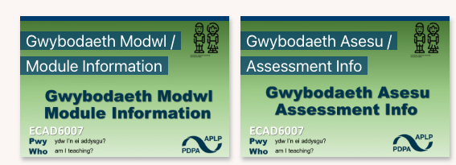


Notes:
Students may already have access to moodle – but please direct them to find the ECAD 6007 tile, and download a copy of the module handbook and the assessment
Give them 5/10 minutes to look them over just to familiarize
Let them know that assessment specific questions will be dealt with in a session, and that anything to fo with assessment comes to karl or ian
Explain the handbook icons – left to right Synchronous sessions (on site) asynchronous (taught but online) and directed (students provided with materials to engage with

Slide 7
Y strwythur
Cael dealltwriaeth o rôl arfer adfyfyriol
Dysgu theorïau perthnasol sy’n ymwneud â’r dysgwr
Arsylwi dysgu ac addysgu mewn amgylchedd ysgol
Defnyddio’r elfennau hyn i hysbysu’r camau nesaf mewn addysgu

Slide 8
Gorffen y gosodiadau
Pan orffennaf y cwrs byddaf….
Rôl y TAR yw……….

Slide 9
Addysgu fel crefft a phroffesiwn
Addysgu fel crefft
“Teaching is a craft and it is best learnt as an apprentice observing a master craftsman or woman. Watching others, and being rigorously observed yourself as you develop, is the best route
to acquiring mastery in the classroom”
(Gove, 2010)
Addysgu fel proffesiwn
“The teacher who is able to engage with theory and the findings of educational research shares with the craft worker teacher a capacity for self- direction. By contrast, though, the professional teacher is able to judge right action in various school and classroom contexts from a more reliable basis for judgment than intuition or common sense. A teacher who is able to make good situational judgments does not rely on hearsay or unreflective prejudice. She draws on a well-thought-through and coherent conceptual framework, on knowledge of well-substantiated empirical research, and on considered ethical principles, to arrive at decisions in the classroom context.
(Orchard et al, 2015)

Slide 10
Yr adolygiad
Am [fod Safonau Cymru] yn canolbwyntio’n bennaf ar yr hyn y mae’n rhaid i athrawon newydd gymhwyso allu ei ‘wneud’ ar ddiwedd eu rhaglenni, does prin ddim cydnabyddiaeth bendant i rôl ymchwil na myfyrdod beirniadol yng ngwaith dysgu proffesiynol athrawon.
(Furlong, J. 2015, t12)
Notes:
In 2013, a review of ITT provision in wales was commissioned and carried out by Emeritus Professor John Furlong, University of Oxford,
The review was to explore the workings in ITT in Wales, and looking at best practice from the UK and abroad, provide an overview with recommendations of next steps for the development of ITT programs.
The statement here READ shows that Furlong could see that a majority of provision focused on teaching as a craft – a “tips for teachers” model. This identification led to changes in ITT developing research informed practitioners – ways that we have achieved this is by:
Developing modules and curricular with schools, to allow clear links between research and practice
Making use of direct links through Bridging experiences (cover meet test share)
Seeking ways to develop practitioners that are critical and reflective
Furlong, J. (2015) ‘Teaching Tomorrow’s Teachers: Options for the future of initial teacher education in Wales’.

Slide 11
Rôl y modwl hwn
“Winch et al.(2013 ) therefore argue that what is missing from both the simplified craft view and the narrow technical view is the capacity for critical reflection; this, they suggest, is the hallmark of the ‘professional teacher’. Good teaching, they argue, develops from interrogating one’s practice and making explicit the assumptions and values that underpin it."
(BERA 2014, t20)
Notes:
Read quote
Explain to students the importance of these concepts:
Being able to interrogate what you do in the classroom
Have the capacity for being critically in how you reflect
Outline how this ad other modules/experiences we offer seek to develop these traits over the course of the program
BERA (2014) ‘The role of research in teacher education: Reviewing the evidence interim report of the BERA-RSA inquiry’,

Slide 12
Yn ystod y modwl hwn byddwn yn…
Archwilio rôl a natur adfyfyrio beirniadol
Mynd i’r afael â theori sy’n ymwneud â’r dysgwr
Deall sut gallwn wneud cysylltiadau rhwng ein harfer a theori
Ystyried sut gallwn ddefnyddio hyn i hysbysu datblygiadau yn y dyfodol
Notes:
Discuss the above

Slide 13
Yn ystod y modwl hwn ni fyddwn yn…
Meddu ar yr holl atebion
Gwybod y cwestiynau i gyd
Y TAR yw’r cam cyntaf (er enfawr!) yn eich gyrfa fel athro – dechreuwch boeni pan deimlwch eich bod yn meddu ar yr holl atebion!
Notes:
This is a really important one to stress – the nature of the teachers we are tasked with helping to develop, is one that encourages ongoing development and engagement with research
The second we think we, or someone else has all the answers is when we need to worry!
They will not be a “finished” teacher at the end of the PGCE, there is no such thing

Slide 14
Bod yn unigolyn adfyfyriol
Yn ôl Dewey (1933), tri phriodoledd unigolyn adfyfyriol yw:
  bod â meddwl agored,
  cyfrifoldeb
  gallu ymroi i’r gwaith o lwyrfryd calon
Beth mae’r rhain yn ei olygu?
Ydych chi’n meddu ar y priodoleddau hyn?
Notes:
Split back into groups for 10 mins, come back and discuss
Simplified:
Willing to consider ALL of the facts and consider alternative views or possibilities
Understanding and awareness that our actions have consequences
Being committed and enthusiastic in the area in which we seek to develop
Dewey, J. (1933). How we think: A restatement of the relation of reflective thinking to the educative process. Boston, MA: DC Heath and Company.

Slide 15
Adfyfyrio a modelau
YN EI HANFOD MAE MEDDWL ADFYFYRIOL YN CYNNWYS TAIR PROSES:
PROFI RHYWBETH
MEDDWL AM (ADFYFYRIO AR) Y PROFIAD
DYSGU O’R PROFIAD.
Notes:
There is broad consensus that teaching effectively requires a reflective approach. However, reflective practice is a term that carries diverse meaning and about which there is not complete consensus. Teaching and learning are complex processes, and there is not one right approach. Reflecting on different approaches to teaching, and reshaping the understanding of past and current experiences, can lead to improvement in teaching practices.

Slide 16
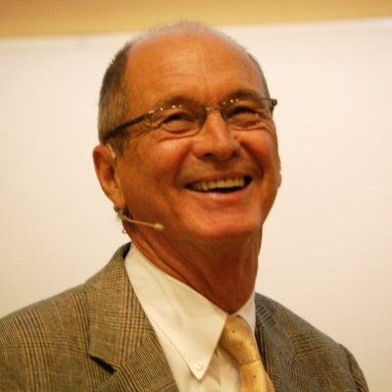
Modelau arfer adfyfyriol:
Kolb, 1975 a 1984
Mae’r Cylch Dysgu yn pwysleisio arsylwi adfyfyriol fel ffordd o ddadansoddi a dod i gasgliadau yn sgil profiad. Y nod yw mynd â’r dysgu hwn i mewn i brofiadau newydd, gan gwblhau’r cylch.
Notes:
Learning theorist David A. Kolb was highly influenced by the earlier research conducted by John Dewey and Jean Piaget. Kolb's reflective model highlights the concept of experiential learning and is centered on the transformation of information into knowledge. This takes place after a situation has occurred, and entails a practitioner reflecting on the experience, gaining a general understanding of the concepts encountered during the experience, and then testing these general understandings in a new situation. In this way, the knowledge that is formed from a situation is continuously applied and reapplied, building on a practitioner's prior experiences and knowledge.

Slide 17
Profiad diriaethol
(profi rhywbeth)
Arsylwad adfyfyriol
(meddwl am y profiad)
Cysyniad haniaethol
(dysgu o’r profiad)
Arbrofi gweithredol
(rhoi’r hyn rydych chi wedi ei ddysgu yn eich arfer)

Slide 18
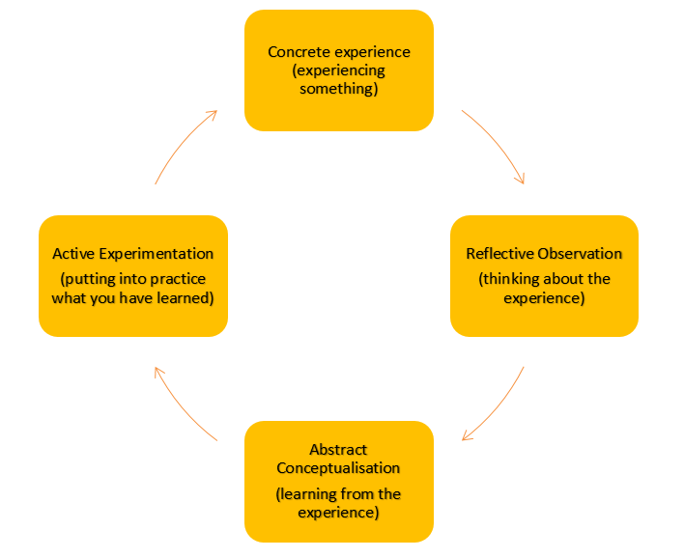

Slide 19
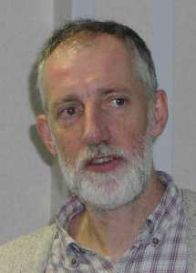
Modelau arfer adfyfyriol:
Gibbs, 1988
Mae gan y Cylch Adfyfyriol chwe cham pendant, gan arwain o ddisgrifiad o’r digwyddiad/profiad hyd at gasgliadau a phethau i’w hystyried ar gyfer digwyddiadau’r dyfodol.
Notes:
Gibbs' suggestions are often cited as "Gibbs' reflective cycle" or "Gibbs' model of reflection”. He discussed the use of structured debriefing to facilitate the reflection involved in Kolb's experiential learning cycle. Gibbs presents the stages of a full structured debriefing as follows:
Initial experience:
Description "What happened? Don't make judgements yet or try to draw conclusions; simply describe." Feelings "What were your reactions and feelings? Again don't move on to analysing these yet." Evaluation "What was good or bad about the experience? Make value judgements." Analysis "What sense can you make of the situation? Bring in ideas from outside the experience to help you”. "What was really going on?” "Were different people's experiences similar or different in important ways?" Conclusions (general) "What can be concluded, in a general sense, from these experiences and the analyses you have undertaken?" Conclusions (specific) "What can be concluded about your own specific, unique, personal situation or way of working?" Personal action plans "What are you going to do differently in this type of situation next time?” "What steps are you going to take on the basis of what you have learnt?”

Slide 20
PARAGRAFF 1
Disgrifiwch beth ddigwyddodd
PARAGRAFF 2
Disgrifiwch eich teimladau a’ch ymatebion emosiynol
PARAGRAFF 3
Ystyriwch yn hyn oedd yn dda a gwael am eich ymateb
PARAGRAFF 4
Sut ydych chi’n gwneud synnwyr o’r sefyllfa?
(Defnyddiwch ffynonellau/damcaniaethau ymchwil academaidd i’ch cynorthwyo i wneud synnwyr o’ch adfyfrio)
PARAGRAFF 5
Pa gasgliadau cyffredinol allwch chi dynnu o’r digwyddiad?
Pa gasgliadau penodol allwch chi dynnu o’r profiad?
PARAGRAFF 6
Yn seiliedig ar eich adfyfyrio, beth fyddech chi’n gwneud yn wahanol yn y dyfodol? Oes gennych chi gynllun weithredol?

Slide 21
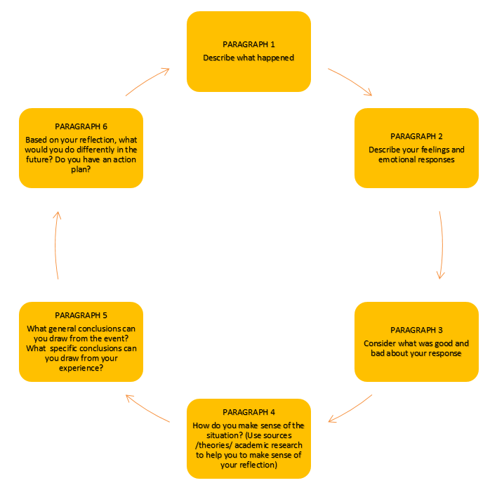

Slide 22
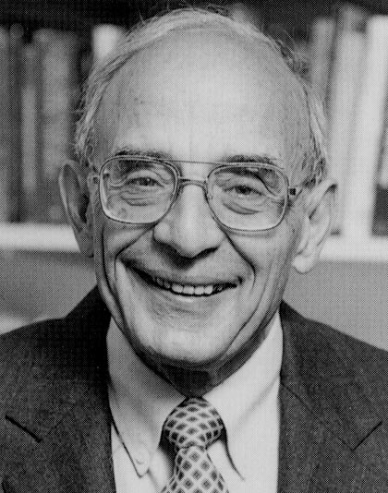
Modelau arfer adfyfyriol:
Schön, 1978
Cryfder y model hwn yw ystyried adfyfyrio wrth weithredu (yn ystod digwyddiad/profiad) ynghyd â’r adfyfyrio sy’n digwydd wrth edrych yn ôl (ar ôl y digwyddiad).
Notes:
Donald Schön's 1983 book The Reflective Practitioner introduced concepts such as reflection-on-action and reflection-in-action which explain how professionals meet the challenges of their work with a kind of improvisation that is improved through practice. Schön claimed to derive the notions of "reflection-on-action, reflection-in-action, responding to problematic situations, problem framing, problem solving, and the priority of practical knowledge over abstract theory" from the writings of John Dewey.
Reflection-in-action can be described as the ability of a practitioner to "think on his or her feet", otherwise known as "felt-knowing”. Within any given moment, when faced with a professional issue, a practitioner usually connects with their feelings, emotions and prior experiences to attend to the situation directly.Reflection-on-action, on the other hand, is the idea that after the experience a practitioner analyses their reaction to the situation and explores the reasons around, and the consequences of, their actions. This is usually conducted through a documented reflection of the situation. However, this notion goes beyond just looking back on experiences and exploring the reasoning behind actions. Rather, it brings into action Schön's notions of "responding to problematic situations, problem framing, problem solving, and the priority of practical knowledge over abstract theory"

Slide 23
Adfyfyrio wrth weithredu
(yn ystod y digwyddiad/profiad)
Y profiad ei hun
Adfyfyrio wrth edrych yn ôl
(ar ôl y digwyddiad)
Adfyfyrio ar brofiad sydd wedi digwydd
Meddwl amdano yn ystod y digwyddiad
Penderfynu sut i weithredu ar y pryd
Gweithredu’n syth
Ysytried am yr hyn y byddech chi’n gwneud yn wahanol petai e’n digwydd eto
Elwa o gael gwybodaeth newydd a/neu safbwyntiau o astudiaethau damcaniaethol sy’n diweddaru profiad yr adfyfyriwr yn cael eu defnyddio i brosesu gweithredoedd a theimladau

Slide 24
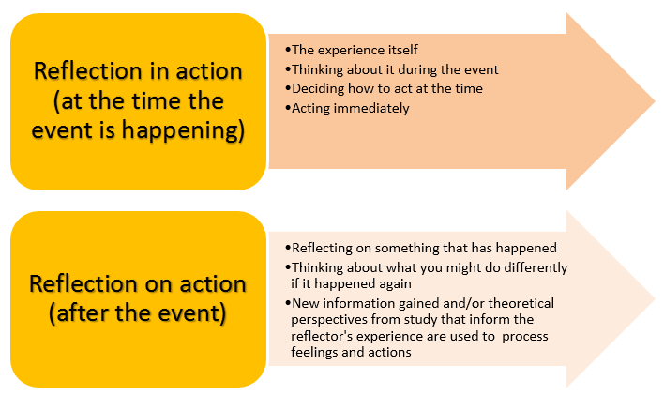

Slide 25
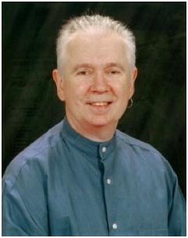
Modelau arfer adfyfyriol:
Brookfield, 1998 & 2005
Mae’r model hwn yn cynnig pedwar lens y gall athrawon eu defnyddio mewn proses o adfyfyrio beirniadol: (1) yr hunangofiannol, (2) llygaid y myfyrwyr, (3) profiadau ein cydweithwyr, a (4) llenyddiaeth ddamcaniaethol.
(Lensiau Brookfield)
Notes:
Stephen Brookfield proposed that critically reflective practitioners constantly research their assumptions by seeing practice through four complementary lenses: the lens of their autobiography as learners of reflective practice, the lens of other learners' eyes, the lens of colleagues' experiences, and the lens of theoretical, philosophical and research literature. Reviewing practice through these lenses makes us more aware of the power dynamics that infuse all practice settings.
Lens 1: Our autobiography as a learner. Our autobiography is an important source of insight into practice. As we talk to each other about critical events in our practice, we start to realize that individual crises are usually collectively experienced dilemmas. Analysing our autobiographies allows us to draw insight and meanings for practice on a deep visceral emotional level.
Lens 2: Our learners' eyes. Seeing ourselves through learners' eyes, we may discover that learners are interpreting our actions in the way that we mean them. But often we are surprised by the diversity of meanings people read into our words and actions. A cardinal principle of seeing ourselves through learners' eyes is that of ensuring the anonymity of their critical opinions. We have to make learners feel safe. Seeing our practice through learners' eyes helps us teach more responsively.
Lens 3: Our colleagues' experiences. Our colleagues serve as critical mirrors reflecting back to us images of our actions. Talking to colleagues about problems and gaining their perspective increases our chance of finding some information that can help our situation.
Lens 4: Theoretical literature. Theory can help us "name" our practice by illuminating the general elements of what we think are idiosyncratic experiences.

Slide 26
Ein hunangofiannau fel dysgwyr
HUNAN
Drwy lygaid y dysgwyr
DYSGWYR
Profiadau ein cydweithwyr
CYMHEIRIAID
Llenyddiaeth damcaniaethol
YSGOLORIAETH
Notes:
This is popular among students!

Slide 27
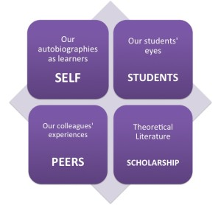
Notes:
This is popular among students!

Slide 28
Cwestiynau Allweddol
Beth maen nhw'n ei ddeall am fyfyrio beirniadol
· Beth, yn eu barn nhw, yw manteision ymarfer myfyriol

Slide 29
Felly beth yw’r pwynt?
Beth yw rôl athro?
Ble mae adfyfyrio’n eistedd yn hyn?
Ydy adfyfyrio yn unig yn ddigon?
Notes:
Ask students to consider the questions ask for volunteers – if none grab them!

Slide 30
Rhwystrau
Beth yw rhai o’r rhwystrau i adfyfyrio effeithiol yn eich blwyddyn TAR?
Notes:
Put to students
Inexperience
Juggling new content
Getting to grips with classroom mastery
Time
Closed context (not the whole picture)
Soooo much research

Slide 31
Tasgiau
· Myfyriwch ar sut maen nhw wedi dod i addysgu
· Beth mae’r profiad personol hwnnw’n ei olygu a sut y bydd yn dylanwadu arnynt ac yn eu siapio fel athro
· Beth mae angen iddynt fyfyrio arno yn eu barn nhw
· Creu hunangofiant yn ystyried eu nodweddion unigryw eu hunain (e.e. yn ymwneud ag oedran, ethnigrwydd, cymhellion, profiad blaenorol a beichiogrwydd)
· Nawr myfyriwch ar eu heffeithiolrwydd yn y canlynol: (a) myfyrio “diwylliannol” amorffaidd, (b) adfyfyrio ar hunaniaeth bersonol, (c) myfyrio ar gymhwysedd diwylliannol, (d) myfyrio teg a chyfiawn yn yr ysgol, a (e) myfyrio ar drawsnewid cymdeithasol.
Myfyrio personol ar eu disgwyliadau o AGA a’u galluoedd rheoleiddio eu hunain a sut y gallai hyn ddylanwadu ar eu harfer yn yr ystafell ddosbarth

Slide 32
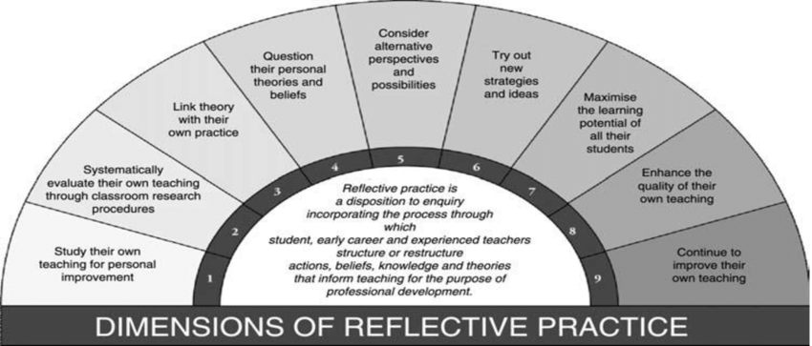
9 dimensiwn arfer adfyfyriol Myer
Notes:
Myers (2012)
These are Myers 9 dimensions of reflective practice
Dimension 1 – identify an aspect of your teaching for development
2 – identify and implement a methods for conducing an evaluation of existing practices
3 – identify the links between theory and practice
4 – question your won persona theories and beliefs
5 – consider alternative perspectives/possibilities
6 – try new strategies
7 – ensure environment is one of inclusion
8 – develop new practices
9 start again
Though we cover much of this in this module, it is integrated throughout much of the course content

Slide 33
Arsylwadau yn yr ystafell ddosbarth
Yn rhan o’r modwl hwn, byddwch yn defnyddio arsylwadau yn yr ystafell ddosbarth fel sail ar gyfer adfyfyrio
Mewn amgylchedd ysgol byddwch yn arsylwi ar ymarferwyr sydd wedi’u lleoli mewn ysgol ac yn defnyddio’r rhain fel sail ar gyfer adfyfyrio

Slide 34
Gweithgaredd
Pam mae angen i chi archwilio eich theorïau a chredoau personol wrth arsylwi?
Beth yw pwysigrwydd ystyried safbwyntiau niferus?
Sut gall eich profiadau eich hun effeithio ar yr hyn y byddwch yn ei arsylwi?

Slide 35
Tasg Ysgrifennu
Ysgrifennwch 250 gair cyflwyniad hunangofiannol i'r aseiniad

Slide 36
Gorffen y gosodiadau
Pan orffennaf y cwrs byddaf….
Rôl y TAR yw……….
Notes:
Send for a coffee – reconsider the original statements
Just ask them to think it over again, has the view changed at all?

Slide 37
Cyfeiriadau
Darlleniadau:
• Key Text: Schön D. (1983). The reflective practitioner. London, England: Temple Smith.
• Gorski, P. C., & Dalton, K. (2020). Striving for Critical Reflection in Multicultural and Social Justice Teacher Education: Introducing a Typology of Reflection Approaches. Journal of Teacher Education, 71(3), 357–368. https://doi.org/10.1177/0022487119883545
• Acquah E. C., Commins N. L. (2015). Critical reflection as a key component in promoting preservice teachers’ awareness of cultural diversity. Reflective Practice, 16(6), 790-805.
• Acquah E. C., Commins N. L. (2015). Critical reflection as a key component in promoting preservice teachers’ awareness of cultural diversity. Reflective Practice, 16(6), 790-805.
• Hatton N., Smith D. (1995). Reflection in teacher education: Towards definition and implementation. Teaching and Teacher Education, 11, 33-49.
• Liu K. (2015). Critical reflection as a framework for transformative learning in teacher education. Educational Review, 67, 135-157.
• Liu K. (2017). Creating a dialogic space for prospective teacher critical reflection and transformative learning. Reflective Practice, 18(6), 805-820.

