Slide 1

Netflix marketing Analysis
By:
Mona Hussien (2211516)
Daniel Dobbs (0750550)
Abdulfatah Esa (1350665)

Slide 2
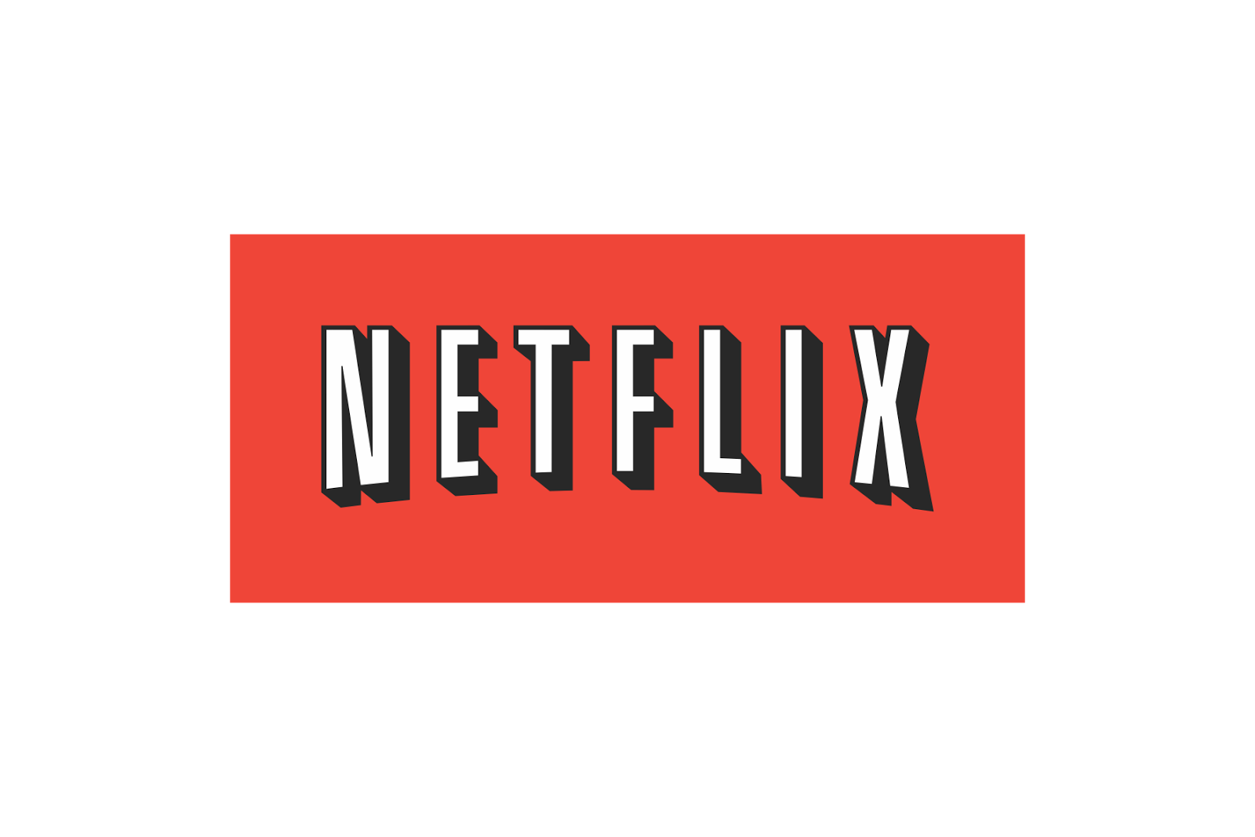
Netflix was founded in 1997 by Reed Hastings and Marc Randolph.
As of Q1 2024, Netflix has over 230 million subscribers globally.(Netflix,2024)
Justified price/ service? Compared to competitor like amazon prime?
Notes:
Hello everyone. My Name is Mona. And I’m part of student Group presentation with Daniel and Abdulfatah. My role is to introduce the topic our group has chosen for this presentation. Today we will be talking about Netflix and the current issues it faces.
*according to Netflix.com, Netflix was founded in 1997 by Reed Hastings and Marc Randolph. It initially started as a DVD rental service before transitioning to a streaming in 2007. The transition to streaming was driven by the increasing popularity of online content consumption and the advancements in technology that made it possible to stream high-quality videos over the internet. Netflix recognized the changing landscape of the entertainment industry and saw the opportunity to provide a more convenient and accessible way for people to enjoy movies and TV shows.
As of the first quarter of 2024, Netflix.com mentioned that Netflix has over 230 million subscribers globally and It operates in over 190 countries and offers a wide range of content, including original series, films, and documentaries. Netflix is available on a variety of devices, including smart TVs, game consoles, and personal computers. It also has its own app for smartphones, tablets, and other devices.
So we will be investigating the current marketing situation of Netflix and whether or not its price is justified for the service it provides. Compared to its rivals. Amazon Prime for instance, which is a streaming service offered by Amazon. It is part of the Amazon Prime membership, according to Amazon website, the membership includes benefits like free shipping, Prime Music, and Prime Reading. And As of 2023, Amazon Prime has over 200 million subscribers worldwide, with Prime Video available in over 200 countries. and their price is cheaper than Netflix.

Slide 3
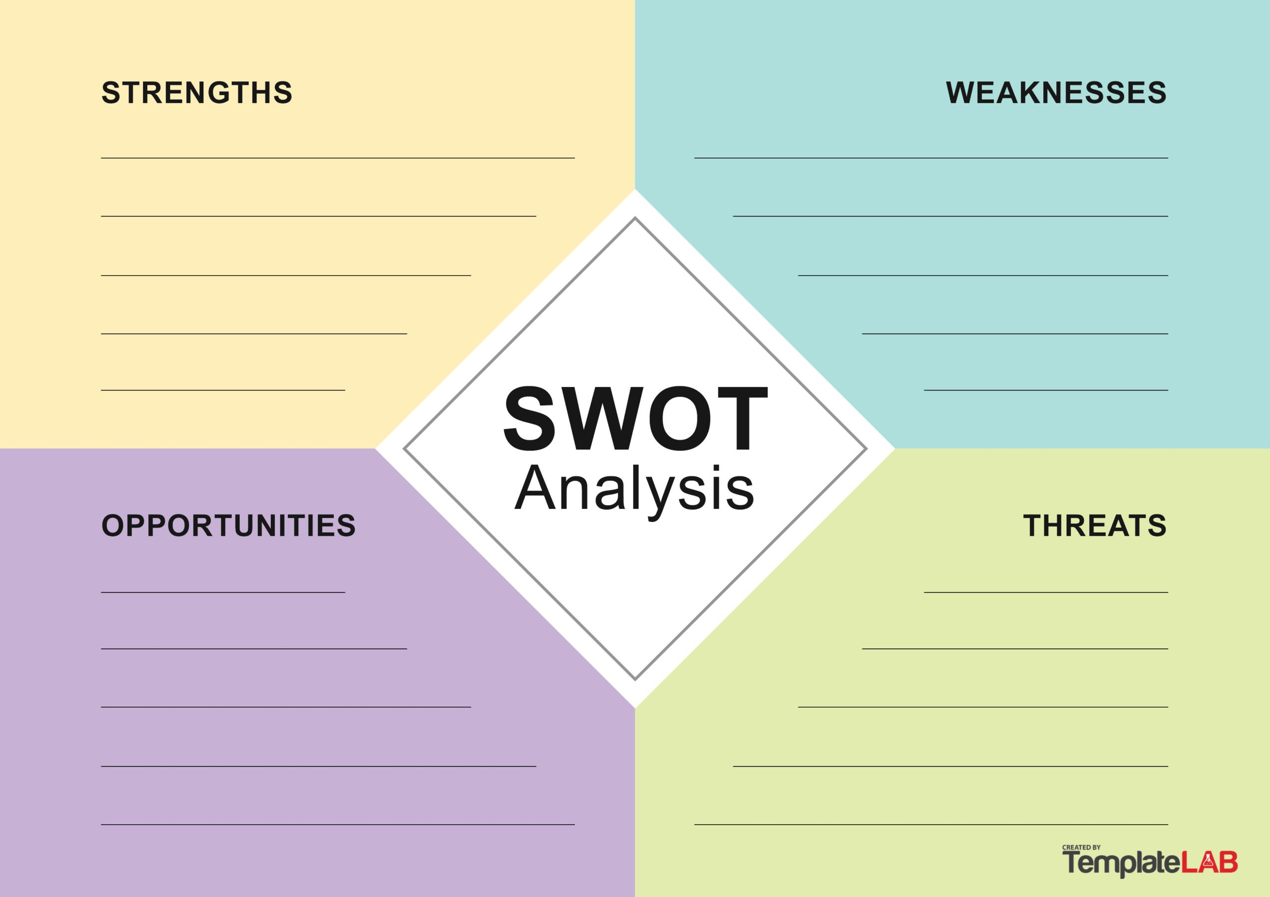
SWOT Analysis
High contents costs
Market Leadership (Holt,2024)
Original Content (Statista,2024)
Limited content libraries in some regions
Global Reach (Smith,2023)
Subscriber Saturation\ resilience
Expansion into emerging markets
Intense Competition (Grand view research,2023)
(Kotler & Keller, 2016).
Ad-Supported model(Brown,2023)
Regulatory Challenges (Gonzalez,2023)
Content Piracy (Lee,2023)
Technological innovations (Johnson,2023)
Notes:
So we started our investigation by Doing SWOTT analysis. Which according to Phillip Kotler is a strategic planning tool used to identify and analyse the Strengths, Weaknesses, Opportunities, Threats, and Trends affecting an organization. It helps companies understand their internal capabilities and external environment, aiding in strategic decision-making and long-term planning. Based on our analysis, Netflix strengths are Market Leadership and the Original content it provides. This has helped differentiate Netflix from competitors. According to Statista.com It has strong portfolio of original programming, including award-winning series like "Stranger Things" and "The Crown.
On the other hand, one of Netflix main weakness is Limited content libraries in some regions. Content availability varies due to licensing agreements. So for instance , Netflix in Australia does not have the same content library as Netflix in the US. , which can frustrate users.
Based on our findings, one of Netflix main opportunities is Potential to grow subscriber base in markets like India, Africa, and Southeast Asia with localized content. According to smith, These markets have large populations and growing economies, and Netflix's localized content can be tailored specifically to these markets as This can help Netflix to compete with local streaming services and gain a competitive edge.
Streaming services like Disney+ and Amazon Prime Video are Netflix's greatest threat, according to Grandview research. because they offer a wide range of exclusive content which attracts customers too.

Slide 4
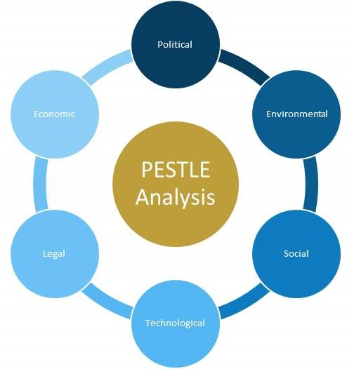
PESTLE Analysis
(Johnson et al., 2020)
Notes:
We also used Pestel analysis on our investigations. PESTEL analysis according to Johnson is a strategic framework used to evaluate the external macro-environmental factors affecting an organization. It stands for Political, Economic, Social, Technological, Environmental, and Legal factors. This analysis helps companies understand external forces and anticipate market trends, aiding in strategic planning and decision-making.
So one of the political factors affecting Netflix is that Different countries have varying regulations and censorship laws affecting content availability and production. And Economic downturns can affect consumer spending on non-essential services like streaming subscriptions. And theres a change in Consumer Preferences. As Increasing demand for on-demand content has increased over traditional TV. And The main technological factor is the Increase of global internet use and this supports the growth of streaming services in general.
Based on our analysis on the environmental factors affecting Netflix, Streaming services like Netflix rely on vast amounts of energy to keep data flowing over the internet. According to the bbc. While some energy comes from clean sources, a significant portion still comes from burning fossil fuels, contributing to rising global temperatures². While the legal factors are Privacy Regulations and copyright protection.
I will now pass you over to my colleague Abdulfatah to elaborate more on the porter 5 forces analysis.

Slide 5
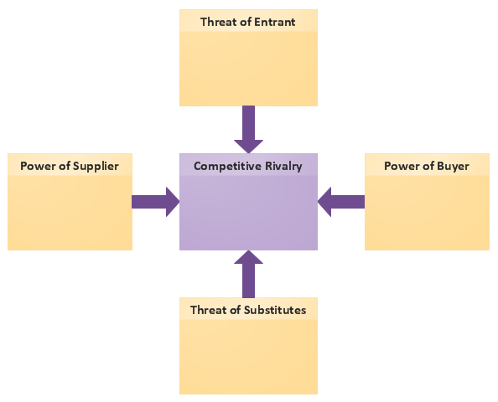
Porter's Five Forces Analysis
MODERATE
MODERATE
HIGH
HIGH
HIGH
Porter, 2008)
Notes:
Porter’s Five Forces analysis is a strategic framework developed by Michael E. Porter that helps analyse the competitive forces within an industry. It examines five key forces that shape every industry and market: competitive rivalry, threat of new entrants, threat of substitutes, bargaining power of buyers, and bargaining power of suppliers. This analysis helps companies understand the intensity of competition and the profitability of their industry. (Porter,2008)
COMPETITIVE RIVALY:
**High**
1. **Intense Competition**: Netflix faces strong competition from other streaming services like Amazon Prime Video, Disney+, HBO Max, and Hulu, which all invest heavily in original content and technology (Grand View Research, 2023).
2. **Market Saturation**: In mature markets like the US and Europe, the competition is particularly fierce, with limited room for subscriber growth (Hastings, 2023).
3. **Content Differentiation**: Competitors are increasingly producing high-quality, exclusive content to attract and retain subscribers (Johnson, 2023).
Threat of New Entrants
**Moderate**
1. **High Entry Barriers**: Significant capital investment is required for content creation and technology infrastructure, making it difficult for new entrants to compete (Smith, 2023).
2. **Brand Loyalty**: Established players like Netflix benefit from strong brand loyalty and subscriber bases, which new entrants find challenging to overcome (Kotler & Keller, 2016).
3. **Regulatory Hurdles**: Navigating international regulations and censorship laws can be complex and costly for new entrants
Threat of Substitutes:
**High**
1. **Alternative Entertainment**: Consumers have numerous entertainment options, such as traditional TV, video games, social media, and other online platforms like YouTube (Statista, 2024).
2. **Piracy**: Illegal streaming and downloading of content continue to pose a significant threat to the profitability of streaming services
3. **Price Sensitivity**: Ad-supported and free streaming services offer viable alternatives to paid subscriptions, appealing to cost-sensitive customers (Brown, 2023).
### Bargaining Power of Buyers
**High**
1. **Low Switching Costs**: Customers can easily switch between different streaming services, making subscriber retention challenging (Adams, 2023).
2. **Subscription Fatigue**: Increasing number of subscription-based services leads to higher expectations and demands from consumers (Nielsen, 2023).
3. **Demand for Quality Content**: Subscribers demand high-quality, diverse, and original content, forcing streaming services to continuously invest heavily in content creation (Smith, 2023).
### Bargaining Power of Suppliers
**Moderate**
**Content Creators**: Producers, directors, and actors can command high fees due to the intense competition among streaming services for premium content.
2. **Licensing Costs**: Rights holders of popular movies and TV shows have significant negotiating power, influencing the cost structure of streaming services (Hastings, 2023).
3. **Technology Providers**: Dependence on technology providers for cloud infrastructure, data analytics, and streaming technology also impacts bargaining power (Johnson, 2023).

Slide 6
Product:
features films
TV shows
documentaries Netflix originals
and many more.
Price:
Subscription pricing
Value chain pricing
Place:
Online
TV
smartphone
any smart device
(Jobber and Ellis-Chadwick, 2019)
People:
Membership has over 223.1 million subscribers globally (Netflix, 2023).
Promotions :
Adds via digital channels
media platform
Marketing mix 7ps
Physical evidence:
Optimized apps
Optimized website
Process:
Netflix is free for 30 days for new members.
Notes:
Netflix is popular streaming service that lets people watch movies, tv series and documentaries online. Started in calfornia in 1997 at first the companies main goal was to rent dvds but in 2007 how ever started its online streaming services which now it’s a major goal. Netflix lets people streaming materials in many devices like smart phones, tablets and TV's. It gives people suggestion based on their age, gender or what they have watched before. Netflix has so many specials in the archives. It has over 230 millions subscribers worldwide. (Netflix, 2024)
The marketing g mix of Netflix analyses the 7Ps of Netflix, which includes the Product, Price, Place, Promotion, People, Physical Evidence, and Process of Netflix. (Allen, 2020)
As mentioned previously Netflix competitors include the likes of Amazon Prime, Disney+, Hulu, Hotstar, HBO Max, Apple TV, and others. Netflix’s profits have skyrocketed as it has established itself as one of the best forms of television streaming.
Im going to to elaborate more on this theory and cover and explain every step on the theory by looking at it from Netflix side.
Number one product: It's critical for businesses to avoid creating goods or services that consumers won't purchase. Netflix came up with the concept of providing users with access to an enormous library of content, including movies, TV series, documentaries, Netflix originals, and much more. (Allen, 2020)
Number 2: Price: One of the most crucial components of Netflix's marketing mix is pricing (7Ps of Netflix). Clients pay a monthly subscription; in the UK, options begin at £4.99 per month and there are no additional fees or commitments; monthly plans can cost anywhere from £4.99 to £15.99. (Allen, 2020)
Number 3 place: Smart TVs, gaming consoles, laptops, tablets, smartphones, and streaming devices can all be used to access Netflix content. As an online streaming company, it is accessible almost anywhere at any time. (Allen, 2020)
Number 5 people: it has over 223.1 million subscribers globally. (Jones, 2024)
Number 6 process: Different business functions may have different processes. For instance, signing up with Netflix is a straightforward process. (Allen, 2020)
number 7 physical evidence : physical evidence is the last element to address in the Marketing mix of Netflix (7Ps of Netflix). As Netflix is a streaming service, its website and app are its primary physical evidence. (Allen, 2020)

Slide 7
Recommendations
Netflix need to advertise openly more.
Market is constantly changing and growing with people getting older and tastes changing. So should the marketing.
New films and series being aired on netflix only need to be spoken about more on platforms rather than word of mouth.
What else can netflix provide. The competition is catching up, Netflix need to act now before the others overtake.
Notes:
The likes of Disney+ and Amazon prime provide the same if not more advertising compared to Netflix. Disney not only release movies themselves through their own platform but also release in cinemas this is extra income and a great benefit to sign up as you tend to get access to the film before it reaches cinemas.
Unless it’s an article you don’t tend to see netflix promote new content unless you are or have been a customer. This is a good way to retain and bring back previous customers but with the market changing you would expect netflix to target the new generation, with Amazon providing additional services they advertise on their own platforms as well as advertising with other TV stations etc... This resulting in Amazon being ahead of Netflix in the marketing area.

Slide 8
Conclusion
Competing in a Competitive market
Different but similar to the other providers
Consumer led for marketing and retention based on services being added.
Political and economical concerns with live sport being added and also creating original content.
Platforms and collaborating.
Notes:
Netflix as mentioned on previous slides has over 230 million customers globally, these customers tend to be on a rolling 30 day subscription especially within the UK. They compete with Amazon Prime and Disney+ as well as a number of other providers. Unlike Amazon currently Netflix only provide streaming services for movies and TV series, but have expanded with providing live sports with the next event expected to be a boxing bout as well as the deal it has established with Wrestling giants WWE in a 5 billion pound deal. (Farrant Ap 2024). With Netflix now providing live sport it has been brought up that customers now need to be paying TV licencing fees which will cause some disappointment to existing and future customers. (TV Licensing 2024)
Netflix was originally an app for use on tablets, phones and laptops as well as smart TVs. Smart TVs now automatically come with Netflix pre installed and is also loaded on TV services such as Sky and can be included within your TV subscription at an additional cost. With this cost being within your sky bill, you would expect the retention of these customers to be for the term of the sky package which upon investigation seems to be 18months (Sky 2024).
Netflix promotes itself to existing customers by promoting films and series most likely to be viewed by the individual customer based on what they have watched on netflix, this makes good use of data collection and retaining customers but also help with where Netflix invest their money to keep retaining and growing customers.

Slide 9
Reference list:
Amazon (2024). How to sign up for Amazon membership. [online] Available at: How to sign up for a Prime membership (aboutamazon.com)
Kotler, P. (2009). Marketing management. 1st ed. Place of publication not identified. Pearson/Prentice Hall. [online] Available at: https://librarysearch.uwtsd.ac.uk/permalink/44WHELF_UWTSD/1pbrh66/alma99100107694302421 [Accessed 2 Jun. 2024]
Statista. (2024). Number of Netflix Subscribers Worldwide from 2013 to 2024. *Statista*. [online] Available at: https://www.statista.com/statistics/250934/quarterly-number-of-netflix-streaming-subscribers-worldwide [Accessed 2 June 2024].
Smith, R. (2023). Netflix’s Global Expansion and Localized Content Strategy. *Media & Entertainment Review*. [online] Available at: <https://www.mediaentertainmentreview.com/netflix-global-expansion> [Accessed 30 May 2024].
Grand View Research. (2023). Video Streaming Market Size, Share & Trends Analysis Report. *Grand View Research*. [online] Available at: https://www.grandviewresearch.com/industry-analysis/video-streaming-market> [Accessed 30 May 2024].
BBC News. (2018). Climate change: Is your Netflix habit bad for the environment?. [online] Available at: https://www.bbc.co.uk/news/technology-45798523 [Accessed 2 June 2024].
Porter, M.E. (2008) The five competitive forces that shape strategy, [online] Harvard business review. United States: Harvard Business Review, pp. 78–137. https://librarysearch.uwtsd.ac.uk/permalink/44WHELF_UWTSD/1ir6fgh/cdi_proquest_miscellaneous_70293081 [Accessed 30 May 2024].
Jones, C. (2024). Netflix profits surge as streaming service adds 9.3m subscribers in latest quarter. The Guardian. [online] 18 Apr. Available at: https://www.theguardian.com/media/2024/apr/18/netflix-earnings-fourth-quarter#:~:text=The%20entertainment%20giant%20added%209.3.

Slide 10
Netflix (2024). About Netflix. [online] Netflix. Available at: https://about.netflix.com/en.
Allen, A. (2020). The 7Ps of The Marketing Mix. [online] Oxford College of Marketing. Available at: https://blog.oxfordcollegeofmarketing.com/2020/10/08/understanding-the-7ps-of-the-marketing-mix/.
‌
Jobber, D. and Ellis-Chadwick, F. (2019). EBOOK: Principles and Practice of Marketing, 9e. [online] Google Books. McGraw Hill. Available at: https://books.google.co.uk/books?hl=en&lr=&id=IMovEAAAQBAJ&oi=fnd&pg=PR1&dq=jobber+%26+ellis-chadwick+electronic+book&ots=4R_nQbp0Kb&sig=DM1JOPB9qfmLSlKid5q8s-JsQc#v=onepage&q=jobber%20%26%20ellis-chadwick%20electronic%20book&f=false [Accessed 2 Jun. 2024].
‌
Sky (2024) https://www.sky.com/tvandbroadband [Accessed 2 Jun 2024].
Farrant Ap (2024) Will netflix become the new home for sport? https://www.euronews.com/culture/2024/03/23/will-netflix-become-the-new-home-of-live-sports-programming-not-for-a-while [Accessed 2 Jun 2024].
TV licensing (2024). FAQs ‌https://www.tvlicensing.co.uk/faqs/FAQ104#:~:text=If you are watching a TV programme live on Netflix,on demand programmes on Netflix [Accessed 2 Jun 2024]

