Slide 1
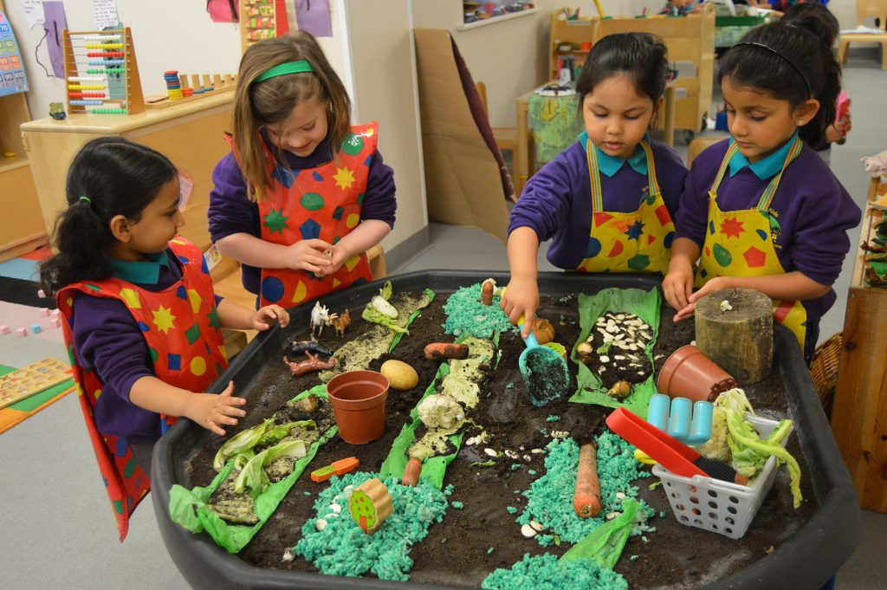
PLAY-BASED LEARNING & ALN
Exploring the Role of Play-Based Learning in Supporting Learners with Additional Learning Needs in Mainstream Primary Schools in Wales
A Small-Scale Qualitative Research Project
Inam Alsalim | Professional Doctorate in Education (EdD) | University of Wales Trinity Saint David

Slide 2
INTRODUCTION & CONTEXT
Why this study matters
Two reforms at once: Curriculum for Wales and the new ALN system
STUDY FOCUS
Schools must include every learner, but practitioners need practical strategies.
How do practitioners in mainstream primary schools in Wales use and experience play-based learning to support learners with ALN?
Play-based learning is well evidenced generally
Its value as an inclusive strategy for ALN in Welsh classrooms is under-explored.
Practitioner experience is the starting point for improvement
What do practitioners do, what helps, and what gets in the way?
Module: ECDE7021 — Applying critical skills, contributing to knowledge: leading improvement
Play-Based Learning & ALN in Wales
2

Slide 3
RESEARCH QUESTIONS
One main question, two sub-questions
MAIN RESEARCH QUESTION
How do practitioners in mainstream primary schools in Wales use and experience play-based learning as a strategy to support learners with Additional Learning Needs (ALN)?
SQ1
SQ2
What strategies do practitioners use to adapt play-based learning for ALN learners?
What training and resourcing factors support or limit this practice?
Play-Based Learning & ALN in Wales
3

Slide 4
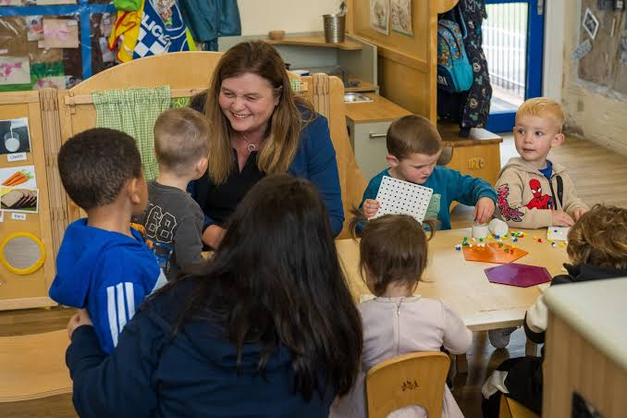
LITERATURE REVIEW (1/3)
The Welsh policy context
1
2
3
ALNET Act 2018 & ALN Code 2021
Curriculum for Wales
What Estyn found
One statutory framework for learners with ALN from birth to 25, replacing the SEN system. Phased implementation began in September 2021. (Welsh Government, 2021).
Inclusive, learner-centred teaching (Welsh Government, 2022). Wales has a play-based tradition in the Foundation Phase for ages 3–7 (Welsh Government, 2015).
2023: ALNCos need sufficient time and resource; professional learning should focus on high-quality teaching for ALN. 2024: implementation inconsistent; leaders concerned about funding ending.
Tension: Conn and Hutt (2020) found practitioners struggle to reconcile individual ALN arrangements with the broader curriculum vision. Policy expects inclusion; the conditions for delivering it look uneven.
Play-Based Learning & ALN in Wales
4

Slide 5
LITERATURE REVIEW (2/3)
What we know about play — and the gap
Play-based learning in primary grades supports working memory, cognitive flexibility and self-regulation, and can reduce stress (Allee-Herndon and Roberts, 2021).
THE GAP THIS STUDY ADDRESSES
General evidence exists on play-based learning and, separately, on ALN reform in Wales. I found little research combining the two: how practitioners in Welsh mainstream primary schools use play-based learning to support learners with ALN. That gap is not just an academic curiosity. Further research into practitioners’ experiences could inform training, guidance and resourcing decisions.
Play is highly relevant to early intervention and special education, yet tensions persist in how it is described and used (Lifter et al., 2011).
Wales has a play-based tradition: the Foundation Phase for 3–7-year-olds (Welsh Government, 2015).
Play-Based Learning & ALN in Wales
5

Slide 6
LITERATURE REVIEW (3/3) — THEORETICAL FRAMEWORK
Vygotsky: play, scaffolding and mediation
1
2
3
Play & the ZPD
Scaffolding
Mediating tools
In play, children can operate above their everyday level, supported by others (Vygotsky, 1978).
A more knowledgeable other supports the learner, then gradually withdraws support (Wood, Bruner and Ross, 1976).
Learning is mediated through cultural tools and signs, such as language and symbols (Vygotsky, 1978).
ANALYTICAL QUESTION
How do practitioners scaffold play for learners with ALN, and what supports them to do it well?
Play-Based Learning & ALN in Wales
6

Slide 7

METHODOLOGY
A qualitative, interpretivist approach
Why qualitative
The question is about meaning-making, not measurement: practitioners' interpretations of their own practice (Creswell and Poth, 2018). This is consistent with a socio-cultural view of learning.
Why semi-structured interviews
A shared schedule gives consistency, with room for participants to shape depth and direction — well suited to small-scale research (Drever, 1995).
Why these participants
Four practitioners, purposively sampled across roles: a Teaching Assistant (P1), a language teacher (P2) and two ALN Co-ordinators (P3, P4) — a rounded picture, not statistical generalisation.
Play-Based Learning & ALN in Wales
7

Slide 8
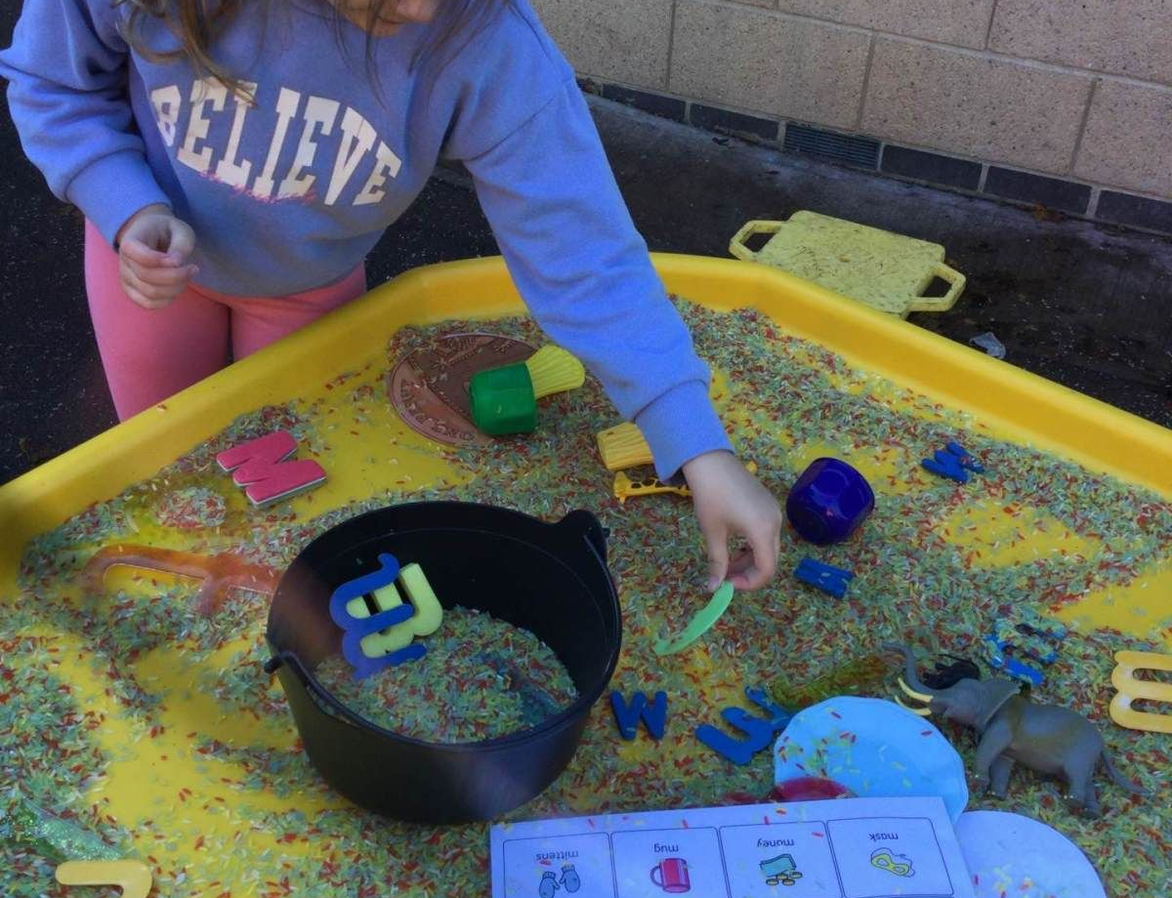
CRITICAL JUSTIFICATION
Naming the limitations honestly
RECRUITMENT CHALLENGE
REFLEXIVITY & DATA LIMITS
4
P1's transcript includes a brief gap; other transcripts are complete. Minor errors may occur during transcription.
participants recruited, against a target of 6–10
A small sample (about 5,300 words of participant speech) limits generalisability: findings are indicative patterns, not population claims
Despite contacting many English-medium primary schools in Wales, recruitment was difficult. Likely reasons: interviews fell in the last weeks of the summer term, school workload (Estyn, 2023), and a cold invitation with no gatekeeper support.
As the sole researcher, my assumptions shape the analysis; each theme rests on at least two participants, and quotations were checked against the transcripts
Play-Based Learning & ALN in Wales
8

Slide 9
RESEARCH TOOLS & ETHICS
How the data was collected — and protected
Research tool
Informed consent
Semi-structured interview schedule; interviews held online and recorded; recordings were manually transcribed and checked. Sole primary data collection method.
Signed consent form after an information sheet issued at least 1 week in advance. Voluntary; right to skip questions or withdraw before anonymisation.
Confidentiality
Governing frameworks
Names, schools and identifying references replaced with codes (P1–P4, "Interviewer"). Data stored on a password-protected personal device.
UWTSD Research Ethics & Integrity Policy; BERA (2024); BPS (2021). University ethics approval obtained before data collection.
Play-Based Learning & ALN in Wales
9

Slide 10
DATA ANALYSIS APPROACH
Braun and Clarke's six-phase thematic analysis
1
2
3
4
5
6
Familiarisation
→
Initial coding
→
Searching for themes
→
Reviewing themes
→
Defining & naming
→
Producing the report
Inductive: themes come from the data, not a pre-set framework.
Cross-case: each theme is a pattern seen in more than one participant.
Theory as lens: Vygotsky's framework is used to interpret the themes, not to generate them.
Play-Based Learning & ALN in Wales
10

Slide 11
INITIAL FINDINGS — SQ1
How practitioners adapt play-based learning
Following interests and strengths (P1–P4)
“
it was just magic that everybody is good at something and it's just giving everybody a chance to shine.”
Visual supports, AAC boards and songs with gestures (P1, P2, P4)
Dedicated, learner-owned environments (P3)
— ALN Co-ordinator (P3), describing a quiet pupil in forest school
“I don't believe you, everybody's able.”
Structured, scaffolded routes into play (P1–P4)
— Language teacher (P2), on being told pupils “are not able”
Play-Based Learning & ALN in Wales
11

Slide 12
INITIAL FINDINGS — SQ2
Training and resourcing gaps
THE TRAINING GAP
STRUCTURAL CONSTRAINTS
No participant described training that combines play-based learning and ALN. P4's staff had play-based learning CPD and separate ALN communication training; P2's course had only a small special-needs component.
Funding (P3), time (P1, P4) and assistant teachers and class size (P2) were the limits raised. P2: with assistants and smaller classes, “no one is left behind”.
“There hasn't been anybody who has been on anything specific that links [play-based learning] with ALN.”
“The word on everybody's lips at the moment is funding... giving teaching assistants the kudos they deserve.”
— ALN Co-ordinator (P4)
— ALN Co-ordinator (P3)
Consistent with Estyn: 2023 - professional learning on high-quality teaching for ALN; ALNCo time and resource.
2024 - leaders concerned about sustaining services when funding ends.
Play-Based Learning & ALN in Wales
12

Slide 13
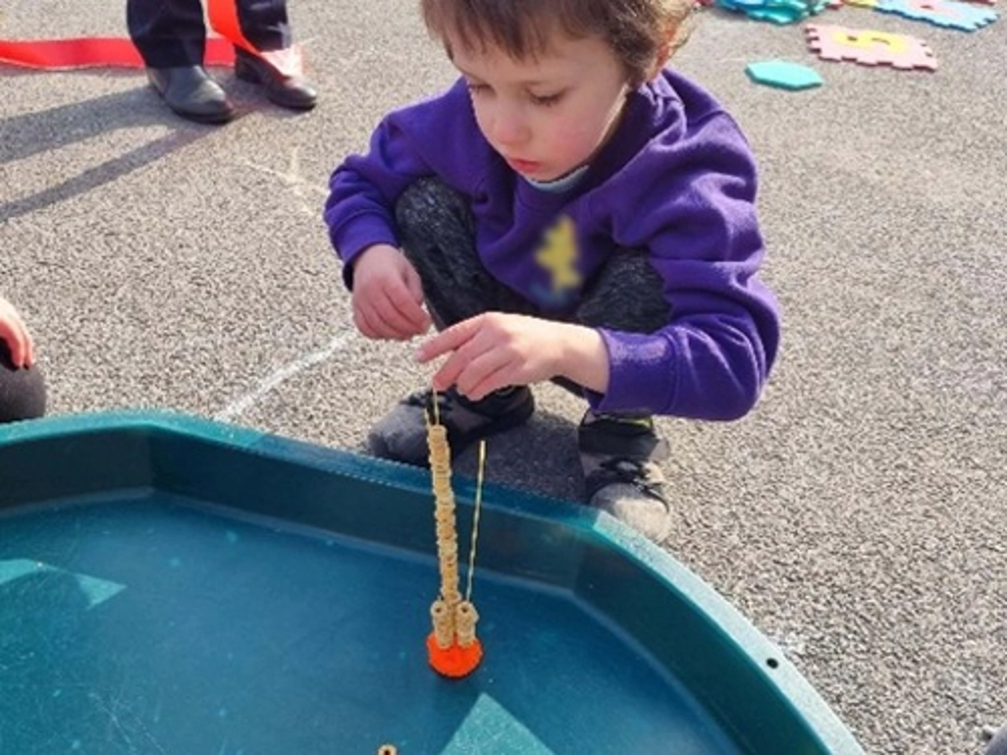
CONTRASTING POSITIONS
Starting from play, or from the child?
Two ALNCos position play-based learning differently. P3's school treats it as "at the very heart of everything" and is extending it into Key Stage 2; P4's plans ALN support from each child's outcomes, using structured play.
“we would go primarily from the children's specific outcomes of what they need, as opposed to giving them the play and adjust it the other way.”
— ALN Co-ordinator (P4)
P3 reports "a mixed response" as the school tries to extend play-based learning upwards. These are contrasting starting points, not necessarily contradictory: P4's structured play sits at the adult-led end of the continuum she described. Each is one school's account, so this is a lead for further research, not a generalisation.
Play-Based Learning & ALN in Wales
13

Slide 14
INTERPRETING THE FINDINGS
Reading the findings through Vygotsky
WHAT PRACTITIONERS DESCRIBED
THEORETICAL READING
Small steps, extra time (P1); pushing, then waiting for a response (P2)
→
Adult scaffolding within the ZPD
Structured sessions leading to children inviting peers into play (P4)
→
Scaffolding with planned withdrawal
A quiet pupil becomes the expert in forest school (P3)
→
Peer as more knowledgeable other
AAC boards (P4); songs with gestures (P2)
→
Mediating tools for communication
Scaffolding depends on skilled adults. "It is a skill to unpick" (P3); no combined play–ALN training (P4).
Critical question: Vygotsky saw play as creating its own zone of proximal development, but P4 says some children cannot use play productively until turn-taking is taught. For children with ALN, does play lead development, or follow it?
Play-Based Learning & ALN in Wales
14

Slide 15

CONCLUSION
Purposeful pedagogy, unevenly supported
Practitioners describe scaffolded, purposeful play — not free play. But scaffolding depends on trained, resourced adults, and participants described uneven access to training, time and resources.
KEY CONCLUSIONS
→
Purposeful, scaffolded teaching, adapted through interests, structure and supports (P1–P4)
→
It depends on skilled adults; combined play-ALN training is missing, and time and funding are tight
→
Schools differ: P3 starts from play, P4 from the child's outcomes
Play-Based Learning & ALN in Wales
15

Slide 16
REFERENCES (1/2)
Reference List
Additional Learning Needs and Education Tribunal (Wales) Act 2018 (anaw 2). Available at: https://www.legislation.gov.uk/anaw/2018/2/contents/enacted
Allee-Herndon, K.A. and Roberts, S.K. (2021) 'The power of purposeful play in primary grades: Adjusting pedagogy for children's needs and academic gains', Journal of Education, 201(1), pp. 54–63.
BERA (2024) Ethical Guidelines for Educational Research. 5th edn. London: British Educational Research Association.
Braun, V. and Clarke, V. (2006) 'Using thematic analysis in psychology', Qualitative Research in Psychology, 3(2), pp. 77–101.
British Psychological Society (2021) Code of Human Research Ethics. Leicester: BPS.
Cohen, L., Manion, L. and Morrison, K. (2018) Research Methods in Education. 8th edn. Abingdon: Routledge.
Conn, C. and Hutt, M. (2020) 'Successful futures for all? Additional learning needs in Wales in the light of curriculum reform', British Journal of Special Education, 47(2), pp. 152–169.
Creswell, J.W. and Poth, C.N. (2018) Qualitative Inquiry and Research Design. 4th edn. London: Sage.
Drever, E. (1995) Using Semi-Structured Interviews in Small-Scale Research: A Teacher's Guide. Edinburgh: SCRE.
Play-Based Learning & ALN in Wales
16

Slide 17
REFERENCES (2/2)
Reference List
Estyn (2023) The new additional learning needs system. Cardiff: Estyn.
Estyn (2024) The additional learning needs system: Progress of schools, settings and local authorities in supporting pupils with additional learning needs. Cardiff: Estyn.
Lifter, K., Foster-Sanda, S., Arzamarski, C., Briesch, J. and McClure, E. (2011) 'Overview of play: Its uses and importance in early intervention/early childhood special education', Infants & Young Children, 24(3), pp. 225–245.
Vygotsky, L.S. (1978) Mind in Society: The Development of Higher Psychological Processes. Cambridge, MA: Harvard University Press.
Welsh Government (2015) Curriculum for Wales: Foundation Phase Framework (Revised 2015). Cardiff: Welsh Government.
Welsh Government (2021) Additional Learning Needs Code for Wales 2021. Cardiff: Welsh Government.
Welsh Government (2022) Curriculum for Wales: Guidance. Cardiff: Welsh Government.
Wood, D., Bruner, J.S. and Ross, G. (1976) 'The role of tutoring in problem solving', Journal of Child Psychology and Psychiatry, 17(2), pp. 89–100.
Play-Based Learning & ALN in Wales
17

