Slide 1

BMSW5002
Developing Relationships and Workplace Achievement
E-LEARNING

Slide 2
E-LEARNING: SESSION PLAN
1. E-learning defined
2. Uses of e-learning
3. Advantages and disadvantages of e-learning
4. Developments in e-learning

Slide 3
E-LEARNING DEFINED
E-learning is learning that is delivered through electronic technology.
E-learning can be defined as ‘the delivery and administration of learning opportunities and support via computer, networked and web-based technology to help individual performance and development’.

Slide 4
E-LEARNING DEFINED
E-learning enhances learning by extending and supplementing face-to-face learning rather than replacing it.
It enables learning to take place when it is most needed (just in time as distinct from just in case) and when it is most convenient.
Learning can be provided in short segments or bites that focus on specific learning objectives.
It is ‘learner-centric’ in that it can be customized to suit an individual’s learning needs – learners can choose different learning objects within an overall package.

Slide 5
USES OF E-LEARNING
E-learning technology provides content in the form of training courses or ‘bite-sized’ leaning material.
As established by the CIPD (2011) survey it is most commonly used for compliance (for example, health and safety, hygiene and data protection).
It is also often used for induction training.

Slide 6
ADVANTAGES AND DISADVANTAGES OF E-LEARNING
E-learning enhances learning by extending and supplementing face-to-face learning rather than replacing it.
The drawbacks are the need for learners to be self-motivated, the time and effort required to develop and update e-learning programmes and the problem of providing adequate support to learners.

Slide 7
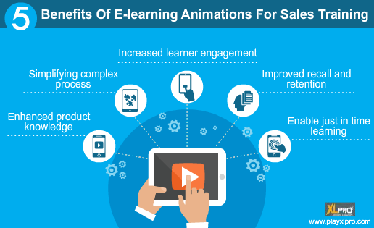

Slide 8
DEVELOPMENTS IN E-LEARNING
Knowledge sharing technologies such as blogs, podcasts, wikis, rapid authoring software
Virtual learning environments (VLEs)
Social media
On-line learning
Mobiles
Game-based learning or ‘gamification’

Slide 9


Slide 10
  How can apps be used in e-learning?
Follow-ups to a learning intervention, broadening access out to different ‘layers’ of sites that provide basic information, and access to broader communities of practice.
Awareness-building material, for example enhancing leadership models with provision of additional guidance, support tools that lay out different options for development, provide feedback and progress checks.
Process confirmation, where learners can record information and the L&D function can check for process alignment and behavioural reinforcement.

Slide 11
What steps are required to introduce game-based learning?
Define objectives – the sort of behaviours the game is intended to develop.
Select or produce a game that will focus on those behaviours and fits the people who are going to play it.
Decide on any help that can be provided through e-learning.
Define to participants how they should analyse their performance in the game under such headings as problem solving, teamwork and leadership.
Ensure that participants carry out this analysis and draw up a list of lessons learnt.
Get participants to define what action they intend to take at work to apply the lessons learnt.

