Slide 1
CSS Page Layouts
Lecture 3: Internet Technology & Security (ITS)
Dr Kemi Ademoye

Slide 2
Today’s Lecture
The CSS Box Model
Semantic Page Elements
Grids and Page Layouts

Slide 3
The CSS Box Model
A rectangular box that represents HTML elements. Margins, borders and padding wrap around the actual content:
Margin: Clear, Transparent Space around the Border. No Background Colour!
Border: an Edge that goes around the content and padding
Padding: Clear space around content. Same background colour as content
Content: the actual HTML content (text, images, etc.)

Slide 4
Exercise
What is the total width of an element that has the following style dimensions?
width: 940px;
padding: 10px;
border: 5px solid blue;
margin: 5px;

Slide 5
Exercise Solution
What is the total width of the element that has the following style definition?
width: 940px;
padding: 10px;
border: 5px…;
margin: 5px;
= 940 (Width i.e. content)
  +20 (Left + Right Padding)
  +10 (Left + Right Border)
  +10 (Left + Right Margin)
= 980 px
Margin
5
Border
5
Padding
10
5
Content
5
5
5
10
10
940
10
5
5

Slide 6
The CSS Box Model
Traditional box model:
  Total Element Width = width + padding + border + margin
Can be confusing working out the width elements occupy.
CSS3 introduced the box-sizing property to simplify this.

Slide 7
CSS3 Box Sizing
The new box-sizing property allows you to set the box-sizing to border-box:
  selector { box-sizing: border-box; }
This indicates that:
  The padding and border is included as part of the element’s total width and height.
  The element’s total width and/or height is what is specified in the CSS width and height properties.
  The padding and border are subtracted from these values.

Slide 8
CSS3 Box Sizing
This <div> has a width of 300px. No padding or border.
div {
width: 300px;
padding: 0;
border: none;
}
This <div> also has a width of 300px, but with a padding of 10px around it.
It’s bigger than the previous <div> because of the default CSS box model – adds 10px to all sides.
div {
width: 300px;
padding: 10px;
border: none;
}
This <div> also has a width of 300px and a padding of 10px around it, but is the same size as div1 because box-sizing: border-box;
div {
width: 300px;
padding: 10px;
border: none;
box-sizing: border-box;
}

Slide 9
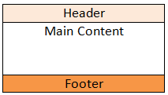
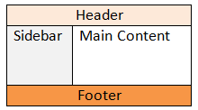
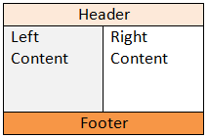
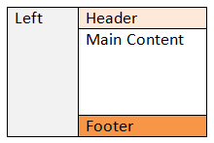
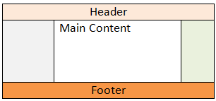
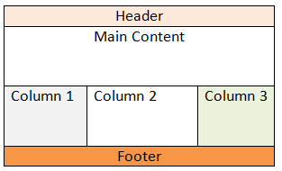
Page Layouts

Slide 10
HTML5 Semantic Elements
Semantic elements are elements with meaning.
  They replace the non-semantic elements, <div> and <span> which tell you nothing about their type of content.
A semantic element clearly describes what its content represents, to the browser and also the developer(s). For example:
  <table>, <form>, <img>
  <header>, <footer>, etc.

Slide 11
HTML5 Semantic Elements
Tag | Description
<article> | Defines an article
<aside> | Defines content aside from the page content
<details> | Defines additional details that the user can view or hide
<figcaption> | Defines a caption for a <figure> element
<figure> | Specifies self-contained content, like illustrations, diagrams, photos, code listings, etc.
<footer> | Defines a footer for a document or section
<header> | Specifies a header for a document or section
<main> | Specifies the main content of a document
 | Defines marked/highlighted text
<nav> | Defines navigation links
<section> | Defines a section in a document
<summary> | Defines a visible heading for a <details> element
<time> | Defines a date/time
See more on W3Schools
Notes:
Source: http://www.w3schools.com/html/html5_semantic_elements.asp

Slide 12
Page Layout Semantic Elements
<header> </header>
<nav> Menu links </nav>
<article> (group content on the page that could stand alone – think of a newspaper article, blog or forum post) </article> | <aside> content aside from the main content – think of sidebar adverts. </aside>
<section> (defines a document section – groups related content in a document, typically with a heading, followed by section content) </section>
<footer> </footer>
More...

Slide 13
Page Layouts
Website content is usually displayed in a grid.
Grid systems are popular in web design and other visual design fields.
A grid system arranges content horizontally (rows) and vertically (columns) in a grid.
Grids are used to achieve an important web design principle: alignment.

Slide 14
Page Layouts: Alignment
Alignment is about organising information to create order.
  Each element on the page visually connects to other elements on the page.
  The grid lines, even when invisible, connect elements and make divisions on the page, creating order.
Alignment is the “A” of C.R.A.P. Design, the four basic principles of good design.
Notes:
C.R.A.P. stands for:
Contrast: used to draw the viewer’s attention and create distinction between elements.
Repetition: key to consistent design across pages. Repeat colours, text styles and graphics to establish a strong visual style for the page and website.
Alignment: every element on the page should be intentionally positioned, not randomly placed. Line up elements horizontally (rows) and vertically (columns).
Proximity: elements and content related to each other should be grouped together (placed close to each other).

Slide 15
960 Grid System
The 960 Grid System was popular in web design.
  Grid has total width of 960px (hence the name).
  960 chosen because 960 is divisible by a lot of numbers between 1 and 16 with no remainder.
There were two versions:
  12 columns (the more popular)
  16 columns
Modern web development use Responsive Grids.
  Most based on the 12-column 960 grid,
  But with variations of the 960px width.
Notes:
960 Grid System: http://960.gs/
Successors to 960 grid: Responsive Web Design, the grids are designed to be responsive (flexible – change based on the current device viewing the website)
https://www.google.com/search?q=responsive+grid+systems
Unsemantic: https://unsemantic.com/

Slide 16
The 12-Column 960 Grid System
It has a width of 960px.
It is divided into 12 columns.
Each column has a gutter (padding or margin) of 10px on either side, giving a total gutter of 20px.
960 px
1 2 3 4 5 6 7 8 9 10 11 12
Gutter (padding/margin)
Gutter (padding/margin)
Gutter (padding/margin)

Slide 17
Question
What is the width of each column in the 960 grid system for the 12-column version?
  The gutter between each column is 20px (10px on each side of a column, including the two end columns).
960 px
1 2 3 4 5 6 7 8 9 10 11 12
Padding (aka gutter)
Padding (aka gutter)
Padding (aka gutter)

Slide 18
Question Solution
There are 12 columns.
Each column has a gutter of 10px on each side.
  Total gutter for each column: 10 + 10 = 20px
  Total gutter of all columns: 20 x 12 = 240px
The grid has a width of 960px.
  Total column widths without gutter =
  Grid width minus total gutter width: 960 – 240 = 720px
  One column width: 720 ÷ 12 = 60px
Notes:
In responsive web design, these widths are expressed in percentages.

Slide 19
Grid Systems In Web Design:
The Design
Row 1
HEADER SECTION
Spans the 12 columns of the grid
Row 2
SIDEBAR SECTION
Spans 3 columns of the grid
MAIN CONTENT SECTION
Spans 9 columns of the grid
Row 3
FOOTER SECTION
Spans the 12 columns of the grid

Slide 20
Grid Systems in Web Design:
The CSS
CSS classes for the elements of the grid, usually:
.container: representing the grid
.row: representing a row
For a 12-column version, you will need 12 column classes representing when the content spans:
  1 column e.g. .col-1
  2 columns e.g. .col-2
  …
  12 columns e.g. .col-12

Slide 21
Grid Systems In Web Design:
The Design
Row 1
HEADER SECTION
Spans the 12 columns of the grid
Row 2
SIDEBAR SECTION
Spans 3 columns of the grid
MAIN CONTENT SECTION
Spans 9 columns of the grid
Row 3
FOOTER SECTION
Spans the 12 columns of the grid

Slide 22
Grid Systems in Web Design:
The HTML - Two solutions for previous slide design
<header>
<div class="container">
<div class="row">
<div class="col-12">
<!-- Header Content -->
</div>
</div>
</div>
</header>
<main>
<div class="container">
<div class="row">
<section class="col-9">
<!-- Col 1, Main Content -->
</section>
<aside class="col-3">
<!-- Col 2, Side Bar Content -->
</aside>
</div>
</div>
</main>
<footer>
<div class="container">
<div class="row">
<div class="col-12">
<!-- Footer Content -->
</div>
</div>
</div>
</footer>
<div class="container">
<header class="row">
<div class="col-12">
<!-- Header Content -->
</div>
</header>
<main class="row">
<section class="col-9">
<!-- Col 1, Main Content -->
</section>
<aside class="col-3">
<!-- Col 2, Side Bar Content -->
</aside>
</main>
<footer class="row">
<div class="col-12">
<!-- Footer Content -->
</div>
</footer>
</div>
Can you think of what the difference between these two structures is?
Notes:
The first design:
has three separate grids, each with one row for the content
Provides the most flexible solution For example, it is easier to have different background colours for the header, main and footer sections with the HTML structure.
The second design has one grid with three rows for the content.

Slide 23
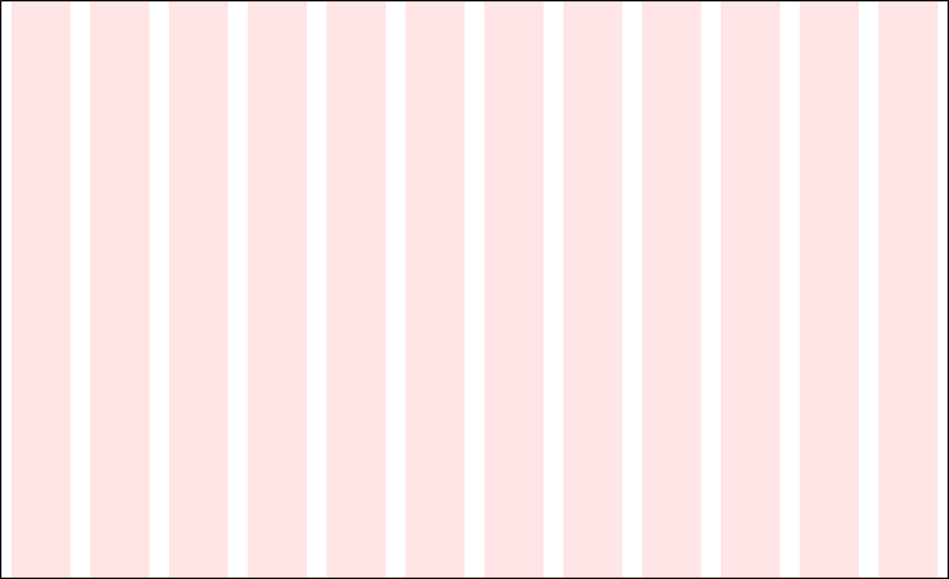
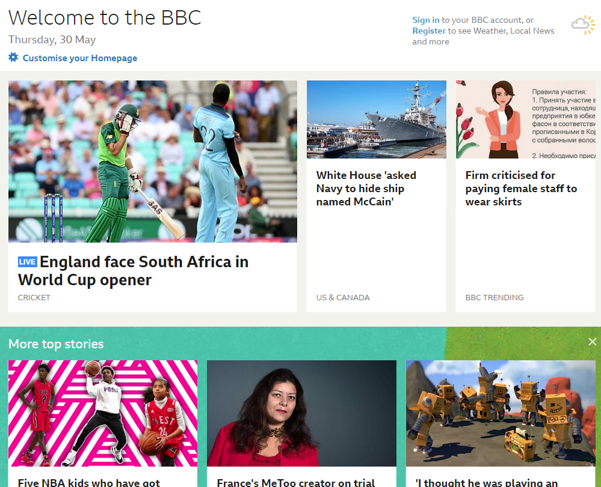
Grid Systems in Web Design
An Example
Row 1: 2 Columns
Column 1: spans 8 columns
Column 2: spans 4 columns
Row 2: 3 Columns
Column 1: spans 6 columns
Column 2: spans 3 columns
Column 3: spans 3 columns
Notes:
Image Source: BBC Website (https://www.bbc.co.uk/) [accessed: 30-May-2019 16:40]

Slide 24
Grid Systems in Web Design:
The CSS
The trickiest part specifying the CSS for the grid elements is the CSS to make the columns stack side by side.
Three main ways to achieve this:
  CSS Floats: old, but tried and tested and supported by old browsers.
  CSS Flexbox: new with CSS3, but not really the best for page layout.
  CSS display: grid, new and supported by modern browsers.
Notes:
To support all browsers (old and new), CSS floats is still the best for page layouts.
Read more about the different options:
CSS Floats: https://www.w3schools.com/css/css_float.asp
CSS Flexbox: https://www.w3schools.com/css/css3_flexbox.asp
CSS display: grid: https://www.w3schools.com/css/css_grid.asp

Slide 25
CSS Grid Frameworks
CSS Grid Frameworks contain ready-made CSS classes that you can use for website layouts.
When looking for a framework to use, look for Responsive Grid Frameworks.
We will be using the popular CSS framework, Bootstrap.
Notes:
If you have plans of going into web development, especially the front-end side of things, you should learn the three methods of creating grids:
CSS Floats: https://www.w3schools.com/css/css_float.asp
CSS Flexbox: https://www.w3schools.com/css/css3_flexbox.asp
CSS display: grid: https://www.w3schools.com/css/css_grid.asp
These techniques are also useful for achieving other design features in your website and we will revisit flexbox and probably floats.

Slide 26
Bootstrap’s CSS Grid
Bootstrap is a CSS framework providing front-end website solutions.
Bootstrap’s grid is a 12-column, responsive CSS grid framework.
Bootstrap 4 is the current version and it supports 5 different grid layout widths:
  Extra small devices
  Small (sm) devices
  Medium (md) devices
  Large (lg) devices
  Extra large (xl) devices

Slide 27
Bootstrap 4 Flexible Grid System
 | Extra small <576px | Small (sm) ≥576px | Medium (md) ≥768px | Large (lg) ≥992px | Extra Large (xl) ≥1200px
Max container width | None (auto) | 540px | 720px | 960px | 1140px
CSS class prefix | .col- | .col-sm- | .col-md- | .col-lg- | .col-xl-
 | You append the number of columns to span after the class prefix
No of columns | 12
Gutter width | 30px (15px on each side of a column) You can remove the gutter by using the class .no-gutters
Nestable | Yes
Column ordering | Yes
Notes:
Bootstrap version 3 had just the 1st four and used the column class prefixes .col-xs-, .col-sm-, .col-md- and .col-lg-.

Slide 28
Bootstrap Grid: Containers
Containers are the most basic element in the Bootstrap grid.
  A container represents a grid.
  Rows and columns are nested inside containers.
  You can also have nested grids.
Two container CSS classes:
  .container: a fixed-width grid centred by default.
    Constrains the grid width to max value.
  .container-fluid: a 100% full-width grid.

Slide 29
Bootstrap Grid: Rows
Rows come next and are parents of columns.
  They are used to create horizontal groups of columns to ensure columns line up properly.
Rows are usually children of:
  Containers
  Columns (to create a nested grid)
The CSS class is .row
<div class="container">
<div class="row">
<div class="col-12">
<!-- Header Content -->
</div>
</div>
</div>

Slide 30
Bootstrap Grid: Columns
Content is placed within columns and columns are children of rows.
There are 12 CSS column classes for each of the five grid sizes: .col-size-n.
Device Size | CSS Size | CSS Classes
Extra small devices (portrait phones) |  | col-1, …, col-12
Small devices (landscape phones) | sm | col-sm-1, …, col-sm-12
Medium devices (tablets) | md | col-md-1, …, col-md-12
Large devices (desktops, etc.) | lg | col-lg-1, …, col-lg-12
Extra large devices (large desktops, tvs, etc.) | xl | col-xl-1, …, col-xl-12

Slide 31
Grid Example
Extra Small Devices
1 | 2 | 3 | 4 | 5 | 6 | 7 | 8 | 9 | 10 | 11 | 12
<div class="container"> <div class="row"> <div class="col-3"></div> <div class="col-9"></div> </div> </div>
col-3 (spans across 3 columns) |  |  | col-9 (spans across 9 columns)
Notes:
The Grid is based on 12 columns, which means it can contain a maximum of 12 columns per line.
The -n, sm-n, md-n, lg-n, xl-n represent the classes that determine column widths.
-n is a value from 1 to 12.

Slide 32
Grid Example
Extra Small Devices
1 | 2 | 3 | 4 | 5 | 6 | 7 | 8 | 9 | 10 | 11 | 12
<div class="container"> <div class="row"> <div class="col-6"></div> <div class="col-6"></div> </div> </div>
col-6 (spans across 6 columns) |  |  |  |  |  | col-6 (spans across 6 columns)
Notes:
The Grid is based on 12 columns, which means it can contain a maximum of 12 columns per line.
The -n, sm-n, md-n, lg-n, xl-n represent the classes that determine column widths.
-n is a value from 1 to 12.

Slide 33
Grid Example
Extra Small Devices
1 | 2 | 3 | 4 | 5 | 6 | 7 | 8 | 9 | 10 | 11 | 12
<div class="container"> <div class="row"> <div class="col-12"></div> <div class="col-12"></div> </div> </div>
col-12 (spans across all 12 columns)
col-12 (spans across all 12 columns)
Notes:
The Grid is based on 12 columns, which means it can contain a maximum of 12 columns per line.
The -n, sm-n, md-n, lg-n, xl-n represent the classes that determine column widths.
-n is a value from 1 to 12.

Slide 34
CSS Float
Specifies how an element should float i.e. to the left or to the right.
Used to position elements horizontally:
  Moves an element as far to the left or right within its parent element.
  If there is not enough room for the element, it moves it down to the next line.
    (Think of how text continues on a line till there is no more room, then wraps round to the next line)
float: left;
float: right;

Slide 35
CSS Float: Content Example
The image has been floated to the right in the paragraph element.
The text wraps around the space left by the image in the paragraph element block.

Slide 36
CSS Float: Block Elements Example
Web page title
http://www.url.com
This <div> is set to float: left;
This <div> is set to float: left;
This <div> is set to float: left;
This <div> is also set to float: left; (no more room on previous line –moves down to next)
This <div> is set to float: right;

Slide 37

Problems with Floating Elements: I
If a parent element contains all floating elements, its height is automatically collapsed to zero
  (think floating in the air – washing on a line)!
To fix this problem, you need to add overflow: auto; CSS property to the parent element.
Parent <div> element collapsed as smiley images are all set to float: left;
Parent <div> element expanded because has the overflow: auto; property.
div.smileys { overflow: auto; }
Notes:
Restoring the height of a parent element containing floating elements:
https://www.sitepoint.com/clearing-floats-overview-different-clearfix-methods/

Slide 38
Problems with Floating Elements: II
Elements after a floating element will continue to wrap around it unless the float is cleared!
The clear property is used to clear floating, e.g.
  p { clear: both; }
It specifies the side of a floating element that elements are not allowed to wrap (float) around:
  Left: does not allow elements to wrap round the left side.
  Right: does not allow elements to wrap round the right side.
  Both: does not allow elements to wrap round both sides.

Slide 39
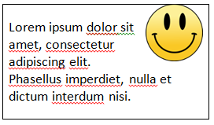
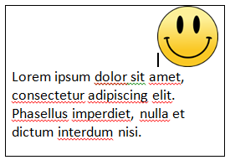
Clearing Floats
The <img /> element is floated to the right.
The following <p> element wraps round it in the space left.
The <img /> element is floated to the right.
The float is cleared on the following <p> element, so it does not wrap round the image.

Slide 40
Lab Exercise
Download instructions from Moodle

