Slide 1
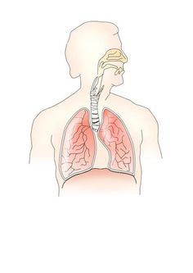
The respiratory system
Sharon Palgrave (2133276)
Introduction to physiology (BMHP5003)
Gillian Weaver and Raheela Shaikh
Assessment 1 – Individual Academic Poster Presentation

Slide 2
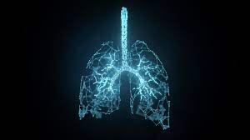
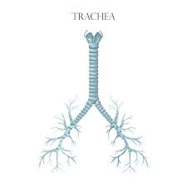
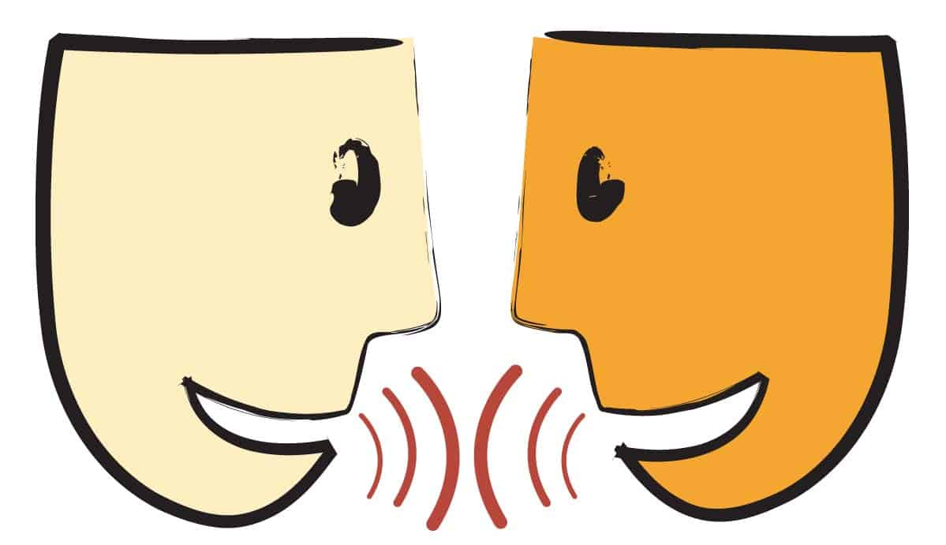

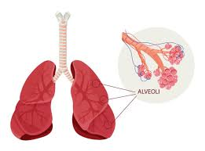
The respiratory system!
The respiratory system:
- A network of organs and tissues that help in respiration.
- This system supports your body in absorbing oxygen from the air so that your organs can function. (1)
The respiratory system also has other parts that collaborate to help us breathe. Breathing is the process of transporting air in and out of the body via the respiratory system. For example:
Mouth and nose: These are the openings that allow air to enter your respiratory system from outside your body.
Trachea: passage connecting your throat and lungs (2)
The respiratory system has other functions than just helping us breath in and out. These include:
- allowing us to talk and smell
- delivering oxygen to the cells in your body (4)
When you exhale, your blood transports carbon dioxide and other waste from your body. Other components that interact with the lungs and blood vessels include as follows:
Alveoli are tiny air sacs in the lungs that exchange oxygen and carbon dioxide.
Capillaries are blood veins found in the alveolar walls that transport oxygen and carbon dioxide.(3)

Slide 3
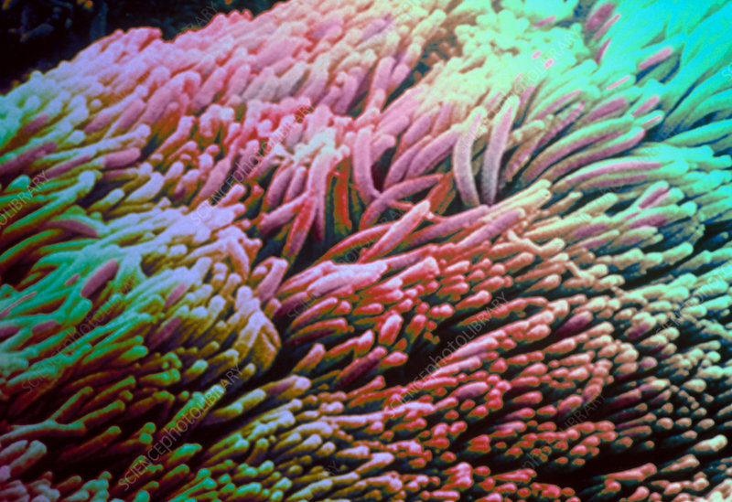
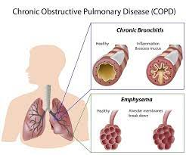
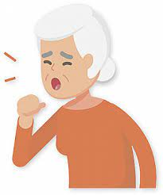
what is a potential health issue related with the respiratory system and how can it be managed/improved?
Chronic bronchitis develops when the bronchial tube lining becomes irritated and inflamed on a regularly.
The constant inflammation can cause airway damage and a buildup of sticky mucus, making it difficult for air to pass through the lungs. (2)
Chronic bronchitis is a kind of chronic obstructive pulmonary disease (COPD) defined as a productive cough lasting more than three months that occurs within two years. (1)
Cilia hairs
symptoms of chronic bronchitis can include:
- shortness of breath
- persistent chesty cough that does not go away (3)
Causes of chronic bronchitis can include many lifestyle factors such as smoking/vaping, air pollution and one’s work environment if they are surrounded by fumes and dust daily.

Slide 4

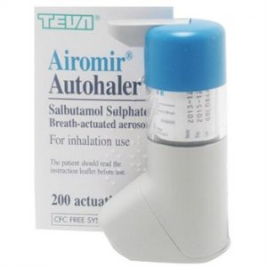
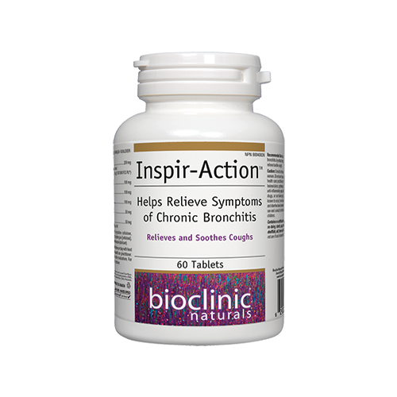
How can you manage chronic bronchitis?
You can manage chronic bronchitis by:
- Stopping smoking: if you smoke stopping smoking is the most important thing you can do if you have chronic bronchitis.
- you can also use smoke inhalers and tablets - to help make breathing easier pulmonary rehabilitation
- also, a specialised programme of exercise and education surgery or a lung transplant - although this is only an option for a very small number of people

Slide 5
Reference page
(2022) Chronic bronchitis - statpearls - NCBI bookshelf. Available at: https://www.ncbi.nlm.nih.gov/books/NBK482437/ (Accessed: 14 November 2023).
(2023) NHS choices. Available at: https://www.nhs.uk/conditions/chronic-obstructive-pulmonary-disease-copd/treatment/ (Accessed: 14 November 2023).
Brain, M. (2022) Is it harmful to breathe 100 percent oxygen?, HowStuffWorks Science. Available at: https://science.howstuffworks.com/question493.htm (Accessed: 14 November 2023).
Godman, H. (2023) Why are you coughing at night?, Harvard Health. Available at: https://www.health.harvard.edu/diseases-and-conditions/why-are-you-coughing-at-night (Accessed: 14 November 2023).
Higuera, V. (2017) Respiratory depression: Symptoms, causes, and treatments, Healthline. Available at: https://www.healthline.com/health/respiratory-depression?epik=dj0yJnU9MXhYc0RpMzBFTmpGQmV6aWE0RjF3azIyd0JZbDVrRkcmcD0wJm49RFlVc0VDelUyaHE4YkZjcDJfcjM4USZ0PUFBQUFBR1ZTeGtV (Accessed: 14 November 2023).
Image respiratory system (2020) www.edupics.com. Available at: https://www.edupics.com/image-respiratory-system-i10686.html (Accessed: 14 November 2023).
Lead Liaison (2014) How to get your lead nurturing prospects to ‘Talk’ to you, Lead Liaison. Available at: https://www.leadliaison.com/best-practices/how-to-get-your-lead-nurturing-prospects-to-talk-to-you/ (Accessed: 14 November 2023).
Library, B.P. (2020) Cilia in lung - stock image - P580/0119, Science Photo Library. Available at: https://www.sciencephoto.com/media/311140/view/cilia-in-lung (Accessed: 14 November 2023).
Madell, R. (2021) Chronic bronchitis: Symptoms, treatment, causes, and more, Healthline. Available at: https://www.healthline.com/health/copd/understanding-chronic-bronchitis#cause (Accessed: 14 November 2023).
Post navigation (2018) OrganicHealthynet. Available at: https://organichealthy.net/when-your-lungs-drown-in-mucus-this-is-the-best-cure-its-100-natural-and-works-in-just-few-hours/?r=1130018298 (Accessed: 14 November 2023).
Premium vector: Human nose colorful line art isolated vector illustration (2023) Freepik. Available at: https://www.freepik.com/premium-vector/human-nose-colorful-line-art-isolated-vector-illustration_45177553.htm (Accessed: 14 November 2023).
Premium Vector: Vector medical educational biological chart for trachea diagram anatomy illustration isolated white background (2022) Freepik. Available at: https://www.freepik.com/premium-vector/vector-medical-educational-biological-chart-trachea-diagram-anatomy-illustration-isolated-white-background_27049573.htm (Accessed: 14 November 2023).
Prof. Leo KoendermanProf. Leo Koenderman did his training as a master of science (biology) at the University of Utrecht (1978-1986). He later received his PhD at the University of Amsterdam on thesis describing mechanisms of activation of eosinophils and (2017) The many inflammatory faces of chronic obstructive pulmonary disease (COPD) cannot be diagnosed by simple testing., On Medicine. Available at: https://blogs.biomedcentral.com/on-medicine/2017/06/06/the-many-inflammatory-faces-of-chronic-obstructive-pulmonary-disease-copd-cannot-be-diagnosed-by-simple-testing/ (Accessed: 14 November 2023).
professional, C.C. medical (2022) Respiratory system: Functions, facts, Organs & Anatomy, Cleveland Clinic. Available at: https://my.clevelandclinic.org/health/body/21205-respiratory-system (Accessed: 14 November 2023).
Undefined, U. et al. (2018) Istock, iStock. Available at: https://www.istockphoto.com/illustrations/drawing-of-the-alveoli (Accessed: 14 November 2023).
(2023) NHS choices. Available at: https://www.nhs.uk/conditions/chronic-obstructive-pulmonary-disease-copd/treatment/ (Accessed: 14 November 2023).
Inspir-action helps relieve symptoms of chronic bronchitis 60 tabs (no date) Rediscover Health Online Dispensary. Available at: https://shop.rediscoverhealth.ca/products/inspir-action?variant=39579247706215 (Accessed: 14 November 2023).

