Slide 1

Module Number: BMHP6029
Assignment No: Component 1- Poster
Student Name: Paulina Slowik​
Student ID: 2332439​
Lecturer’s Name: Bianca Sanfilippo
Psychopathological Classifications and Provisions Component
Acknowledgement of the use of AI tools
I confirm that I have not used any AI tools in the research and creation of this assignment. I confirm that I have not presented any AI generated materials as my own work. I confirm I have copies of my drafts, notes, and other resources I used, which I may be asked to provide in evidence.

Slide 2
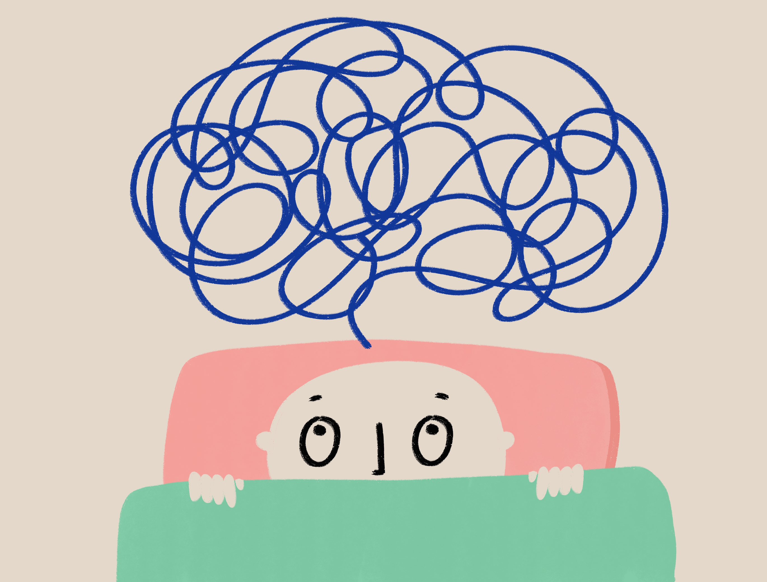
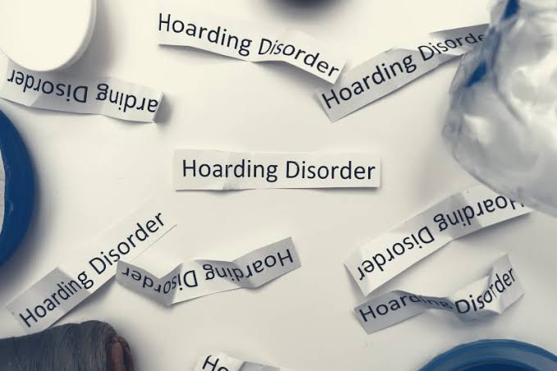
Hoarding Disorder (6B24)
Understanding Causes, Symptoms and Management
INTRODUCTION
CAUSES. SYMPTOMS, DIAGNOSIS
HISTORICAL PERSPECTIVES AND TREATMENTS
Current services and treatments
Causes
Unknown cause; linked to genetic, brain and environmental factors (World Health Organization, 2024).
Family history and stressful life events may increase risk (Mataix-Cols et al., 2010; NHS, 2026).
Symptoms
Difficulty discarding possessions (World Health Organization, 2024).
Strong need to save items.
Excessive clutter affecting daily life (NHS, 2026).
Poor organisation and decision-making (American Psychiatric Association, 2022).
Diagnosis
Diagnosed by a mental health professional using ICD-11 criteria (World Health Organization, 2024).
Based on clinical assessment and impact on daily functioning (NHS, 2026).
Symptoms must not be explained by another condition (World Health Organization, 2024).
Past Views
Hoarding was traditionally viewed as a symptom of OCD or obsessive-compulsive personality disorder (OCPD) rather than a separate condition (Nakao and Kanba, 2019).
People with hoarding behaviours were often seen as untidy, irresponsible or lacking self-control, contributing to social stigma (Ayers et al., 2019).
Current Views
Hoarding Disorder is now recognised as a distinct mental disorder in ICD-11, with its own diagnostic criteria and treatment approaches (World Health Organization, 2024).
Current research recognises hoarding as a complex mental health condition requiring specialised assessment and evidence-based treatment rather than judgement (Grisham and Norberg, 2020).
CBT – first-line treatment for Hoarding Disorder (NICE, 2022; NHS, 2026).
SSRIs may help if OCD, anxiety or depression are also present (NHS, 2026).
Community mental health teams and occupational therapists provide ongoing support (NHS, 2026).
Specialist hoarding services and home visits are available in some UK areas (Oxford Health NHS Foundation Trust, 2024).
6B24 Hoarding Disorder (ICD-11)
Broad category: Obsessive-Compulsive and Related Disorders (World Health Organization, 2024).
Definition: Persistent difficulty discarding possessions, excessive accumulation of items and clutter that interferes with the use of living spaces and daily functioning (Frost and Hartl, 1996).
Prevalence: Affects 2–6% of the global population and 2–5% of the UK population (≈ 1.2 million people) (Postlethwaite, Kellett and Mataix-Cols, 2019; Oxford Health NHS Foundation Trust, 2024; NHS, 2026).
Diagnosis rates: Often underdiagnosed, as many people do not seek help due to shame or poor insight (NHS, 2026).

Slide 3





Hoarding Disorder (6B24)
Understanding Causes, Symptoms and Management
RECOMMENDATION
CONCLUSIONS
Increase public awareness to reduce stigma around Hoarding Disorder.
Encourage early diagnosis and intervention to improve outcomes.
Improve access to specialist CBT and community support services.
Educate families and carers to provide supportive, non-judgemental care.
Promote further research to improve understanding and treatment of Hoarding Disorder.
Recognised mental health disorder within the Obsessive-Compulsive and Related Disorders category.
Causes are likely genetic, psychological and environmental.
Symptoms can significantly affect daily functioning and quality of life.
Early diagnosis and CBT improve outcomes. Greater awareness, support and access to services are essential.

Slide 4
REFERENCES:
American Psychiatric Association (2022) Diagnostic and Statistical Manual of Mental Disorders. 5th edn, Text Revision (DSM-5-TR). Washington, DC: American Psychiatric Association. Available at: Diagnostic and Statistical Manual of Mental Disorders | Psychiatry Online
Frost, R.O. and Hartl, T.L. (1996) ‘A cognitive-behavioral model of compulsive hoarding’, Behaviour Research and Therapy, 34(4), pp. 341–350.
Grisham, J.R. and Norberg, M.M. (2020) ‘Recent advances in research on hoarding disorder’, Current Psychiatry Reports, 22(5), pp. 1–9.
Mataix-Cols, D., Frost, R.O., Pertusa, A., Clark, L.A., Saxena, S., Leckman, J.F., Stein, D.J., Matsunaga, H. and Wilhelm, S. (2010) ‘Hoarding disorder: A new diagnosis for DSM-5?’, Depression and Anxiety, 27(6), pp. 556–572.
Nakao, T. and Kanba, S. (2019) ‘Pathophysiology and treatment of hoarding disorder’, Psychiatry and Clinical Neurosciences, 73(7), pp. 370–375.
NHS (2026) Hoarding disorder. Available at: https://www.nhs.uk/mental-health/conditions/hoarding-disorder/ (Accessed: 21 July 2026).
NICE (2022) Obsessive-compulsive disorder and body dysmorphic disorder: treatment. Available at: https://www.nice.org.uk (Accessed: 29 July 2026).
Oxford Health NHS Foundation Trust (2024) Hoarding disorder. Available at: Hoarding disorder - OHSPIC (Accessed: 21 July 2026).
Postlethwaite, A., Kellett, S. and Mataix-Cols, D. (2019) ‘Prevalence of Hoarding Disorder: A systematic review and meta-analysis’, Journal of Affective Disorders, 256, pp. 309–316.
World Health Organization (2024) International Classification of Diseases 11th Revision (ICD-11): 6B24 Hoarding Disorder. Available at: https://icd.who.int (Accessed: 21 July 2026)

