Slide 1
Collaboration in action: tHE CRITICAL ROLE OF TEAMWORK IN ACHIEVING SUCCESS
BY BRADLEY Jones
Bmpl4014
Sadie france

Slide 2
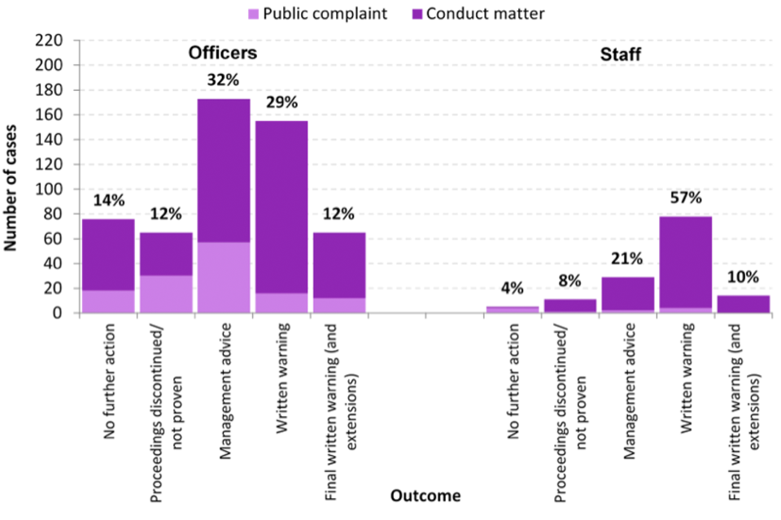
Police interorganisational collaboration
Collaboration in teamwork is a vital attribute of team work.
-College of Policing (2024-1)
As seen from this chart from Gov.uk (2020) the different responsibilities faced by different groups of Police staff.
ThePhoto by PhotoAuthor is licensed under CCYYSA.

Slide 3
Collaboration between different agencies within public sector
Cabinet Office (2014-1). Importance of communication and collaboration between multiple agencies. To achieve a greater result.
Calling 101 either contacting law enforcement or another required organisation.
Cabinet Office (2014-2)

Slide 4
Collaboration with protected characteristic communities
Attempting to collaborate with Black communities' groups to establish trust within the police (College of Policing-2)
Employing new police officers who belong to ethnic minorities to start a focus on those communities (College of policing 2024-3)
Post George Floyd.

Slide 5
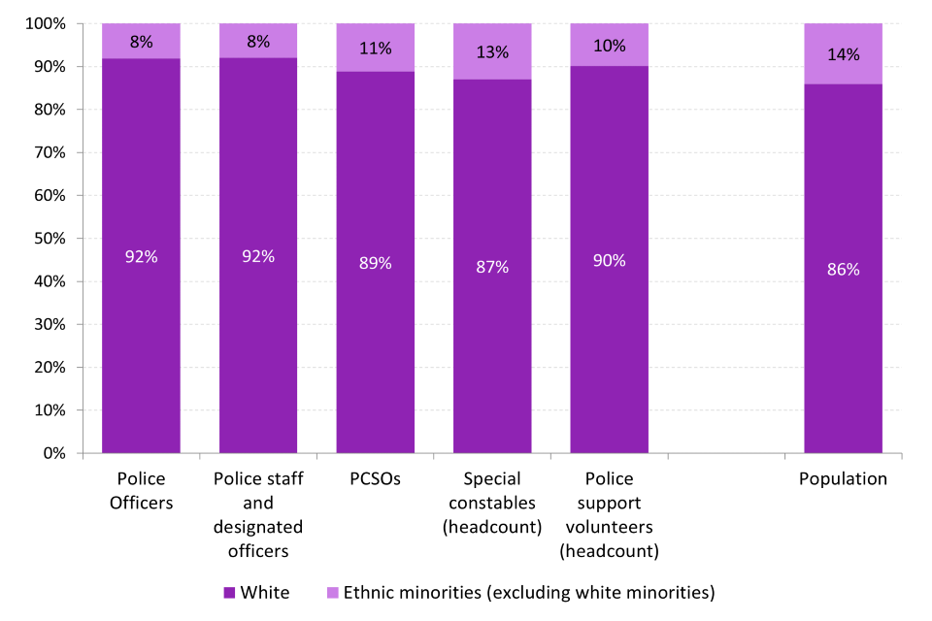
Many different groups within the police that all have to work together
Collaboration between PCSO and PCO aswell as the general population
Image from Gov.uk (2022)

Slide 6
Collaboration with non public sector organisations
pcc
STATUTORY GUIDANCE FOR POLICE COLLABORATION
Police and crime commisioner works within the police rank structure and serves as an important tool for collaboration Gov.uk (2024)
Guidance for leaders in the Police rank system to help establish collaboration with non-public sector organisations.
Gov.uk (2012)

Slide 7
Collaboration of leadership
Higher rank collaboration with lower ranks
Reports on collaboration inside of constabularies
Simon Burge (2024) Shows us how they interact from your frontline constables to chief constable
The Police foundation (2014) talks about the future of leadership within the police

Slide 8
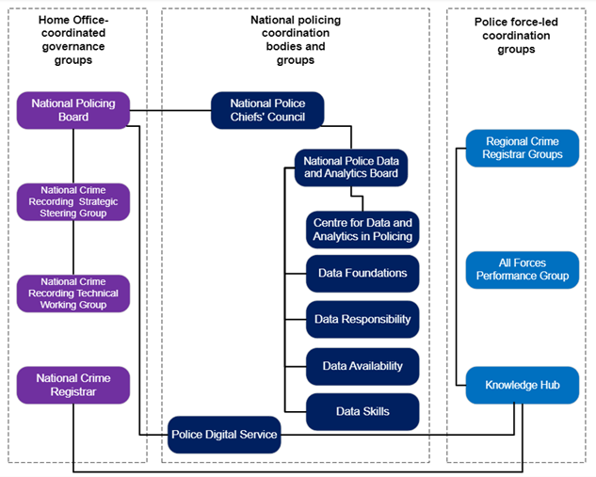
This image shows us the internal structure of the Policing organisation. The three main groups show us how integral inter-collaboration is in the Police.
Image from Office of national statistics (2024)

Slide 9
To conclude
Collaboration is a key attribute of the Police.
The Leaders of our Police forces must understand how to collaborate with each other and fellow public service organisaitons.
Collaboration with groups of protected characteristics must also attain higher collaboration with the police.

Slide 10
Reference List:
College of Policing (2024-1)https://www.college.police.uk/career-learning/competency-and-values-framework/we-collaborate
Cabinet Office (2014-1) https://www.local.gov.uk/sites/default/files/documents/partnering-and-multi-agen-ee0.pdf
Cabinet Office (2014-2) https://www.local.gov.uk/sites/default/files/documents/partnering-and-multi-agen-ee0.pdf
Gov.uk (2024)https://assets.publishing.service.gov.uk/media/5a7a3c06ed915d1a6421c029/police-collaboration.pdf
Gov.uk(2012)https://assets.publishing.service.gov.uk/media/5a819a54e5274a2e8ab54df0/2016_Candidate_Guidance__Working_with_other_PCCs_and_forces__v2.pdf
Image from Office of national statistics (2024) https://osr.statisticsauthority.gov.uk/publication/the-quality-of-police-recorded-crime-statistics-for-england-and-wales/pages/5/

Slide 11
Reference List continued:
College of Policing 2024-2 https://www.college.police.uk/support-forces/diversity-and-inclusion/action-plan
College of policing 2024-3 https://www.college.police.uk/guidance/effective-implementation-problem-oriented-policing/partnerships
Gov.uk (2020) https://www.gov.uk/government/statistics/police-workforce-england-and-wales-30-september-2020/police-workforce-england-and-wales-30-september-2020
Simon Burge (2024) https://securityjournaluk.com/british-police-ranks/
The Police foundation (2014) https://www.police-foundation.org.uk/wp-content/uploads/2017/06/Police_force_collaboration_FINAL_REPORT.pd

