Slide 1

New L5 Online Learning module. Enhancing Creativity & Innovation in the 21st Century.
L5: Changemakers: Creativity & Value Creation
Support Tutorial:
Assessment Support 2.
This Photo by Unknown Author is licensed under CC BY-SA-NC

Slide 2

Open and review Assignment 1:
Assignment 1 Specification.
Assignment 1 Submission Template.
Assignment 1 TURNITIN Link.

Slide 3
Open and review: Assignment 2
Assignment 2 Specification.
  Minor update made last week (after IV) to Assignment 2 Specification ‘Submission instructions’ i.e. Add a screenshot to the TURNITIN submission document. The most important content is a working link to the streamed Video presentation.
Assignment 2 TURNITIN Link.

Slide 4

Example Timeline for Computing Innovation Project
October: Ideation & Start Design work.
November: Design & Start Dev. work.
December: Development work.
January wk. 1: Project Video presentation.

Slide 5
Next progress steps:
Finish Assignment 1 tasks.
Upload to e-portfolio.
Submit Assignment 1 to Turnitin.
Schedule in your diary /\.
Typically for a 20c semesterized module learners are asked to attend 4hrs of classes and 8-10hrs of private study.

Slide 6
Register.
Download Attendee list.

Slide 7

Questions.
Any questions?, particularly about the Assignment task or Project.

Slide 8

Student Social Support.
(Chat & Support each other.)

Slide 9
The End.

Slide 10
Archive slides: Computing Innovation Project.
The following slides have been covered during the Weekly support sessions to assist and support you with your project idea, design and to kick start development.
They remain here for reference purposes.

Slide 11
Bg. Idea Tips for Computing Innovation Project
Your project should help you to develop new up-to-date skills.
Your project should be of interest to you, relevant to your course and your future career.
In addition to learning new skills, your project will need to have a purpose e.g. to serve the community, to help a group of people, to solve a problem, for an Organisation, to offer a product or service that would add value and benefit society in some way.
Due to the time limitations, be careful to limit the scope of your project.

Slide 12

Bg. Initial Project Planning
Consider and state your project’s scope e.g.
  Aim and Objectives.
    Aim (1): E.g. To research design and develop a … or … To research test and evaluate a ….
    Objectives (3/4): The 1st objective could be to simply research appropriate technology to use. The 2nd objective to design a potential solution. The 3rd to develop a basic prototype. The 4th to test, evaluate and provide recommendations.
  Deliverable / Prototype: What do you intend to create / build / test or simulate.
  Key milestones: State approx. dates for each project stage.
  Project constraints: State the project's limitations.
  Note: If time: start some initial design work.

Slide 13
Bg. Design Overview
Example Design work: Requirements specification, MVP (Minimum viable product), Sketches/drawings/illustrations, storyboards, UI, colour scheme, wireframe diagrams, flow chart, data structures, circuit diagrams.
The main focus of the project is ‘innovation’ and on allowing you to develop your skills using new technologies through practice and prototyping. There needs to be some planning of course, but do not spend too much time in this stage.
Design work between students will vary significantly and depend on your project area. You will all have different design documentation. And that’s ok.

Slide 14
Bg. For Design tips below – See end of Slide deck
The next slides listed below, contain example tips on the following areas that may be useful for the Design phase of your project. Due to the varying project types the following will not be covered in detail and you certainly do not need to include all of these, e.g. Approx. 2 types, which may or may not be listed below.
Bg. Note: For further information, see the slide deck titled ‘Prototyping Design’ in the Additional Resources tile on Moodle. For additional and more specialist support, if needed, please ask your SA&D (Systems Analysis & Design*) module tutor, Module tutor in the area of your project or Programme tutor. * Included within L4 Academic & Employability Skills, or Computational Thinking or Database Design & Systems Analysis type module. Games Design & Computer Animation, tutor of relevant design/illustration/modelling/development module.
Requirements Specifications | UI Design & Wireframes
Example Requirement list (Basic) | Version control
Minimum Viable Product (MVP) | Product design specifications
Prototyping on Paper (PoP) | Design work.

Slide 15
Bg. Design tips
The next slides listed below, contain example tips on the following areas that may be useful for the Design phase of your project. Due to the varying project types the following will not be covered in detail and you certainly do not need to include all of these, e.g. Approx. 2 types, which may or may not be listed below.
Bg. Note: For further information, see the slide deck titled ‘Prototyping Design’ in the Additional Resources tile on Moodle. For additional and more specialist support, if needed, please ask your SA&D (Systems Analysis & Design*) Module tutor, Module tutor in the area of your project or Programme tutor.
* Included within Academic & Employability Skills, or Computational Thinking or Database Design & Systems Analysis type module. Games Design & Computer Animation in another design/illustration module.
Requirements Specifications | UI Design & Wireframes
Example Requirement list (Basic) | Version control
Minimum Viable Product (MVP) | Product design specifications
Prototyping on Paper (PoP) | Design work.

Slide 16
Prototype Specifications
Requirements specifications: Suitable for the creation of new prototypes particularly software.
Product specifications: Suitable for the creation of new hardware products e.g. a component list.
With regards to prototype features (hardware or software) what methods can be used to set ‘priority’? e.g. By number (1, 2, 3, etc..), Top Med. High, MoSCoW* method.
  * M for Must haves, S for Should haves, C for Could haves and W for Won’t haves.

Slide 17
Requirement Specification List
A Requirements specification is a description of the features for a proposed prototype to be developed. It outlines the SCOPE of the prototype.
A Requirements specification (RS) can start with a number and statement that briefly describes the Aim/Purpose of the prototype.
The Requirements specification lays out functional (Fr) and non-functional requirements (NFr).
You may have different types of Non-functional requirements and they can be grouped together or partitioned into e.g. Design requirements, Performance req., Security req. etc…
Prototype features can be prioritised e.g. simply By Number, Top Med. High or MoSCoW method (Must have (Mh), Should have, Could have, and Won't have) or a combination. For example for each requirement:
Unique number | Requirement Name
Priority status | Requirement brief description.

Slide 18
Example Requirement list (Basic: KISS)
Fr:1 | Requirement Name
Mh | Requirement brief description.
Fr:2 | Requirement Name
Mh | Requirement brief description.
Fr:3 | Requirement Name
Mh | Requirement brief description.
Fr:4 | Requirement Name
Mh | Requirement brief description.
Fr:5 | Requirement Name
Ch | Requirement brief description.
Fr:6 | Requirement Name
Wh | Requirement brief description.

Slide 19
MVP - Minimum Viable Product
MVP Minimum Viable Product is a product with just enough features to satisfy early customers, and to provide feedback for future product development.
Team Activity to note: What is your MVP?
Bg:
MVP is a used Lean Start-Up method. Termed by early Tech Entrepreneurs based in Silicon Valley California and adopted by the most successful Tech companies such as Google e.g. Gmail launch.
It is now used by Tech Start-Ups across the world.
Notes:
A minimum viable product (MVP) is a product with just enough features to satisfy early customers, and to provide feedback for future product development.

Slide 20
POP & Marvel App
For initial App Prototype design you could try:
  POP App: for ‘Prototyping on Paper’.
    Bg. 15sec Video Overview: https://vimeo.com/101373355.
  MarvelApp: for Prototyping from paper, pics, photos, e-drawing - https://marvelapp.com/.
    Bg. 6min Video Overview: click here.
For initial Hardware Prototype design you could use CAD, Adobe Illustrator, Photoshop or alternative.
  For electronics you could use ‘Proteus Design Suite’ to create automate and test electronic circuit board schematics.

Slide 21
UI Design: Balsamiq Wireframes
Balsamiq Cloud: User Interface (UI) Design Wireframe tool. If you are building an App / Software / Web App etc.. you might find it useful at the 'Design' stage.
  1min Video intro: click-here.
    Website: https://balsamiq.com/.
    Cloud and desktop App: https://balsamiq.com/wireframes/
    Learn to Wireframe: https://balsamiq.com/learn/.
+ You can put it on fish and chips ;-) balsamic lol.

Slide 22
Github for Software Project Management
GitHub.com is a web-based hosting service for software development projects.
Bg. Great for Team based projects.
It has good version control. A system for tracking changes in computer files and coordinating work on those files among multiple people.
It is used for source-code management (SCM).
Commonly used to host open-source software projects.
Launched in 2008 in 2018 it has over 28 million users and 57 million repositories making it the largest host of source code in the world.
Microsoft acquired GitHub in 2018 for US$7.5 billion.
GitHub will continue to operate independently as a community, platform and business.
GitHub Student Developer Pack = free student access to great developer tools.
  How to get started: Github for Beginners: Overview Video 1, Video 2.
Note: You can use your own version control method/system, or use VS or Unity with Github. With prototyping Keep it Simple. You may not need one.
  VC AWS option: https://aws.amazon.com/codecommit/pricing/
  VC Azure option: https://azure.microsoft.com/en-us/services/devops/repos/ - & - https://azure.microsoft.com/en-gb/pricing/.
Notes:
Ref: https://en.wikipedia.org/wiki/GitHub

Slide 23
Product Design Specs (PDS)
Product design specifications suitable for more hardware / electronic prototypes usually include a table diagram that documents the prototypes proposed characteristics, components, dimensions etc.

Slide 24
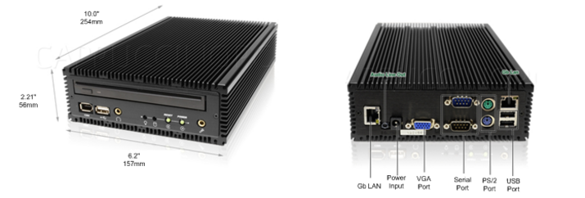
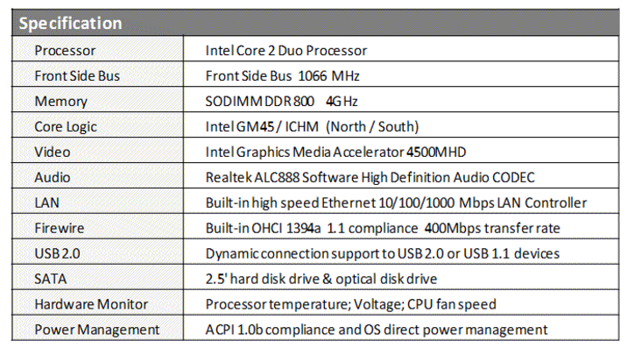
Example: Product Design & Specification
Illustration:
Specification:
Notes:
Ref: http://multigate.homestead.com/Product-Specifications.html

Slide 25
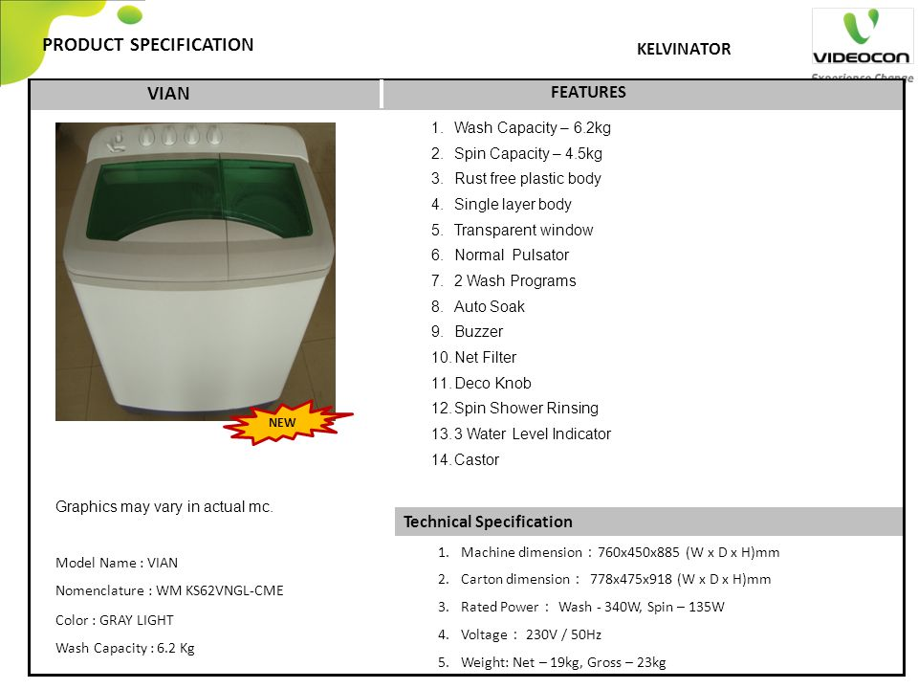
Notes:
Ref: https://slideplayer.com/slide/3559426/ - Washer/dryer.

Slide 26
Games Des. & Animation
Please do include some initial design work e.g. character design, sketches, illustrations, models, storyboards etc.

Slide 27
KIS: Design & System Modelling
Complicated charts and diagrams are not required but can be created and included if you feel it necessary.
Keep the Design docs simple. For this module you do not need to go into detail with your Design planning & documentation.
  keep it Clean Lean & Simple.

Slide 28
Archive.

Slide 29
Requirements Specification List
For Software prototypes: Your Requirements list will likely have 2 sections
  1 section for Functional requirements; and a
  2nd section for Non-functional requirements.
For Hardware prototypes: Your Requirements list will likely have 3 sections:
  1 section for Hardware requirements and component list;
  1 section for Software requirements; including
    1 section for Functional requirements; and a
    2nd section for Non-functional requirements.
Notes:
A more comprehensive example: https://krazytech.com/projects/sample-software-requirements-specificationsrs-report-airline-database – but this detail is unlikely to be required.

