Slide 1

International Gastronomy Management
BMGM5005
Professional Service
Paulina Anna Skoczek 2219392
Individual Presentation
Chris Wilkin
12 March 2024

Slide 2
Content:
Bistrot Pierre: About the restaurant.
Understanding current trends in Hospitality.
Exploring the Generation Gap and its impact.
Solutions with industry examples.
The Leadership Style.
Summary of Key Points.

Slide 3
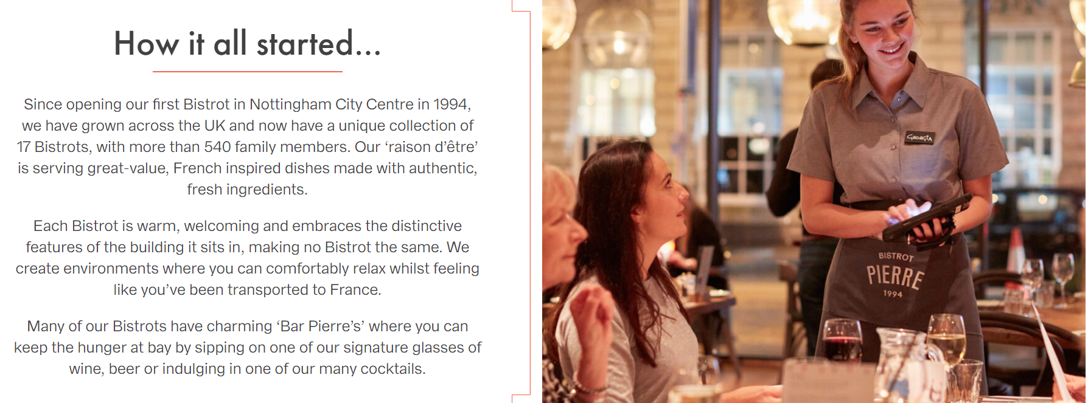
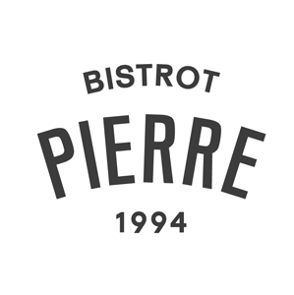
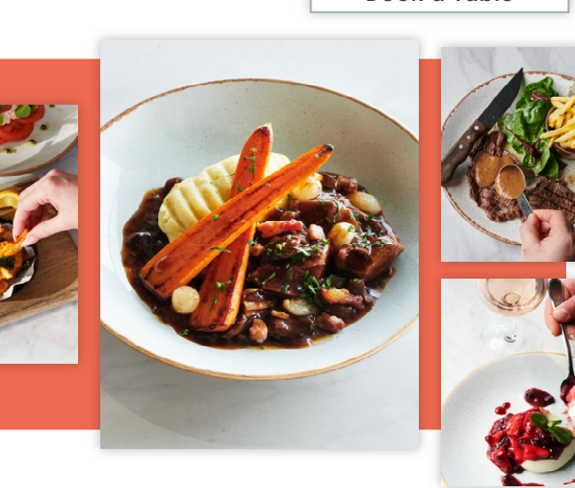
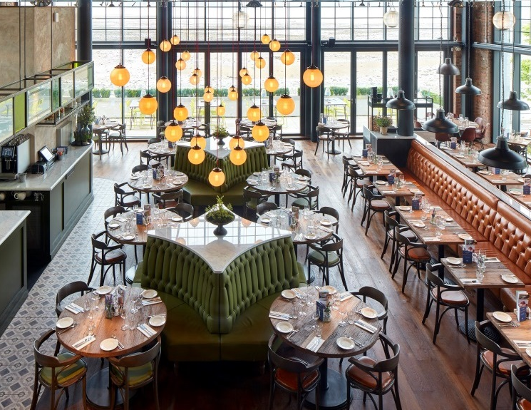
About The Restaurant...

Slide 4
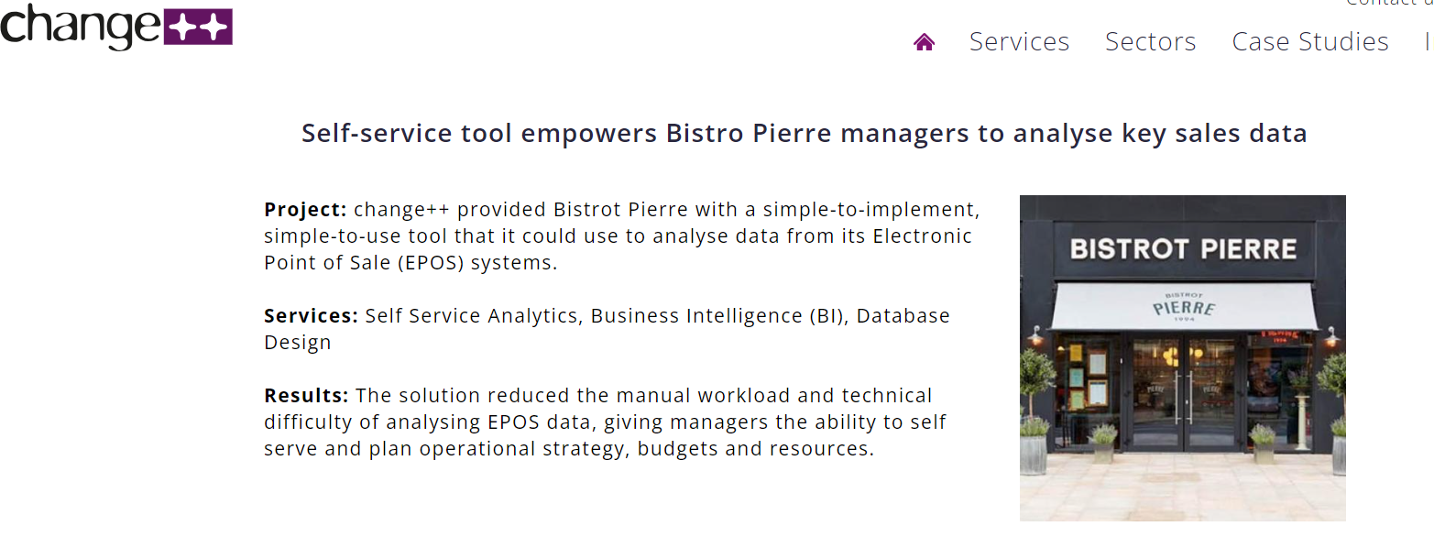
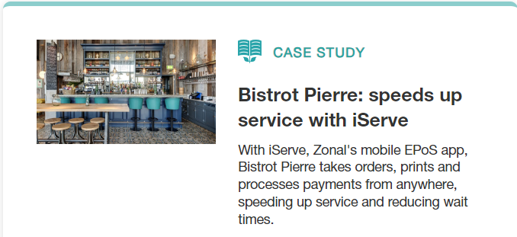
Bistrot Pierre Case Study: iServe and Business Intelligence
Zonal (2021)

Slide 5
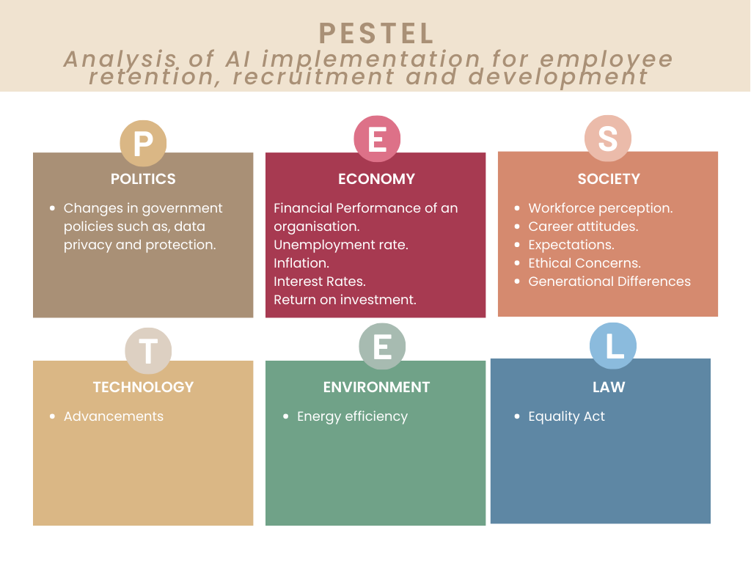
External Factors Analysis: PESTEL

Slide 6

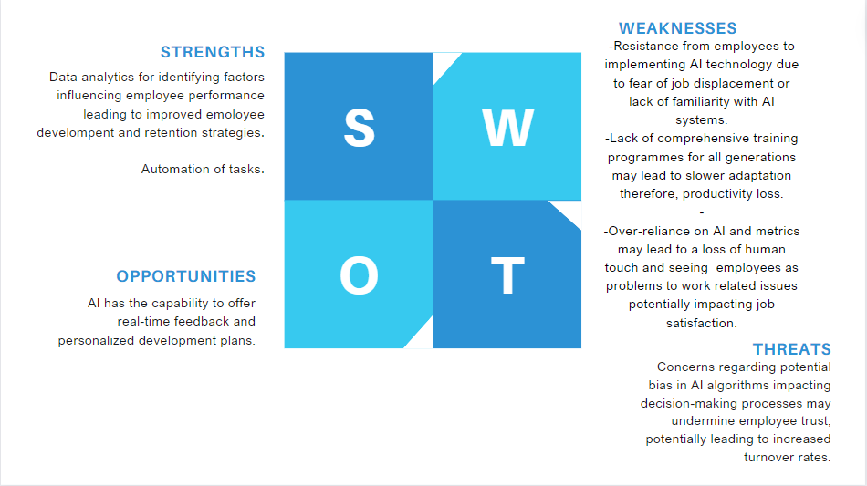
The Artificial Intelligence, Human Resource Department and The Employees
(Bashynska, Prokopenko and Sala, 2023)
(Ruel and Njoku, 2021)
(Ersoy and Ehtiyar, 2023).

Slide 7
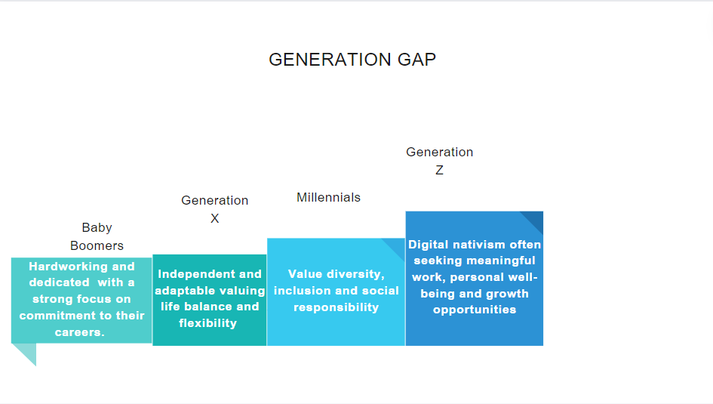
Generation Gap: How Does It Affect Recruitment and Retention?
Characteristics of Generation to Other Generations
PwC (2013)
(Gursoy, Maier, and Chi, 2008)

Slide 8
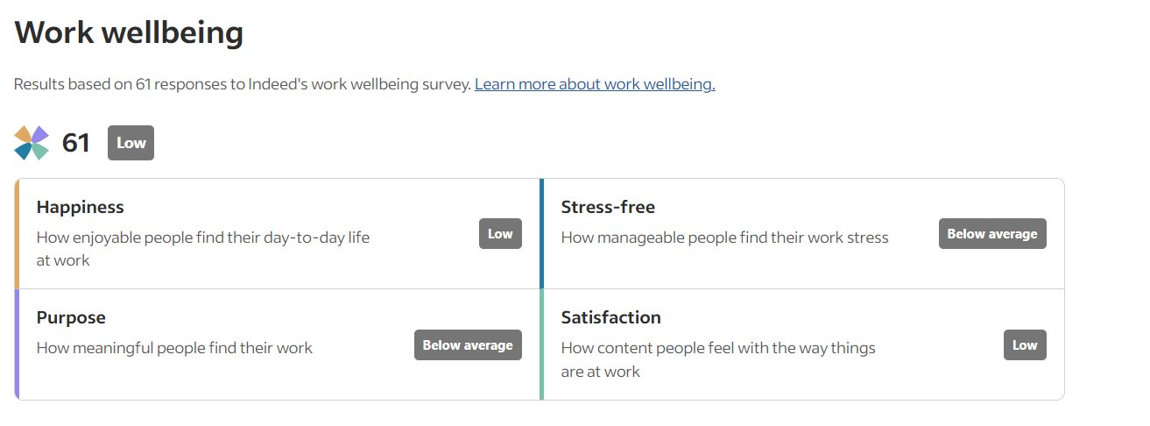

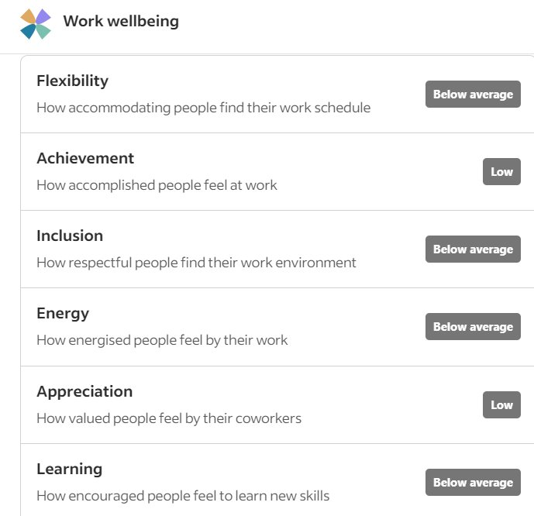
Example: Retention and Recruitment

Slide 9
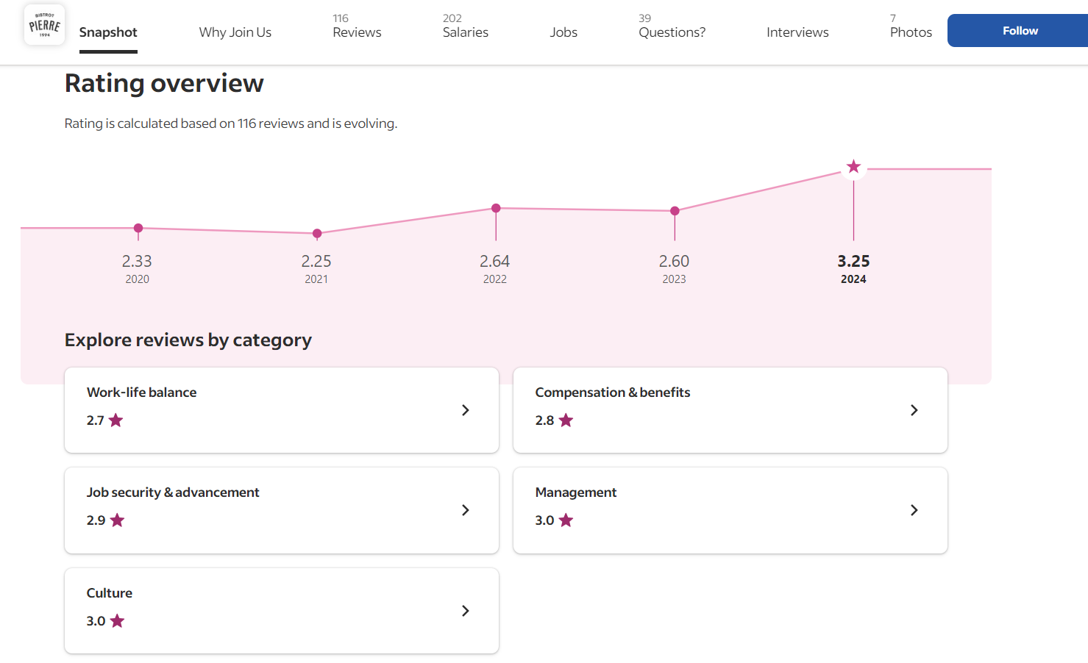

Slide 10




Solutions

Slide 11
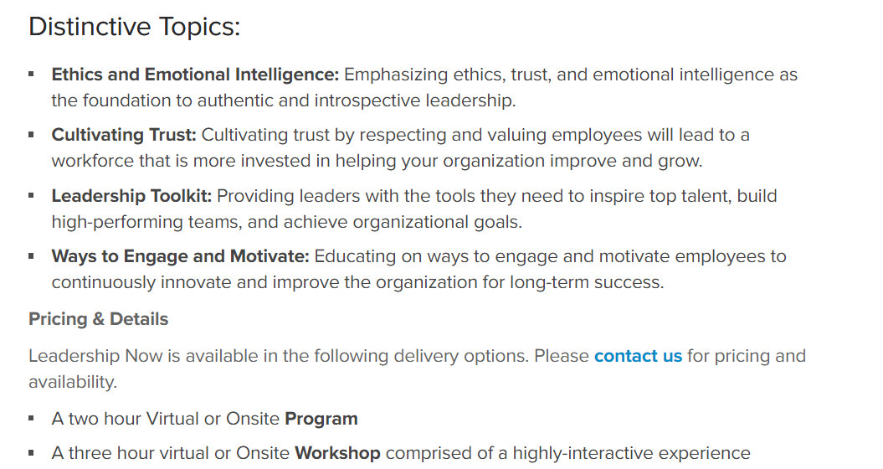
The Ritz: Leadership Development
Invests in Leadership development programs that equip managers with the skills and knowledge needed to effectively lead diverse teams.
The Ritz-Carlton Leadership Center (2023)

Slide 12
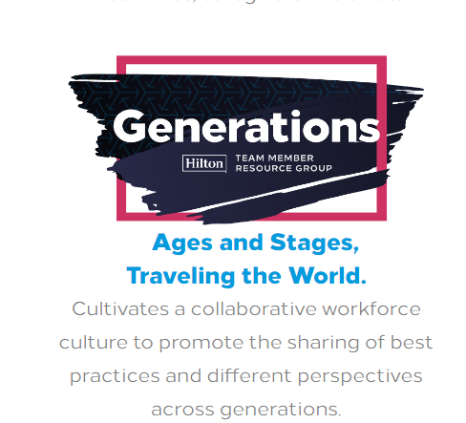
Foster Cross-Generational Mentoring.
Foster Mentoring programmes for employees across various generations, where experienced employees' mentor younger colleagues and vice versa.
Hilton (2022)

Slide 13
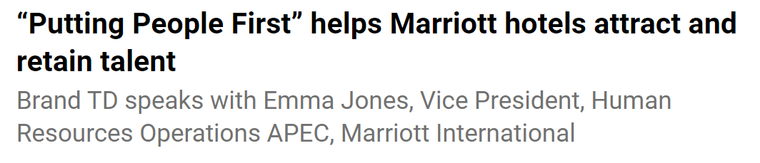
Employee well-being at a heart.
(Nath, 2024)

Slide 14
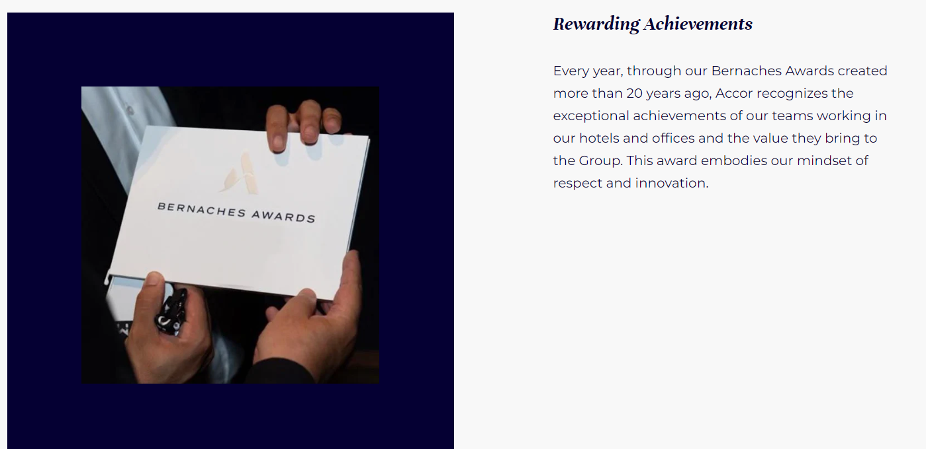
Celebrate and reward employee achievements and contributions.
Accor (2024)

Slide 15

Human-Centric Leadership: Balancing The Generation Gap and AI
Importance:
Application:
Healthy Balance: Embracing AI while upholding human values.
Employee enagegemt: Employees of all generations feel valued and supported
Adaptability: AI enabled not AI dominated.
Empathy
Communication.
Collaboration.
Geniue care and understanding.
Value feedback
Build relationships
Trust
''The human-centric leadership style changes the leader’s focus from profit, productivity and output towards the employees’ needs, feelings and goals'' (Schmitt, 2022).
(Sinek, 2016)

Slide 16

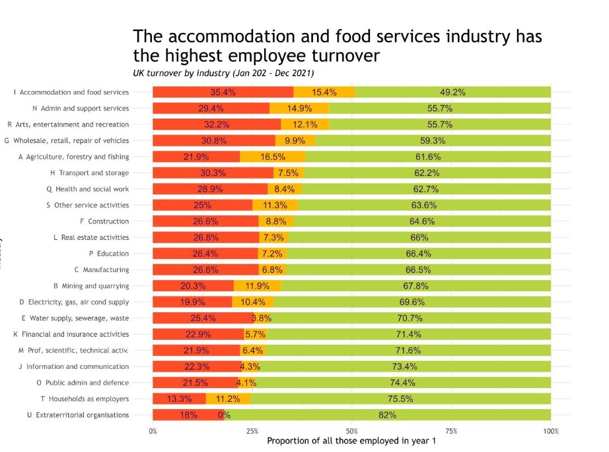
Why is it important to Food and Beverage Department?
Market data:
A. Hospitality has the highest turnover rates of any sector (Bureau of Labor Statistics, 2024).
B. According to CIPD (2024) food services and accommodation has the highest employee turnover showing 35.4% in turnover status.

Slide 17
Summary of Key Points:
AI: Explored the impact of AI adoption in hospitality based around a theme of employee retention.
Generation Gap: Discussed the differences between different age group showing an example of implications for recruitment and retention.
Proposed solutions based on industry examples.
Advocated for human-centric leadership approaches explaining the importance and application.
Identified challenges faced by the Food and Beverage Department.

Slide 18
Thank You !

Slide 19
References:
1.Accor (2024). Driving our employer promise forward.
Available at: https://group.accor.com/en/careers/join-accor/career-growth-opportunities
(Accessed: 11 Mar.2024)
2.Bashynska, I., Prokopenko, O. and Sala, D. (2023) 'Managing Human Capital with AI: Synergy of Talent and Technology'. Scientific Journal of Bielsko-Biala School of Finance and Law, 27(3), pp.39–45.
Available at: doi:https://doi.org/10.19192/wsfip.sj3.2023.5.
3.BUREAU OF LABOR STATISTICS (2014). Annual total separations rates by industry and region.
Available at: https://www.bls.gov/news.release/jolts.t16.htm.
[Accessed: 6 March. 2024]
4.CIPD (2024). CIPD Community
Available at: https://community.cipd.co.uk/cipd-blogs/b/cipd_voice_on/posts/why-staff-turnover-data-matters.
[Accessed: 6 March. 2024]
5.ERSOY, A. and EHTİYAR, R. (2023) 'The Impact of Artificial Intelligence on Hospitality Employees’ Work Outcomes.
Available at: doi:https://doi.org/10.30519/ahtr.1264966.
6.Gursoy, D., Maier, T.A. and Chi, C.G. (2008) “Generational differences: An examination of work values and generational gaps in the hospitality workforce,” International journal of hospitality management, 27(3), pp. 448–458.
Available at: https://doi.org/10.1016/j.ijhm.2007.11.002.

Slide 20
7.Hilton (2022) Building Generational Bridges.
Available at: https://www.hospitalitynet.org/news/4112676.html
(Accessed: 11 Mar. 2024)
8.Indeed (2024) Work Well-Being overview.
Available at: https://uk.indeed.com/cmp/Bistrot-Pierre
(Accessed: 10 March. 2024)
9.Nath, K. (2024) ‘Putting People First’ helps Marriott hotels attract and retain talent'.
Available at: https://www.traveldailymedia.com/putting-people-first-helps-marriott-hotels-attract-and-retain-talent/.
(Accessed: 11 March.2024)
10.Pwc (2013) 'A Global Generational Study. Evolving talent strategy to match the new workforce reality'.
Available at: https://www.pwc.com/gx/en/hr-management-services/pdf/pwc-nextgen-study-2013.pdf
(Accessed: 10 March. 2024)
11.Ruel, H. and Njoku, E. (2021) “AI redefining the hospitality industry,” Journal of tourism futures, 7(1), pp. 53–66.
Available at: https://doi.org/10.1108/JTF-03-2020-0032.

Slide 21
12.Schmitt, A. (2022) The right leadership mindset and competencies from EHL Graduate School.
Available at: https://hospitalityinsights.ehl.edu/leadership-mindset-an-competencies.
(Accessed: 11 March.2024)
13.Sinek, S (2016) 'Most leaders don’t even know the game they are in' [video]
Available at: https://www.youtube.com/watch?v=RyTQ5-SQYTo.
(Accessed: 11 March.2024)
14.The Ritz-Carlton Leadership Center (2023) 'Engaging Employees in an Ever-Changing Workforce'.
Available at: https://ritzcarltonleadershipcenter.com/what-we-offer/onsite-programs-experiences/leadership-now/
(Accessed: 10 March.2024)
15.Zonal (2021) 'Bistrot Pierre: speeds up service with iServe'.
Available at: https://www.zonal.co.uk/resources/bistrot-pierre-case-study/
(Accessed: 10 Mar. 2024)

